Slide 1

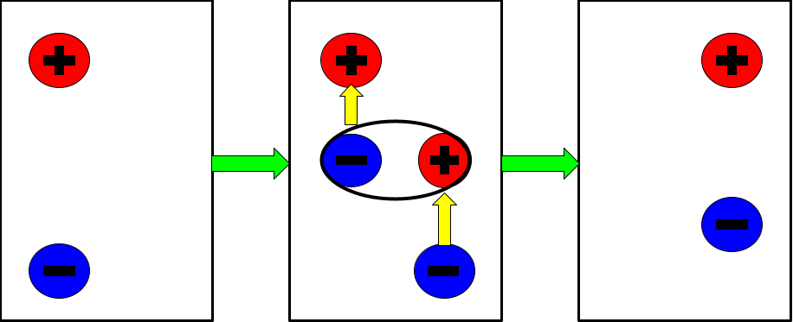

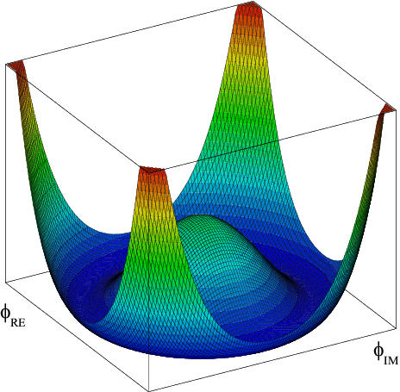
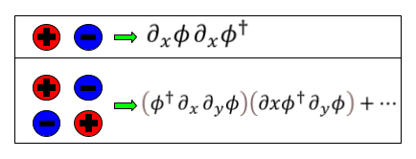
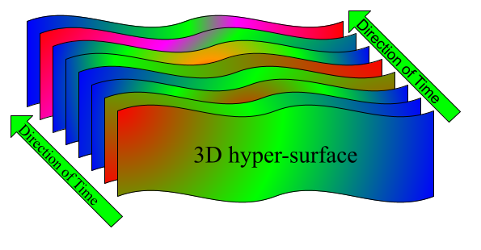
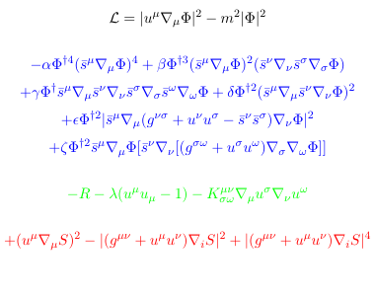
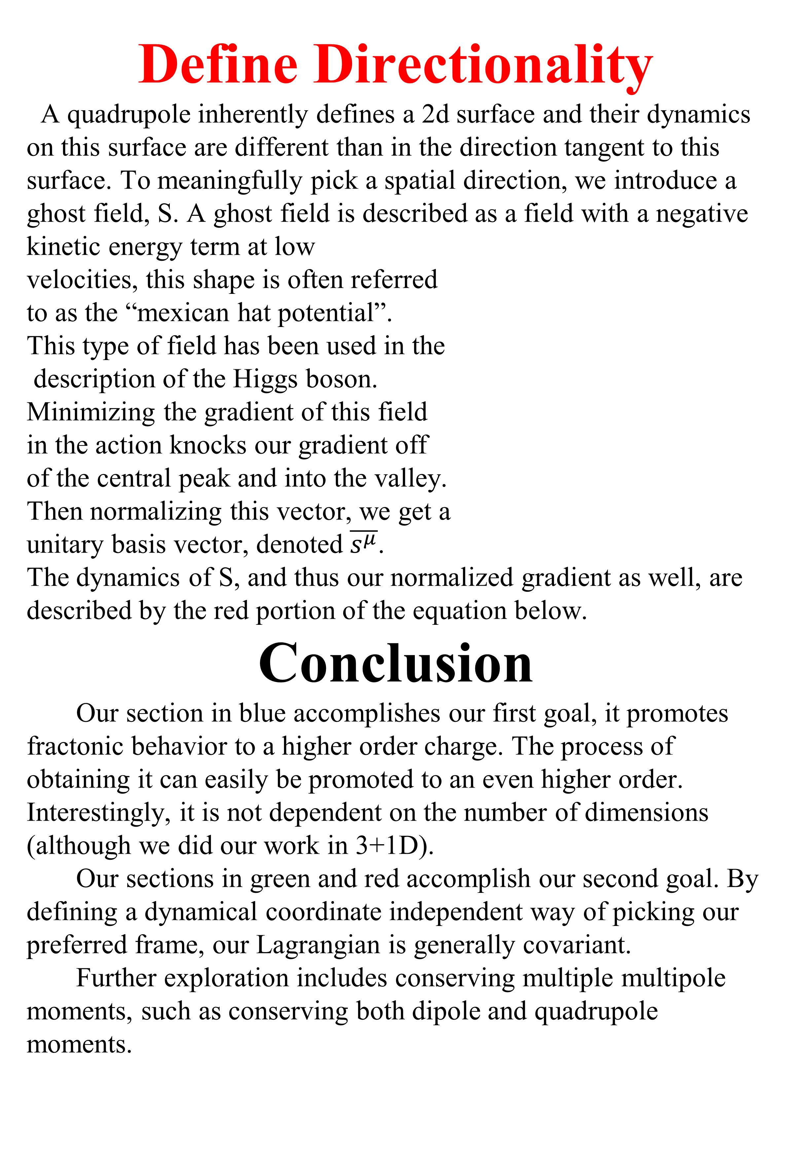
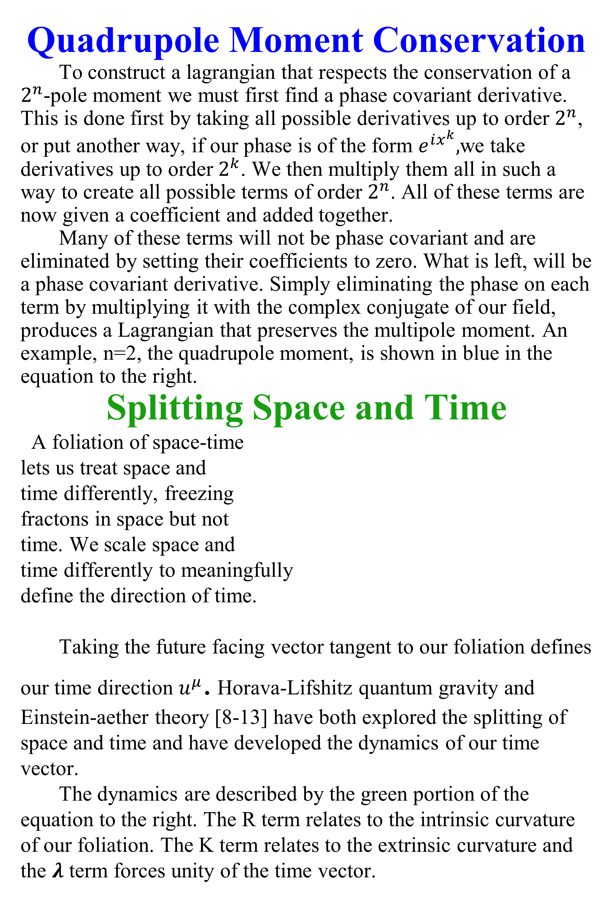
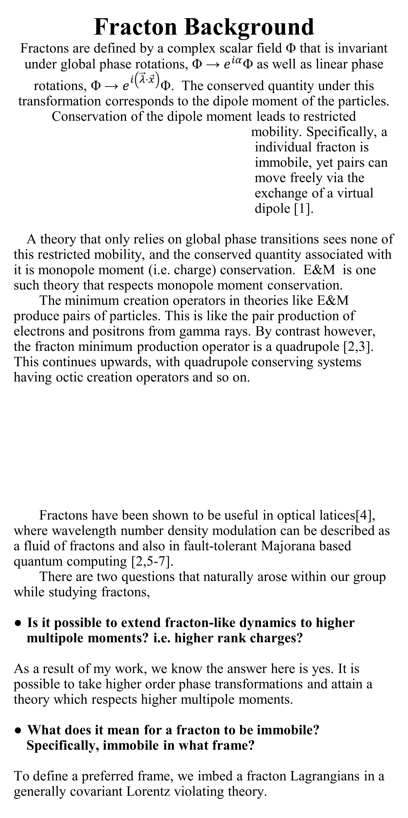
Generally Covariant Theory of Multipole Moment Conserving Quasiparticles
Author: Gavin Riley
Advisor:Prof. David Mattingly
Department of Physics and Astronomy, University of New Hampshire
Fracton Background
Fractons are defined by a complex scalar field Φ that is invariant under global phase rotations, Φ → $ⅇ^{iα}$Φ as well as linear phase rotations, Φ → $ⅇ^{ⅈ\left(\vec{λ}⋅\vec{x}\right)}$Φ. The conserved quantity under this transformation corresponds to the dipole moment of the particles. Conservation of the dipole moment leads to restricted
mobility. Specifically, a
individual fracton is
immobile, yet pairs can
move freely via the
exchange of a virtual
dipole [1].
A theory that only relies on global phase transitions sees none of this restricted mobility, and the conserved quantity associated with it is monopole moment (i.e. charge) conservation. E&M is one such theory that respects monopole moment conservation.
The minimum creation operators in theories like E&M produce pairs of particles. This is like the pair production of electrons and positrons from gamma rays. By contrast however, the fracton minimum production operator is a quadrupole [2,3]. This continues upwards, with quadrupole conserving systems having octic creation operators and so on.
Fractons have been shown to be useful in optical latices[4], where wavelength number density modulation can be described as a fluid of fractons and also in fault-tolerant Majorana based quantum computing [2,5-7].
There are two questions that naturally arose within our group while studying fractons,
Is it possible to extend fracton-like dynamics to higher multipole moments? i.e. higher rank charges?
As a result of my work, we know the answer here is yes. It is possible to take higher order phase transformations and attain a theory which respects higher multipole moments.
What does it mean for a fracton to be immobile? Specifically, immobile in what frame?
To define a preferred frame, we imbed a fracton Lagrangians in a generally covariant Lorentz violating theory.
Goals
We wish to expand the previously established theory to higher order moments. In particular, we will attempt to conserve quadrupole moment in a way that allows for further expansion upwards. This is done by demanding the Lagrangian be invariant under a quadratic phase transformation.
Secondly, we wish to meaningfully define a preferred frame. We wish to define this frame in such a way that it is invariant under all coordinate transformations, known as general covariance. This is because the form of physical equations should not depend on our arbitrary choice of coordinate systems.
Define Directionality
A quadrupole inherently defines a 2d surface and their dynamics on this surface are different than in the direction tangent to this surface. To meaningfully pick a spatial direction, we introduce a ghost field, S. A ghost field is described as a field with a negative kinetic energy term at low
velocities, this shape is often referred
to as the “mexican hat potential”.
This type of field has been used in the
description of the Higgs boson.
Minimizing the gradient of this field
in the action knocks our gradient off
of the central peak and into the valley.
Then normalizing this vector, we get a
unitary basis vector, denoted $\overline{s^{μ}}$.
The dynamics of S, and thus our normalized gradient as well, are
described by the red portion of the equation below.
Conclusion
Our section in blue accomplishes our first goal, it promotes fractonic behavior to a higher order charge. The process of obtaining it can easily be promoted to an even higher order. Interestingly, it is not dependent on the number of dimensions (although we did our work in 3+1D).
Our sections in green and red accomplish our second goal. By defining a dynamical coordinate independent way of picking our preferred frame, our Lagrangian is generally covariant.
Further exploration includes conserving multiple multipole moments, such as conserving both dipole and quadrupole moments.
Quadrupole Moment Conservation
To construct a lagrangian that respects the conservation of a $2^{n}$-pole moment we must first find a phase covariant derivative. This is done first by taking all possible derivatives up to order $2^{n}$, or put another way, if our phase is of the form $ⅇ^{ⅈx^{k}},$we take derivatives up to order $2^{k}$. We then multiply them all in such a way to create all possible terms of order $2^{n}$. All of these terms are now given a coefficient and added together.
Many of these terms will not be phase covariant and are eliminated by setting their coefficients to zero. What is left, will be a phase covariant derivative. Simply eliminating the phase on each term by multiplying it with the complex conjugate of our field, produces a Lagrangian that preserves the multipole moment. An example, n=2, the quadrupole moment, is shown in blue in the equation to the right.
Splitting Space and Time
A foliation of space-time
lets us treat space and
time differently, freezing
fractons in space but not
time. We scale space and
time differently to meaningfully
define the direction of time.
Taking the future facing vector tangent to our foliation defines our time direction $u^{μ}$. Horava-Lifshitz quantum gravity and Einstein-aether theory [8-13] have both explored the splitting of space and time and have developed the dynamics of our time vector.
The dynamics are described by the green portion of the equation to the right. The R term relates to the intrinsic curvature of our foliation. The K term relates to the extrinsic curvature and the 𝝀 term forces unity of the time vector.
By Gonis, CC BY-SA 3.0,

