Slide 1


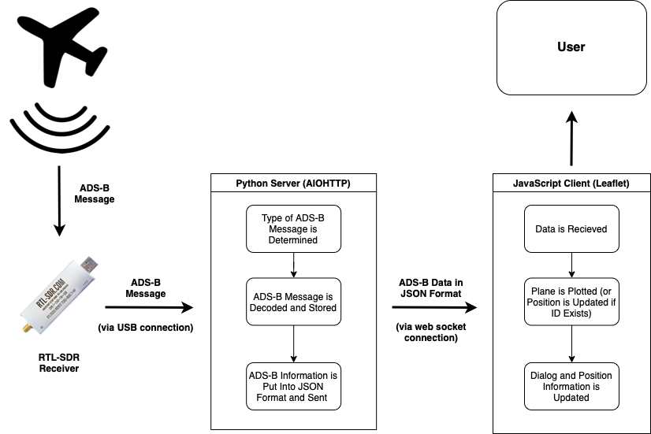
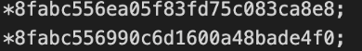
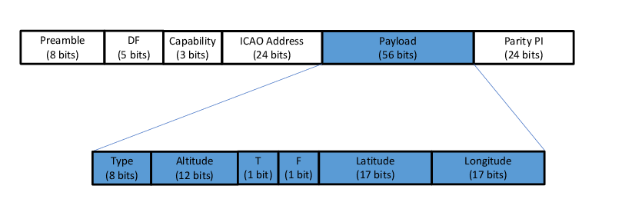
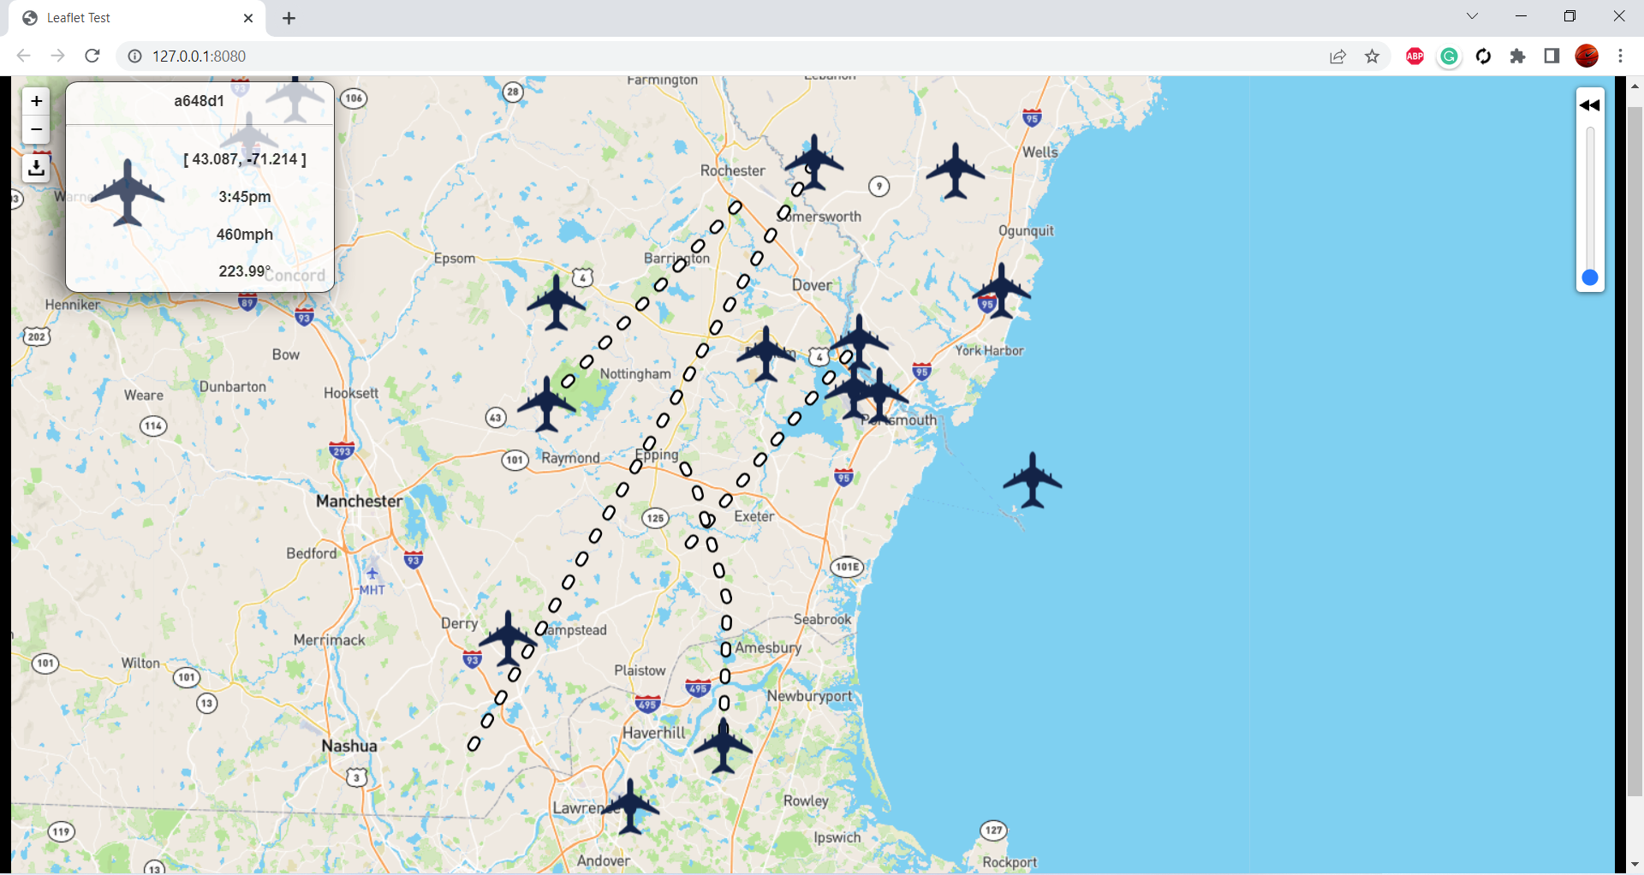
Air Traffic Visualiser
Nick Spezzano, Nick Moreschi, Razz Alkalay
College of Engineering and Physical Sciences, University of New Hampshire, Durham, NH 03824
Project Sponsor: Professor Radim Bartos
Introduction
Challenges
Decoding ADS-B (Automatic Dependent Surveillance - Broadcast) messages containing aircraft data
RTL-SDR receiver to capture incoming messages
Application is fed decoded ADS-B data through a websocket connection
Data is plotted and stored in the program
Decoding each ADS-B message requires a
pair to decode and receive information
Using a Websocket to ensure real time
updates when receiving new ADS-B
messages
Efficient data storage methods to plot each
point on Leaflet
Raw ADS-B Data
Solution
Goals
ADS-B messages are decoded and sent to
the client to visualize
Leaflet, a JavaScript library, is used to
provide an easily manipulable map
AioHTTP, a Python Library, is used to open
a websocket to our client
Store a downloadable log of message data
using JSON
Record the path of each plane to be
displayed to the user when requested
Allow for visualization of aircraft using inexpensive hardware
Ensure ADS-B data is delivered in real time and updated for visualization
Allow the user to download a log of plane history
Include controls that allow users to look closer into plane movement
Ensure the application is easy to set up and use
Zoom In
ADS-B Message Contents
Select Plane and Slide to Show Past Coords
Zoom Out
Download JSON
Dialog Window (On Plane Click)
Current Capabilities
Testing
Decode ADS-B Messages
Plot the decoded plane data on a map
Download a record of data since beginning search
Alternate version of our application is used to read test data
  Feeds our web application with a log of known raw ADS-B messages
  Can easily spot inconsistencies within our program
User testing was done to ensure ease of use
Next Steps
Compatibility with ships and other vehicles
Additional and improved data collection features

Slide 3
This poster template provided courtesy of
UNH ESRC Poster Printing Services
Trust us to make your poster look GREAT!
Website: http://posters.unh.edu
Poster Guide: http://goo.gl/1E7TJY
DELETE THIS SLIDE BEFORE PRINTING

