Slide 1

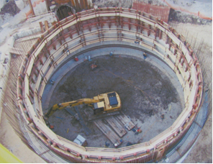
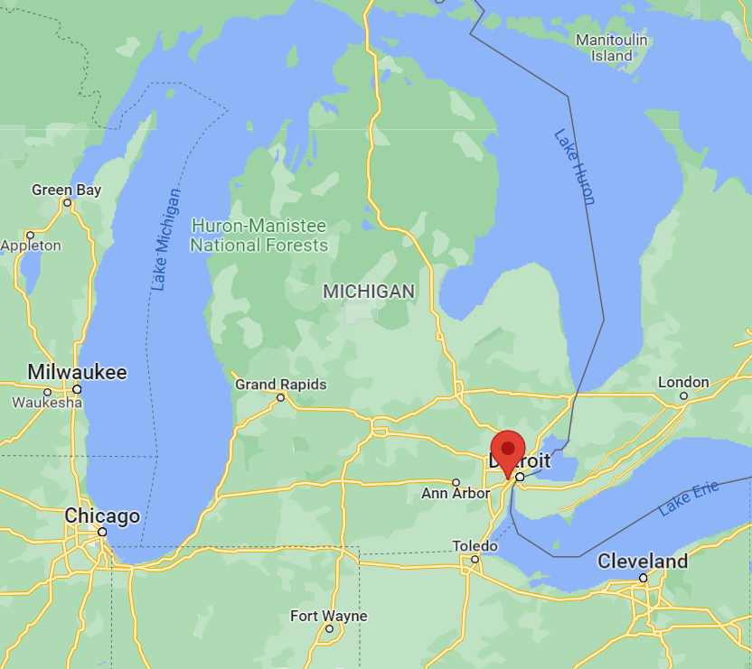
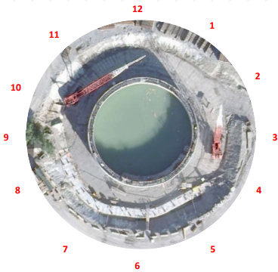
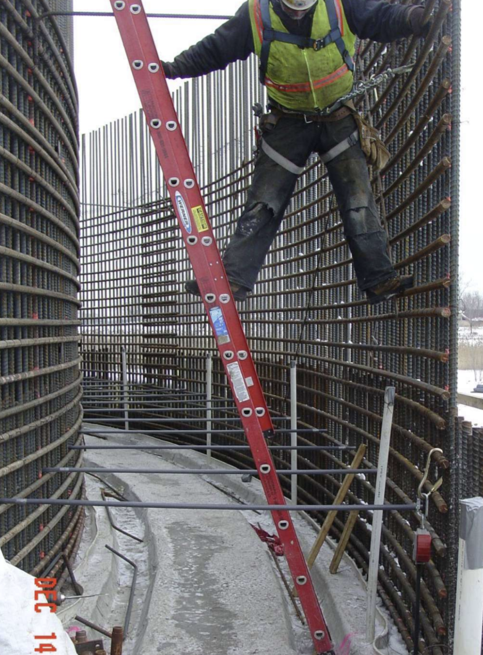
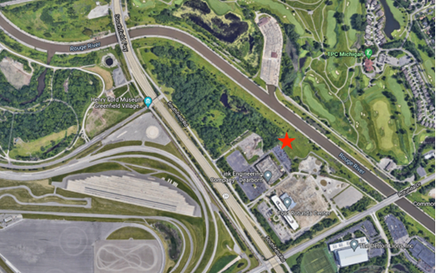
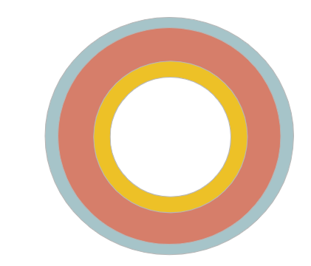
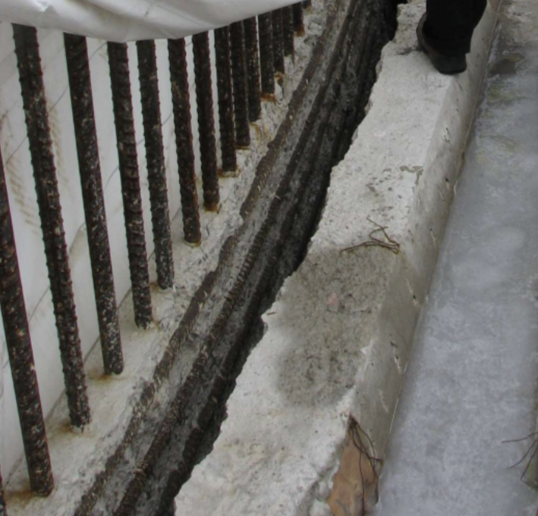
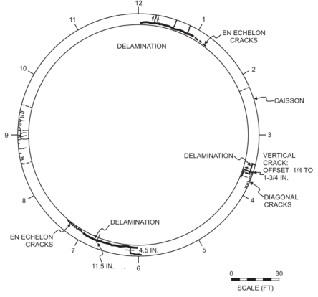
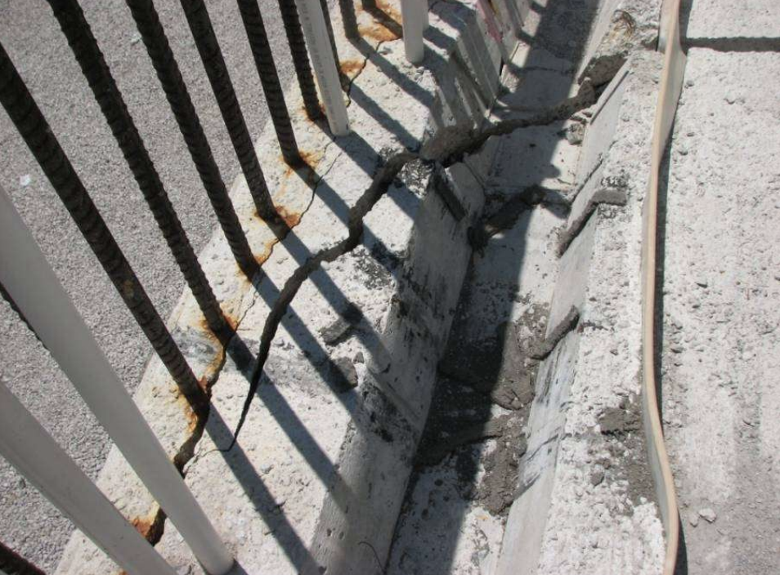
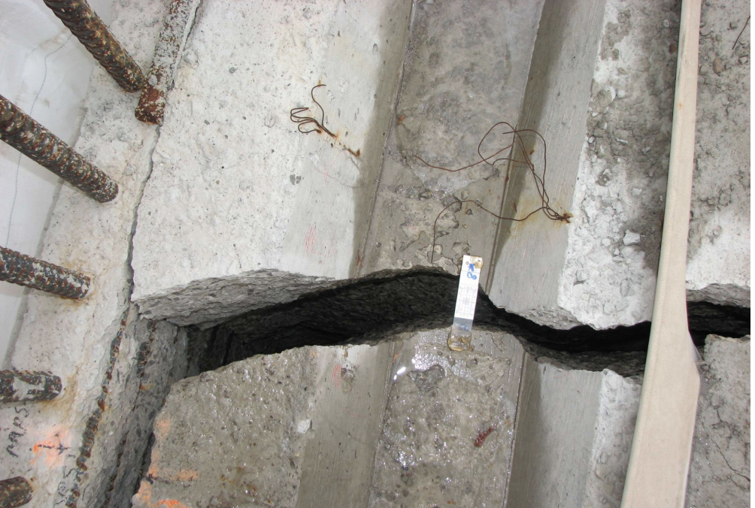
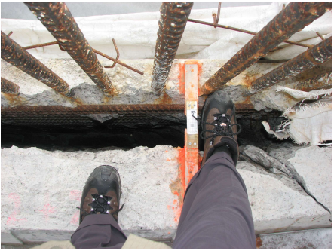
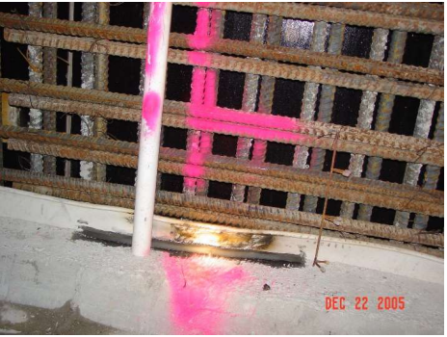
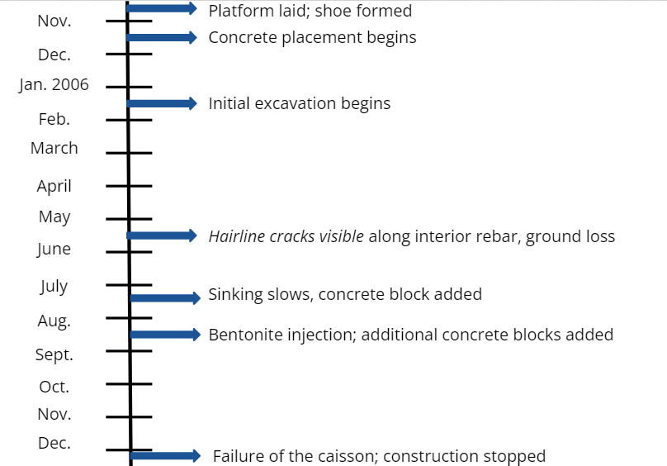
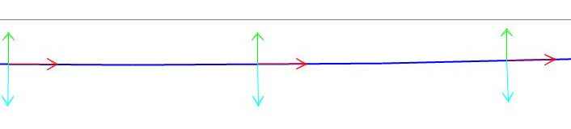
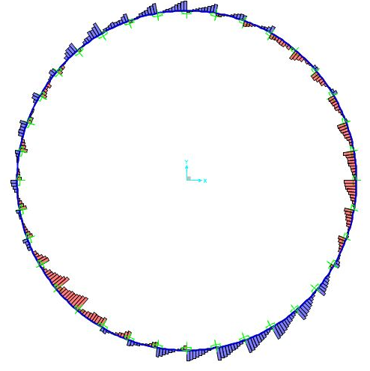
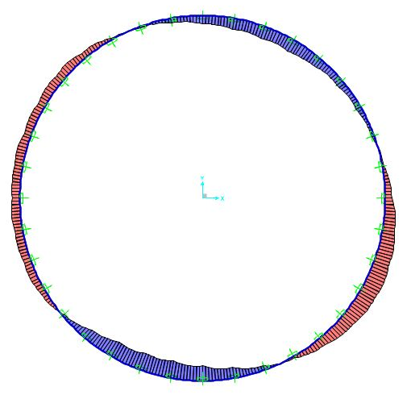
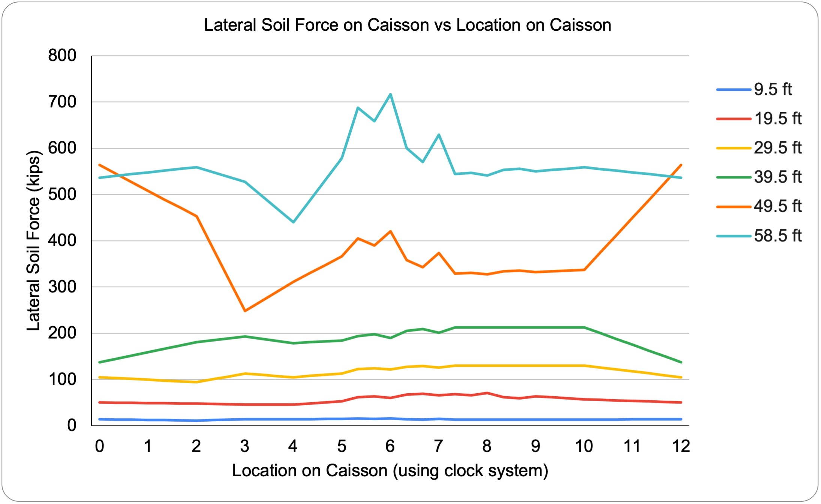

Self-Sinking Caisson Failure Investigation
Alissa Reitter, Will Conley, Rita Masouras, Maya Norris
Civil Engineering, University of New Hampshire, Durham, NH 03824
Team #1
Introduction
Caisson Location
Analysis
Overview:
In December 2006, a self-sinking caisson, referred to as Contract 3 or Combined Sewer Overflow Unit 14 (CSO 14), shown in Figure 2, experienced a delamination failure in the thick concrete walls of the caisson. The timeline of construction and failure of the caisson is shown in Figure 1.
Purpose:
A caisson is an underground structure designed to contain water or liquids. The caisson analyzed in our project was designed to retain combined sewage overflows in wait of treatment in Dearborn, MI, shown in Figures 3 and 4, and was planned to hold approximately 10.5 million gallons.
Hypotheses:
The team researched and formulated hypotheses to figure out why the caisson may have failed. See Table 1 below for the specific hypotheses. Moving forward, the team performed calculations to validate the hypotheses.
Variable Soil Properties:
The Boring logs were taken around the caisson at the “clock times” 12:00, 2:00, 2:30, 4:20, 6:00, 8:00, and 10:00. This data demonstrated that the borings 1, 2, 3, and 6 taken at the clock times 12:00, 2:00, and 6:00 portrayed a spike in the number of blows per foot. Using the boring logs, the shaft resistance and base resistance around the caisson were determined.
Radial Reinforcement
Thermal Differential:
Reduced Concrete Area:
Figure 3: Location of Dearborn, MI.
The caisson design specifies no stirrups to be used as structural reinforcement against shear failure, as shown in Figure 15. Based on the Design Method for Reinforced Concrete Box and Pipe Sections the ultimate shear resistance without stirrups is 120 kips. The shear force in the radial direction developed in the caisson at depths up to 29.5 ft are greater than the allowable 120 kips.
Figure 2: CSO 14, 151’ in diameter with 7.5’ thick reinforced concrete walls.
Figure 4: Area surrounding CSO 14.
Figure 5: Location designations (labeled like a clock).
Key Hypotheses
Failure Photos and Crack Map
Figure 15: Existing radial reinforcement.
Table 1: Primary hypotheses to explain the caisson failure.
The caisson was analyzed as three separate rings as shown in Figure 16. Preliminary analysis shows that the stresses developed by thermal differential would not have been large enough to cause the caisson to crack, but it could have contributed to the ultimate failure.
Soil Profile and Properties: | The soil layers around the caisson are not uniform which may have led to uneven settling.
Lack of radial reinforcement: | Potentially insufficient amount of radial reinforcement in the caisson wall contributed to the delamination failure.
Thermal differential: | With a wall 7.5’ thick, the internal temperatures during curing could have reached extreme highs, while the exterior of the caisson was exposed to ambient temperatures. This differential could cause stress within the caisson walls.
Rebar Spacing & Splicing: | Reinforcement was specified at #11 at 6”OC for both horizontal and vertical bars, which created a cylindrical plane of weakness. Additionally, the splices further decreased the space between the reinforcement.
Ovaling: | Uneven soil pressures on the caisson, forcing it to deform into a rough oval shape.
Figure 16: The three rings analyzed for thermal differential.
Figure 6: Detail 7:00.
Figure 9: Detail 1:00.
The dense rebar grid, shown in Figure 17, resulted in a significantly reduced concrete area between the bars (down to 17%). Furthermore, the rebars, representing a void in the concrete would have caused a stress concentration alongside the bars (strength of materials Hibbeler, Mechanics of Materials, 10th ed). As a result, tension stresses may have been as much as 10 times higher than average.
Figure 7: Detail 6:30.
Figure 8: Cracking patterns.
Figure 10: Detail 1:00.
Figure 17: Rebar grid.
What Went Wrong - Timeline
Caisson Modeling
Conclusions
The soil around the perimeter of the caisson varied in strength, causing the caisson to sink unevenly.
There was uneven lateral earth pressure acting around the caisson, causing ovaling. Finite element analysis resulted in moments that correspond to the cracking patterns seen.
The major delamination cracks occurred in the plane of the rebar grid, which corresponds to stress concentrations estimated herein.
Figure 11: Local Axis for Model Frame (Red – 1, Green – 2, Blue – 3).
Figure 13: V3 at a depth of 58.5’.
Figure 14: M2 at a depth of 58.5’.
The lateral soil force was modeled in SAP2000 using point loads that represent the lateral soil pressure.
Figures 13 and 14 display the resultant shear and moment respectively for the 2D model of the caisson at a depth of 58.5 ft.
The maximum shear at a depth of 58.5 ft is 704 kips in compression.
The maximum moment at a depth of 58.5 ft is 130,600 kip-in in positive bending.
Figure 13 shows that the lateral soil force on the caisson peaked at 5, 6, 7:00 at a depth of 58.5 ft and 12 and 1:00 at a depth of 49.5 ft.
Acknowledgements
Thank you!
Project Sponsor: Zack Chabot
UNH Faculty Advisor: Dr. Ray Cook
Additional help from: Dr. Fei Han
Figure 1: Timeline of events.
Figure 12: Lateral Soil Force on Caisson vs Location on Caisson.

