Slide 1

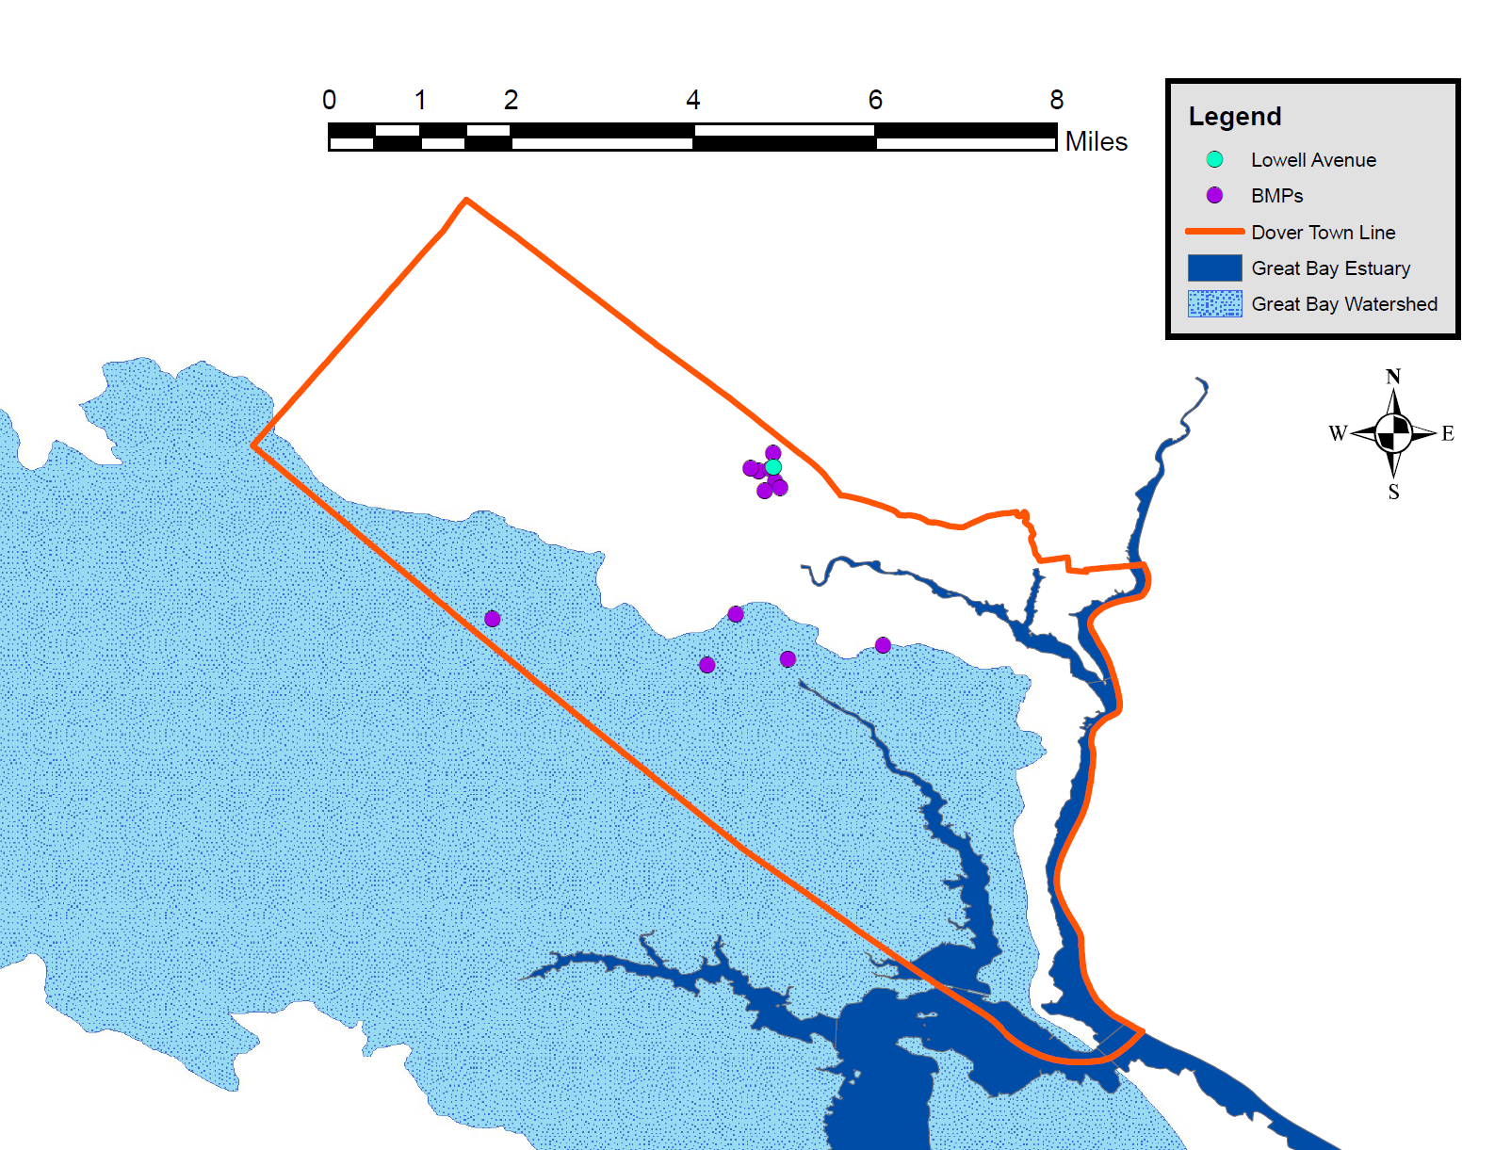
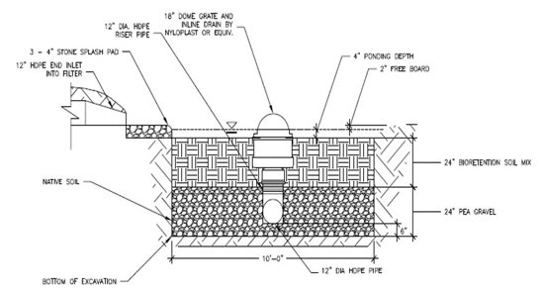
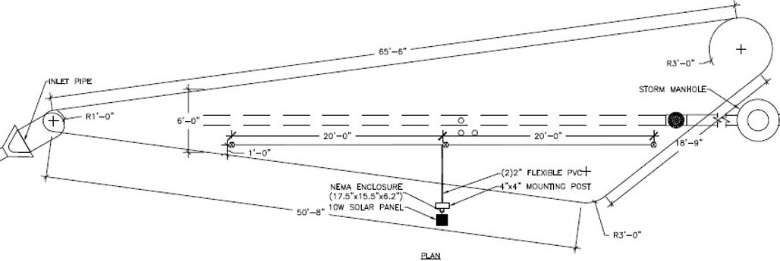
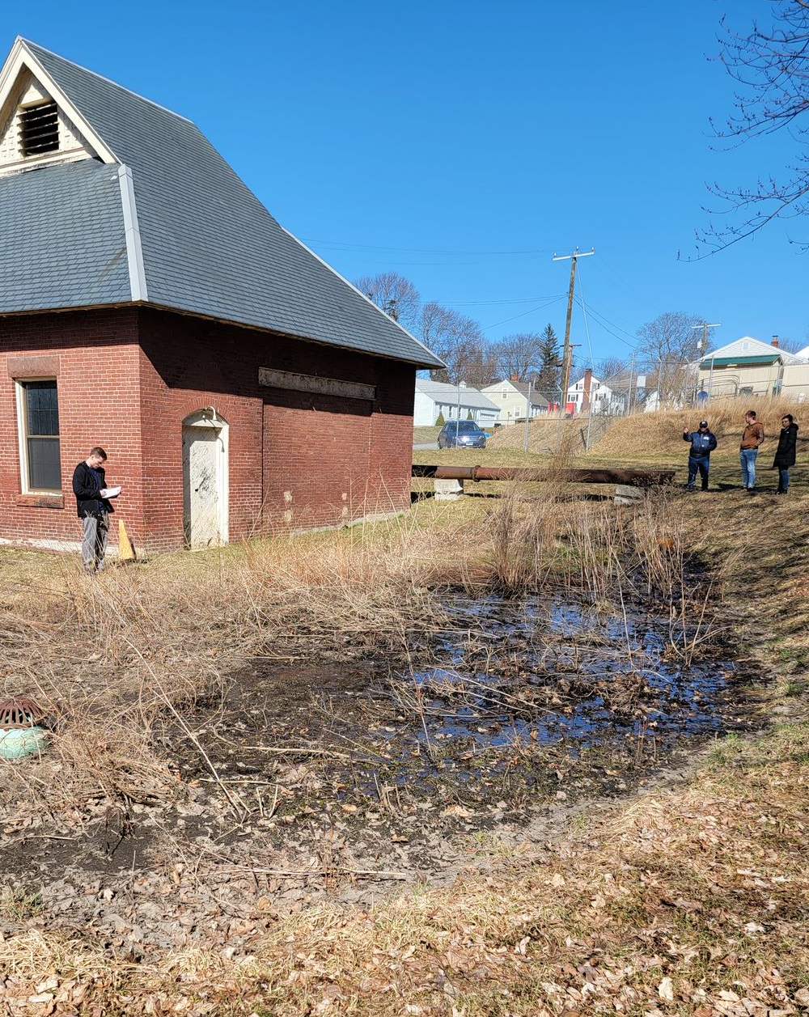
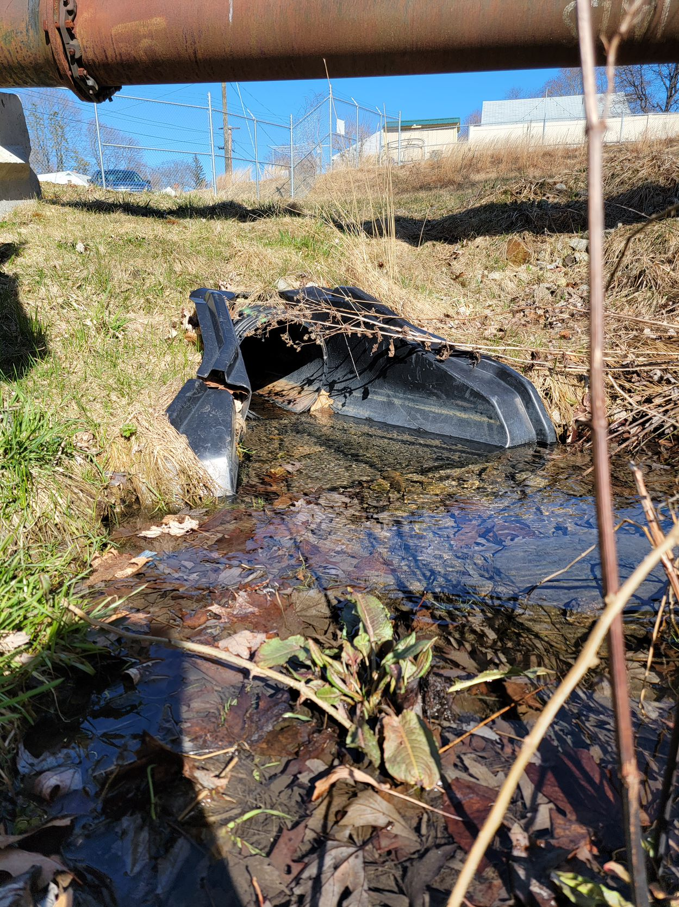
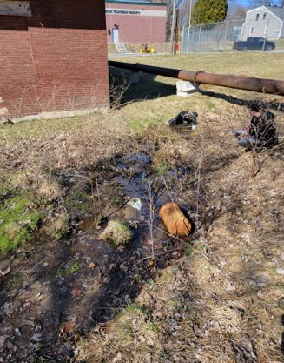
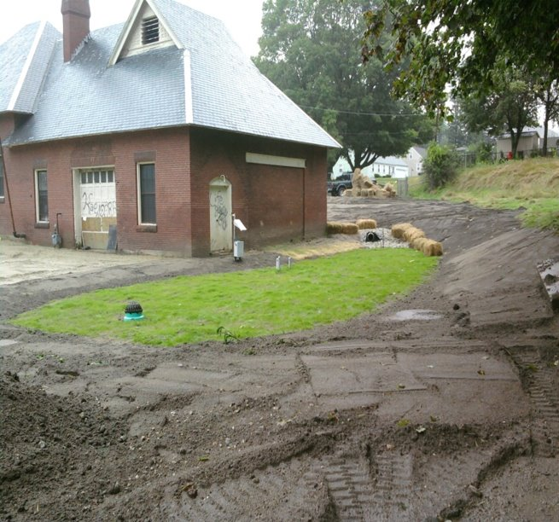
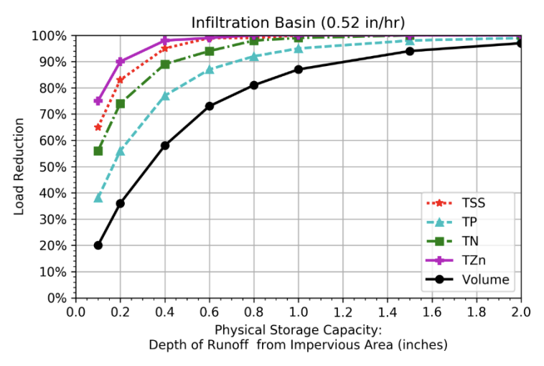
Tracking and Accounting of Stormwater Best Management Practices in Dover, NH
  Nicole King, Kiara Boren, James Carney, Mitchell Heidler
  Project Advisor: Dr. James Houle Project Sponsor: Gretchen Young, PE
Introduction
Implementation
Results
The city of Dover, New Hampshire has over 100 Best Management Practices (BMPs) installed to reduce non-point source stormwater pollution directed towards the Great Bay Estuary. Enforced by the EPA, cities discharging into the Great Bay were to develop a Storm Water Management Program (SWMP) to include pollution prevention measures, treatment, and removal practices. Additionally, the EPA issued the city of Dover the Municipal Separate Storm Sewer Systems (MS4) permit and Great Bay Total Nitrogen General permit. A collection of site data to estimate nitrogen and phosphorus reductions are monitored through UNH Stormwater Center’s Pollutant Tracking Accounting Program (PTAP) Portal.
Lowell Avenue DSV Calculations
Layer | Area | Depth | Porosity | DSV
 | (ft²) | (ft) | (-) | (ft³)
Pool | 630 | 0.33 | 1.00 | 210
Bioretention Soil Mix | 630 | 2.00 | 0.22 | 277
3/8" Pea Gravel | 630 | 0.28 | 0.40 | 71
3/4" Stone | 630 | 1.22 | 0.40 | 307
Freeboard | 630 | 0.17 | 1.00 | 105
 |  |  | Total | 970
We were successfully able to analyze 13 sites in total and measure their projected nutrient reductions.
This bioretention system removes 3.53 lbs N and 0.84 lbs P from this drainage area annually.
The removal efficiencies were determined using the PSC and HSG.
The HSG values were determined by analyzing the soil types and runoff classes for each site using Web Soils Survey.
Lowell Avenue Site Characteristics​
Location​ | IC (acres)​ | TN Load (lb/yr)​ | TP Load (lb/yr)​ | Runoff Load (ft³/yr)​ | DSV (ft³)​ | BMP​ | HSG (in/hr)​ | PSC (in)​
Lowell Ave​ | 1.21​ | 17.06​ | 2.37​ | 2.00 x 10^{7​} | 970​ | Bioretention​ | 0.52​ | 0.22​
Cross-Sectional View of Lowell Avenue BMP
Lowell Avenue Load Reductions​
Vol (RE)​ | TN (RE)​ | TP (RE)​ | Total Mass Removed (lbs/ac-yr)​ | TN (lbs/ac-yr)​ | TP (lbs/ac-yr)​
36%​ | 75%​ | 57%​ | 10.28​ | 3.53​ | 0.84​
To measure the efficiency of the Lowell Avenue BMP along with the 12 other locations, a cost analysis was done by comparing the nitrogen reductions to the Dover WWTP.
The estimated nitrogen load that was removed by the 13 total sites was 151.6 lbs. The following example shows the cost analysis in dollars per pound of nitrogen for Lowell Ave:
Cost per pound analysis of Lowell Avenue BMP:
                1. We assumed an hourly wage of $75 / hr.
      2. Average site visit time is 30 minutes, therefore it cost $37.50 per site.
    3. Average time for performing calculations and entering data into PTAP is 3 hours, therefore $225 overall in cost for analyzing the site.
    4. For the BMP, 3.53 pounds of nitrogen was calculated to be removed annually.
    Cost per pound for Lowell Avenue BMP is $74.40 / lb.
  Cost per pound analysis for Dover WWTP:
  - Great Bay Total Nitrogen General Permit¹ done for the 13 NH WWTPs discharging into the Great Bay provided a range of nitrogen removal of $300 to $1500 per pound.
  - Dover falls in the middle of that range with regards to daily WWTP discharge, so an assumed value of $1000 / lb. was used for the cost analysis.
  Cost per pound for the Dover WWTP is $1000 / lb.
  The cost analysis shows why it is worth the time and effort to input these BMPs into the PTAP database. This minimal cost helps to show why taking the time to input the BMPs into PTAP allows for the city to ensure that that their BMPs are operating properly.
  ¹ Roseen Ph.D., P.E., D.W.R.E, R. M. (2020). Feasibility Analysis for USEPA'S Draft Great Bay Total Nitrogen General Permit. Waterstone Engineering, PLCC. https://www.clf.org/wp-content/uploads/2020/05/2020-5-8-GBNCP-Study-Summary.pdf
Plan View of Lowell Avenue BMP
Methods
To estimate pollutant, total nitrogen (TN) and total phosphorus (TP), reductions, site plans were utilized to examine existing conditions of the BMP; structural or vegetative system that reduce pollutants from stormwater through retention, filtration, and infiltration into the ground.
A checklist was developed to observe visual indicators of the performance of the BMP that would impact the system’s efficiency. Metrics include but not limited to:
                - Note excess inorganic and organic debris that would impact inflow and outflow
- Determine if system was operating as designed
- Visible damage of the system due to erosion
The following were calculated for each system:
  - Drainage Area (DA); total land area that drains to the BMP
  - Design Storage Volume (DSV); the void space capacity
- Physical Storage Capacity (PSC); depth of runoff from impervious cover (IC) that is treated
Subsequently, the mass of pollutant removed was determined for each system.
Data gathered for each system was entered into PTAP.
Conclusion
This BMP is one of 100+ BMPs acting together to help reduce Dover's pollutant input to the Great Bay from stormwater pollution.​
PTAP allows a municipality to better account for their BMPs and shows how efficient the city/town is at reducing pollutant contamination.​
To continue the improvement of reducing stormwater pollution, Dover would need to account for all the BMPs within the city and implement them into the PTAP system to help protect the Great Bay.
Procedure
Pollutant Tracking Accounting Program (PTAP)
Initial BMP investigation checklist
DA calculation, including IC
DSV cross section calculations
Hydraulic Soil Group (HSG) selection using Web Soil Survey
PSC calculation
Use of BMP Performance Curve for Soil Infiltration for nitrogen, phosphorous, and volume reduction
Final TN, TP, and total mass removal calculations
Verify validity with project advisor and sponsor
This database was produced by the UNH Stormwater Center and is used for municipal accountability to reduce pollutants from non-point sources.
Each site's information was uploaded and saved into the database to be accounted for Dover's asset management.
Site indicators, such as Parcel ID and BMP type, were included into the input for proper identification of the site.
Parcel ID | Land Use | Hydrologic Unit Code | Structural BMP (PTAP Input)
37040-000000 | Medium-Density Residential | 0106000309 | Bio-filtration
Acknowledgements
We thank Gretchen for her time and effort spent helping us preform our site visits and informing us about the sites. Special thanks to Dr. Houle for his overall guidance and assistance with analyzing our results, as well as providing access to PTAP and design work from the UNH Stormwater Center.

