Slide 1


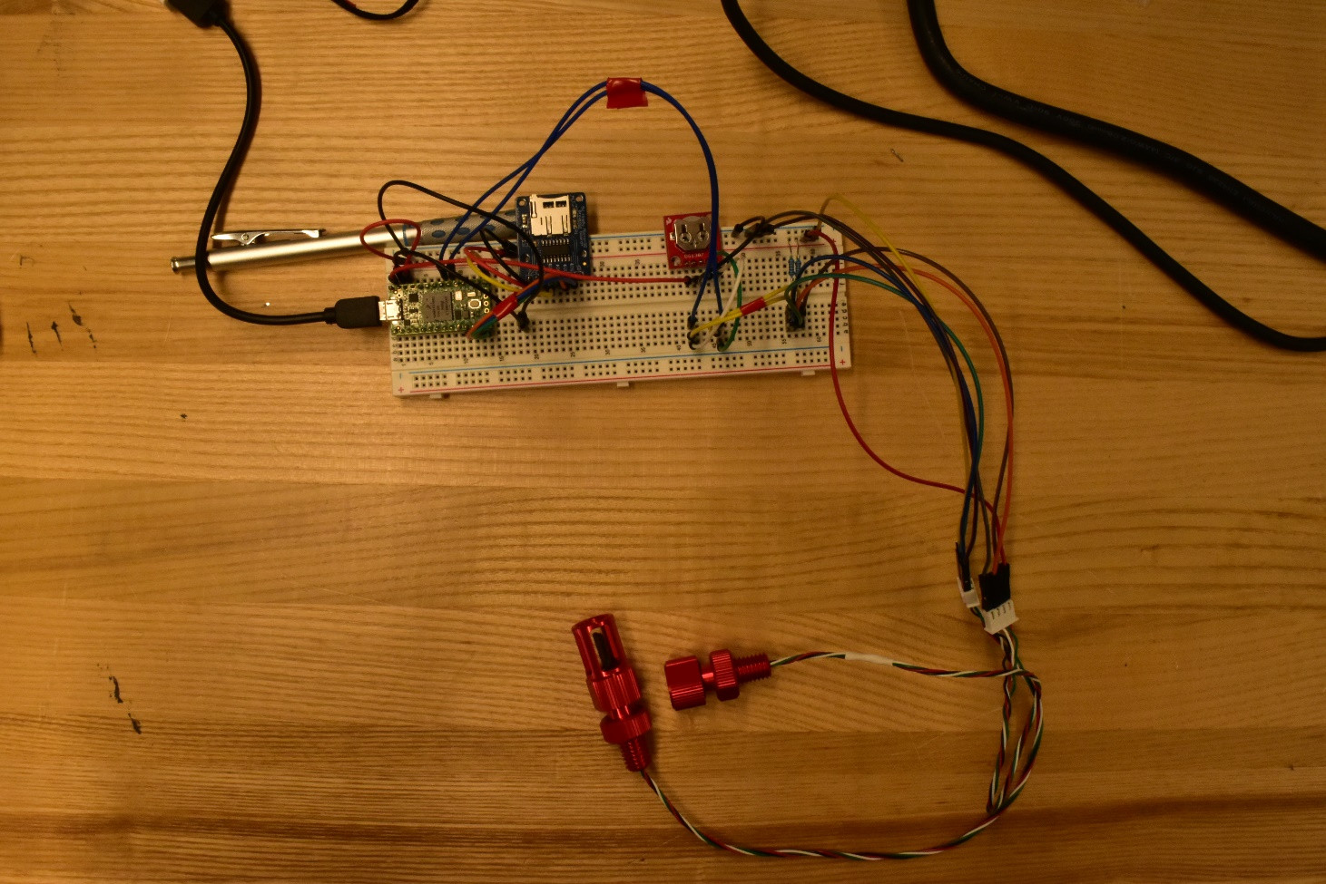
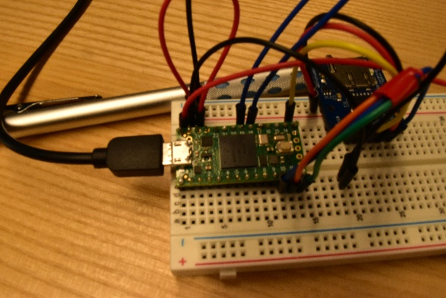
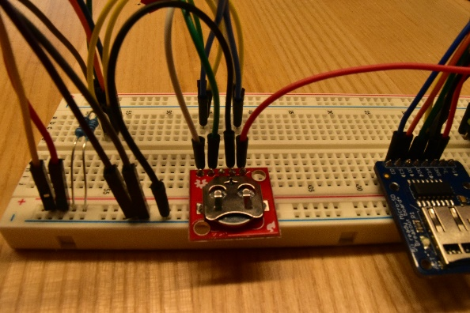
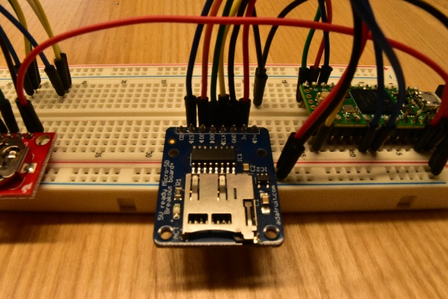
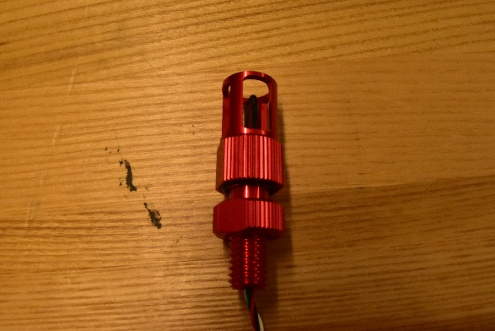
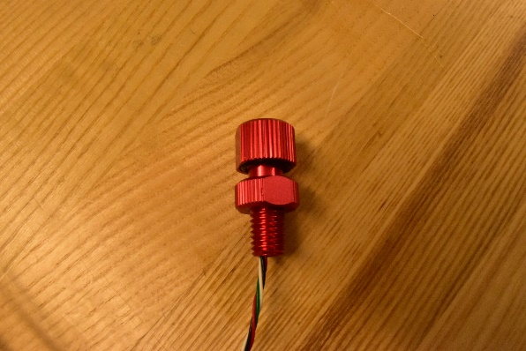
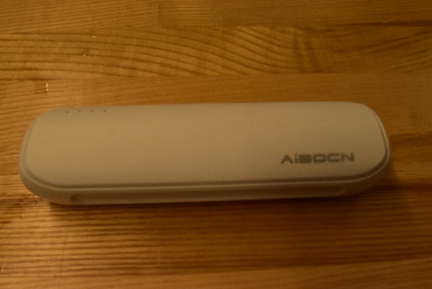
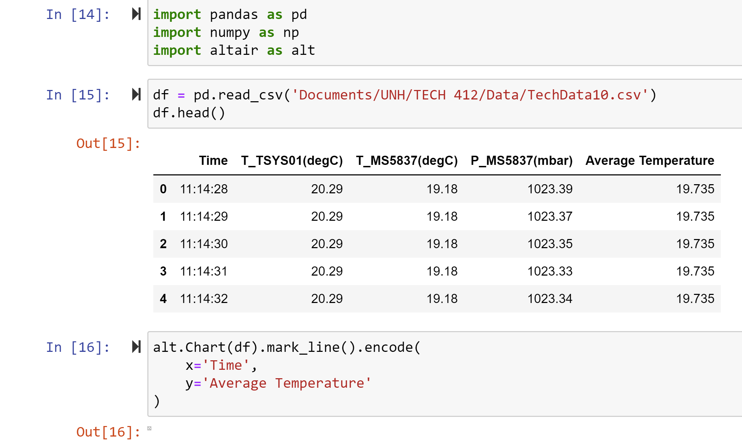
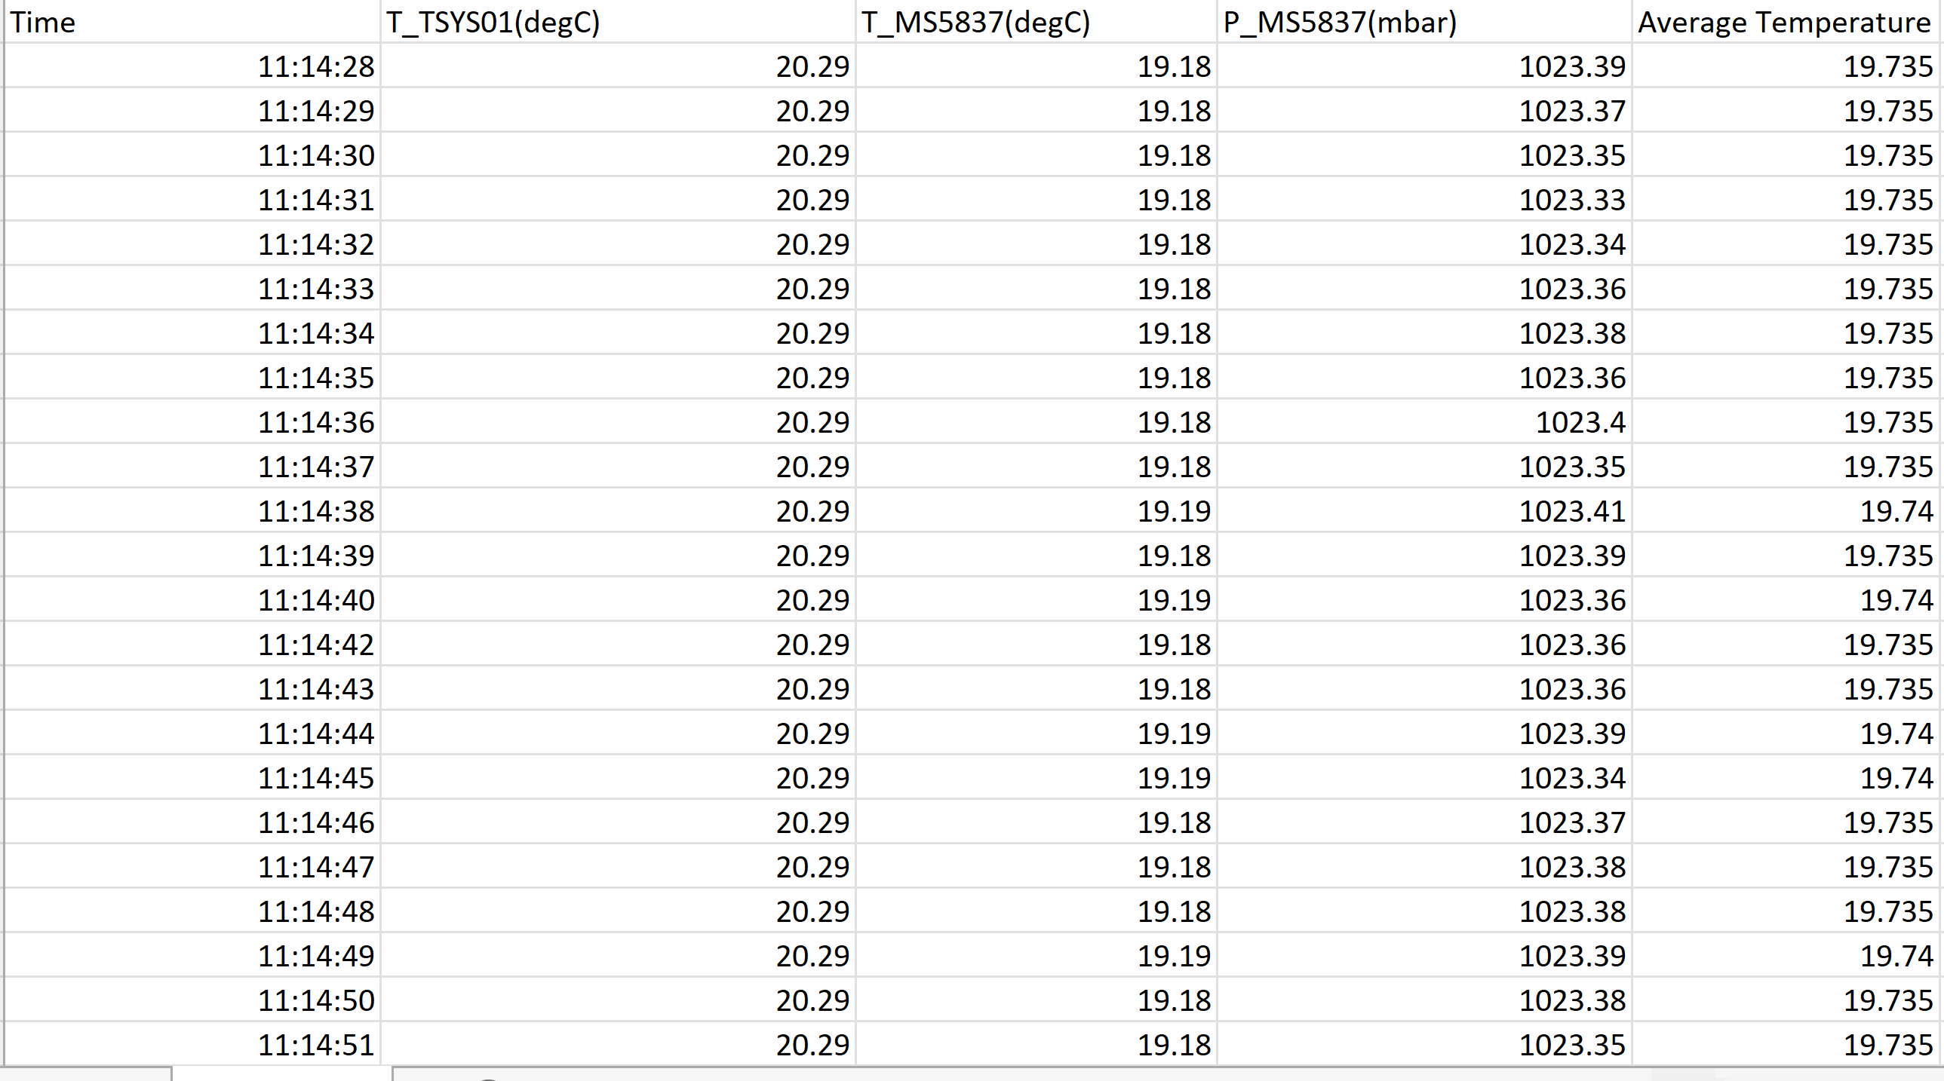

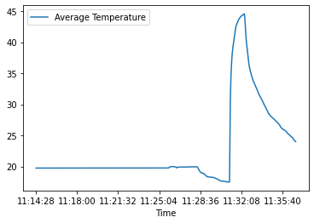
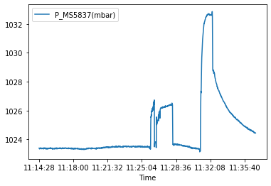
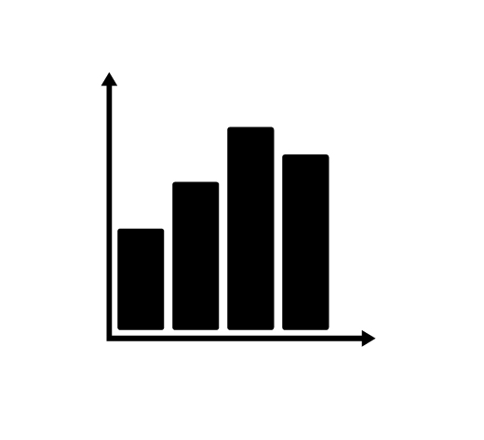
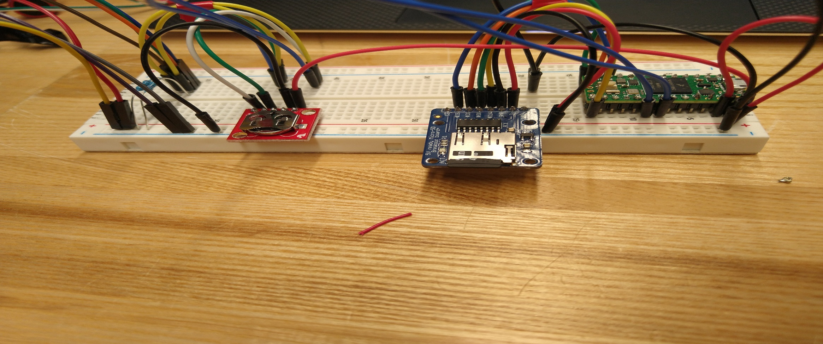
Pressure and Temperature Sensor Circuitry
Nicholas Gacharna, Corey Zima, and Morgan Smith
Innovation Scholars: Ocean Engineering Section, University of New Hampshire, Durham, NH 03824
Introduction
Components
Results
This circuitry was built in response to awareness of the king tidal flooding that occurs regularly in Hampton NH. The issue is currently being dealt with reactively, with measures in place such as stilted houses and special parking lots on higher ground that are opened when flooding is imminent. The purpose of these sensors is to help citizens of Hampton learn more about the incoming tides than they know now and to get them this information farther in advance so they can be better prepared for future flooding events. This is achieved by measuring pressure and temperature data of flooding which will help in determining patterns in flooding. Currently, the closest NOAA water level sensors to Hampton are in the areas of Portland ME and Boston MA, so the deployment of these sensors locally would provide much more accurate data to the residents of Hampton than that which they are currently receiving.
Circuit Overview
All components used
Developed Circuit able to communicate with sensors as well as components.
Collected Data that showcased accuracy of sensors in controlled conditions.
Developed Code that allowed for basic visualization of collected data.
Conducted battery test which gave time frame one circuit could last for using a full battery.
  Estimated that the battery could last 24 hours..
  With this amount of charge the circuit should be able to last at least one tidal cycle on a full charge.
Circuit was able to log temperature and pressure values for every second it was on.
Image 2: Components: First Row Left Side: Teensy Micro Processor, Real Time Clock, Data Logger
Second Row Left Side: Temperature Sensor, Pressure Sensor, Battery Pack
Image 1: Breadboard design of our circuit
Methodology
Code And Data
Conclusions
The circuit was designed to accommodate the various power needs of different components present. Mainly some components such as the sensors themselves required 5V of power draw while others such as the real time clock needed only 3 V.
The circuit includes a real time clock (RTC), micro-SD, teensy, and datalogger as supporting components as well as a pressure and temperature sensor. The Teensy microprocessor handles the code and communication between the various components. The RTC allows for time logging of temperature and pressure to relate data to event. The Datalogger records measurements as a .txt file which can later be converted to a .csv for data analysis. Onboard sensors include a Blue Robotics TSYS01 temperature sensor and a MS5837-30BA pressure sensor also capable of recording temperature. For power it was found that an Aibocn USB 3.0 Charger powered the circuit for about a day.
Chart #1 Sub-Title Here
Chart #2 Sub-Title Here
From the bread board circuit developed many improvements can be made. Models for a Perf Board version as well as a printed Circuit board version of the circuit were made and sketched however due to time constraints, they were unable to be utilized in a deployment setting. For the future as the perf board version of the circuit was nearly complete a deployment within the full housing to either controlled or field environments is desired. However, with the current model of circuit other improvements could involve battery capacity to allow for longer deployments as the goal is deployment at Hampton Beach during a King Tide.
Image 3: Code done in Jupyter notebooks using Pandas and Altair
Image 4: Example of what the data looks like when placed into an excel sheet
Data
sTAMD Simulations
Acknowledgements
Graphs
For this project, a test was conducted by placing the sensors into a cup of cold and hot water in order to determine how fast the sensors would react to temperature changes and the accuracy of the sensors.
Due to the sensors logging a new value every second a different approach was needed in order to create visualizations of the data. In order to accomplish this, the .txt file was opened in excel and then converted into a .csv file. This then allowed for the data to be uploaded as a data frame using the python-based application pandas in a Jupyter notebook. Then in order to create visualizations the addon altair was used to create graphs seen in the section graphs
Time v. Pressure (mBar)
Savannah DeVoe, Dr. Diane Foster, Alyson Eberhardt, Malin Clyde, Peter Howd, Hampton Department of Public Works, The Hampton Community, and those who run Innovation Scholars.
Time v. Average Temperature (C°)
References
NOAA. (n.d.). The state of high tide flooding and annual outlook. State of High Tide Flooding and Annual Outlook. Retrieved December 2, 2021, from https://tidesandcurrents.noaa.gov/HighTideFlooding_AnnualOutlook.html
Image 5: Average temperature taken from the two temperature values over the course of 20 minutes. Peak from when sensor was submerged in warm water.
Image 6: Pressure recorded by the sensor versus time, all jumps come from when sensor is submerged in water.

