Slide 1


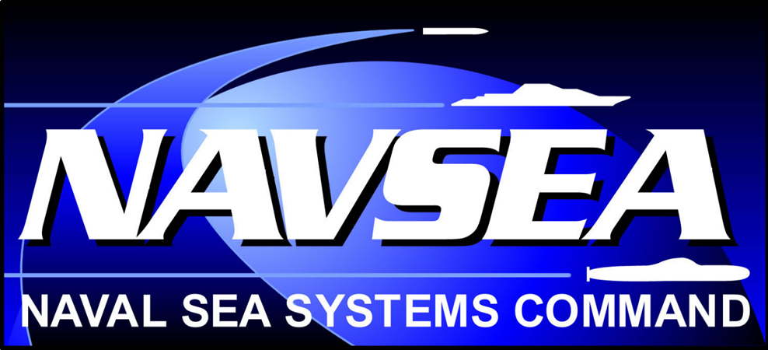

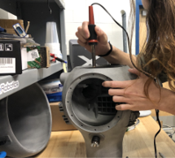
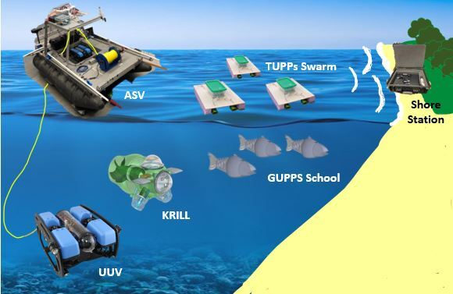
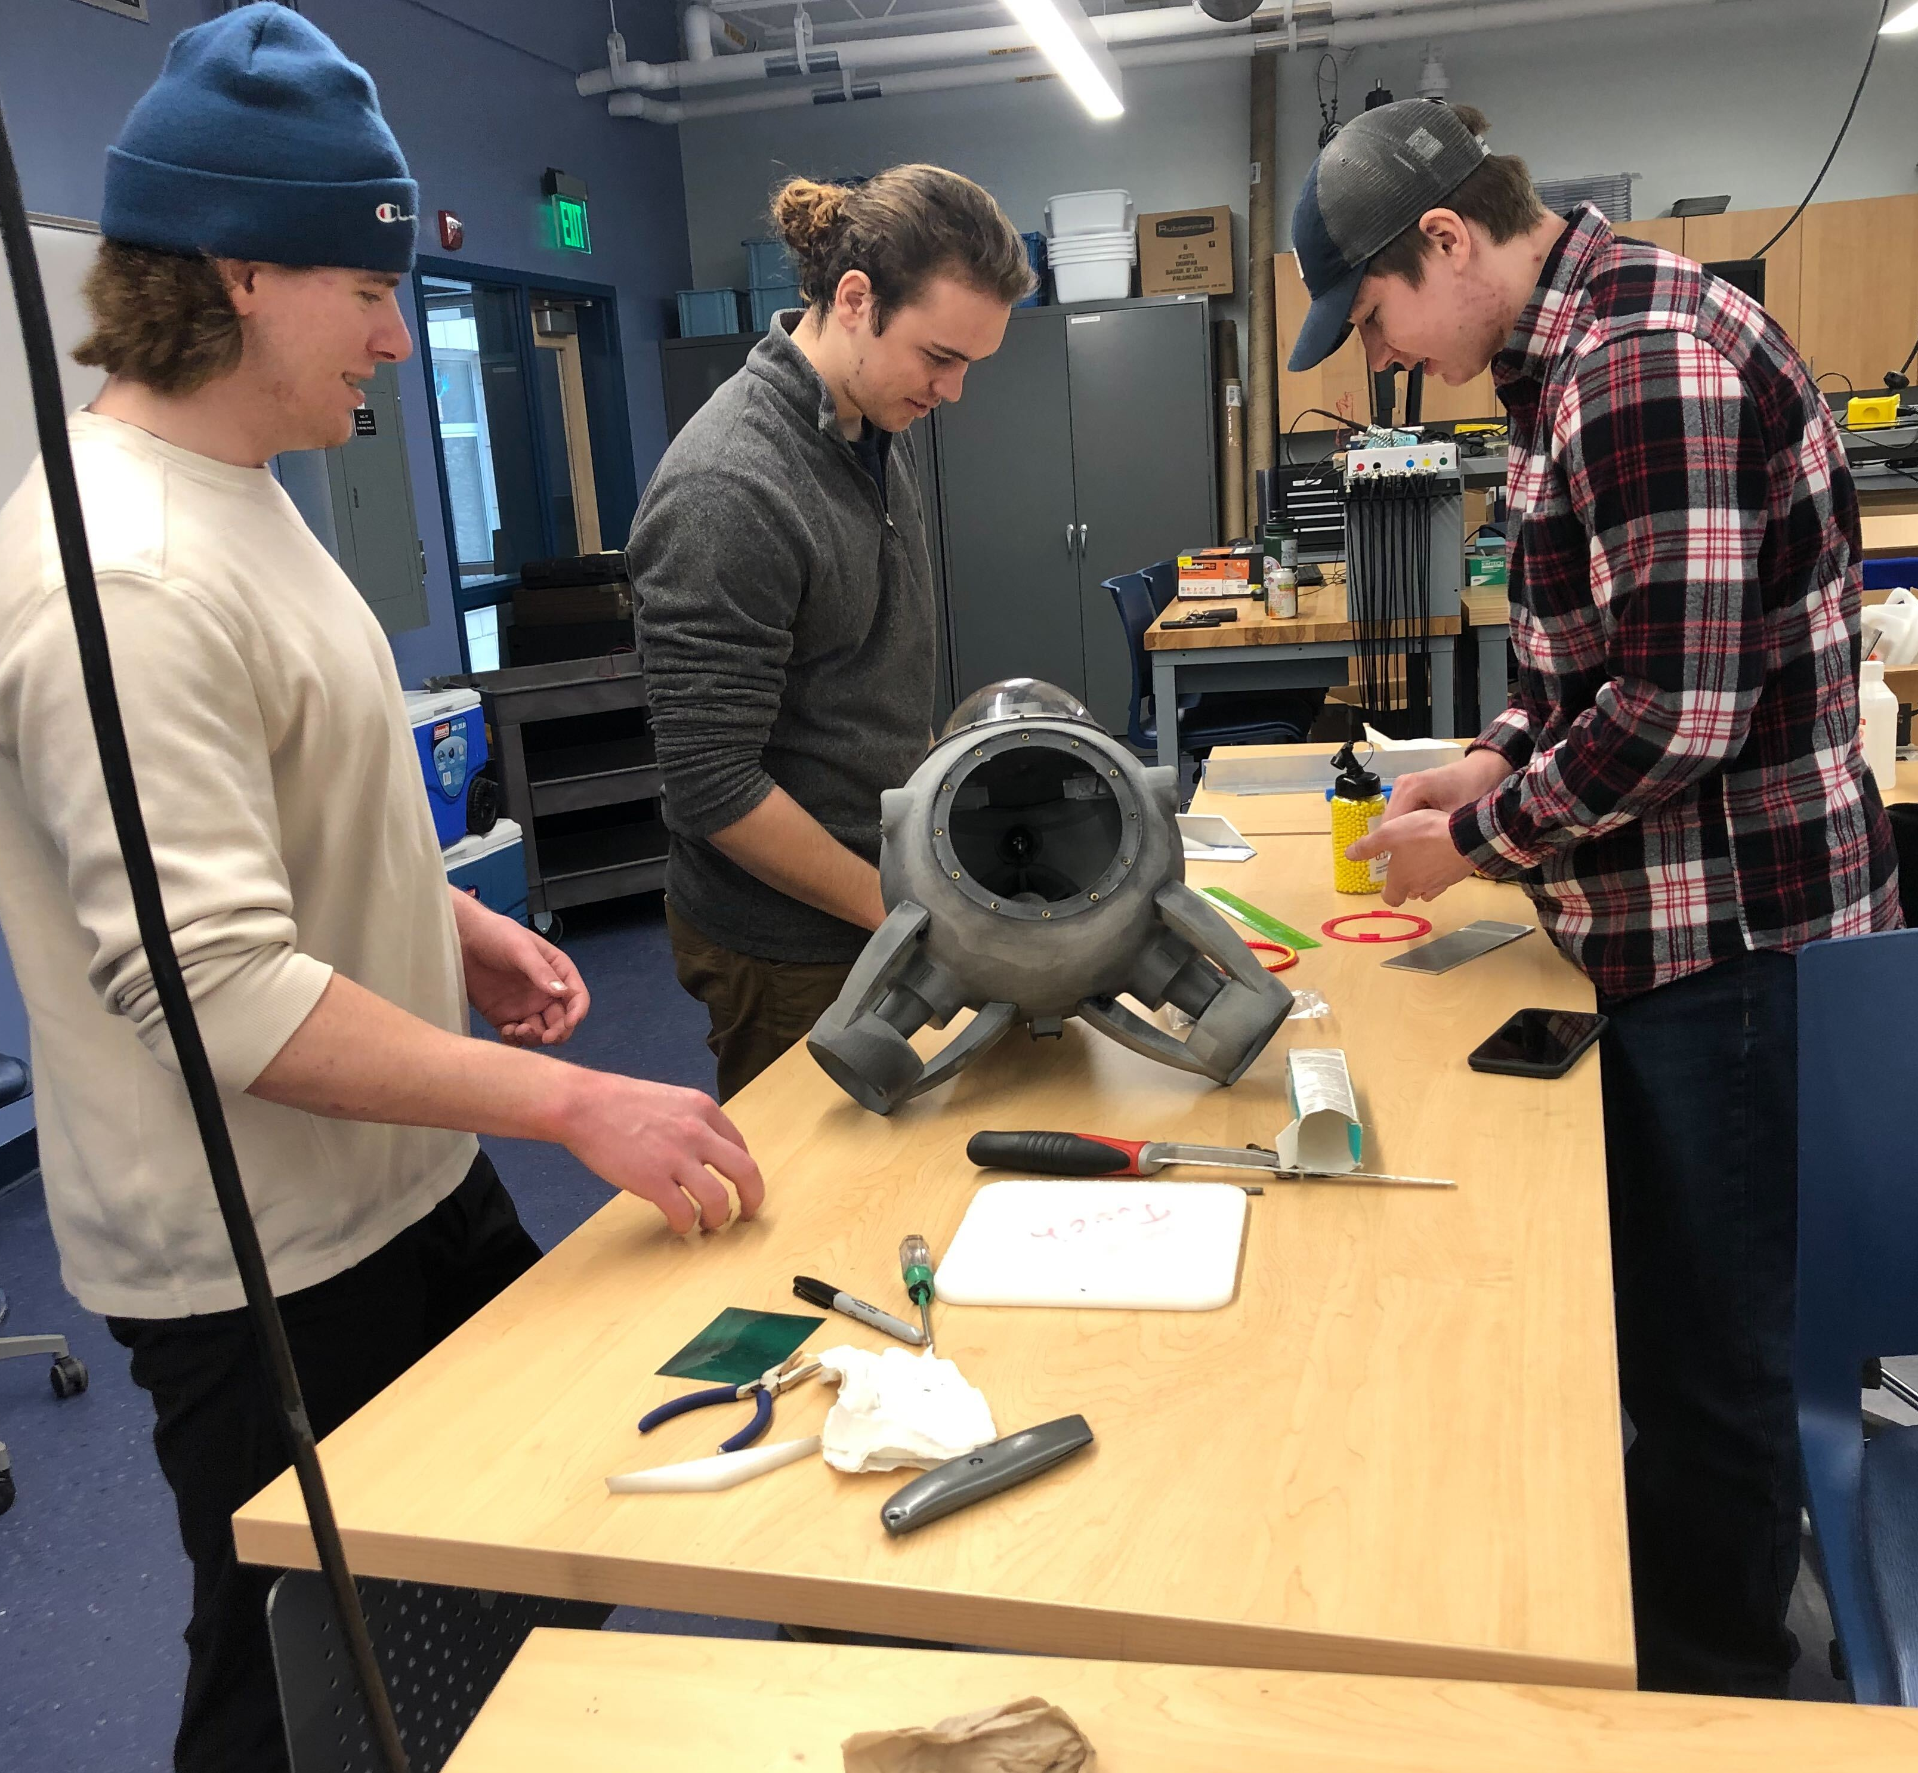
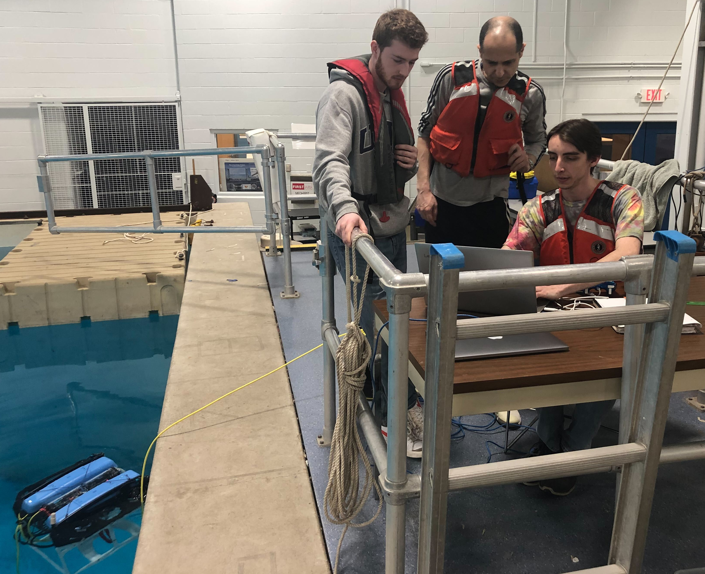
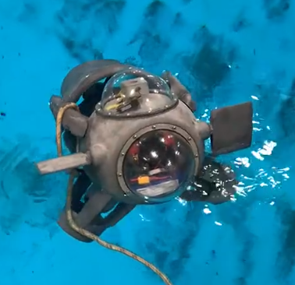
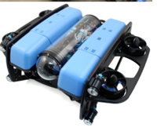
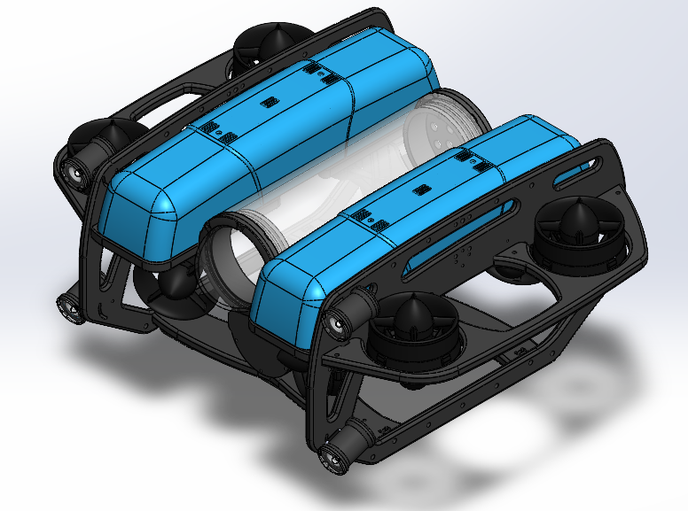
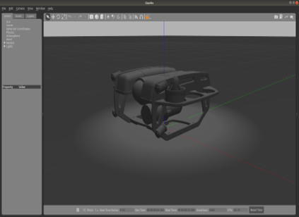
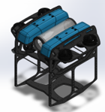
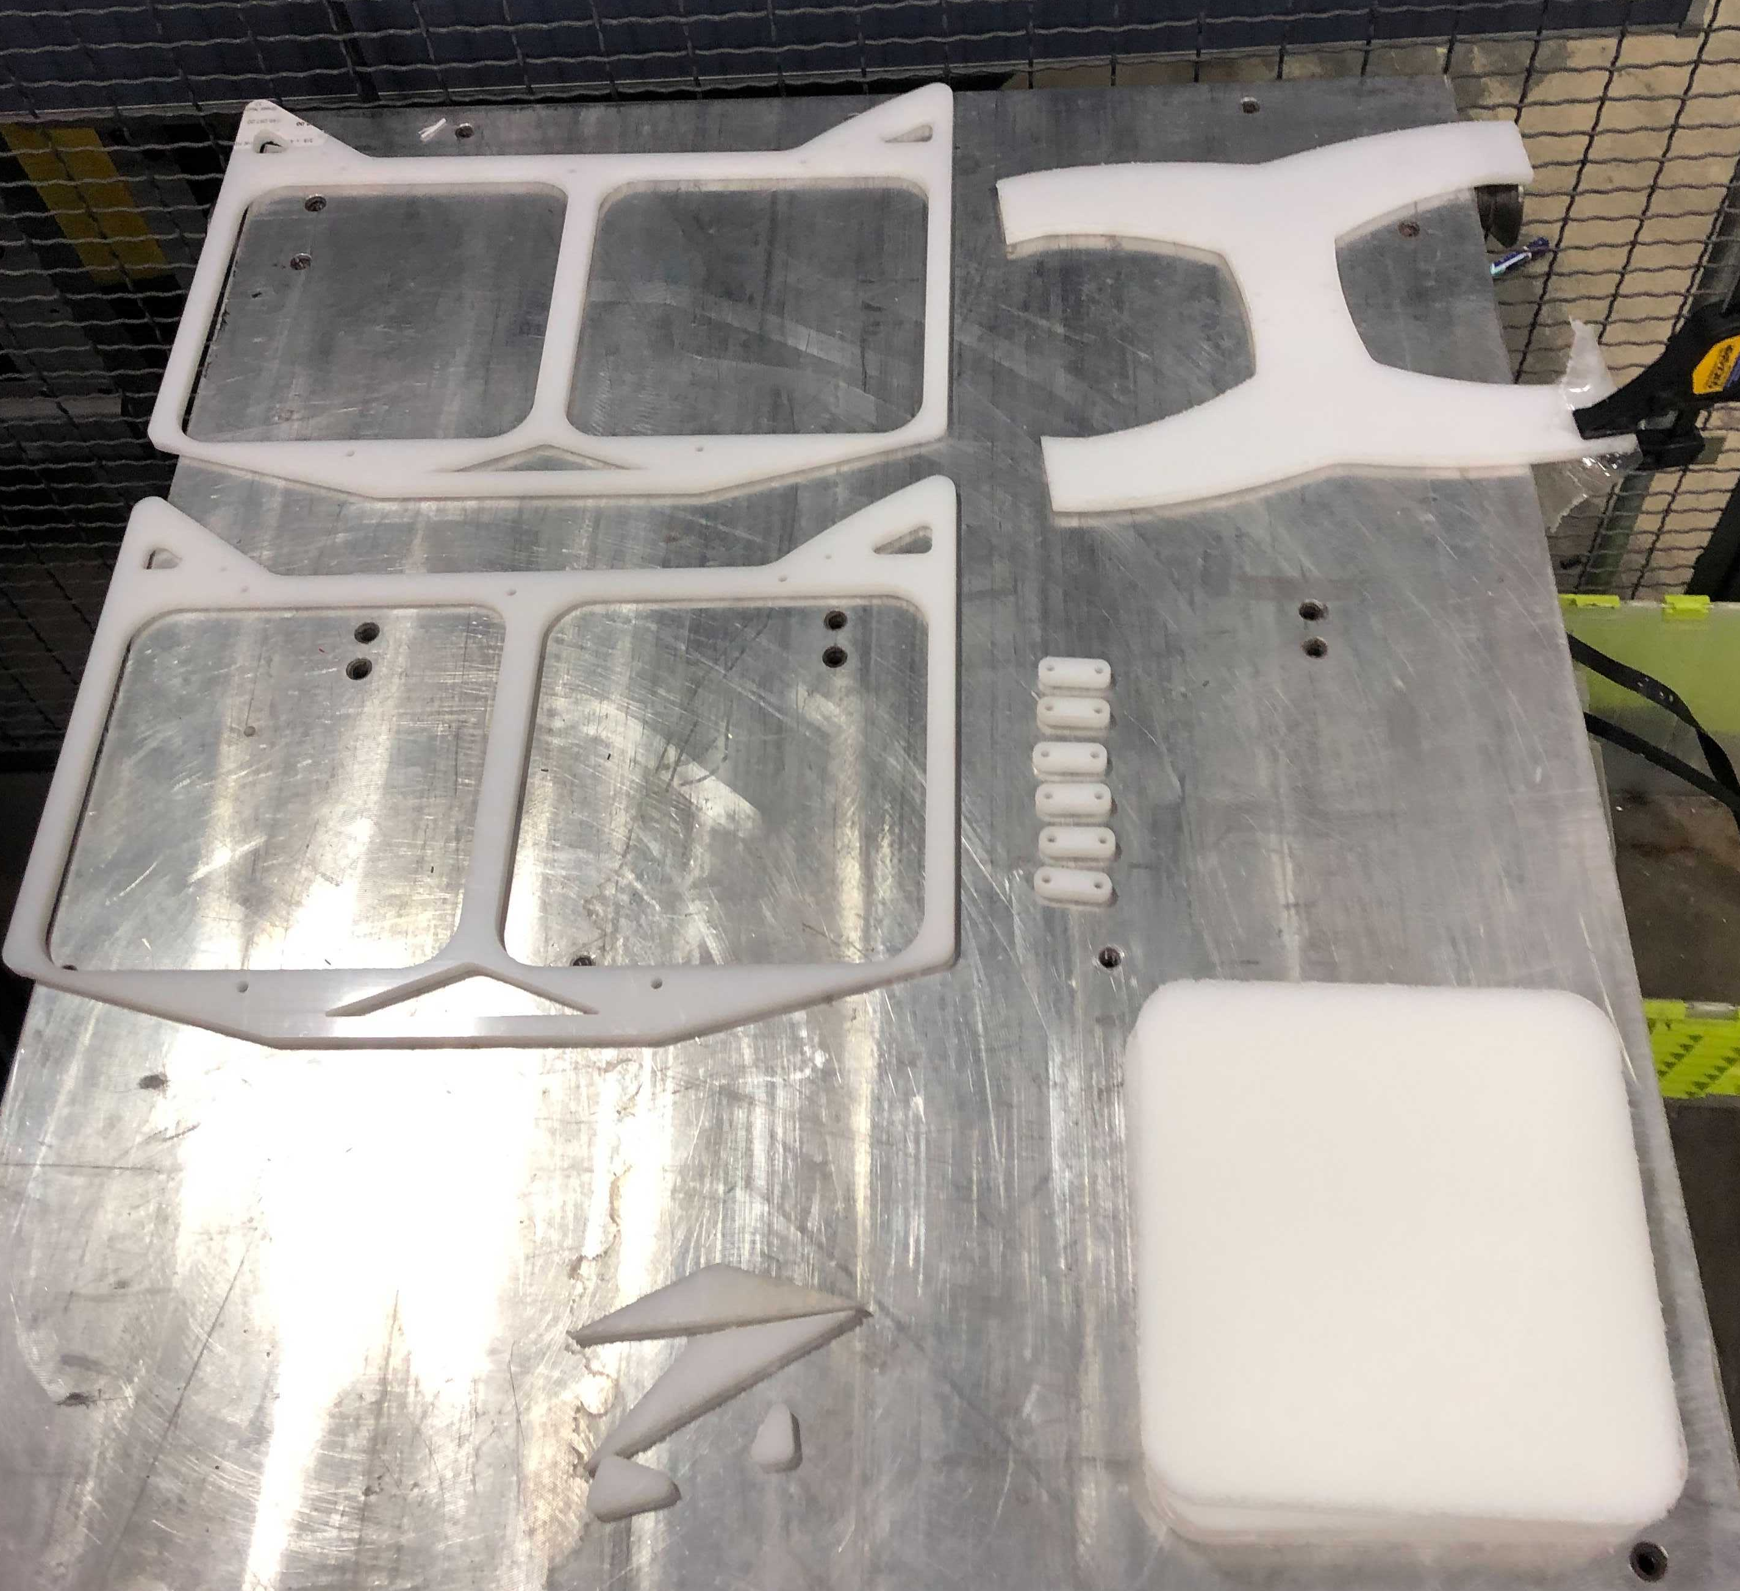
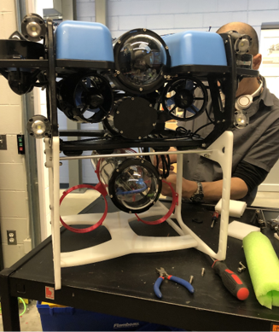

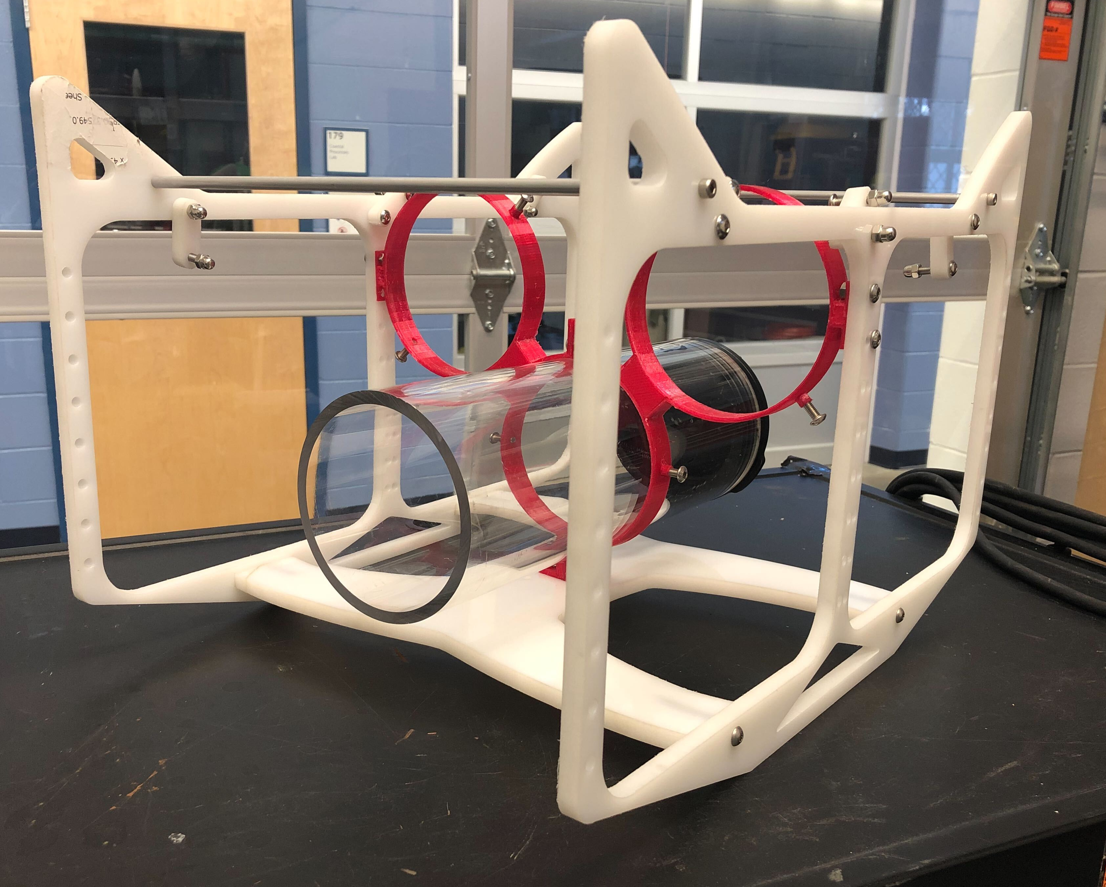
Marine And Naval Technological Advancements for Robotic AutonomY (MANTA RAY):
Unpiloted Underwater Vehicle (UUV)
Project Advisors: Dr. May-Win Thein, & Dr. Yuri Rzhanov
Graduate Advisors: Oguzhan Oruc, Hannah Arnholt, Nicholas Custer, Igor Vladimirov, Richard Randall
Team Members: Marguerite Kennish (ME), Jack Hamilton (ME), Brendan Ulrich (ME), Noah Wilder (CS),
Jeff Pitts (CS), Sydney Chock (EE), Gabriella Liano (EE), Aidan Boucher (CS)
subTeam Overview
Manta ray Mission
KRILL - manufacturing
Development
UUV and ASV communications for deployment
UUV Navigation
PhD. Candidate Oguzhan Oruc's control hardware
Exploration
UUV and White River Technologies partnerships
GAZEBO simulation introduction
Manufacturing
KRILL assembly components
Skid housing
Team MANTA RAY is an interdisciplinary project dedicated to creating, maintaining, and expanding a network of marine robots for seafloor mapping and underwater perception. The network began as just the autonomous surface vehicle (ASV) and unpiloted underwater vehicle (UUV), but has expanded to include a prototype of the ASV, known as TUPPS, and two kinds of remotely operated vehicles, known as GUPPS and KRILL. With these systems, students work to improve communication between vehicles, develop autonomous behaviors and algorithms, and upgrade existing mechanical systems to improve precision and performance.
Reason
NUWC-Keyport design for modularity and limited penetrations
Recreate and improve designs
Reverse Engineering
Disassemble 3D files
Determine make list
Cross-reference bill of materials
Manufacturing
Mill additional dome features
Laser-cut Gaskets
Water Jet Pressure plates
Hardware inserts
Soldered threaded heat inserts
Epoxy Neodymium Magnets
software Development
Software
The Pi sends and receives data from the pixhawk to and from the ASV
UUV functionality is split into many loosely coupled functions
A connection object is created between the ASV and the UUV’s PixHawk using the RaspberryPi as a bridge.
Communication between ASV & UUV is handled by leveraging the MavLink protocol
ASV controls the sequence of UUV operations by calling functions as needed
KRILL - Tank Testing AND FUTURE WORK
UUV subteam mission
Preliminary Tank Test
Side thrusters performed as expected
Hull remained waterproof throughout the test
Main thruster lacked power
Fin actuators did not operate to expectations
Future Work
Operational main thruster and fin actuators
Buoyancy and balance need to be adjusted
The UUV subgroup prioritizes communication between the ASV and the UUV. The ASV deploys the Underwater GPS acoustics nodes, and the UUV. The ASV relays its GPS position. The UUV determines its positional coordinates below the surface using the nodes to evaluate its relative distance from the ASV.
The 2021-2022 UUV team developed communication software, investigated GAZEBO simulation, designed custom skid housing, and partnered with KRILL Electrical Engineers.
Gazebo
Reason
Gazebo has ability to
  Simulate physics
  Create sensor feedback
  execute ROS, Python, and Linux scripts
Adapt Hippocampusrobotics Scaffolding
Convert Noetic to Melodic
SOLIDWORKS to Gazebo Model
Converting file types
  .sldprt .blend .dae Gazebo model file
SKID - Design
SKiD - Manufacturing
SkiD - Assembly and Installation
Reason and Design Constraints
Support the 22 lb UUV in air
House three 4-inch BlueRobotics payload tubes
  Controller hardware
House two 8-inch payload tubes
  Future sensor housing
SolidWorks Design
Rings were designed to hold the payload tubes in the skid
Initial inspiration from BlueRobotics skid
Adapted design has increased height to meet constraints
FEA simulations confirm viability
Materials
High-Density Polyethylene (HDPE) plastic
  High elastic modulus
  Marine applications
  Corrosion resistant
Aluminum standoffs
Marine Grade Stainless steel fixtures
Manufacturing Process
CNC Water Jet Cutter
John Olson Advanced Manufacturing Center
  Pannel bases
CNC Milling
Kingsburry Hall
  Finalized panel features
Lathe
Kingsburry Hall
  Standoffs
Payload Rings
The rings were redesigned after an initial design was tested and found to be unsuitable
Threads were placed in the rings to house set screws which hold the tubes
Installation
Additional standoffs were created for stability
The completed skid was then installed
Special Thanks to Dr. Martin Renken, Thai Tran, Laura Gustafson, Kelly Danforth, Scott Campbell, Debarpan Bromwick and the Olson Center
Notes:
To change this poster, replace our sample content with your own. Or, if you'd rather start from a clean slate, use the New Slide button on the Home tab to insert a new page, then enter your text and content in the empty placeholders. If you need more placeholders for titles, subtitles or body text, copy any of the existing placeholders, then drag the new one into place.

