Slide 1

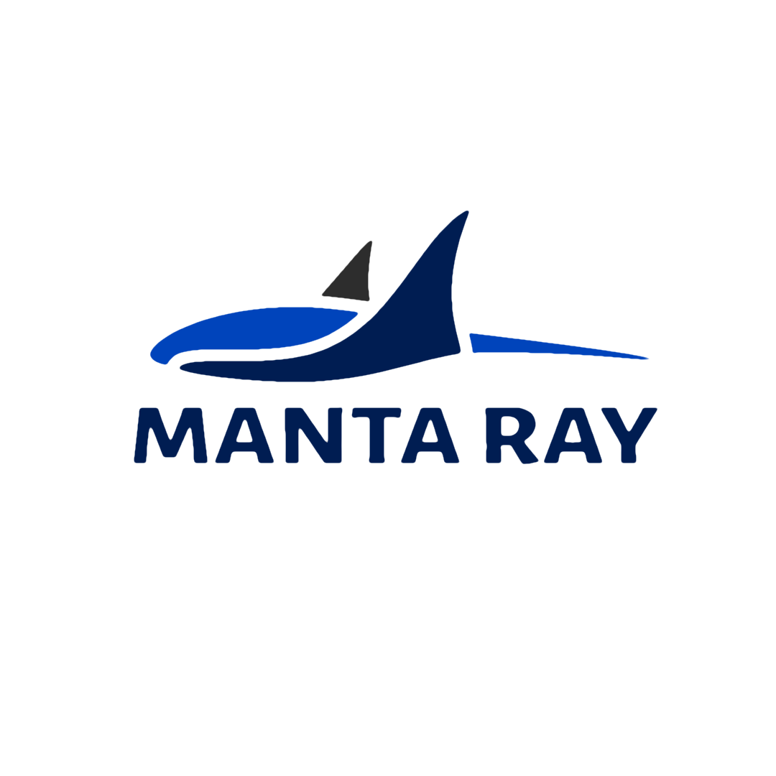
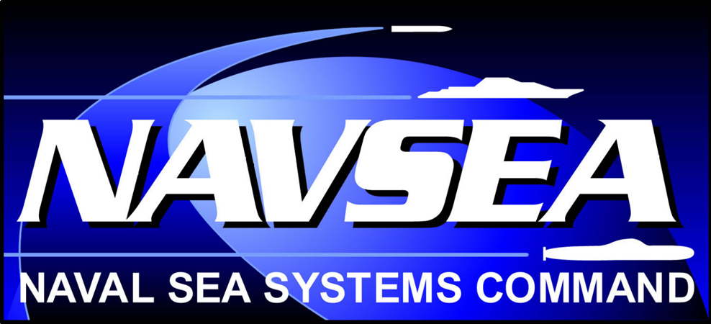

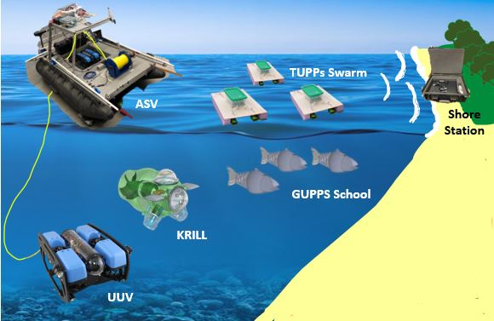
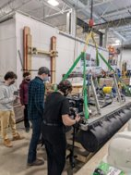
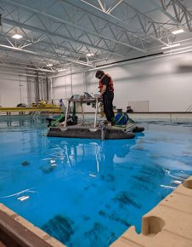
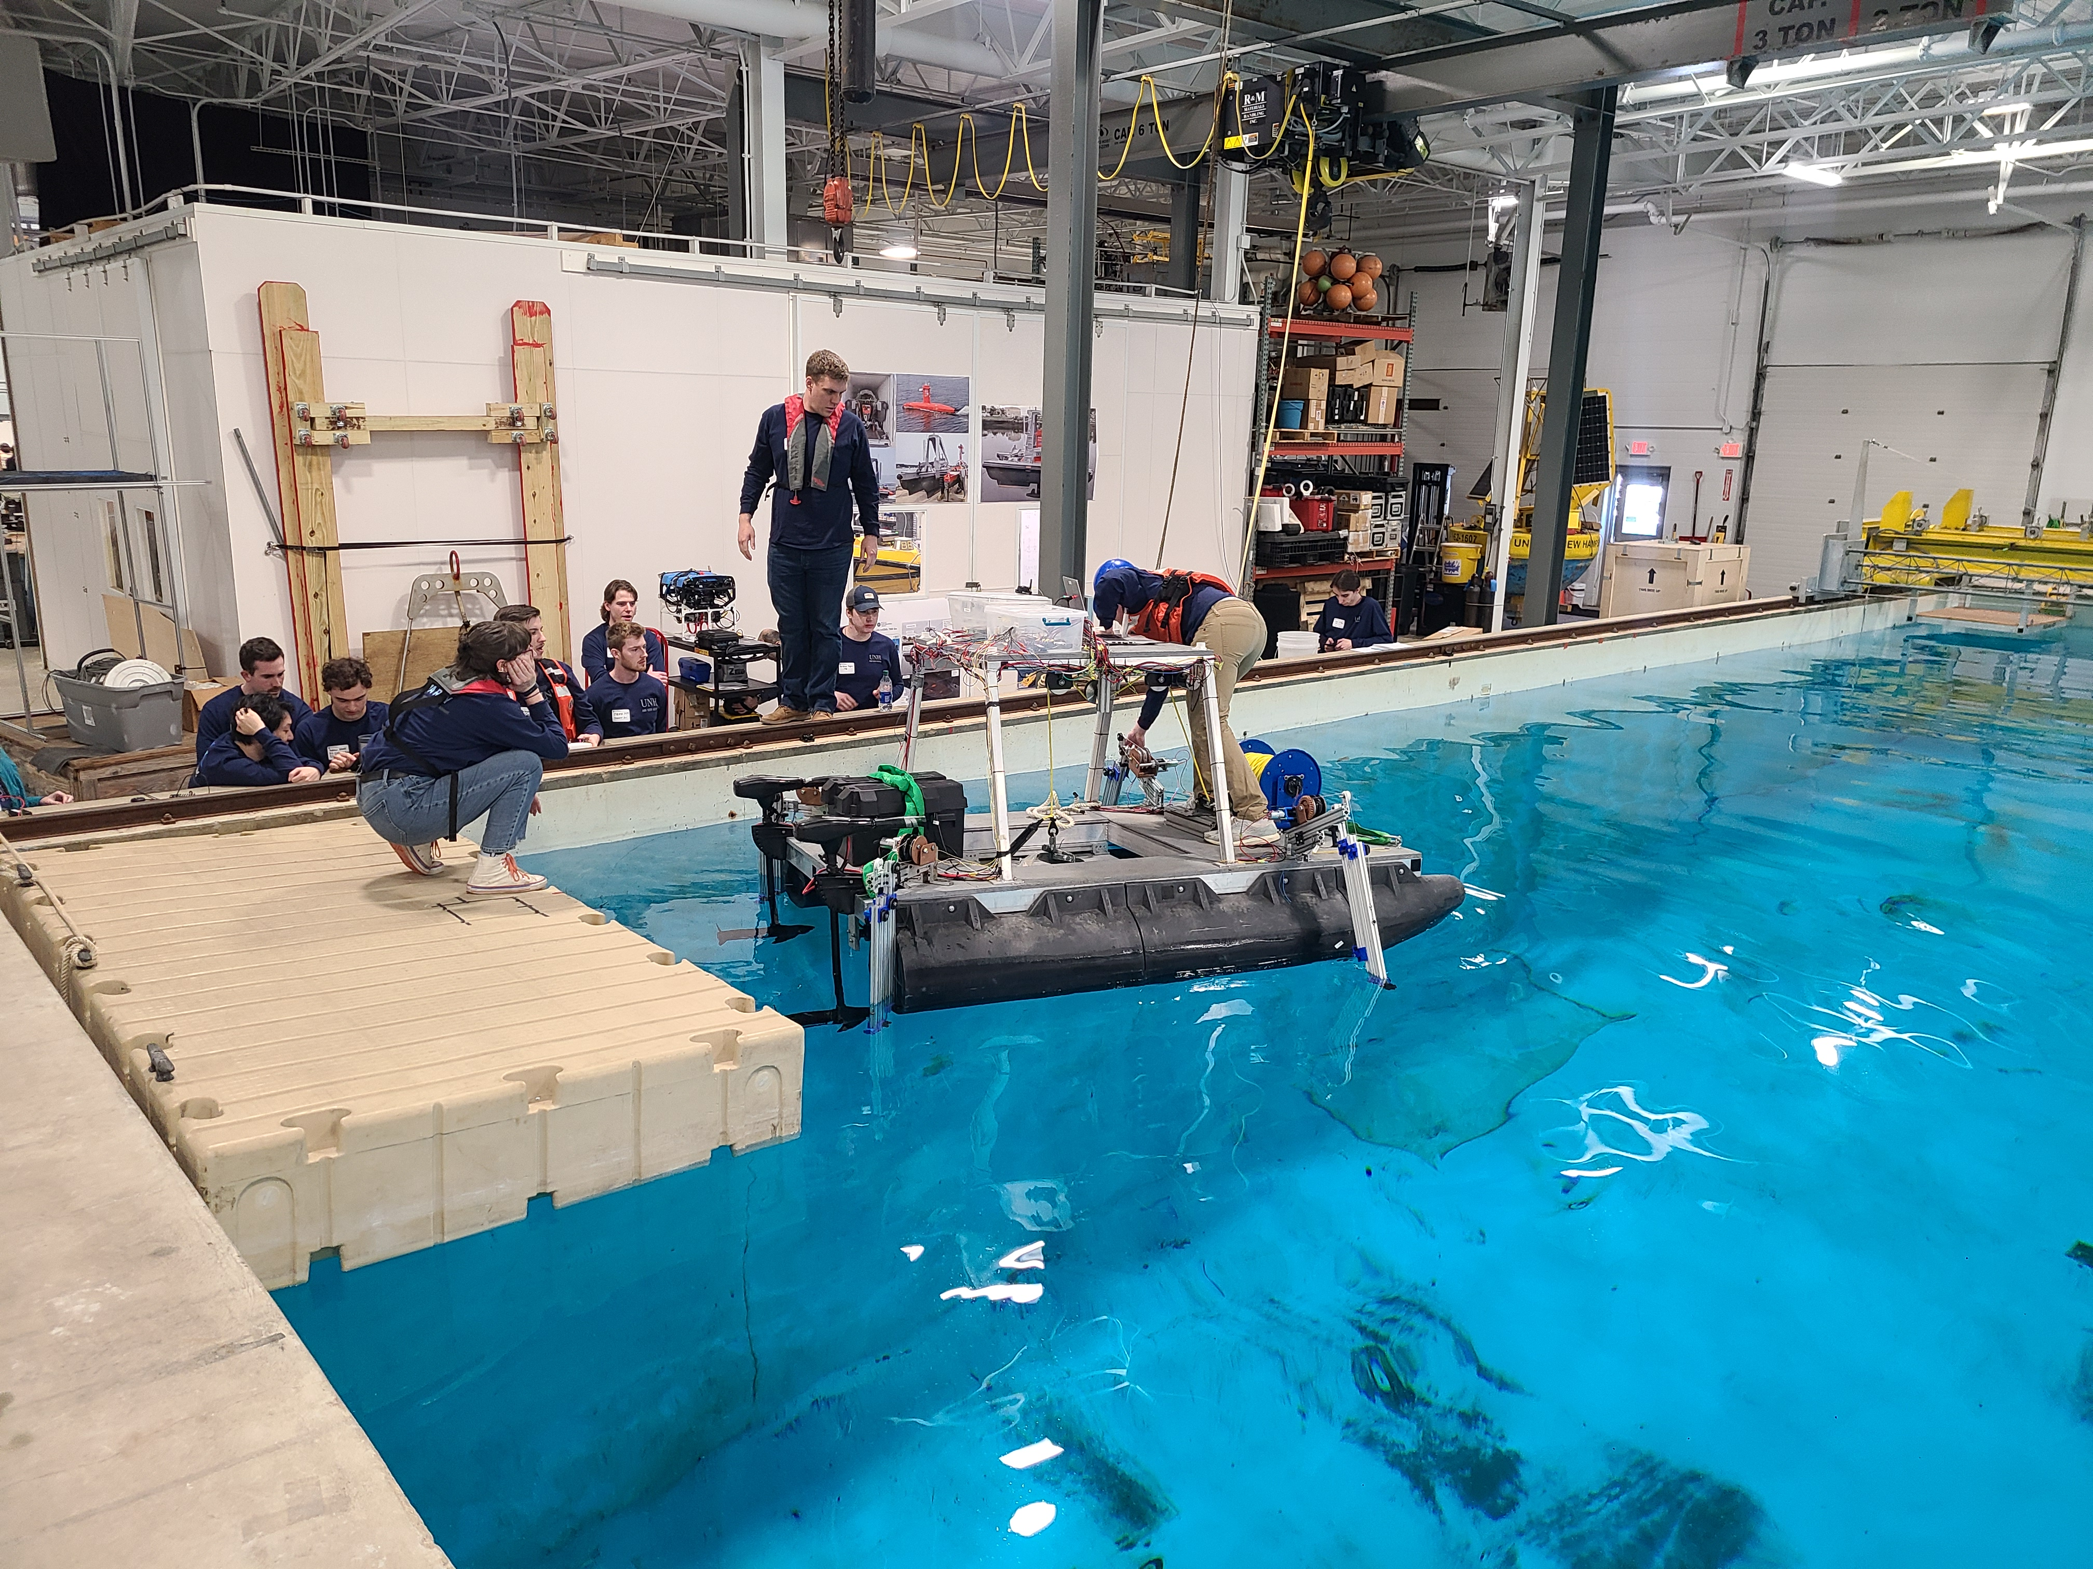
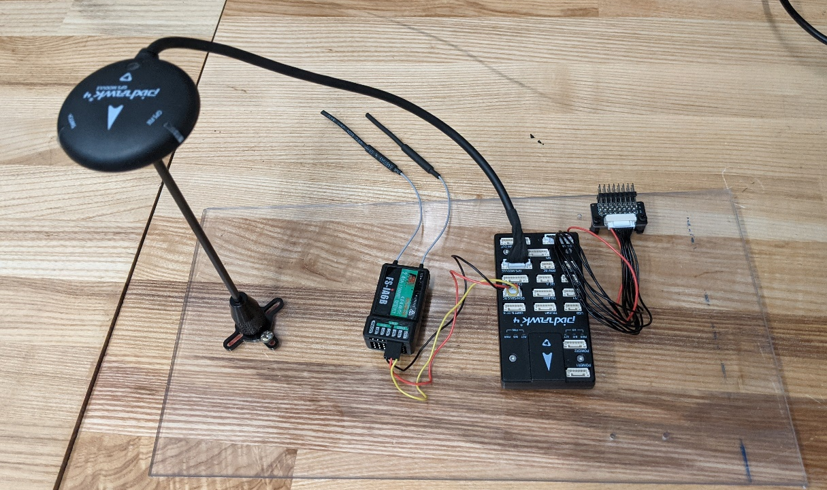
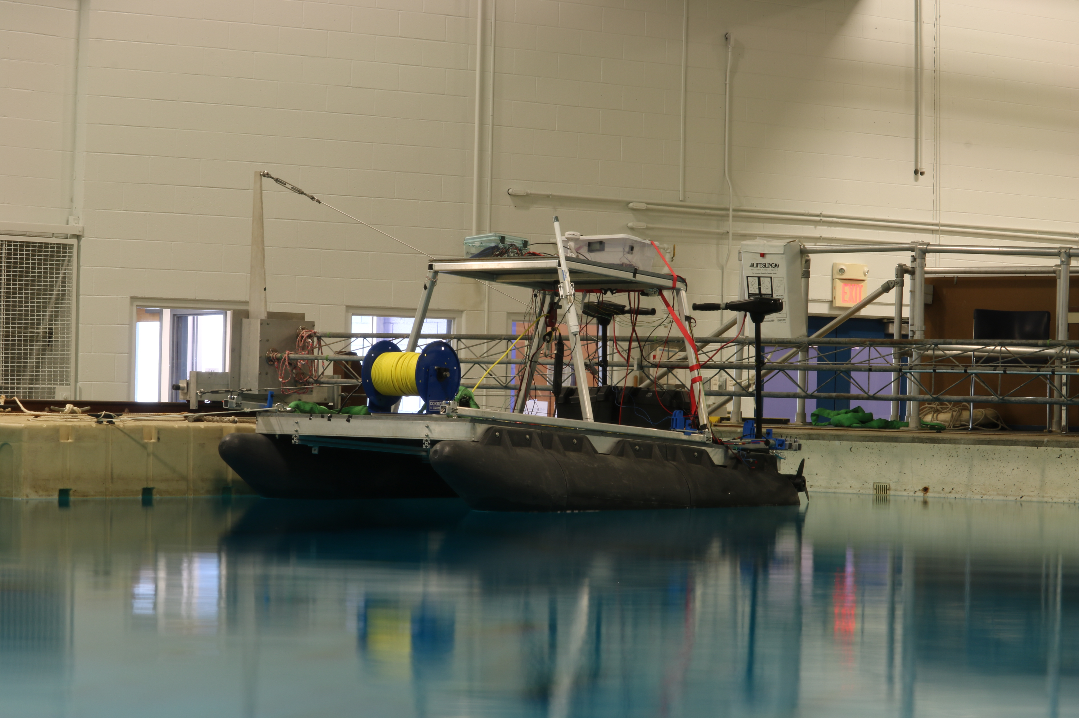
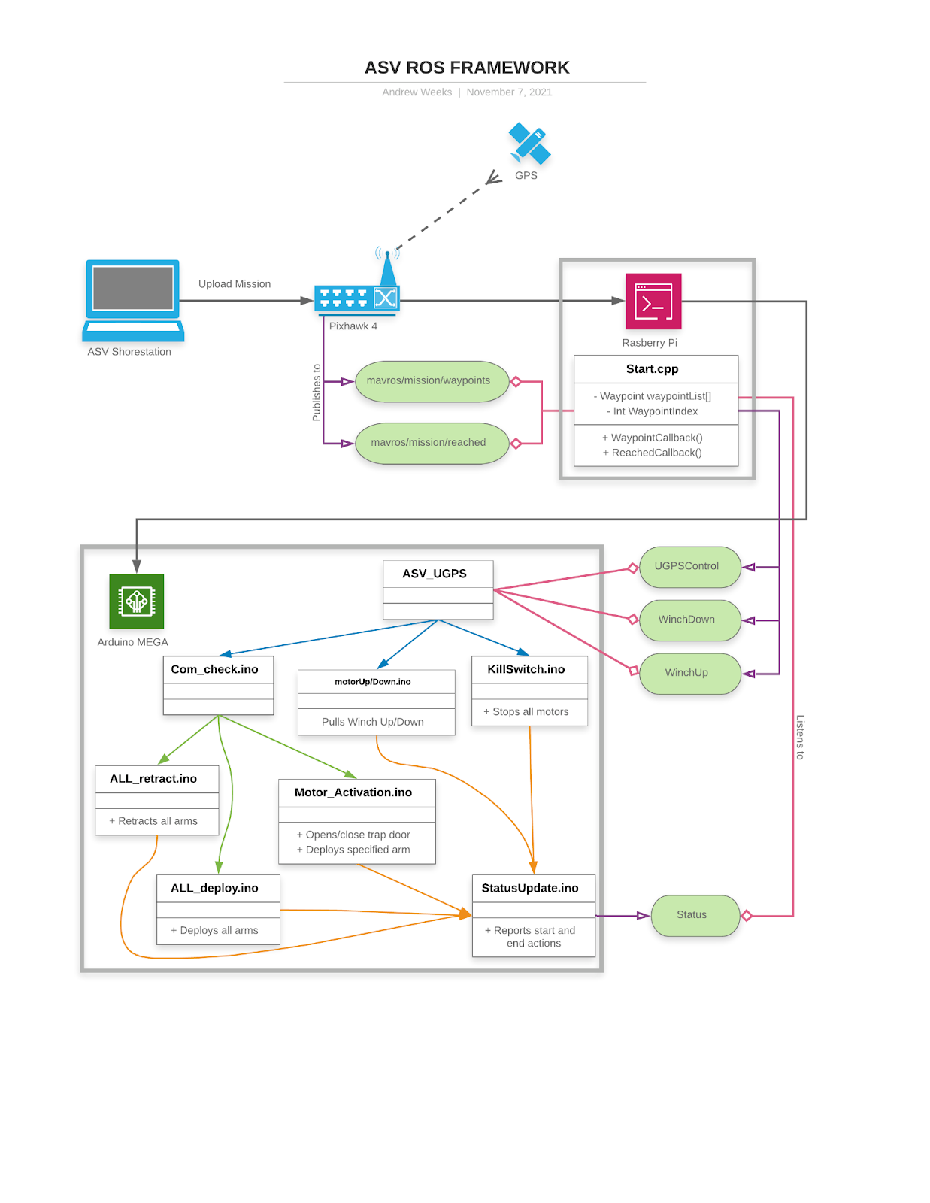
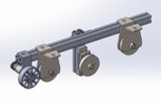
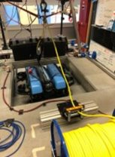
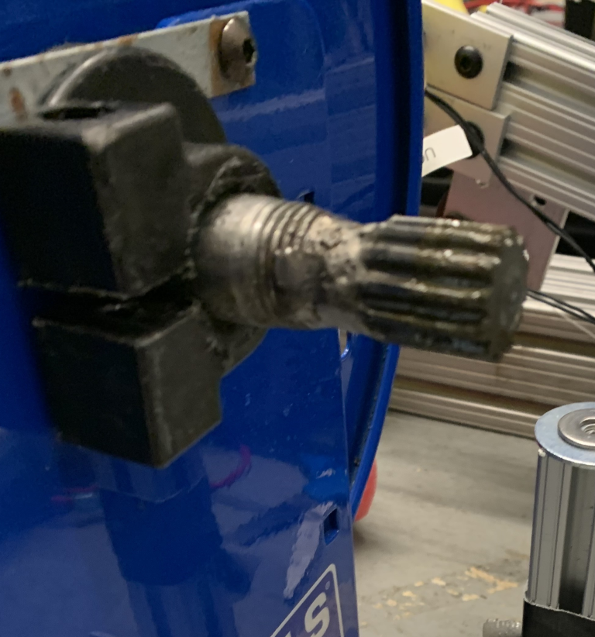
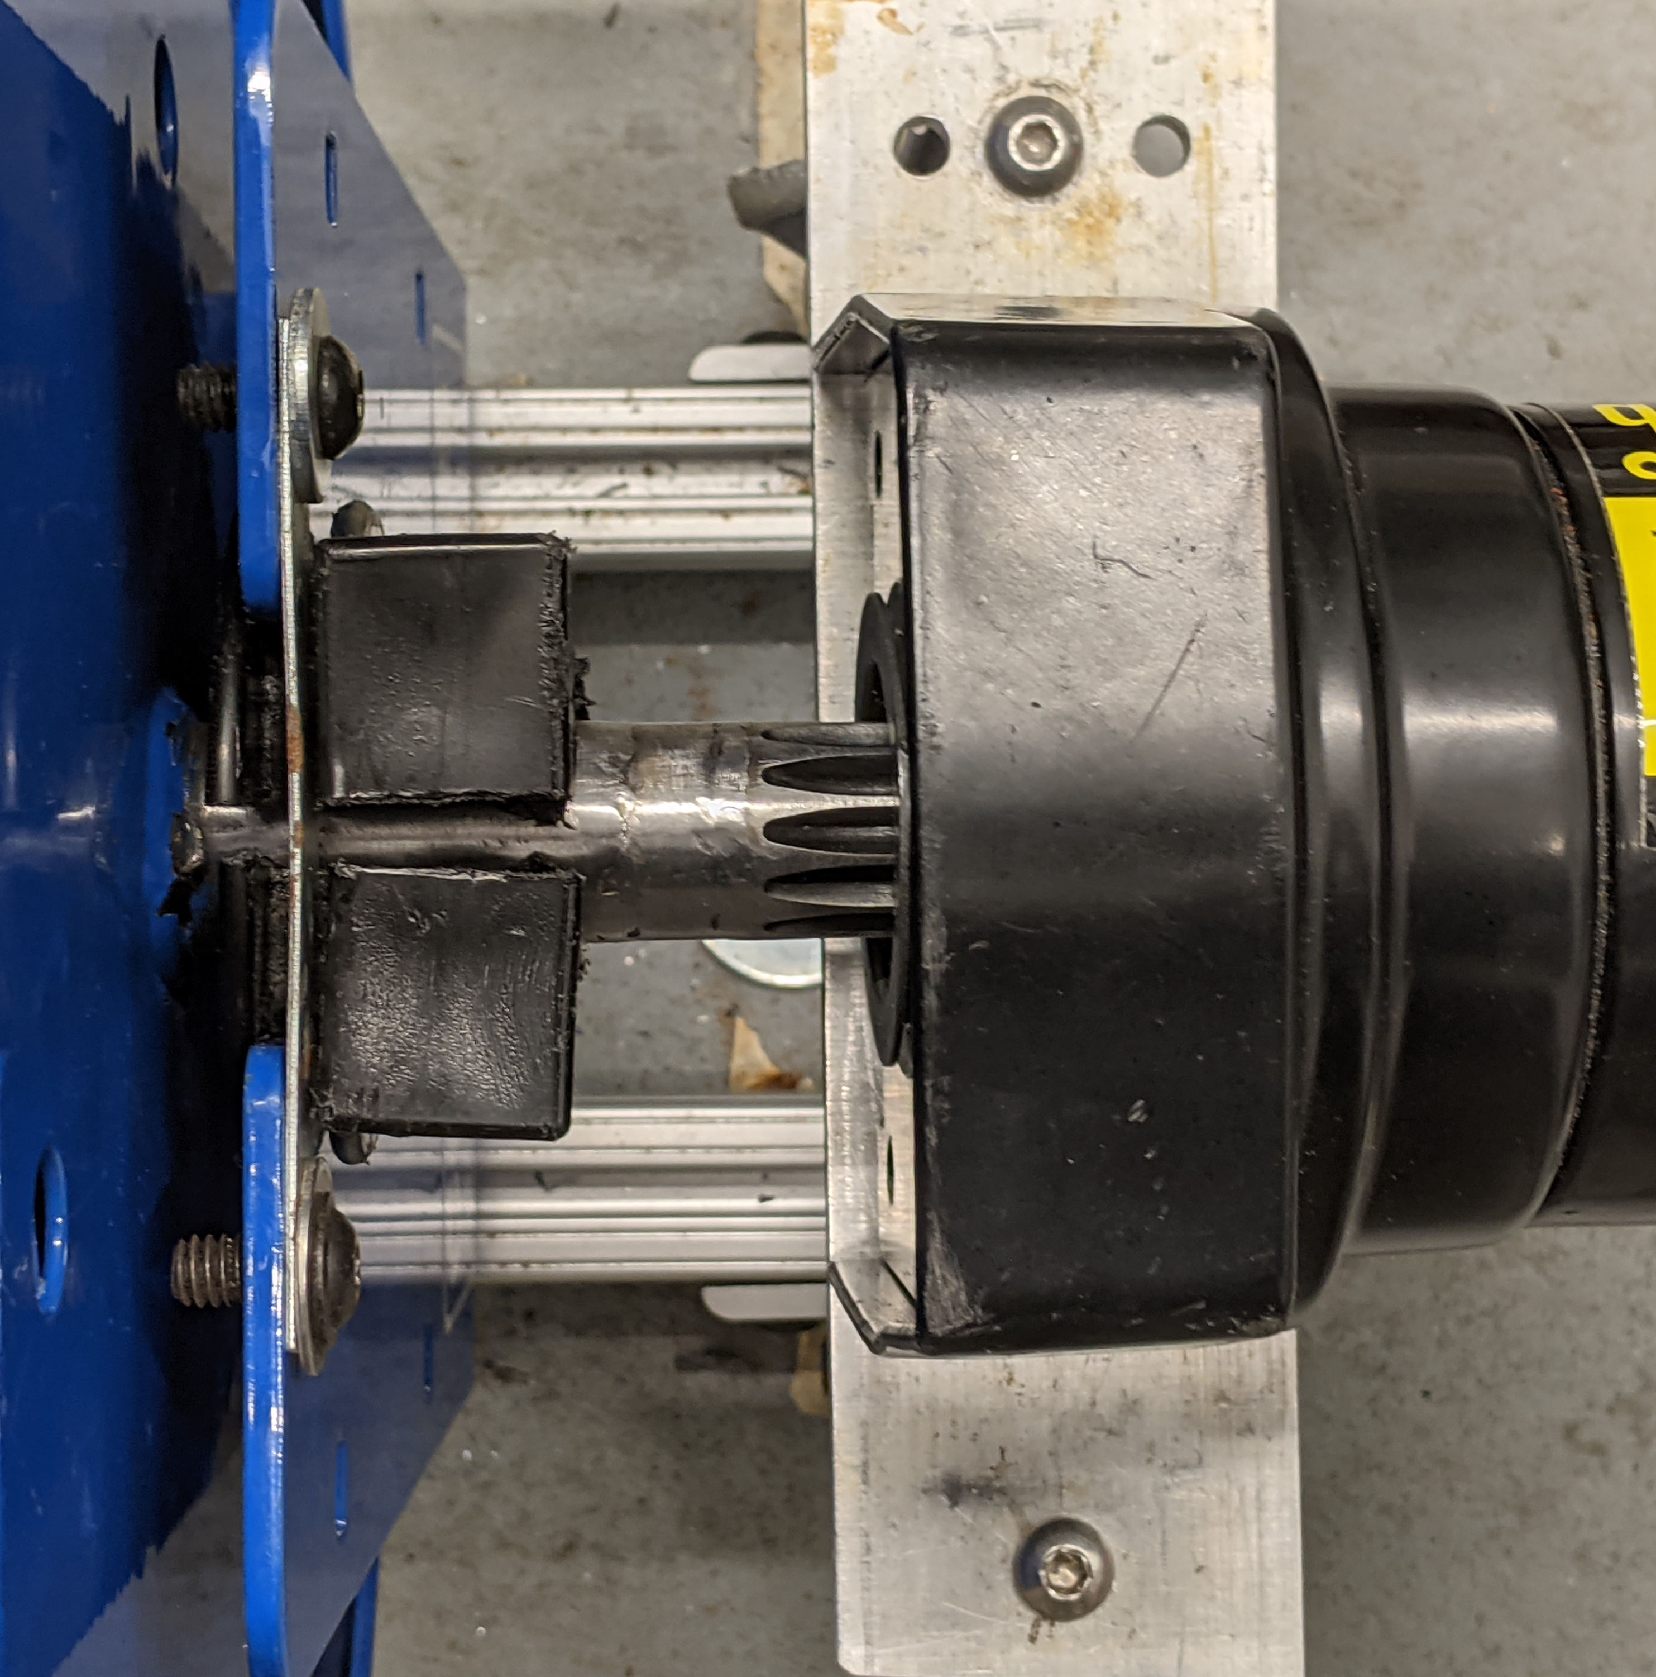
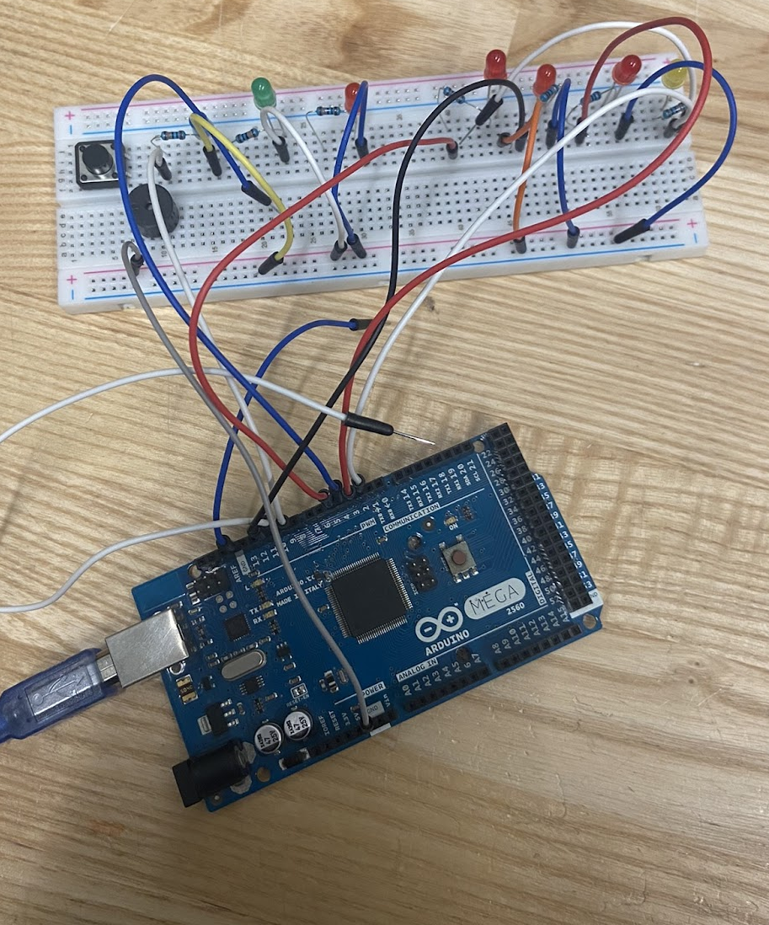
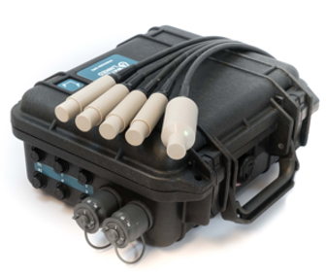
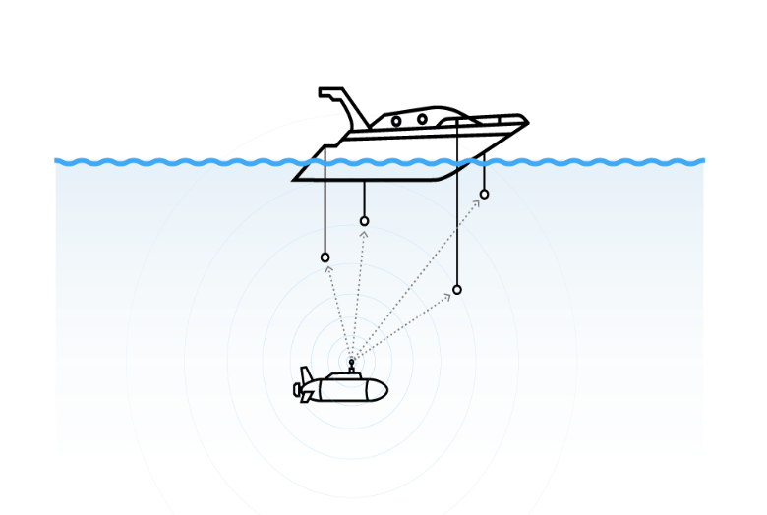
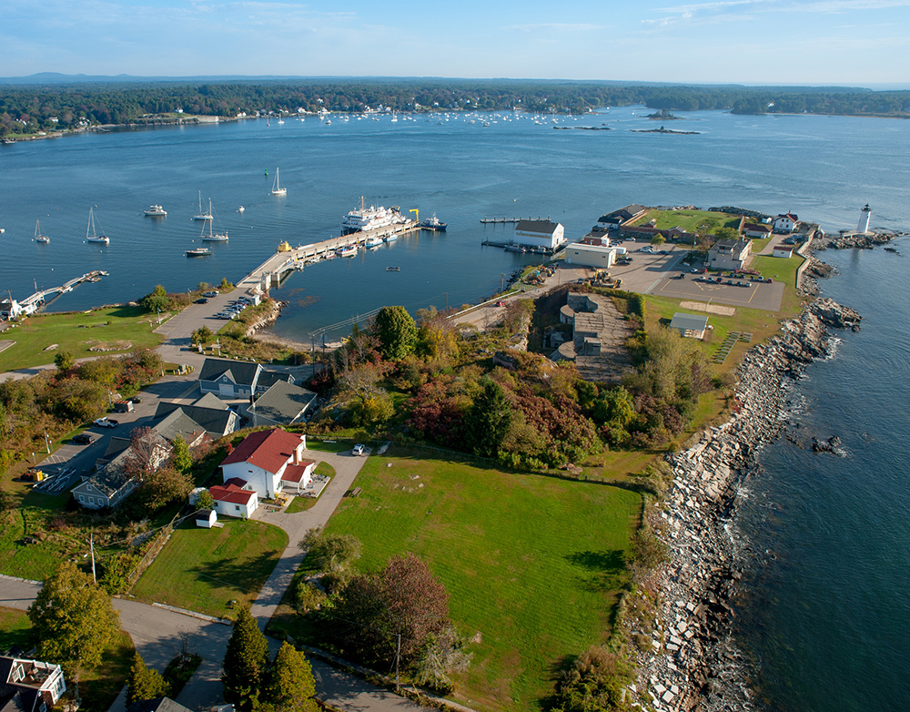
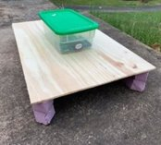
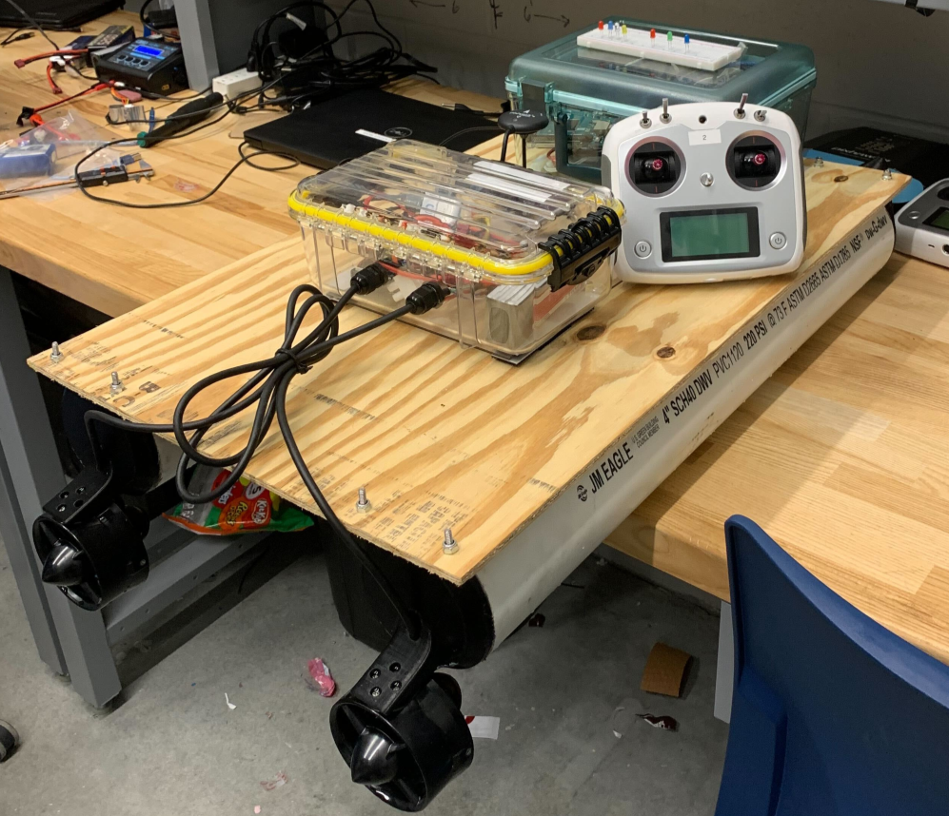
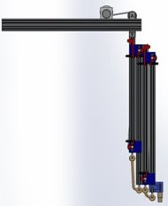
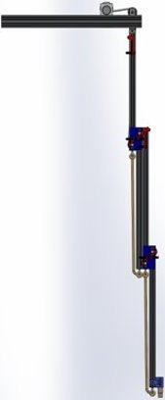
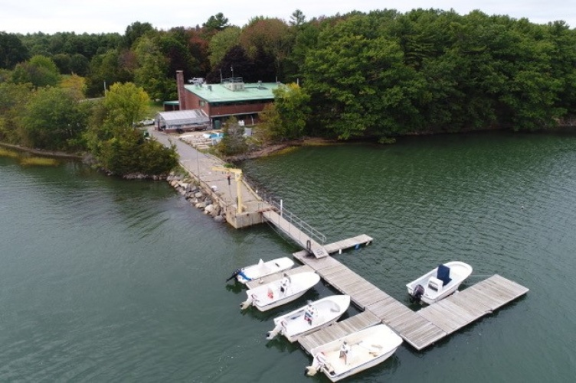
Marine And Naval Technological Advancements for Robotic AutonomY (MANTA RAY):
Autonomous Surface Vehicle (ASV)
Project Advisors: Dr. May-Win Thein, Dr. Yuri Rzhanov
Graduate Advisors: Nick Custer, Richard Randall, Oguzhan Oruc, Hannah Arnholt, Igor Vladimirov
Team Members: Matthew Radzelovage (ME) Jessica Barker (ME), William Seguin (ME), Patrick McKinnon (CS), Andrew Weeks (CS), Jenna Ehnot (OE)
Background
Manta Ray Mission
TESTing
Mechanical Design
Built by 2017-2018 ASV Team
Catamaran body: 7’9” length, 5’6” beam
Twin 55lb thrust electric trolling motors
"Penthouse" platform to keep electronics far from waterline
Tether winch and trapdoor for UUV tether management and deployment
Software Design:
Pixhawk Flight Controller
Hardware standard for open-source autopilot
Enables missions uploads and performs scripted autonomous navigation between waypoints, as well as remote controlled capabilities
Contains a robust sensor suit including a compass, internal IMU and GPS capability
Installed on ASV penthouse
Robotic Operating System (ROS)
Open-source robotics middleware suite
Enables communication between Pixhawk and ASV subsystems through network of publishers and subscribers
Capabilities
  Tracking system location with GPS and acoustic system (UGPS)
Communication hub for entire system; transmits data and status updates to shore station
UUV deployment and retraction
Autonomous path planning and heading control
Seafloor mapping with acoustic sonar
Team MANTA RAY is an interdisciplinary project dedicated to creating, maintaining, and expanding a network of marine robots for seafloor mapping and underwater perception. The network began as just the autonomous surface vehicle (ASV) and unpiloted underwater vehicle (UUV), but has expanded to include a prototype of the ASV, known as TUPPS, and two kinds of remotely operated vehicles, known as GUPPS and KRILL. With these systems, students work to improve communication between vehicles, develop autonomous behaviors and algorithms, and upgrade existing mechanical systems to improve precision and performance.
Several full-scale tank tests were performed in the Chase engineering tank to test the subsystems and autonomous launch protocol
Acoustic modems, “Indoor GPS”, were used to simulate GPS waypoints for the Pixhawk flight controller
Our findings show that the final design is ready for more robust components and wiring
Launch Protocol
Pixhawk with RC and GPS modules
Uses ROS to allow communication between each subsystem on board to know when to deploy
Deployment.py listens to ROS topics that the Pixhawk publishes to allow detection of when the ASV has reached the desired waypoint to begin deployment of the UUV
The Pi 4 will sequentially send messages to the UGPSControl, WinchDown and WinchUp topics on the ROS network
Each subsystem listens to one of the three topics and deploys accordingly
After each deployment, a “finished” message is sent to the Status topic which the Pi 4 is listening to in order to know which subsystem to deploy next
Tether Tensioning System (TTS)
Rotary encoder added to allow for deployment/retrieval of tether based on distance, rather than time
Three pully system with motorized rubber compliant wheel that spins at the same rate as the tether deployment motor, applies tension to tether and prevents back spooling at the winch
Winch axle rewelded to be aligned with motor gearbox
TESTING unpiloted
PERFORMANCE PLATFORM (TUPPS)
Purpose: A scaled down version of the ASV that replicates the full scale ASV's architecture for indoor testing in a tank.
Cost-effective, modular construction
Arduino microcontroller to simulate the ASV subsystems
Raspberry Pi ARM single board computer to replicate the ASV computer
Pixhawk flight controller
Pontoons redesigned with PVC pipe, 3D printed end caps, and repositioned Blue Robotics thrusters
UNDERWATER “GPS” SYSTEM
Future Plans
Needed to track postion of UUV with respect to ASV location
Uses a Waterlinked® Underwater USBL© System
  4 submersible transducers (on ASV), 1 receiver (on UUV), and an Electronics dry box (on ASV penthouse)
Updated old linear arm system to cascading arm system
  Submerges acoustic transducer further underwater, thus increased accuracy
  Faster deployment time
  Sturdier, less upkeep
Each arm utilizes a bi-directional spooling method in conjunction with dual limit switches to deploy and retract the nodes
UGPS API interface to retrieve GPS coordinates for UUV
Mission assertation for UUV from ASV
Reorganize the subsystem code
UUV Retrieval sequence
Active spooling on TMS
Open water testing off UNH Research Pier in New Castle, NH
Waterlinked® Components
Previous design
New design
Retracted
Deployed
Special thanks to Dr. Martin Renken, Thai Tran, Laura Gustafson, Kelly Danforth, Scott Campbell, Debarpan Bromwick, and the Olson Center
Cascading Arm Solidworks Rendering

