Slide 1


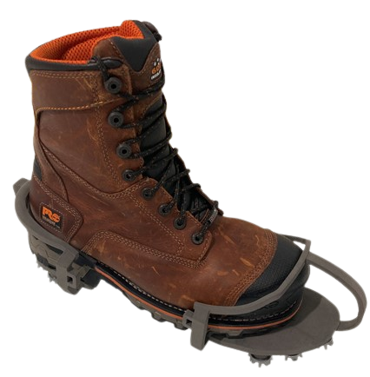
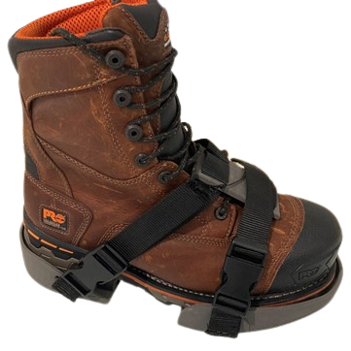
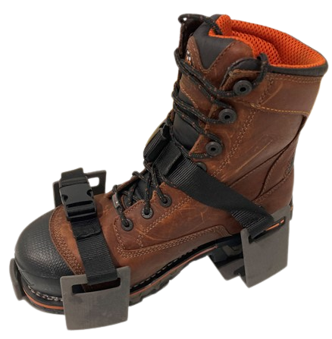
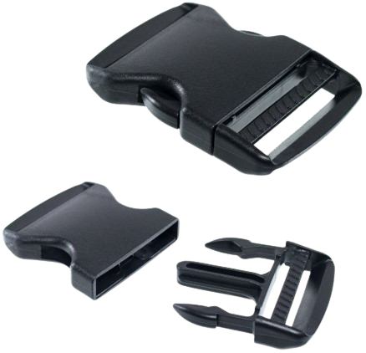
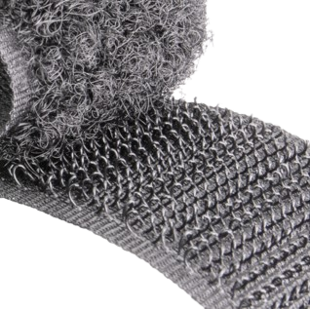
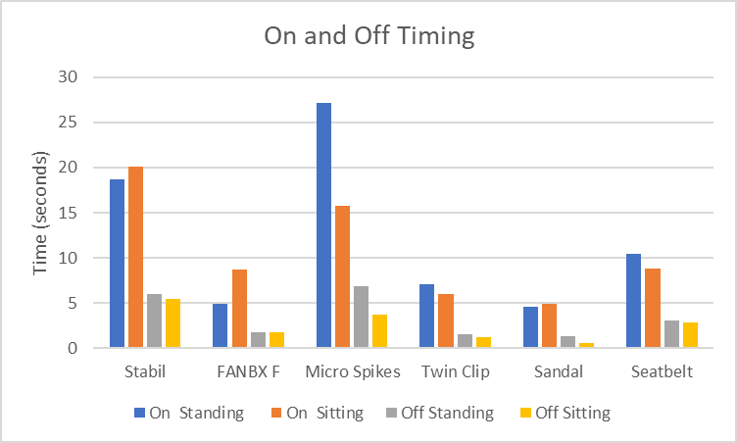
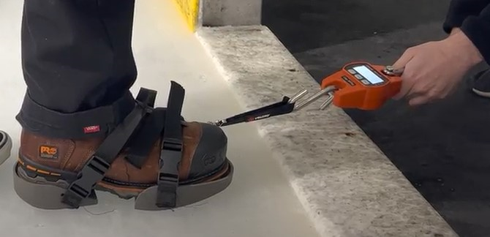
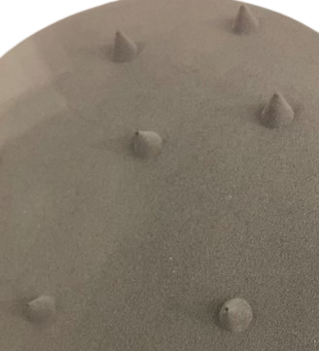
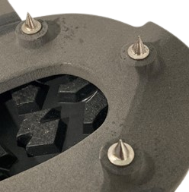
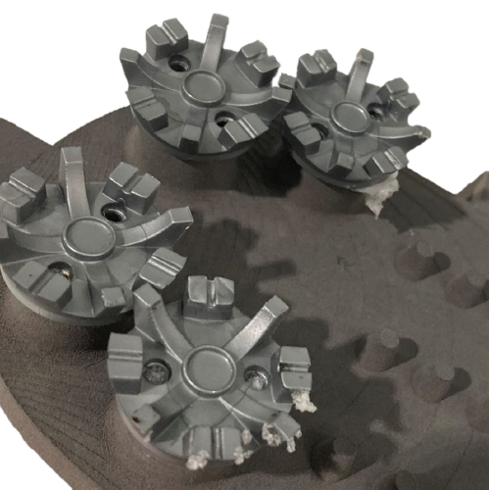
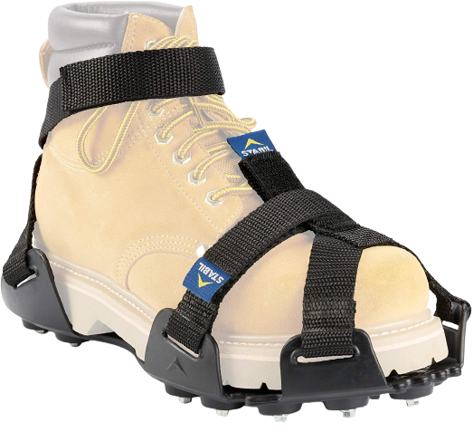
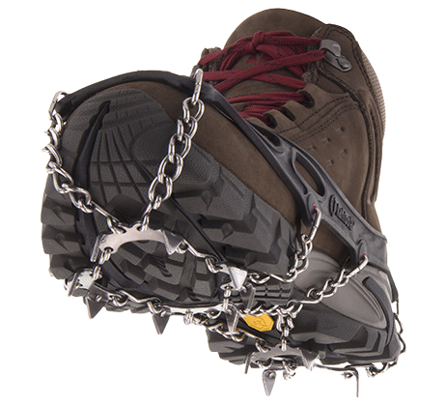
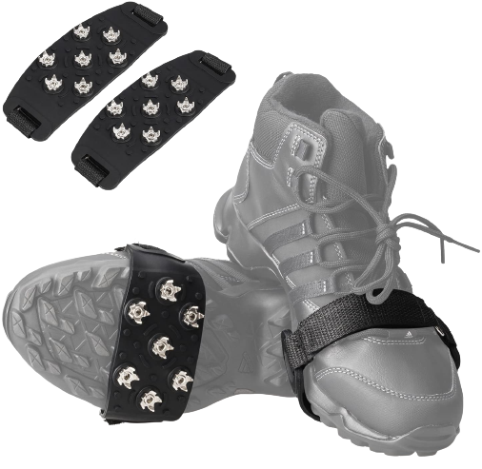
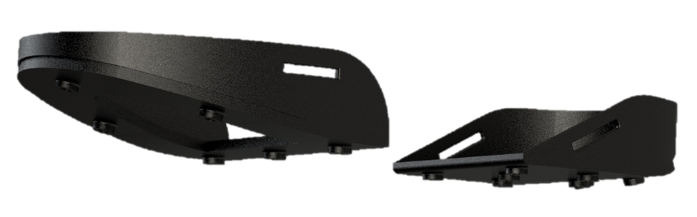
Timberland Pro Dynamic Outsole
Team Members: Kyle Preble, Matt Batal, Russ Somphonlug, Lexi Yerardi, Andrew Trasatti
Dept. of Mechanical Engineering, University of New Hampshire, Durham, NH 03824
Project Overview
Prototype Design
Results
Mission Goal
Create an innovative outsole design for construction workers to wear that increases safety in icy winter conditions.
Design Criteria
The developed design was required to meet the following criteria:
Durable
Quick and Easy On/Off (<10 Seconds)
As light or lighter than competitors
Affordable
Incorporate Ladder Lock Feature
General Overview
From wear testing, the “Seatbelt” prototype fit the shape of the boot best, tightened and gripped the boot while wearing and walking.
From wear testing and friction testing, the metal cone spikes outperformed the others as they gripped the ice best and had the highest coefficient of friction (C.O.F).
Testing category specifics
From C.O.F. testing, the highest competition was the Microspikes traction device with a C.O.F of 0.2.
The best team prototype was the “Metal Spikes” design with a C.O.F of 0.35.
From testing the on/off time, the best average time of competitor models was FANBX. It had an on time of 6.8 seconds and an off time of 1.78 seconds.
The shortest average time of team prototypes was the Sandal model. It had an on time of 4.71 seconds and an off time of 0.97 seconds. The downside of this design was it not being tight enough around the boot which contributed to a short on/off time.
Once our prototype is in full, ready-for-market quality, we believe it will outperform the competition even more so than it currently does.
Sandal
Seatbelt
Twin Clip
Methodology
Attachment Design
Steps in Design Process
Market Research
Rough Sketches and Design Drawings
3D Modeling Prototypes from Drawings in SolidWorks
3D Prints of Solidworks Models
Testing of Competitors Models (On/off Time, Friction Testing)
Initial Testing of 3D Prints
What was Evaluated
Timed how long it took to add and remove each model from a boot
Friction traction test with weights in the boot to determine the coefficient of friction
On/Off Time Comparison
Buckles
Velcro
Setup of Friction testing (left): Crane scale used to measure force required for boot slippage
Spike Design
Competitor’s Models
Figure 1: On/off time comparison of prototypes and competitor models.
3D Printed Polymer Spikes
Metal Spikes
TPU Golf Spikes
Coefficient of Friction Results
Device Used | Normal Force applied with weight (N) | Average Force required to slip from 3 Trials (N) | Average Coefficient of Friction
STABILicers | 732 N | 120 N | 0.16
FANBX | 732 N | 100 N | 0.13
Microspikes | 732 N | 150 N | 0.20
Metal Spikes | 732 N | 260 N | 0.35
3D Printed Spikes | 732 N | 150 N | 0.20
TPU Golf Spikes | 732 N | 40 N | 0.05
Final Design
STABILicers
Microspikes
FANBX
Acknowledgements
Special thanks to Joshua Thorson, Matt Piotrowski, the Timberland PRO Team, and our advisor Todd Gross for their guidance throughout the project. Thanks as well to Dover Ice Arena for allowing us to complete traction testing at their rink.
Seatbelt with clips and metal spikes
Table 1: C.O.F. Testing between prototypes and competitor models. Competitors in grey color. Team prototypes in orange. NOTE: 732 N is equivalent to 165 lbs.

