Slide 1


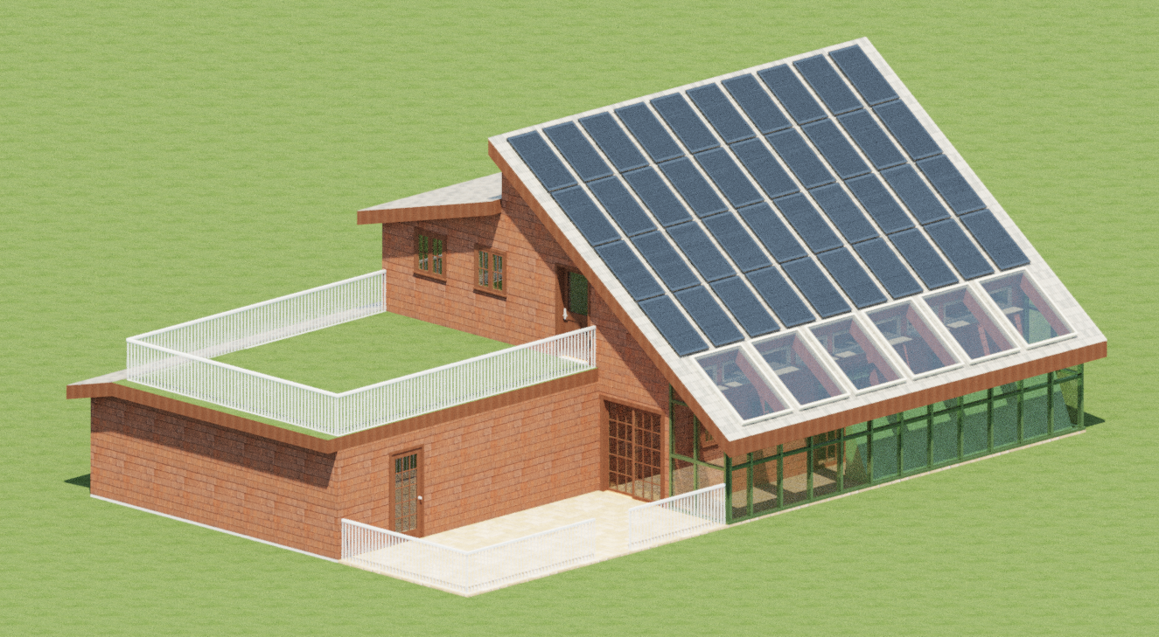
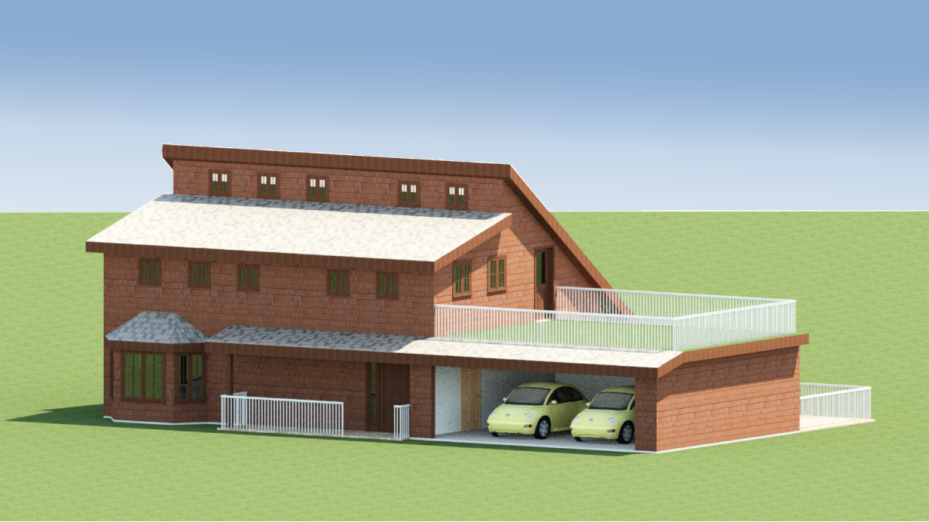


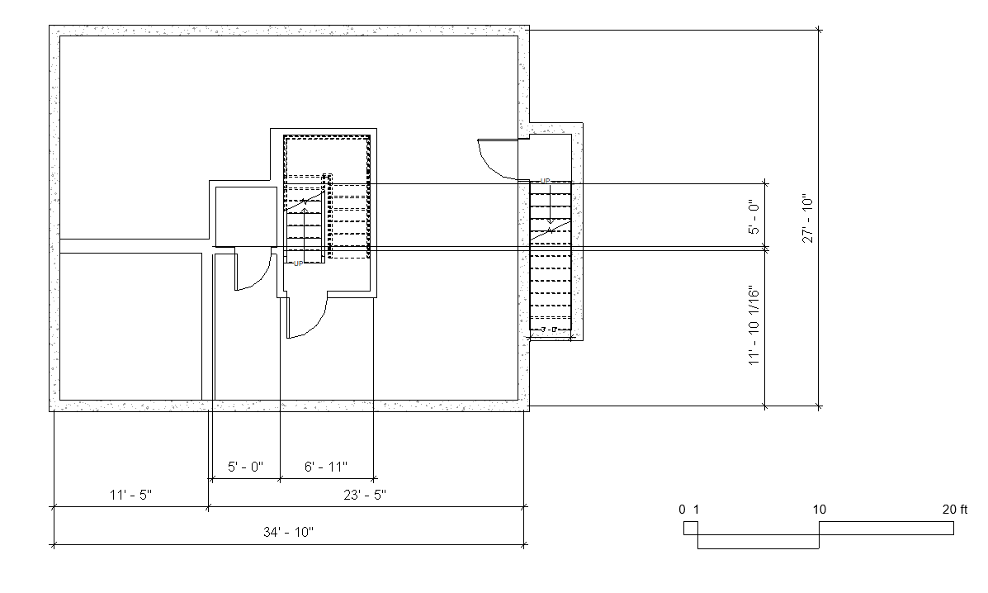
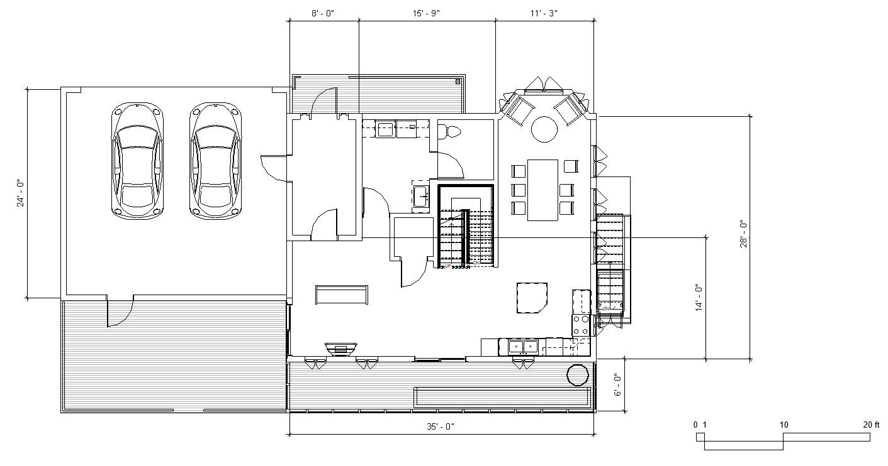
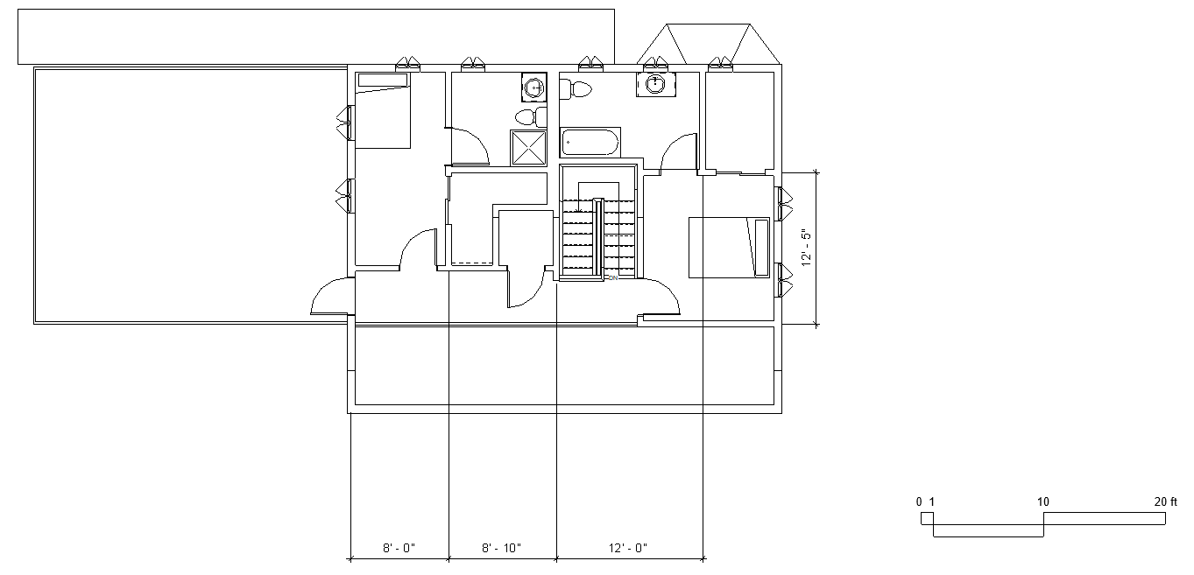
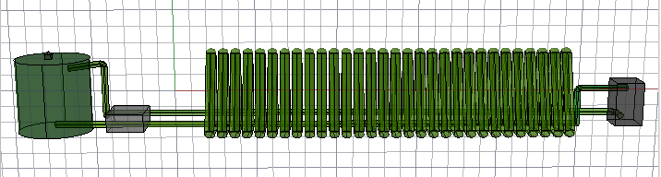
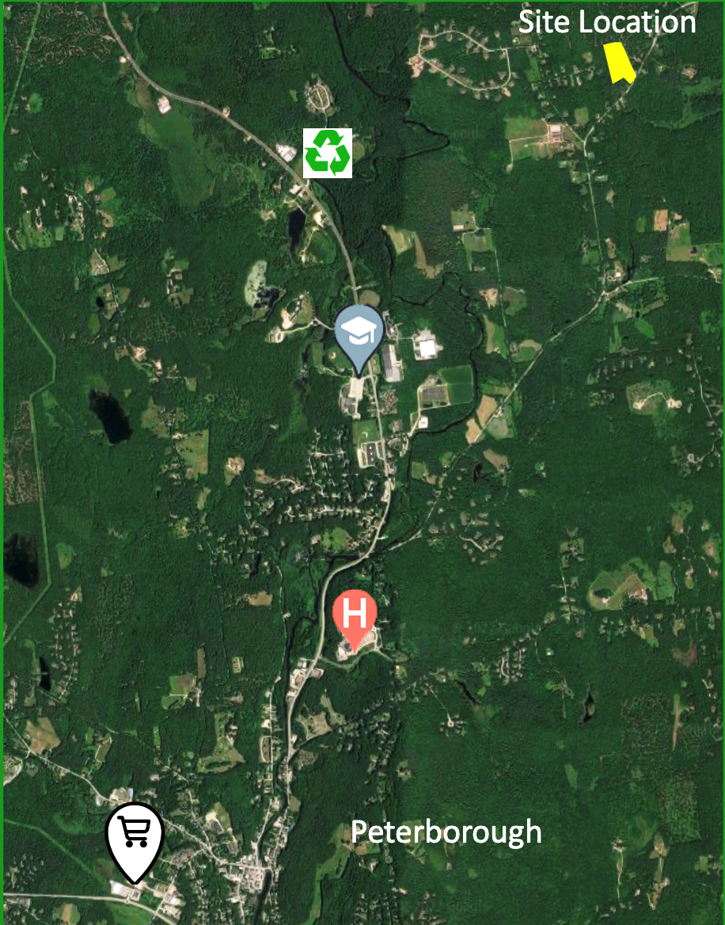
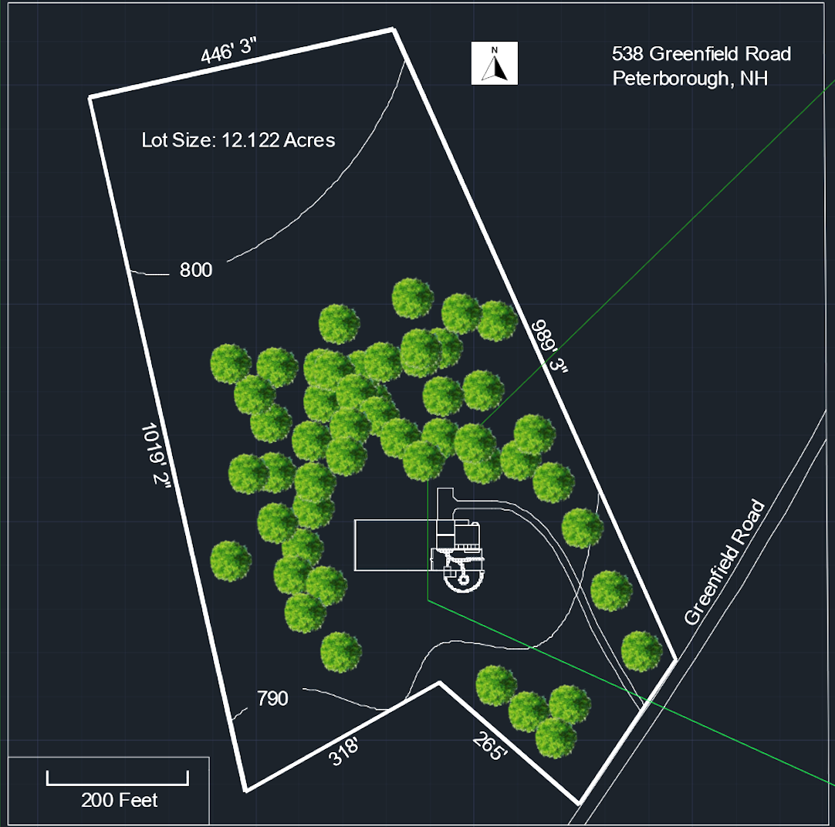
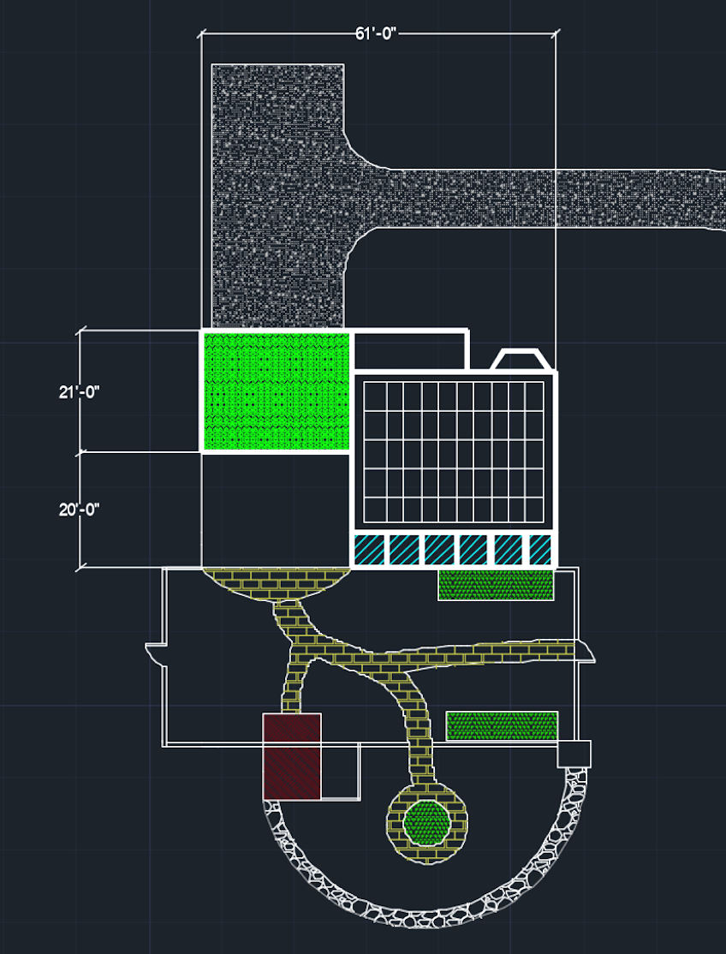
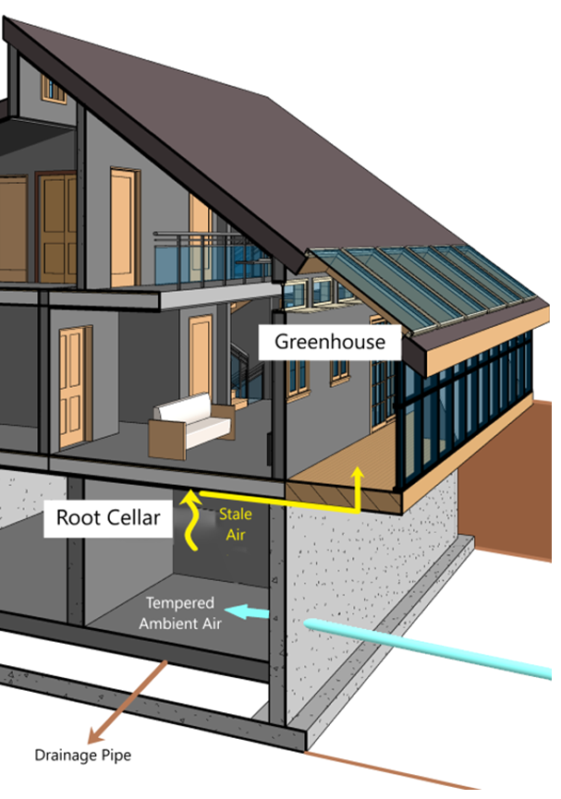
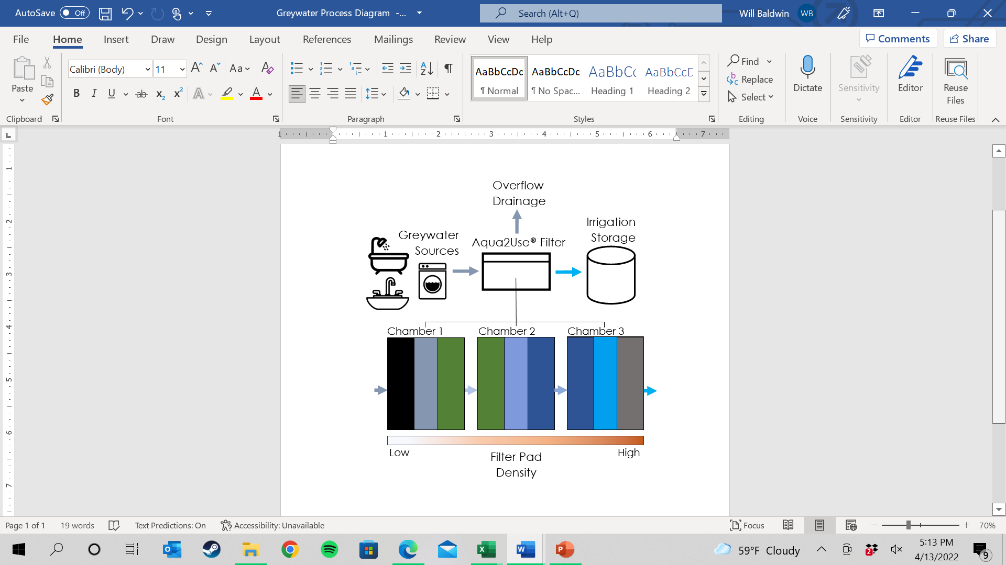
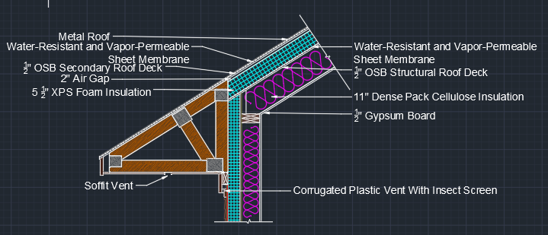
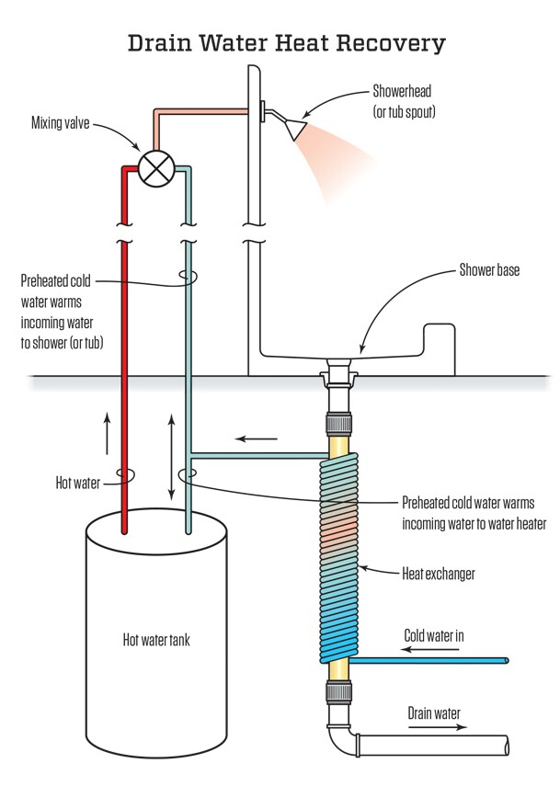
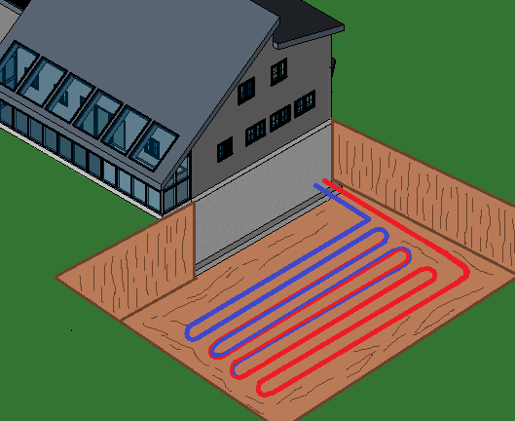
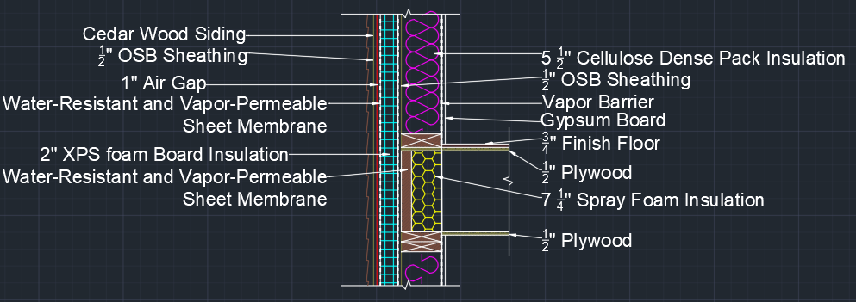
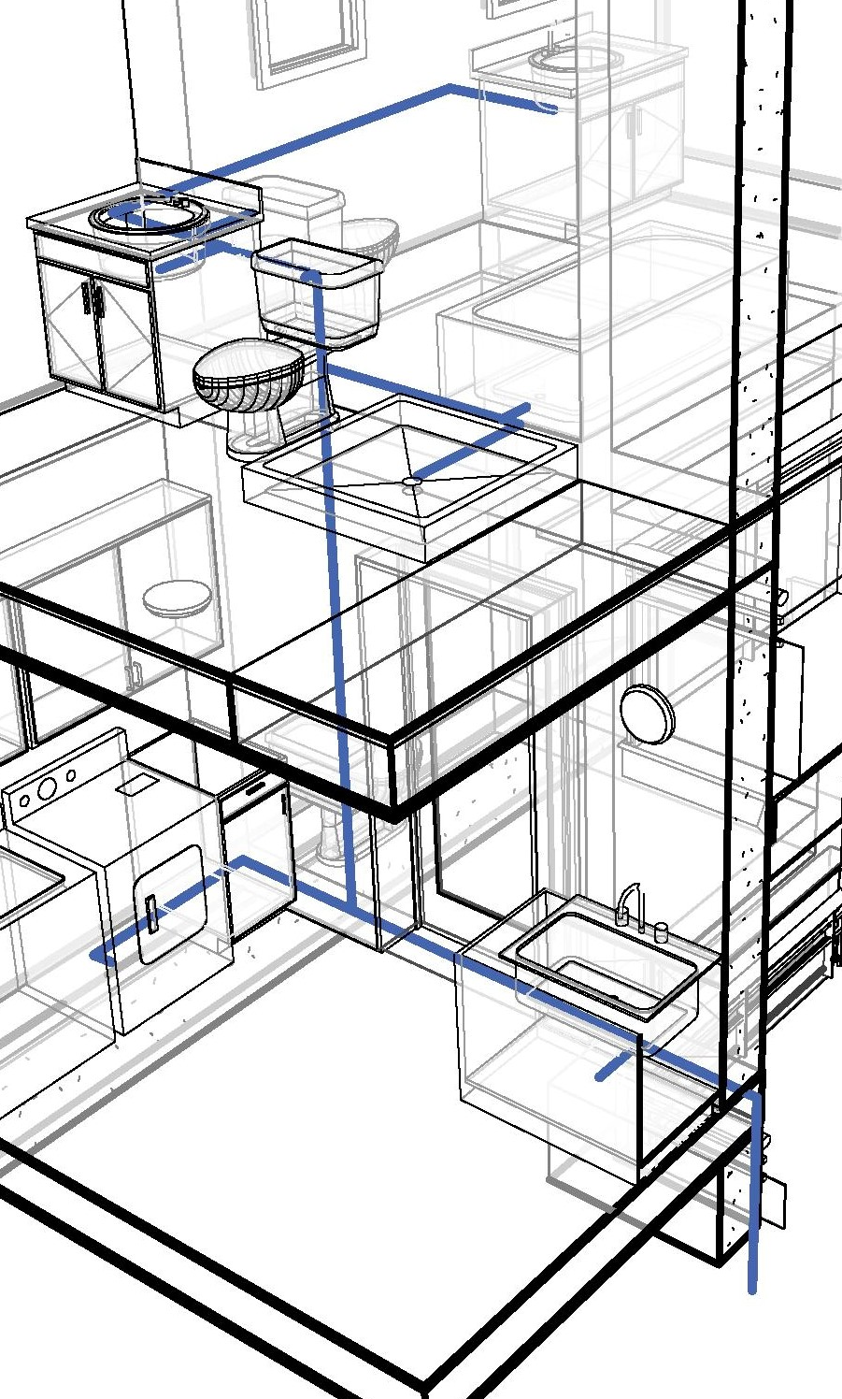
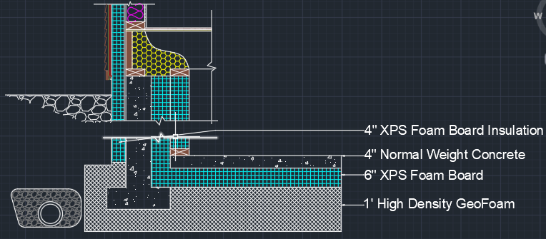
U.S. Department of Energy Solar Decathlon
Introduction
The Green Standard Team
Renewables
Objective
The Green Standard will contribute to environmentally conscious, self-reliant and homesteading lifestyles with our residential design. The team presented this design in the 2022 DOE Solar Decathlon Design Challenge.
Solar Decathlon
An annual collegiate competition where teams around the world take up the challenge to design highly efficient, innovative, low-carbon buildings powered by renewable energy. Each team is judged based on 10 contests.
Homesteading
Lifestyle of self-sufficiency where gardening and raising livestock on one’s property is common. There is a current resurgence of this sustainable lifestyle.
University of New Hampshire, Departments of Civil, Environmental, & Mechanical Engineering
Jacob Roberts, Nathan Raffa, Will Baldwin, Wilder Byrne, Cole Gorham, Ben Guertin, Elizabeth Gunn, Miles Libby
Algae Photobioreactor
Process Flow Diagram
AutoCAD-3D Photobioreactor System Rendering
Summary of Algae Photobioreactor Energy Yield
Photovoltaics (PV)
The 16-kW system will produce 168% of the homes estimated annual power consumption. The system will pay for itself within 12 years.
Architecture
Engineering
Market Analysis
Durability and Resilience
Embodied Environmental Impact
Integrated Performance
Occupant Experience
Comfort & Environmental Quality
Energy Performance
Presentation
Algae + Nutrients + CO2
Recirculating Growth Medium
Feeding Tank
Pump
Algae Photobioreactor
Filter
Algae
Drying
Pelletization via Compression
Filtered Biomass
Algae PBR
Filtered Biomass
Dried Biomass
Combustion
Design Goals
Basement
First Floor
Second Floor
Homesteading
Allow for the occupants to comfortably live a modern homesteading lifestyle while residing in a suburban environment.
New Hampshire Location
Function in accordance with all aspects of New England’s environment, climate, and lifestyle.
Net Zero
A home where the annual amount of energy used is produced or exceeded by onsite generation.
538 Greenfield Road, Peterborough NH
Climate Zone 5A
Zoned Residential
Outside of Public Water and Sewer Zones
Within 5 Miles of Hospitals, Schools, Grocery, Downtown Amenities, and Recycling center
12.2 Acres
Average Algae Energy Density​​​​ (kWh/kg)​​ (1) | Energy Yield ​​ (kWh/day)​​ | Net Balance ​​ (Production – Consumption) ​​ (kWh/day)​​ | Net Generation​​ (kWh/year)​​
7.5 | 6.83​​ | 4.43​​ | 1,551​​
Architecture & Building Envelope
Dynamic Architecture
  Includes classic elements of a New England home while providing suitable mobility and space for the homesteading lifestyle. It includes an open floorplan, split roof design, greenhouse, and root cellar.
  Passive Solar Heat Gain Utilized
  Large windows on the south side take in heat, while smaller windows along the north roof release the unwanted heat.
Follows ADA standards
By including wheelchair lift, keeping door frames at 36’’, with a 5 ft turning radius, the design is ADA compliant.
Building Envelope
Environmental Impact
Mechanical Systems
25 Year Analysis of PV Savings
3-ton Ground Source Heat Pump
Energy Recovery Ventilator
Drain Water Heat Recovery + Manual Demand Controls
Solar Assisted Water Heater
Energy Star Appliances
Highly Efficient Low-Carbon
Heating and Cooling
$123,884
Passive Greenhouse - Root Cellar Cooperative System
Graywater System
US Dollars
$84,220
$39,664
Greenhouse
Roof: R-67.6
Root Cellar
Wall: R-46
Floor: R-35
31,000 GPY Reduction
Acknowledgements
Project Advisor Felix DeVito
Sunergy Solutions LLC
Department of Energy Solar Decathlon
References
-46.3%
-56.1%
(1) Biloria et al. Integrating algae building technology in the built environment: A cost and benefit perspective. Frontiers of Architectural Research, Vol 9, https://doi.org/10.1016/j.foar.2019.12.004.
-81.6%
Legacy
Foundation: R-49
The Green Standard worked with the green building design course offered at UNH to pass down valuable information gained from this project.
Notes:
Top banner: US Dep. Of Energy Solar Decathlon, team name, members,
HOMESTEADING , NET ZERO
Build this around homesteading, we chose these materials or this architecture for this reason relating to homesteading

