Slide 1


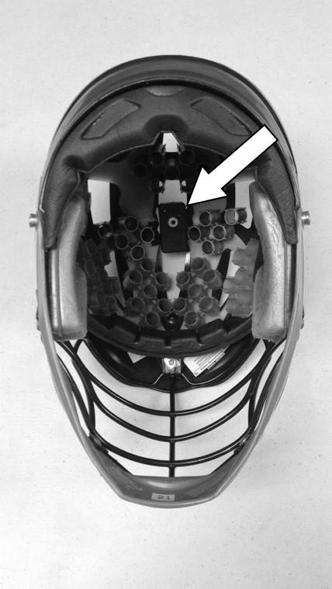
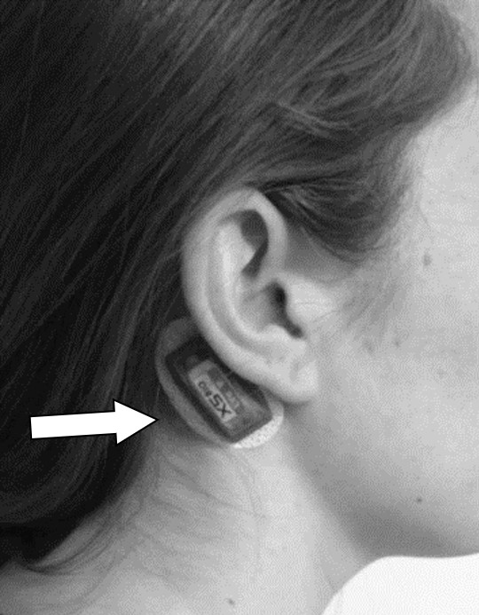
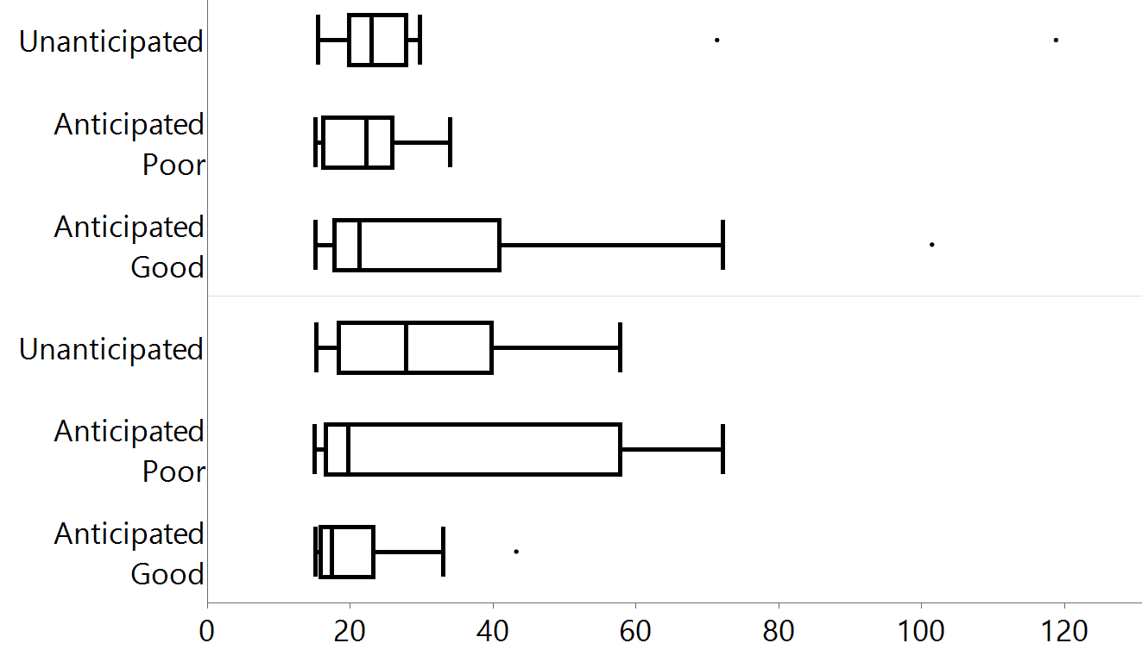
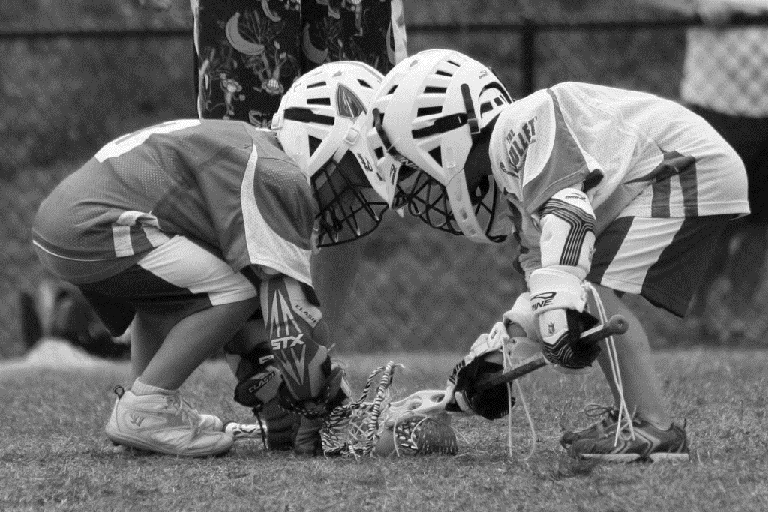
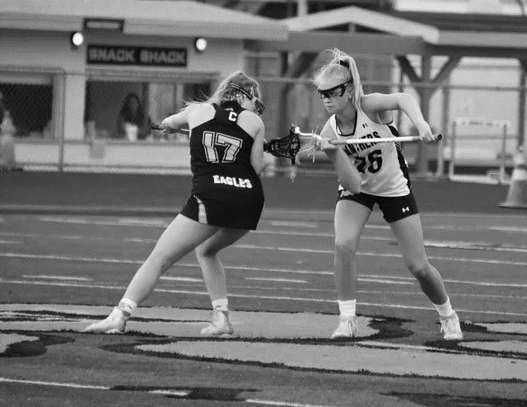
Is anticipated body position associated with impact magnitudes in youth lacrosse?
Erik Montoya & Patricia M. Kelshaw
College of Health and Human Services, Department of Kinesiology
Brain Research & Assessment Initiative of New Hampshire (BRAIN) Laboratory
Key Findings
1
No differences were observed for impact magnitudes by player preparedness
2
Preparedness for impact had no effect on head impact magnitudes
3
These findings did not vary by boys’ or girls’ youth lacrosse athletes
Purpose:
Investigate if player preparedness for collision is associated with impact magnitudes in youth lacrosse
Background
Results & Conclusions
  Participation in organized youth lacrosse continues to increase, coupled with an increased risk of head injury
  Previous research has incorporated wearable sensor technology and video analysis to characterize head impacts in collision sports (e.g., football, hockey, & lacrosse)
  Recent evidence suggests that player anticipation and body positioning while experiencing a collision may mitigate impact magnitudes
69 impacts were observed for boys (IR=0.86), the majority (88.4%) were to the head (n=61; IR=0.76); whereas 38 impacts were observed for girls (IR=0.26) and less than 1/3 were to the head (n=11; IR=0.07)
Boys: There were no differences observed for overall impact magnitudes or head impact magnitudes by player preparedness (H=1.47, p=0.48; H=1.40, p=0.50, respectively)
Girls: There were no differences observed for overall impact magnitudes or head impact magnitudes by player preparedness (H=4.32, p=0.12; H=4.30, p=0.12, respectively)
Figure 2 presents the impact magnitudes among boys’ and girls’ lacrosse athletes by player preparedness for collision
Our findings were not consistent with other published articles; future research should investigate the intersection of anticipating collision in sport and subsequent head impact magnitudes on a larger and more representative sample of youth athletes
A
B
Methods
Figure 1. (A) The GFT sensor affixed to the inner crown of a youth boys’ lacrosse player’s helmet & (B) the xPatch sensor located along the right mastoid process of a youth girls’ lacrosse player
Participants: Data were collected from boys’ (n=15; age=12±1.0) and girls’ (n=18; age=13±1.2) lacrosse athletes from 12 games over 1 competitive season
G Force Tracker sensors (GFT; Gforcetracker Inc., Narkham, Ontario Canada, Figure 1A) and XPatch sensors (X2 Biosystems, Seattle WA, Figure 1B) were used in conjunction with video for impact verification
Impacts greater than ≥15g were reviewed and evaluated according to player preparedness for collision
A 10-item Lacrosse Collision Readiness Index (LCRI) was used to qualitatively evaluate the struck player’s visual awareness and body posture in the moments before an impending bodily contact as a measure for player preparedness for collision
Player preparedness for collision was coded as: (i) anticipated good, (ii) anticipated poor and (iii) unanticipated
Analyses: Impact rates (IR) were reported; Kruskal-Wallis tests were used to compare impact magnitudes overall and for head impacts by player preparedness code; Post-hoc Mann Whitney U tests were planned to be used upon significant Kruskal Wallis tests
Boys
Player Preparedness
Girls
Peak Linear Acceleration (g)
Figure 2. Impact magnitudes by player preparedness for boys’ and girls’ youth lacrosse
Notes:
1
Can include references

