Slide 1




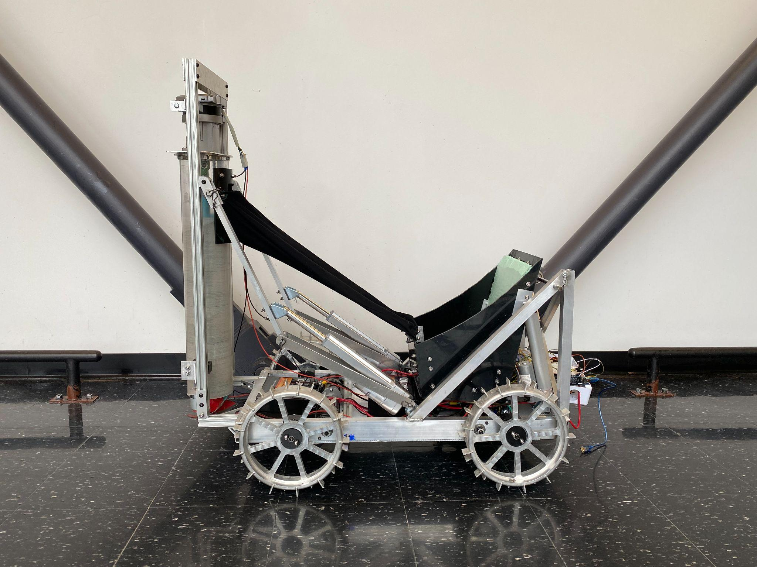
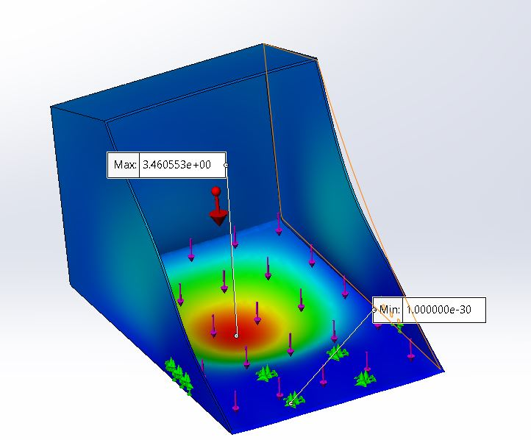
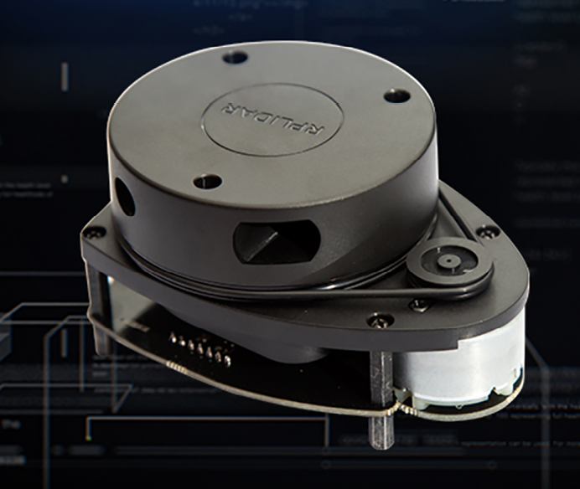
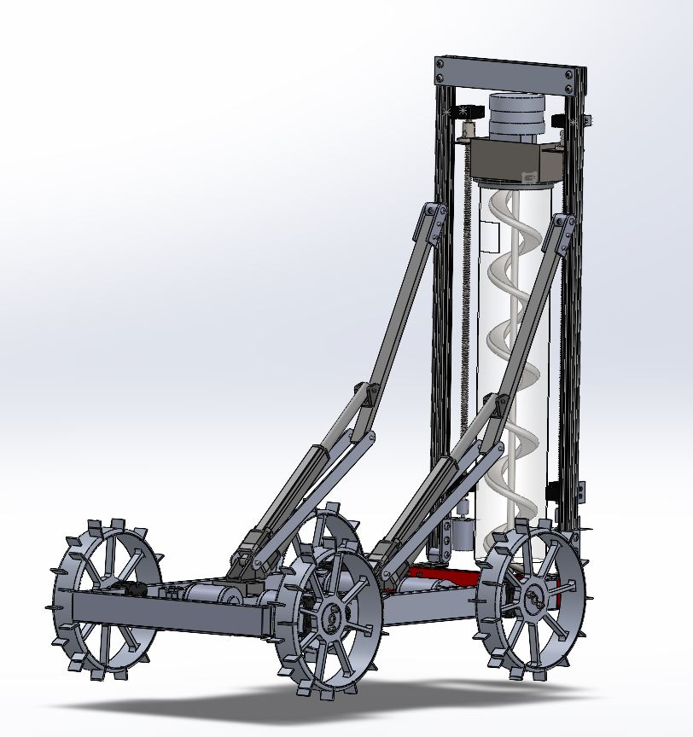
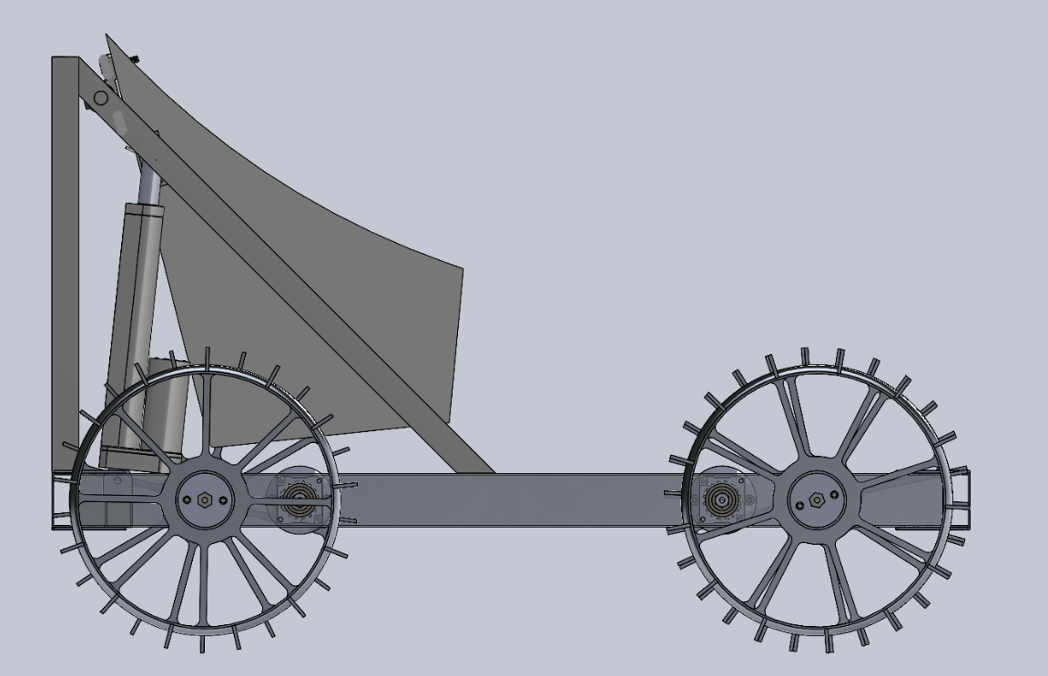
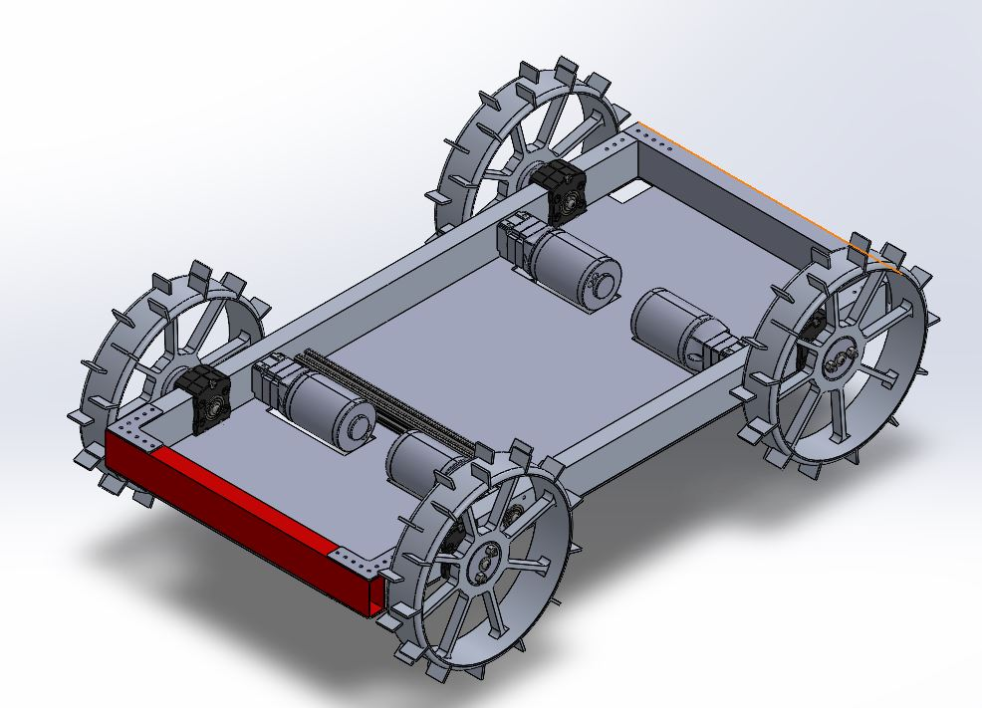
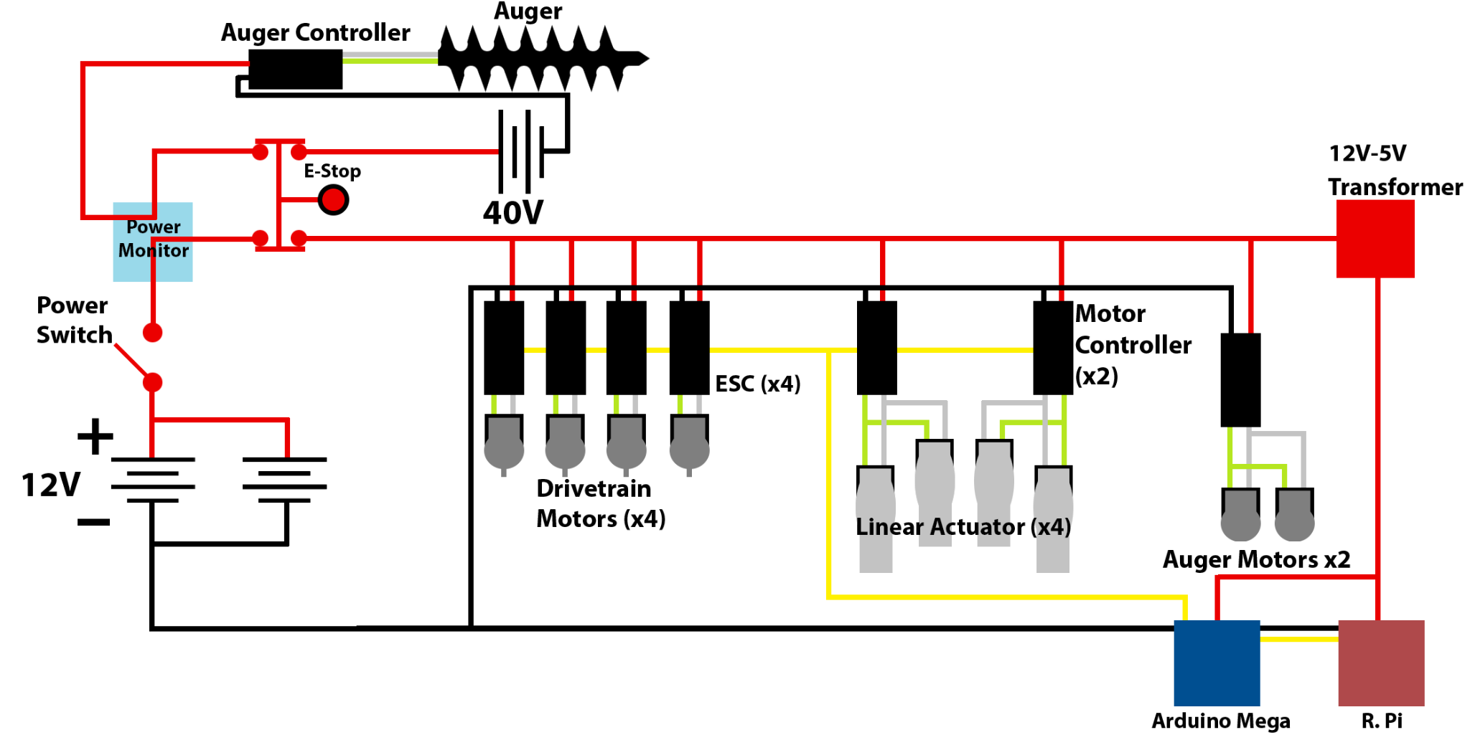
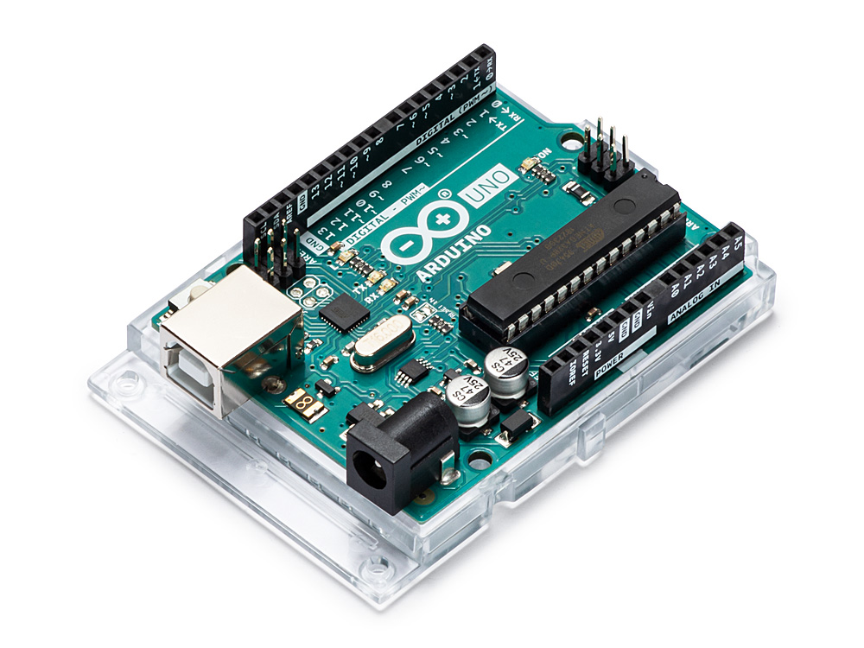
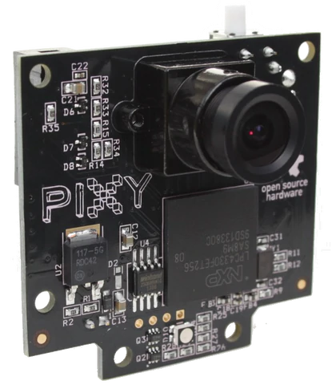
Extraterrestrial Mining Robot
Mechanical Engineering: Caroline Flood, Doug Breault, Jason Cagney, Spencer Brush, Devon Bushey, Stephen Heirtzler, Ruicong Feng, Ben Brockway, Thomas Oliver, Sawyer Banley-Bill, Trevor Cox (Engineering Physics)
Computer Science: Brandon Lo, Anthony Tam, David Liu, David Nguyen
Computer Engineering: Abe Elias, Jonathan Merheb, Ryan Baer
Advisor: Professor May-Win Thein
Background
Multidisciplinary team comprised of undergraduate and graduate students
Entirely new group of students this year
Build a robot capable of mining, transporting and depositing material
Participate in NASA’s Robotic Mining Competition (RMC)
NASA Robotic Mining Competition
Robot must fit into a 1.1m x 0.6 m x 0.6 m volume when undeployed
15 minute competition run to excavate simulated lunar regolith, transport to a designated area and deposit material into collection bin
        Must be able to traverse over or navigate around craters and rocks
        Submit all preliminary NASA deliverables throughout the academic year
        National competition between 50 universities held at the Kennedy Space Center in Florida
Changes from Past Designs
Complete redesign
      Drivetrain System: Reused last year’s wheels but did not use a suspension system
      Depositing System: Utilized a bucket and actuator system instead of a conveyor belt
      Mining System: Switched to an auger system instead of a bucket-conveyor excavation system
      Added a transfer system to connect the bucket and the auger together
Outreach Events
Partnered with 3 local K-12 schools throughout the year
Introduced the students to the LunaCats project and other opportunities within the STEM fields
Mentored a high school’s FIRST Robotics Competition Team
Organized age appropriate activities for the K-8 students that exposed them to different science & engineering concepts
Analysis
Drivetrain:
4 Mini CIM Motors on 28:1 Reduction
Wheels should slip under stall
Depositing System:
Actuator strength analysis
Pin strength analysis
Bucket strength and tear out analysis
Mining System:
Actuator strength analysis
80/20 frame analysis
Future Expectations
Finish building and wiring the robot
Conduct testing on complete robot and individual subsystems for proof of life video
Compete at the RMC in Florida at the end of May
Mechanical
Electrical
Computer Science
Mining
Deposit
Drivetrain
Electrical box
Batteries
Python
Arduino
Future Testing
Maneuverability and maximum speed
Efficiency of the mining system
Determine the maximum amount of regolith that the actuators can support for the depositing system
Transistors
Client
Pixy Camera
Bucket
Chassis
Electrical Speed Controllers
Deposit Frame
Gear Ratio
Controller
Lidar Sensors
Emergency Stop
Actuators
Wheels
Digital Display
Server
GUI
Deployment Actuators
Bucket
CIM Motors & Gearbox
Vertical Translation Gear Motors
Auger Motor
Mining Frame
Thank you to Pam Lovejoy, Kelly Danforth, Noah MacAdam, Scott Campbell, Kyle Preble, UNH Parents Council, UNH Alumni Association & UNH CEPS Dean

