Slide 1




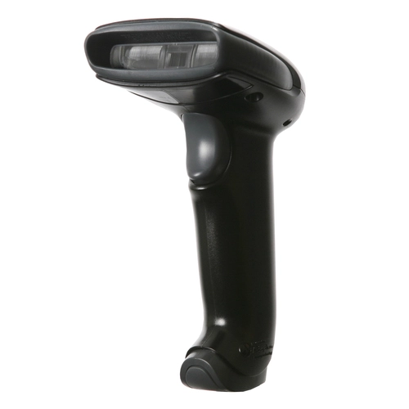
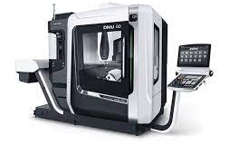

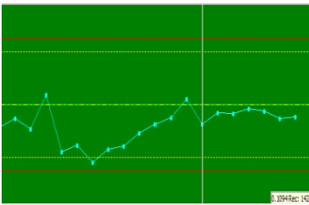
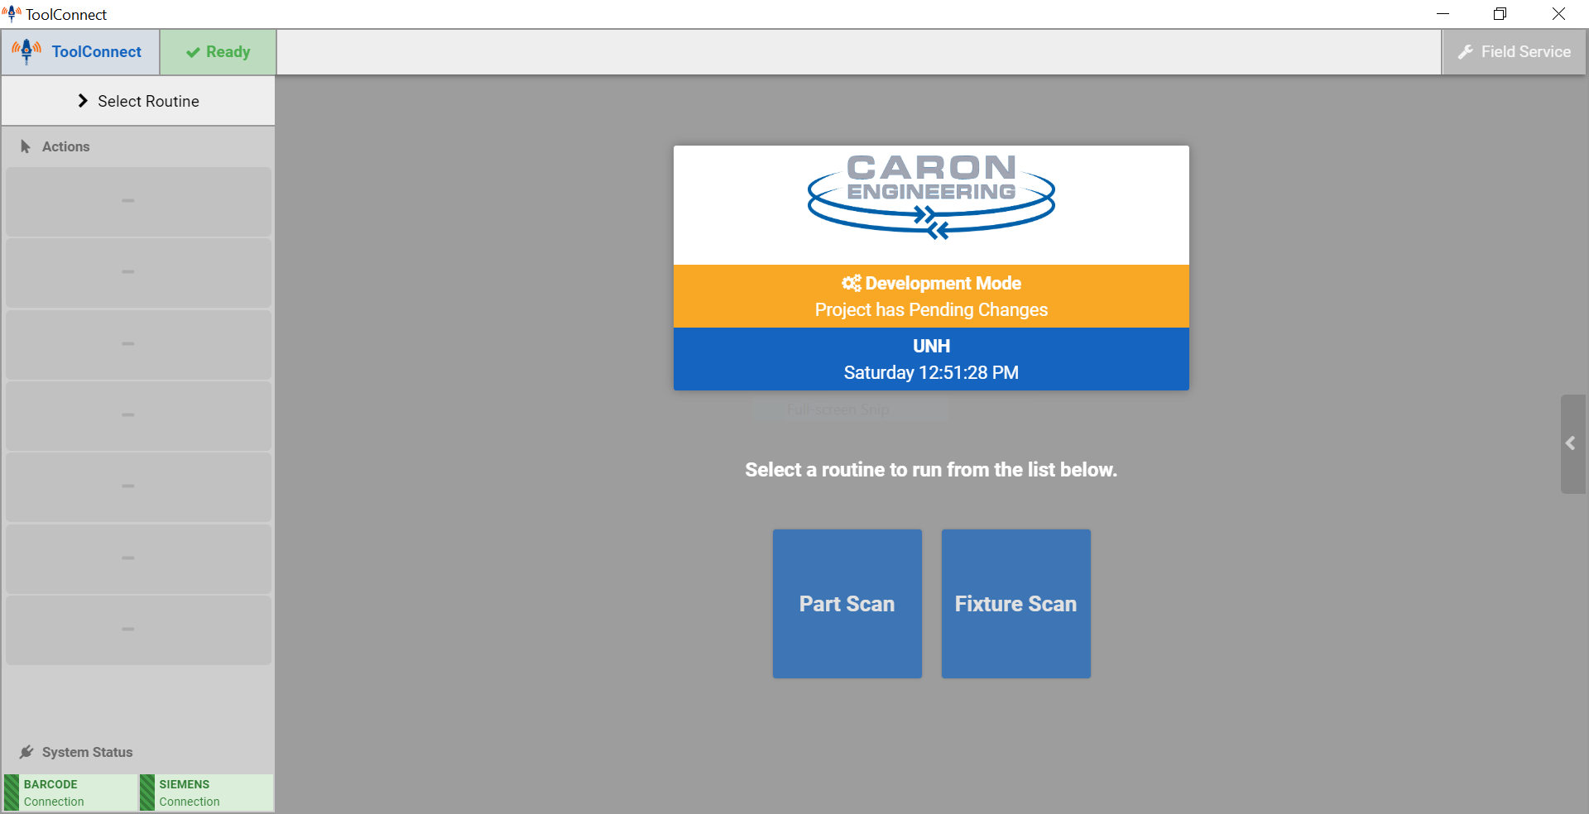
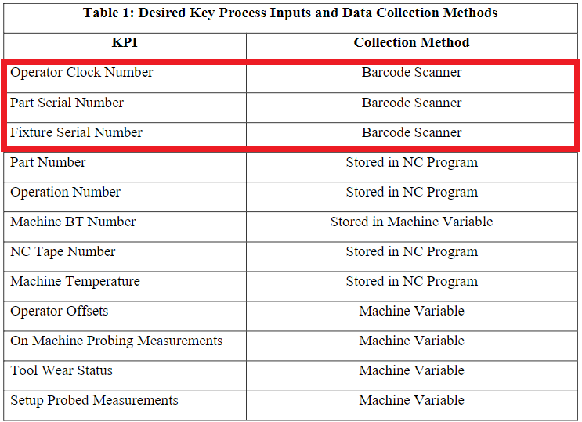
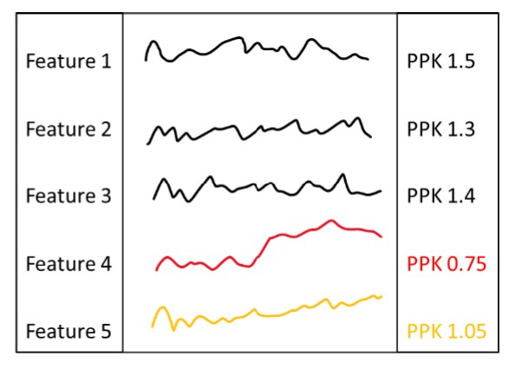
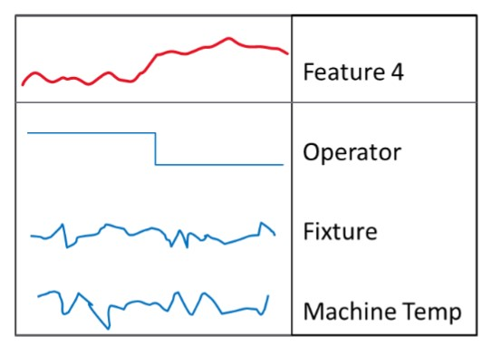
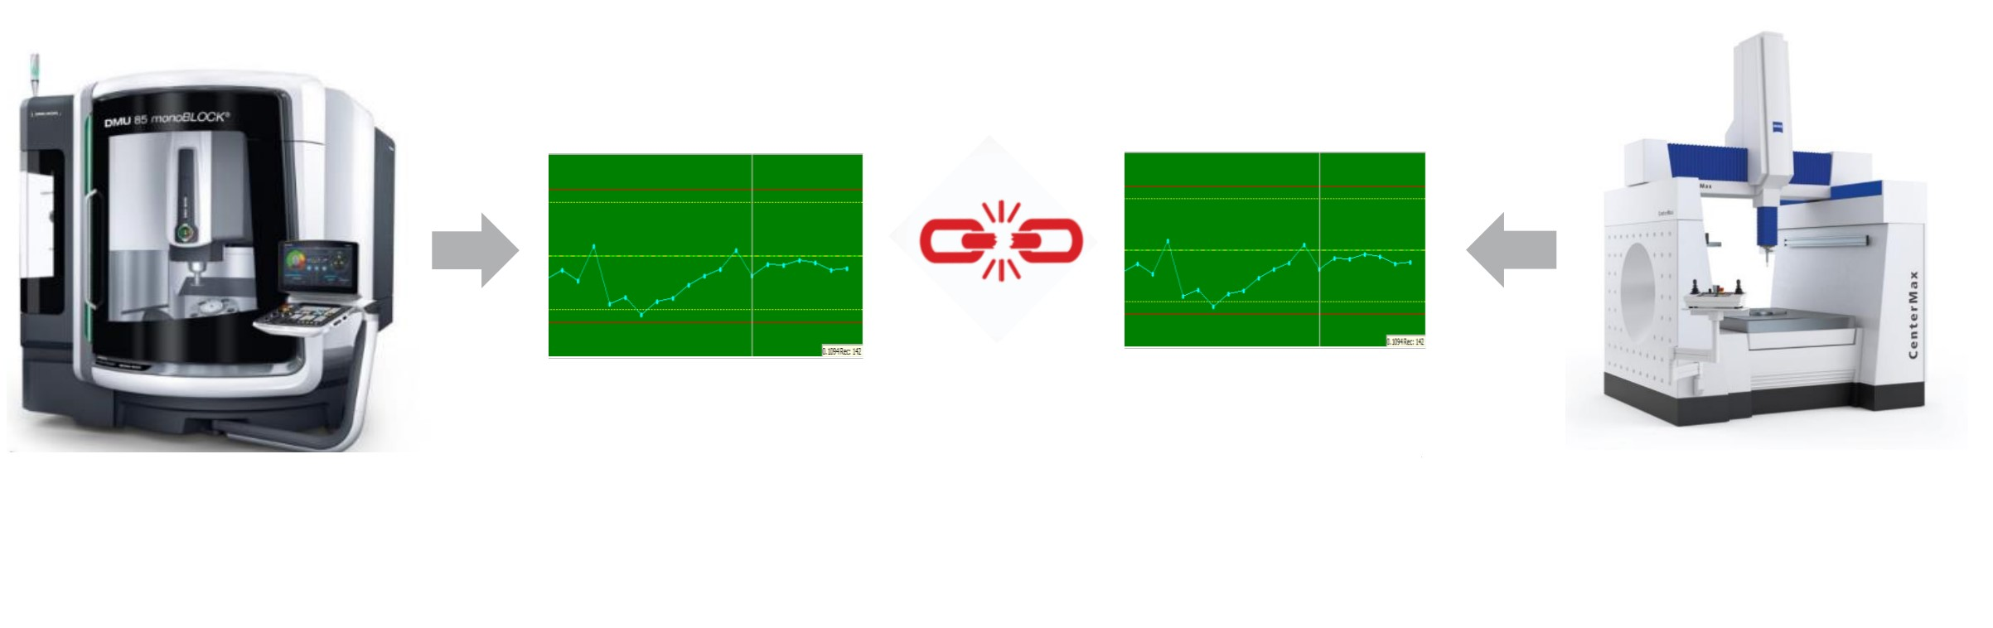
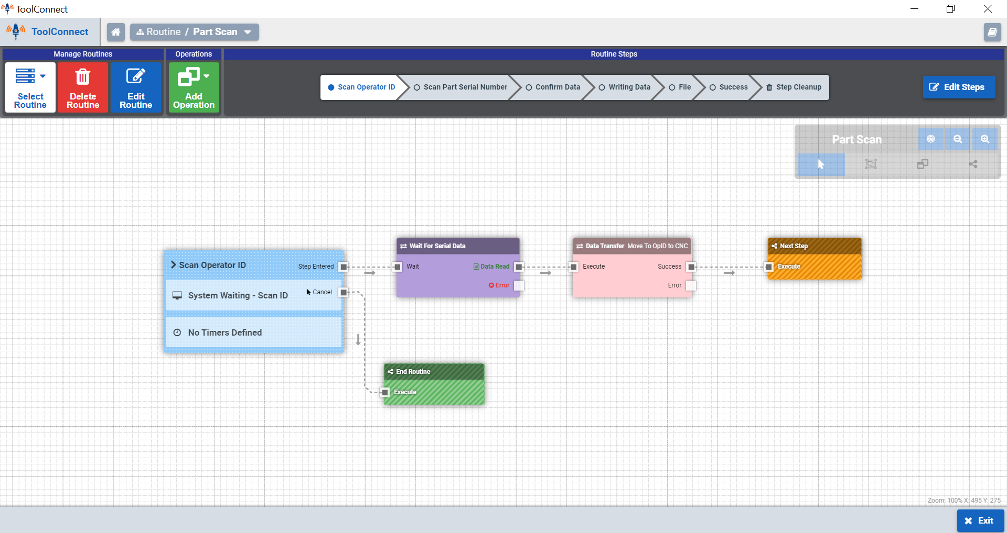
Machine Process Health Monitoring
Development of Data Collection Interface
Alana Pettaway, Ryan Olson, Mohamed Altamimi
Mechanical Engineering, University of New Hampshire, Durham, NH 03824
Introduction
Improved Process Flow
Pratt & Whitney is an aircraft engine manufacturer. The ability to analyze machine processing data is critical to prevent potential quality issues, improve productivity and observe trends.
Through current methods, there is no way to automatically capture manufacturing Key Process Inputs (KPIs) during part machining and connect KPI data to post machining measurement data, or Key Process Outputs (KPOs).
The goal of this project is to create an interface that will collect data for KPIs that are currently not being captured, so that data can be linked to KPOs in post processing. This is done by programming routines for the machine operator to follow.
The routine prompts the user to scan a barcode, in which the barcode data is transferred to the scanner. Once the data is confirmed, the data is transferred into the MiConnect program. The program then stores the data into the CNC machine and writes the data to a text file which is stored in a PC location. The text file can then be imported to the desired post processing software.
Current Process
Design Considerations & Criteria
Impact on Data Processing
The current process for monitoring process data is limited to part features.
Many KPIs are currently stored in the part program or inherent to the CNC machine, however, some desired KPIs have no way of being collected.
Post part machining feature measurements are collected; however, they cannot be linked to the KPIs to determine correlations.
Connect KPI data that is not currently being collected
  ID number for the operator manufacturing the part
  Serial number of the part being manufactured
  Serial number of the fixture being used in the CNC machine
Store data in CNC machine
Make the process transferable across multiple CNC machines
Read and process alphanumeric part numbers
Save all KPI data to a central location to later be post processed
Maintain efficiency and ease of use for the operator to ensure productivity is not affected
PPK values indicate how well the measurement stays within its tolerance
All part features (or measurements) are expected to remain above a 1.33 PPK value, which is the industry standard.
The ability to link KPIs to post processing measurement data allows for conclusions to be made about possible causes of a part feature going out of tolerance
Table 1: List of all the KPIs and corresponding data collection methods
DMG Mori CNC Machine
Part feature process data
Post part machining measurement data
Part Measurement Machine
Figure 1: Post processing measurement data visualization
Figure 2: Example measurement data and corresponding KPIs
Methodology Using Caron Engineering MiConnect Software
Conclusions
Process Flow of Routine Step
Using Caron Engineering MiConnect software a program was created that:
Creates a routine that the machine operator must follow
  Routines for each input are separated to be individually called by the part program
Prompts the user to follow each step in the routine, indicating which barcodes to scan
Connects directly to the controller of the CNC machine, and stores each input as a machine variable
Writes data from each machine variable into a text file, which will be imported to a post processing software to link to post part machining KPOs
The Caron Engineering MiConnect software:
Has a user-friendly interface that will ease access to the production data
Can manage routines easily to modify it for any CNC machines
Will not require operators to need more training to operate the DMG Mori CNC machine in the future
Will avoid potential wrong barcode scans using preset error validation and giving the user an option to confirm the data before it is saved
Acknowledgments
Pratt & Whitney Advisors: Mike Newsky, Eric Stuckey
Caron Engineering Assistance: Derrill Vezina, Rowan Boyer
Academic Advisors: Anthony Putin, Todd Gross
Figure 3: MiConnect routine editor showing process flow once a scan occurs
This document does not contain technical data

