Slide 1

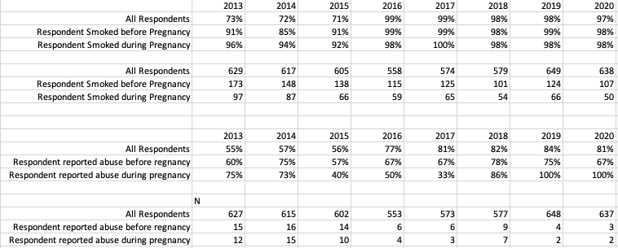
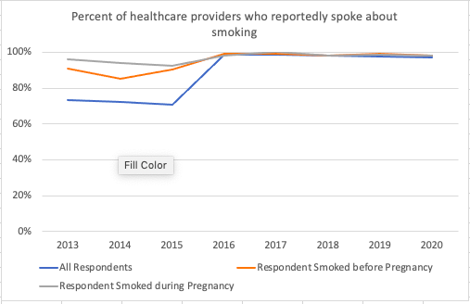
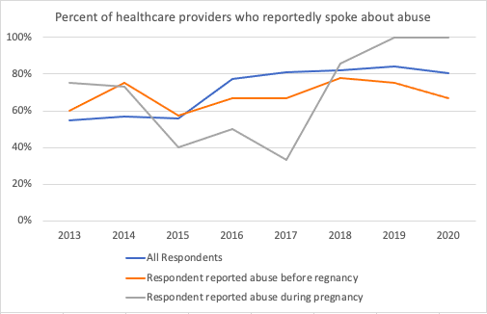

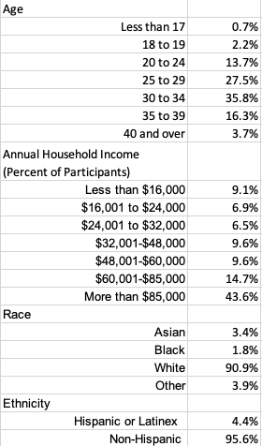
Perinatal Patient Education on Substance Use
Risk Factors in the Age of the Opioid Crisis
Rebecca Leary, SN & Dr. Alyssa O’Brien, Ph.D., RN
Department of Nursing, University of New Hampshire
Background
Results
Discussion
In 2017, New Hampshire had the 3rd highest rate of fentanyl-involved overdose deaths in the United States only behind West Virginia and Ohio (United States Drug Enforcement Administration, 2020).
Substance use is as common as many conditions routinely screened for and assessed during prenatal care (Wright et al., 2016).
Each year it is estimated that 15% of newborns are affected by exposure to alcohol or illicit drugs in utero (Office of the Child Advocate, 2019).
In utero substance exposure places a child at a higher risk for developmental, behavioral, and physical health concerns. Consistent and comprehensive prenatal care increases the chances of a healthy delivery and can connect mothers to services for managing a substance use problem (Office of the Child Advocate, 2019)
Table 2: Participants Reporting Conversations with Health Care Professional
In 2014, opioid-related deaths were the highest ever recorded up until that point. A total of 28,647 drug overdose deaths occurred in the United States that year, representing a 1-year increase of 14% from 2013 (CDC, 2016).
This significant loss of life called for change related to health care practices related to the opioid crisis.
As a result of the increased morbidity and mortality in 2014, new patient care bundles were created related to perinatal SU by professional organizations and subsequently adopted by healthcare providers across the country and in NH between 2015 and 2017.
These new perinatal bundles focused on non-stigmatizing care so respondents would feel less judged if they reported SU during pregnancy.
The Alliance for Innovation on Maternal Health’s (AIM) bundles are supported by specific quality metrics and measures through the AIM Data Center to best address the leading causes of preventable maternal morbidity and mortality in the United States (AIM, 2020).
The opioid use disorder bundle from AIM calls for all pregnant women to be assessed for SU disorders, screened and evaluated for commonly occurring co-morbidities (abuse and smoking) if they have an opioid use disorder, and for the treatment response to be matched to each woman’s stage of recovery and/or readiness to change (AIM, 2020).
The bundle also included readiness resources for providers to use.
This could be a likely contributing factor as to why more healthcare providers were discussing these risk factors of smoking and abuse with patients because risk assessment in general increased and improved during this time.
Graphic 1
Graphic 2
Research Questions
As substance use (SU) has increased in New Hampshire (NH), have rates of SU risk factors (childhood trauma, mental health, insurance status, drinking, intimate partner violence, healthcare access) also increased?
Since SU rates have increased, are perinatal providers talking with their patients more about these risk factors?
The data shows that over time, more participants have reported conversations with their care providers regarding the SU risk factors of smoking and abuse from an intimate partner.
The means began trending up in 2015. This followed the 2014 marked increase in opiate-related deaths in NH.
The participants reporting the lowest rates of conversations regarding risk factors with their providers across time are the subsample of women who are reporting intimate partner abuse.
While we were unable to correlate these conversations with improved birth outcomes, mainly because the rate of poor outcomes were so low, it is important to remember that the conversation itself is an intervention.
  Motivational interviewing and the Screening, Brief Intervention, and Referral to Treatment Services (SBIRT) are effective evidence-based approaches to managing perinatal SU (Smith et al., 2021).
This begs the question as to what happened between 2014 and 2017 in terms of prenatal care and healthcare provider conversations.
Sample
Table 1: Sample Characteristics
The Pregnancy Risk Assessment Monitoring System (PRAMS) is a surveillance project for the Centers for Disease Control and Prevention (CDC). PRAMS was first developed in 1987 to reduce infant morbidity and mortality. Using population-based surveillance, PRAMS can identify groups of infants and women at high risk for health problems (CDC, 2021). In NH, one in every twelve mothers of newborns are randomly selected from birth records to participate in PRAMS (NH DHHS, 2016). Sample characteristics for this project were selected to best understand the demographics and backgrounds of the respondents in our analysis.
(AIM, 2020)
References
Limitations
Alliance for Innovation on Maternal Health. (2020). Core aim patient safety bundles.
Patient safety bundles. https://safehealthcareforeverywoman.org/aim/patient-safety-bundles/#core
Centers for Disease Control and Prevention. (2016, January 1). Increases in drug and opioid
overdose deaths — United States, 2000–2014. Morbidity and mortality weekly report (MMWR). https://www.cdc.gov/mmwr/preview/mmwrhtml/mm6450a3.htm
Centers for Disease Control and Prevention. (2021, November 15). What is PRAMS?. PRAMS.
https://www.cdc.gov/prams/index.htm
New Hampshire Department of Health and Human Services (NH DHHS). (2016). Pregnancy risk assessment
monitoring system (PRAMS). Maternal and child health.
https://www.dhhs.nh.gov/dphs/bchs/mch/prams.htm
Office of the Child Advocate. (2019, November 21). System Review Report - New Hampshire.
Division for children, youth and families enhanced response to substance exposed infants.
https://childadvocate.nh.gov/documents/reports/OCA-SR-Subs-Exp-Infants-11-22-19.pdf
Smith, R., Ridout, A., Livingstone, A., Wango, N., Kenworthy, Y., Barlett, K., Coburn, H., Reid,
H., Jones, N., & Mackillop, L. (2021). Motivational interviewing to increase physical activity in
women with gestational diabetes. British Journal of Midwifery, 29(10), 550–556.
https://doi.org/10.12968/bjom.2021.29.10.550
Stengel, C. (2014). The risk of being ‘too honest’: drug use, stigma and pregnancy. Health, Risk & Society,
16(1), 36–50. https://doi-org.unh.idm.oclc.org/10.1080/13698575.2013.868408
United States Drug Enforcement Administration. (2020, January 30). 2019 national drug threat assessment. DEA.
https://www.dea.gov/documents/2020/2020-01/2020-01-30/2019-national-drug-threat-assessment
Wright, T. E., Terplan, M., Ondersma, S. J., Boyce, C., Yonkers, K., Chang, G., & Creanga, A. (2016). The role
of screening, brief intervention, and referral to treatment in the perinatal period. American Journal of
Obstetrics & Gynecology, 215(5), 539–547. https://doi.org/10.1016/j.ajog.2016.06.038
Methods
These are very marked increases. There could be a reporting issue or an instrumentation issue.
  The PRAMS questionnaire changes over time. Since the questions were being asked differently in each survey, the response rates may have changed.
  The literature points to underreporting of stigmatizing personal information.
    Pregnant women who smoke or report abuse are often subjected to stigmatization.
    Reporting drug use is also known to increase stigmatization and discrimination in the health care setting.
    This may influence reporting to providers and reporting on the PRAMS survey.
    Mothers with SU conceal risk-taking behaviors from healthcare providers due stigmatization and moral scrutiny (Stengel, 2014).
Sample is higher income, mainly white non-Hispanic, and over the age of 30.
Secondary analysis of federal PRAMS data between 2013 and 2020.
Data was cleaned and recoded based on the CDC code book.
Descriptive statistics were completed using STATA and Excel to describe the sample characteristics and show trends in means within the sample over time.
Findings were discussed and reviewed within the research team.

Slide 2

This poster template provided courtesy of
UNH ESRC Poster Printing Services
Trust us to make your poster look GREAT!
Website: http://posters.unh.edu
Poster Guide: http://goo.gl/1E7TJY
DELETE THIS SLIDE BEFORE PRINTING

