Slide 1

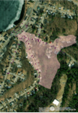
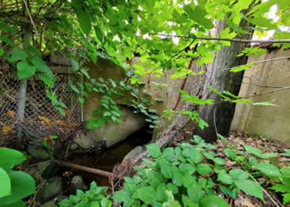
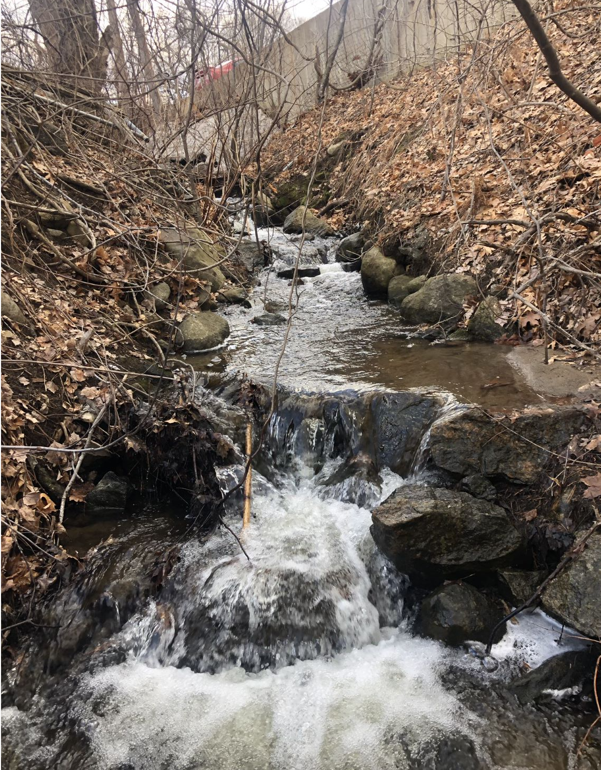
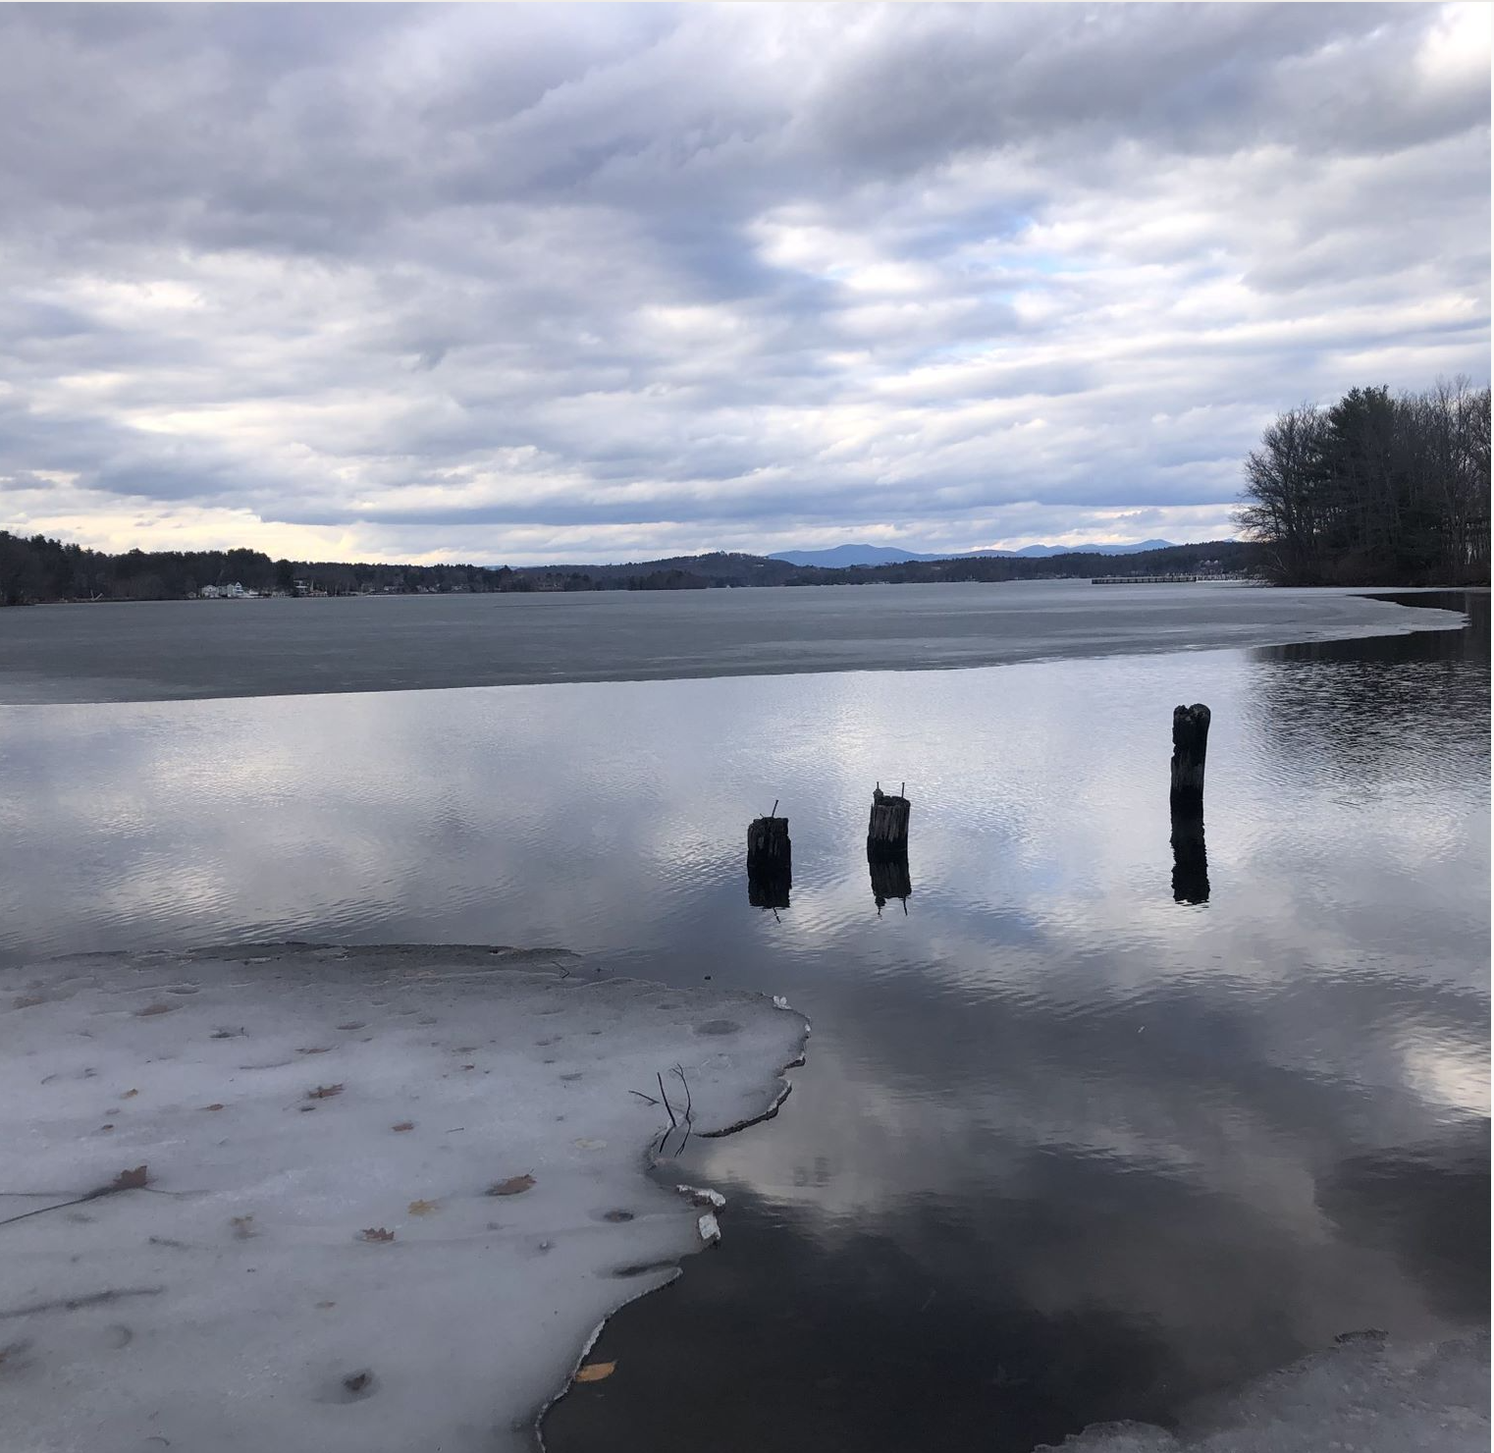
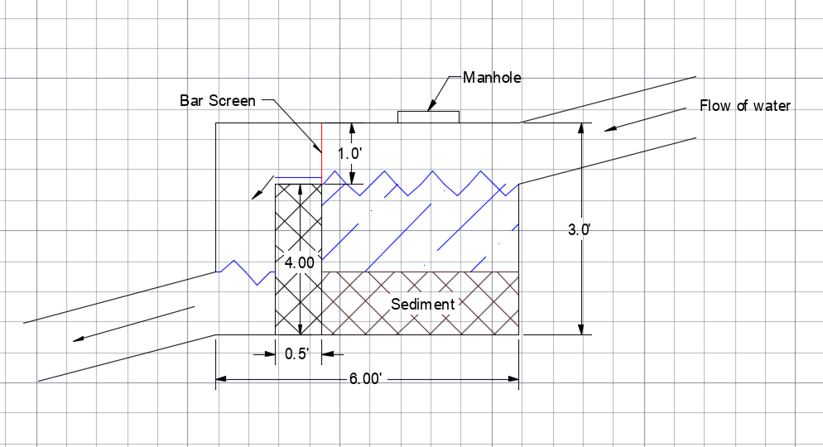
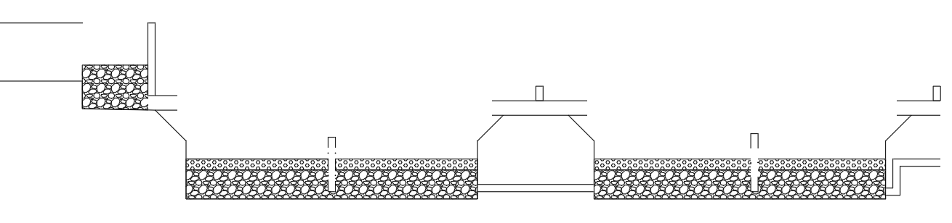
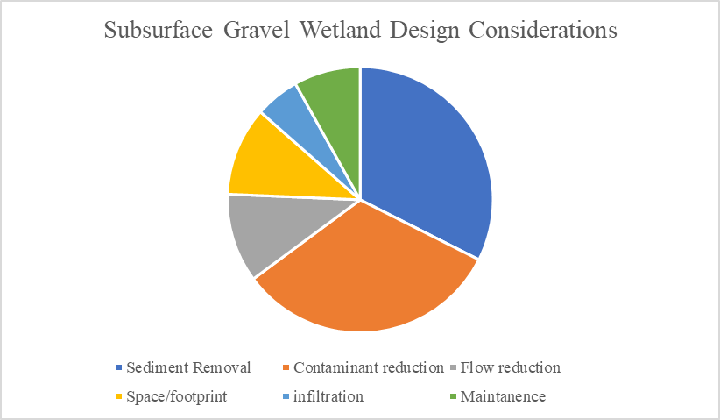
Laconia Stormwater Treatment
Subsurface Gravel Wetland
Sian Davis, Victoria Kapantais, Kenny Chen, Xander Oram
Department of Civil/Environmental Engineering, University of New Hampshire
Introduction
Results
Discussion
The City of Laconia requires an upgrade of their current stormwater management system at the intersection of Union Ave and Stark Street
Current system diverts water into Paugus Bay and does not treat stormwater
Client wants to reduce the amount of nutrients entering the drinking source of the town
Components will also be added to increase longevity of the system
Objectives:
Select system for treating the stormwater
Determine flow entering the system
Calculate Water Quality Volume
Design system based on calculated parameters
Design Specifications:
Total Volume of Water:
38,000 cubic foot
Area of Watershed:
35 acres
Treatment Area:
4,000 square feet
Peak Discharge:
48 cubic feet/second
Drainage Watershed to Treatment Area
Subsurface Gravel Wetland can continue to treat to remove contaminants.
Subsurface Gravel Wetland system removes sediment, phosphorus, and nitrogen.
By using static design for sizing the subsurface gravel wetland, the system will be able to treat more water than designed for.
Pretreatment Area
Next Steps
Methods
Standard Subsurface Gravel Wetland Design
Technical Software Used
ArcGIS
AutoCAD
Mathematical Methods Used
Water Quality Volume
Rational Method
Mannings Equation
Finalize design specifications
Optimize system components
Utilize all allowed space
Finalize cost estimate
Contacts
.
References
Sian.Davis@unh.edu Xander.Oram@unh.edu
Victoria.Kapantais@unh.edu Kenny.Chen@unh.edu
UNH Stormwater Center Biennial Report (2012)
Laconianh.gov

