Slide 1


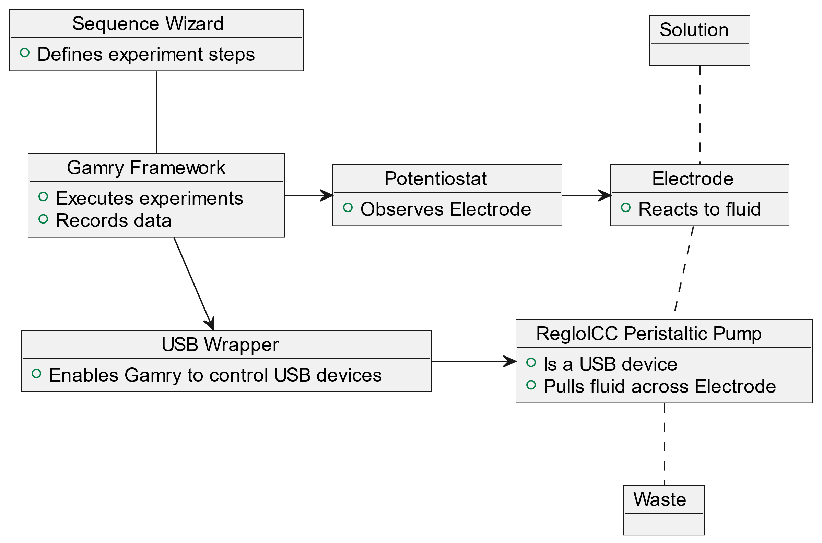
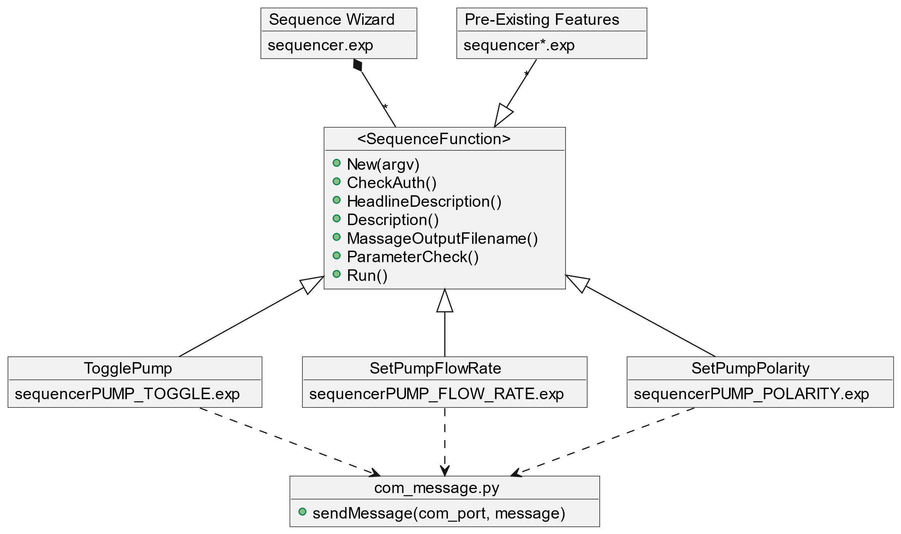
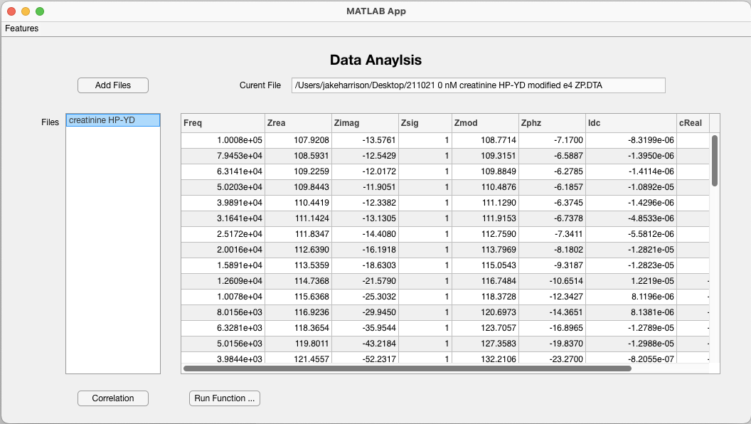

Experiment Automation for an Electrochemical Sensor
Christian Pribyl (Christian.Pribyl@unh.edu), Jacob Harrison (Jacob.Harrison@unh.edu), Jonathan Nelson (Jonathan.Nelson@unh.edu)
Introduction
Goals
The composition and properties of bodily fluids like saliva change in response to a variety of illnesses, including sepsis.
The SEEDS lab intends to create an electrochemical sensor, which combined with machine learning can diagnose sepsis.
This requires running many experiments with different sensor surfaces, which is labor intensive.
We will save the SEEDS Lab time by automating the pump used in experiments, and by providing an extendable data analysis application
Create software tools that can control the pump autonomously
Integrate the automation tools into the Sequence Wizard, making them available to researchers
Create a MATLAB application for processing the data produced by the experiments and produce visualizations and statistics that can be used to quickly understand the data
Goal 1: Pump Automation
Goal 2: Sequence Wizard Integration
Goal 3: Data Analysis Application
The Gamry Framework already controls everything except the pump.
The pump is a USB device, which is not supported by the Gamry Framework
We wrap the USB communications with a Python script
Gamry invokes the Python script, which forwards commands to the pump
Researchers design experiments by selecting steps from a GUI
Experiment steps are implemented as subclasses of SequenceFunction
We implement new subclasses to define new experiment steps
Application designed to save researchers time by analyzing the output data from the experiment.
Designed for functions to be added as the understanding of the data changes
Programmed in MATLAB so the SEEDS lab can maintain the project
Multiple files can be loaded at once, allowing for complex analysis
Tags are extracted from file names to identify data from each file
Figure 1: The Gamry Framework executes the experiment by controlling the Peristaltic Pump, and the Potentiostat. The dashed lines indicate movement of fluid.
Figure 2: describes the class structure of the sequence wizard. We are adding the classes TogglePump, SetPumpFlowRate, and SetPumpPolarity which implement the SequenceFunction interface. These new classes invoke our Python USB wrapper.
Figure 3: UI of Data Analysis application. Currently the application supports adding multiple files and displaying their data.
Results
Acknowledgements
Pump Automation Functionality
Turn pump on/off
Set rotation direction (polarity)
Set flow rate (ml/min)
Future Work
Extend automation to other pump brands
Control individual pump “channels” (feature of RegloICC Peristaltic Pump)
Sequence Wizard Integration
Pump control library is integrated
Our functions can be selected through the Sequence Wizard
Future Work
Simplify setup to a single shell script
Detect pumps automatically
Data Analysis Application Functionality
Parses experiment data files
Calculate total capacitance
Correlation tables
Future Work
ANOVA
Multivariate analysis
Hot color plots
Project Sponsor
Professor Jeffrey Halpern
Capstone Advisor
Professor Matthew Plumlee
SEEDS Lab
Zahra Panahi
Emma Roberge
This work was supported in part by NSF EPSCoR (1757371): NH BioMade

