Slide 1

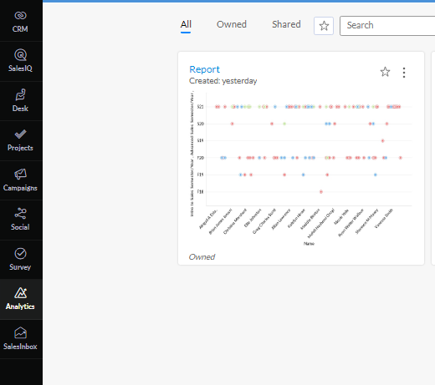
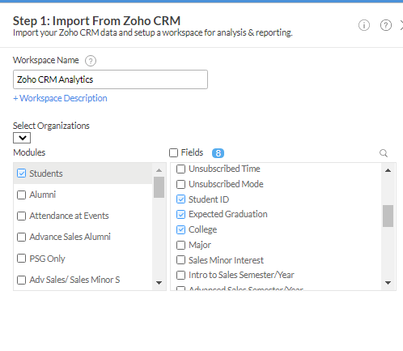
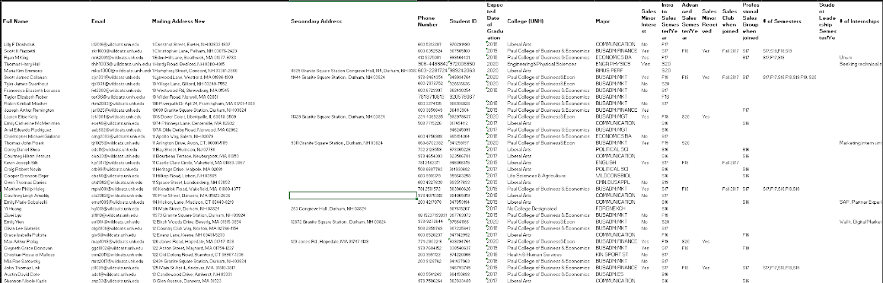
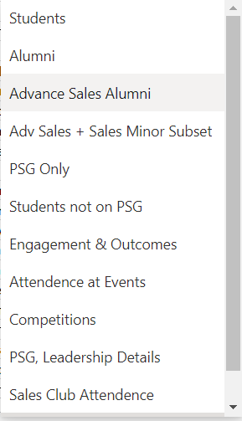
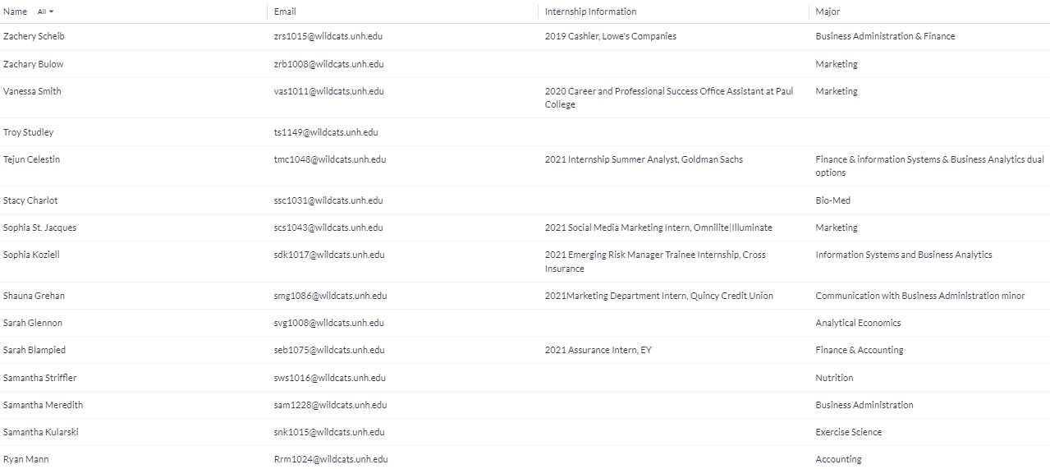
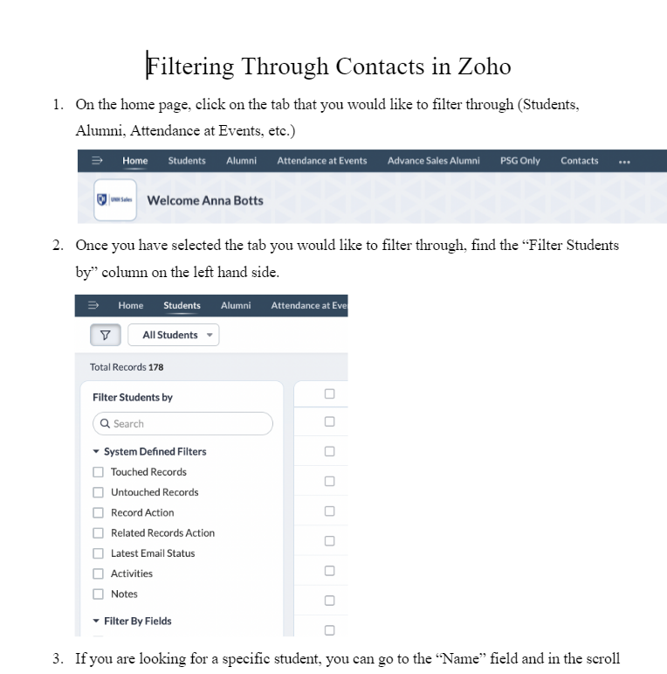
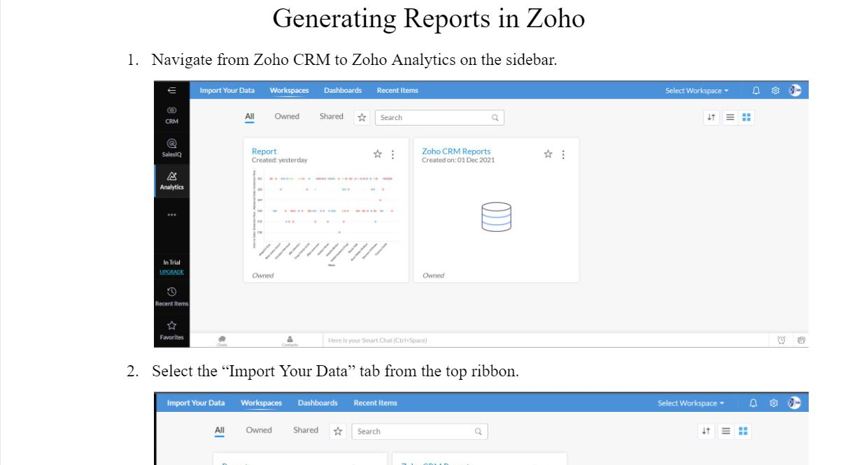
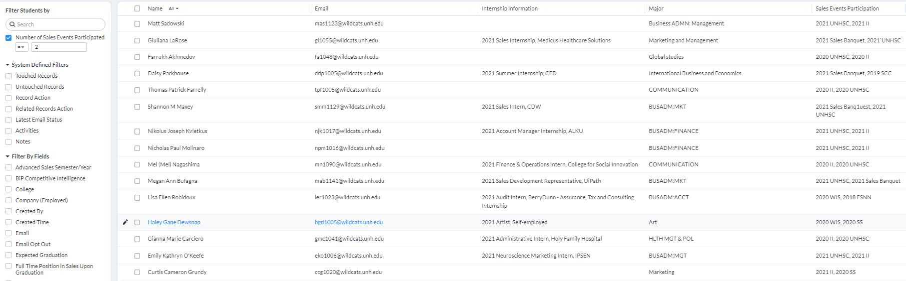
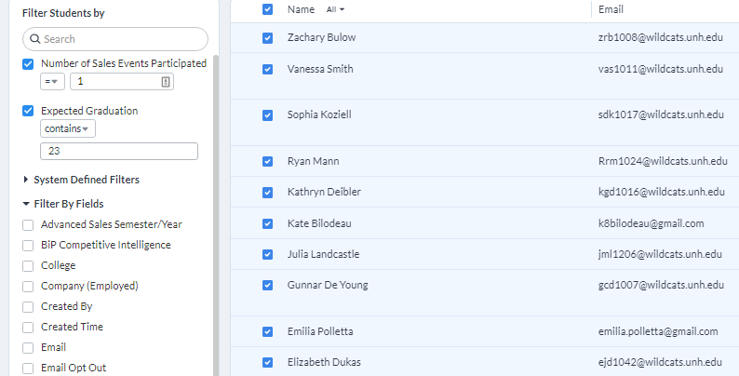
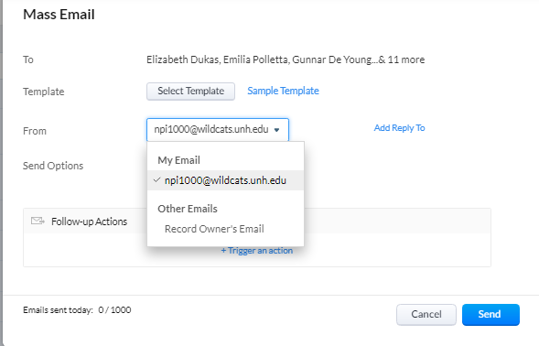
Contact and Event Management Solution (Output Team)
UNH Sales Center
Anna Botts, Nick Braga, Conor Harrington, Chafik Nadim
College of Engineering and Physical Sciences, University of New Hampshire
Introduction
Design & Implementation
The UNH Sales Center needed a more efficient contact and event management solution compared to their previous method of managing their events and contacts through Microsoft Excel sheets. As the team in charge of the contact and event management outputs, we were focused on the functionality of the database and what it could produce.
We selected a customer relationship management software called Zoho to manage the UNH Sales Center's events and contacts because of the built-in add-ons that we would be able to implement. Using Zoho, we were able to create a database that would allow the UNH Sales Center to filter through their contacts, send out blast emails to these contacts based on certain parameters, and generate reports and analytics for the end user to be able to investigate.
Figure 5: This displays the method of generating reports and analytics. The UNH Sales Center can generate analytical reports based on certain fields and criteria. After selecting the desired filters, various types of graphs can be generated to visualize to help aid in displaying data.
Figure 1: The original format of the data given to use by the UNH Sales Center
Requirements
Reorganize and properly format the data provided to us by the UNH Sales Center within the Microsoft Excel sheets
Upload the data into the database and create fields for the contacts so that the data would be able to be filtered through based on certain parameters
Provide a method of filtering through the contacts
Provide a method of sending blast emails to specific students, alumni, and business professionals in the Sales group
Provide a method of generating reports and analytics that the UNH Sales Center would be able to use to analyze
Utilize those reports to measure engagement and Sales Center metrics
Provide documentation for end users on methods for using the database
Figure 2: The data uploaded and formatted in Zoho CRM
Figure 6: Documentation on functionality for end users
Results and Conclusion
This project will be successful if the UNH Sales Center is able to filter through data and generate reports to interpret analytical data about its students, alumni, and sponsors 50% faster using our database than their current method. They should also have a method of contacting these individuals and viewing analytics on the groups within.
To test this, we timed the UNH Sales Center finding a group of students who have taken a certain class and are graduating in 2022 using both their previous method, and the new method of the Zoho database. We found that our database and filtering options made the process over 50% faster and would thereby allow the Sales Center to also contact these specific students that much faster as well. The option to generate reports also provides an easy and effective way to interpret analytical data.
As companies grow, they need a way to manage their contacts. Using our methodology could be a concrete method of managing these contacts for businesses and other groups with many contacts.
Figure 3: The UNH Sales Center can select certain filters based on the specific students they would like displayed. When importing the contacts, we attached fields to all the data so that filtering would be possible.
Contacts
      Anna Botts anna.botts@unh.edu
      Nick Braga nick.braga@unh.edu
      Conor Harrington conor.harrington@unh.edu
      Chafik Nadim chafik.nadim@unh.edu
Acknowledgements
Figure 4: Mass emails can be easily sent to specific students fulfilling certain parameters. After filtering the data, there is a button "Mass Email" that allows you to use templates to send a blast email to the specific students.
Thank you to our sponsors, James McIlroy and
Amy Sununu, of the UNH Sales Center for this opportunity!

