Slide 1




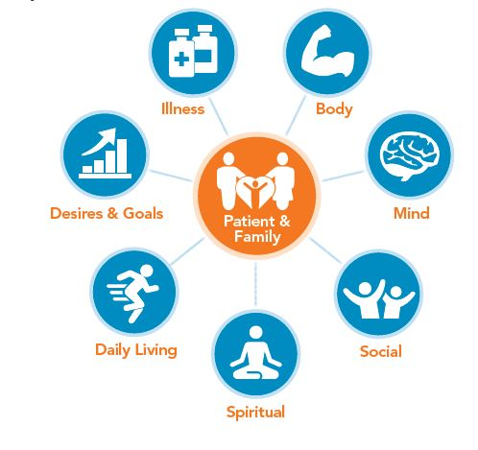
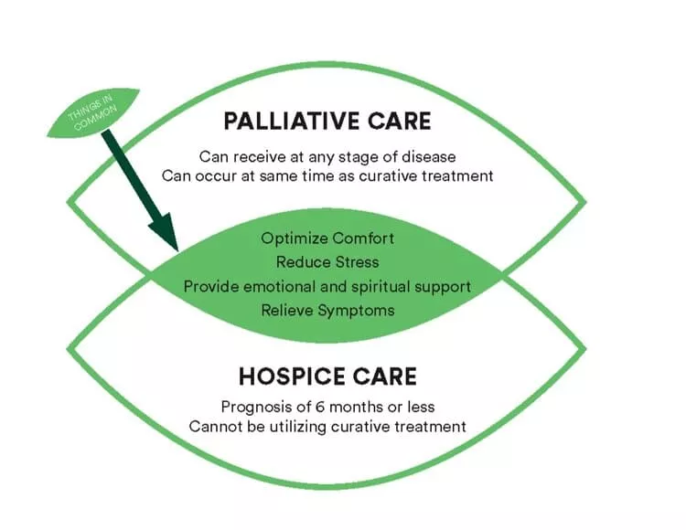
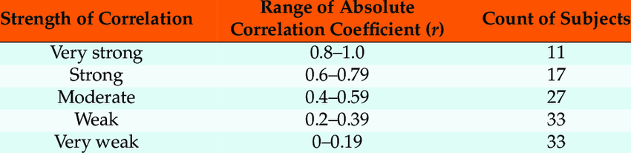
Knowledge Gaps:
Addressing the Need for Palliative Care Education for University Students
Odin Bickford
Professor Michele Lovell, Faculty Advisor
Department of Nursing, University of New Hampshire
Background
Methods
Discussion
Palliative care is specialized medical care to improve the quality of life of individuals with chronic, complex or life-limiting disease processes
It is intended to optimize quality of life by “anticipating, preventing and treating suffering” (Ferrell et al., 2018, pg. 1685)
This goal is achieved through systematic symptom management and is appropriate for patients of any age and at any stage in their disease process. Includes:
  Relief from pain
  Shortness of breath
  Fatigue
  Nausea
  Constipation
  Other symptoms that are often associated with chronic disease
This study utilized the Undergraduate Nursing Palliative Care Knowledge Survey (UNPCKS) tool to analyze the primary palliative care knowledge of undergraduate nursing students at the University of New Hampshire
This tool comprehensively addresses critical aspects of palliative care practice through 27 questions grouped into four subcategories:
1. Principles of Primary Palliative Care
2. Pain and Symptom Management
3. Communication
4. Spirituality and Grief
Through these survey questions, researchers were able to assess for a gap in primary palliative care knowledge to determine if there is a need for further palliative care education in the undergraduate curriculum
Descriptive statistics were calculated. Correlations between UNPCKS total score, scores in the four UNPCKS subcategories and participant experiences that may influence palliative care knowledge were calculated. The participant experience questions were:
1. Have you ever had a loved one with a complex, chronic, or life-limiting illness? (examples: COPD, type II diabetes, congestive heart failure, cancer)
2. Have you ever been the primary caregiver to someone else? (examples: parent, child, loved one, friend)
3. Are you a Licensed Nursing Assistant? (LNA or CNA)
4. Have you seen someone pass away?
5. Have you ever provided postmortem care (care after someone has passed) to a body?
6. Have you taken the UNH course “Death and Dying”?
Strength of correlations and significance (p>.05) were evaluated
The average UNPCKS survey score was 77%. Past studies that have utilized the UNPCKS survey tool have had similar participant scores prior to palliative care education, so this range was roughly expected
It was an unexpected finding that having provided postmortem care was correlated to a higher UNPCKS score and higher score in the spirituality and grief subcategory
Future research endeavors that could elaborate on the postmortem care aspect of palliative care could include simulation experiences and the ELNEC modules
The curriculums of many undergraduate nursing, prelicensure programs do not include adequate palliative care modules to sufficiently educate nurses on how to address the concerns of their palliative care patients competently and holistically
The AACN recommends integrating the End-of-Life Nursing Education Consortium (ELNEC) modules into undergraduate nursing curriculums in order to prepare nurses to deliver quality palliative care
Students must be taught that palliative care is essential at the time of diagnosis of any serious illness or event and be provided with the knowledge they need to be able to provide this quality care regardless of their work settings (AACN, 2016)
Conclusions
Palliative Care is important because it gives patients an option for pain and symptom management and improved quality of life while still pursuing curative measures
It is important to establish a foundation and framework of primary palliative care knowledge within undergraduate nursing students so that nurses possess the appropriate education to be able to address the concerns of their palliative care patients competently and holistically
Results
Significance to Nursing:
There is an increasing rate of chronic and life-limiting illness in this country, and palliative care is the key to optimizing quality of life, managing distressing symptoms, and eliciting goals of care to best match the care we provide with the care our patients would like us to provide
“Nursing education consistently lacks an effective, efficient approach to educating students about palliative care” (Dimoula, et al., 47)
Limitations
This study was completed using a sample of undergraduate nursing students at the University of New Hampshire, a relatively limited participant pool
30 participants have already taken the UNH course Death and Dying and 33 of the respondents were seniors. Both factors could skew the results in an upward manner
Participants have all had different experiences with death and dying. Such personal experiences have the potential to negatively impact their scores and participation in the survey
The survey is 27 questions long, followed up with 8 demographic questions. The length of the survey may have dissuaded active participation from respondents
This was a voluntary survey with no incentive beyond helping the researchers broaden their data. This survey was not attached to any course and participants had nothing to gain personally from completion
71 responses were lost within the Qualtrics system. These responses appeared to end after the participant completed the consent form, and were marked with “This question was not displayed to the respondent”
Research Objective
This study aims to determine the primary palliative care knowledge of undergraduate, prelicensure nursing students to determine if there is a need for further palliative care education in the undergraduate curriculum
There is a weak correlation between the principles of primary palliative care subcategory and having been a primary caregiver that is significant
There is a weak correlation between the total UNPCKS score and having provided postmortem care that is significant
There is a weak correlation between the spirituality and grief subcategory and having provided postmortem care that is significant

Slide 2

Davis, A., Lippe, M., Burduli, E., & Barbosa-Leiker, C. (2020). Development of a new undergraduate palliative care knowledge measure. Journal of Professional Nursing, 36(1), 47–52. https://doi.org/10.1016/j.profnurs.2019.06.007
Desbiens, J.-F., Gagnon, J., & Fillion, L. (2011). Development of a shared theory in palliative care to enhance nursing competence. Journal of Advanced Nursing, 68(9), 2113–2124. https://doi.org/10.1111/j.1365-2648.2011.05917.x
Dimoula, M., Kotronoulas, G., Katsaragakis, S., Christou, M., Sgourou, S., & Patiraki, E. (2019). Undergraduate nursing students' knowledge about palliative care and attitudes towards end-of-life care: A Three-cohort, cross-sectional survey. Nurse Education Today, 74, 7–14. https://doi.org/10.1016/j.nedt.2018.11.025
Ferrell, B. R., Twaddle, M. L., Melnick, A., & Meier, D. E. (2018). National Consensus Project Clinical Practice Guidelines for Quality Palliative Care Guidelines, 4th edition. Journal of Palliative Medicine, 21(12), 1684–1689. https://doi.org/10.1089/jpm.2018.0431
Mallory, J. L. (2003). The impact of a palliative care educational component on attitudes toward care of the dying in undergraduate nursing students. Journal of Professional Nursing, 19(5), 305–312. https://doi.org/10.1016/s8755-7223(03)00094-2
References

