Slide 1
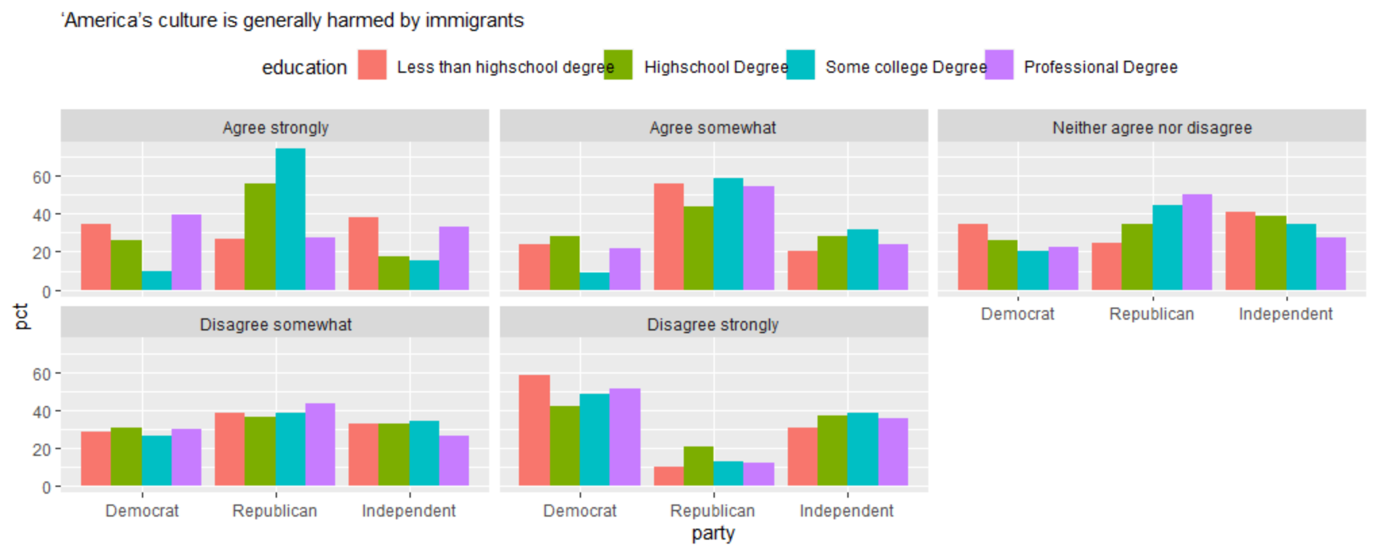
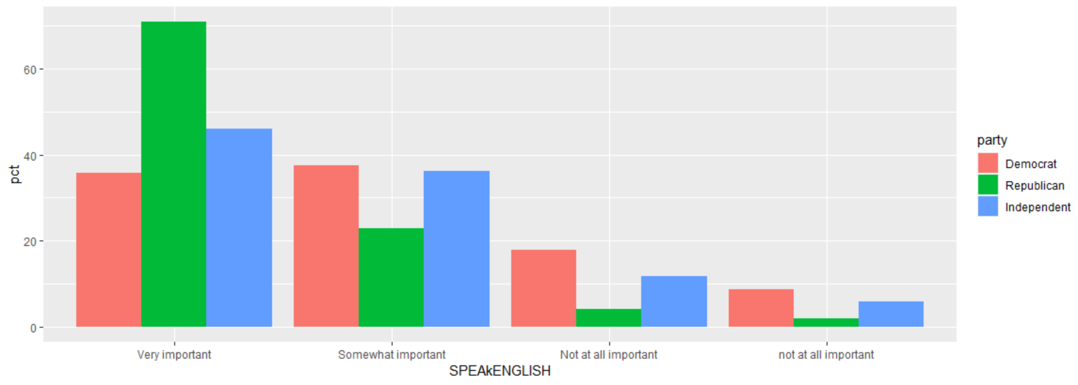
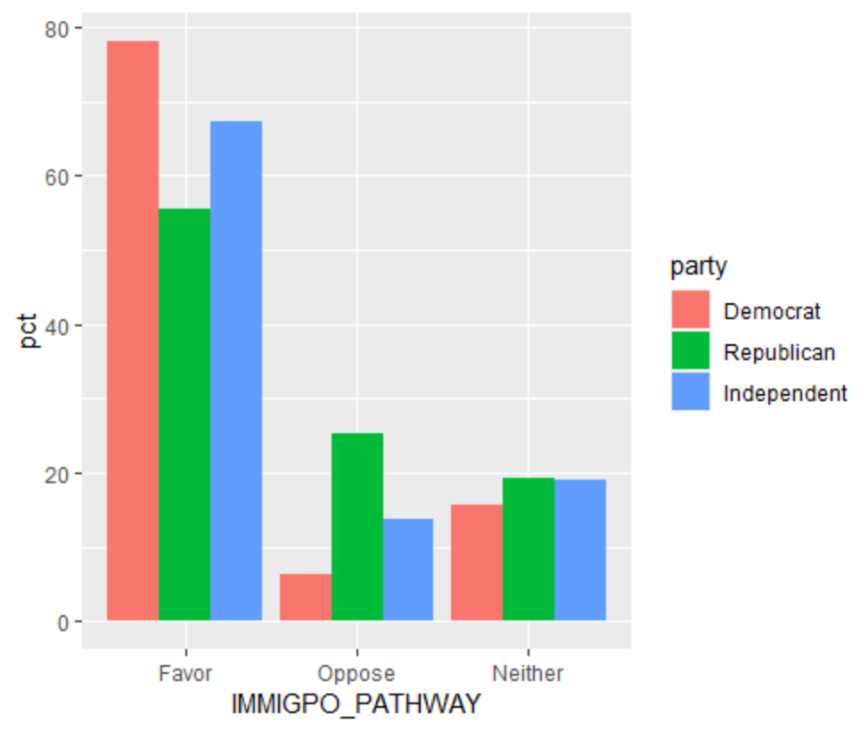
Immigration: How party identification effects public opinion on Immigration
Abigail Battles, Polt595, Department of Political Science
Introduction
Immigration policies have always been a debate in the United States. Statistics show that there is a political divide when it comes to Americans’ view on immigration with a majority of Democrats viewing immigration as a positive thing, while a majority of Republicans view immigration as a negative thing. It is apparent from the articles and data that the two parties view immigration very differently. These two different mindsets and visions for what America should look like shape each parties’ agendas concerning immigration. For example, a major issue for the Republican Party is stopping immigration at the southern border where people are trying to migrate to America from Mexico while the Democratic Party is trying to promote programs like Deferred Action for Childhood Arrivals (DACA). The Democratic and Republican parties statistically seem to represent two very different visions for America.
DATA ANALYSIS
Results & Conclusion:
Data and Analysis:
  The results conclude that there is a correlation between party affiliation and opinion on immigration. It shows that people who identify as republican are more likely to oppose pathways to immigration and more likely to believe that immigration is harmful to American culture.
  Where as people who identified as democratic were more likely to favor providing a path towards citizenship and less likely to believe that America’s culture is harmed by immigrants. That being said both parties believed that speaking English was important.
How important is it to speak English
Hypothesis:
In a study of individuals those that identify as republican will be more likely to have a negative view on immigration and will be more likely to favor stricter immigration policies
Do you favor or oppose providing a path to citizenship
References:
Methods & Variables:
Used the ANES2020 dataset, which surveys over 8,000 people pre-election and over 7,000 people post election.
And Made several crosstabs that were run on RStudio, including those controlling for education and political party
Merolla, Ramakrishnan, S. K., & Haynes, C. (2013). “Illegal,” “Undocumented,” or “Unauthorized”: Equivalency Frames, Issue Frames, and Public Opinion on Immigration. Perspectives on Politics, 11(3), 789–807. https://doi.org/10.1017/S1537592713002077
Gans, Replogle, E. M., & Tichenor, D. J. (2012). Debates on U.S. immigration. SAGE Publications.
The nativist millstone; Immigration politics. (2012). The Economist (London), 403(8782), 31–.
Is Americas culture harmed by immigration
This was one of the variables tested
Do you favor or oppose providing a path to citizenship
This was one of the variables tested
How important is it to speak English
This was one of the variables tested
Its code on the ANES data set is V202419
Its code on the ANES data set is V202240
Its code on the ANES data set is V201427
IMMIGPO_PATHWAY
SPEAkENGLISH
CSES5_IMMCULT

