Slide 1


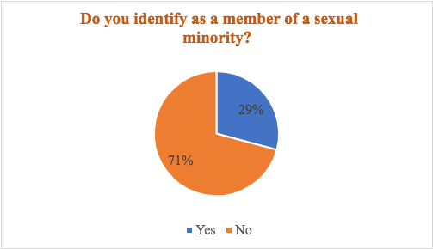
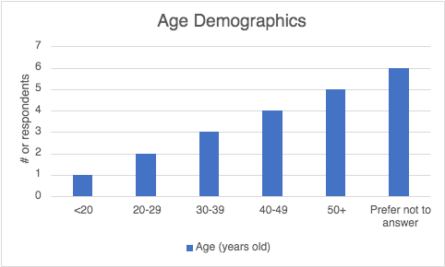
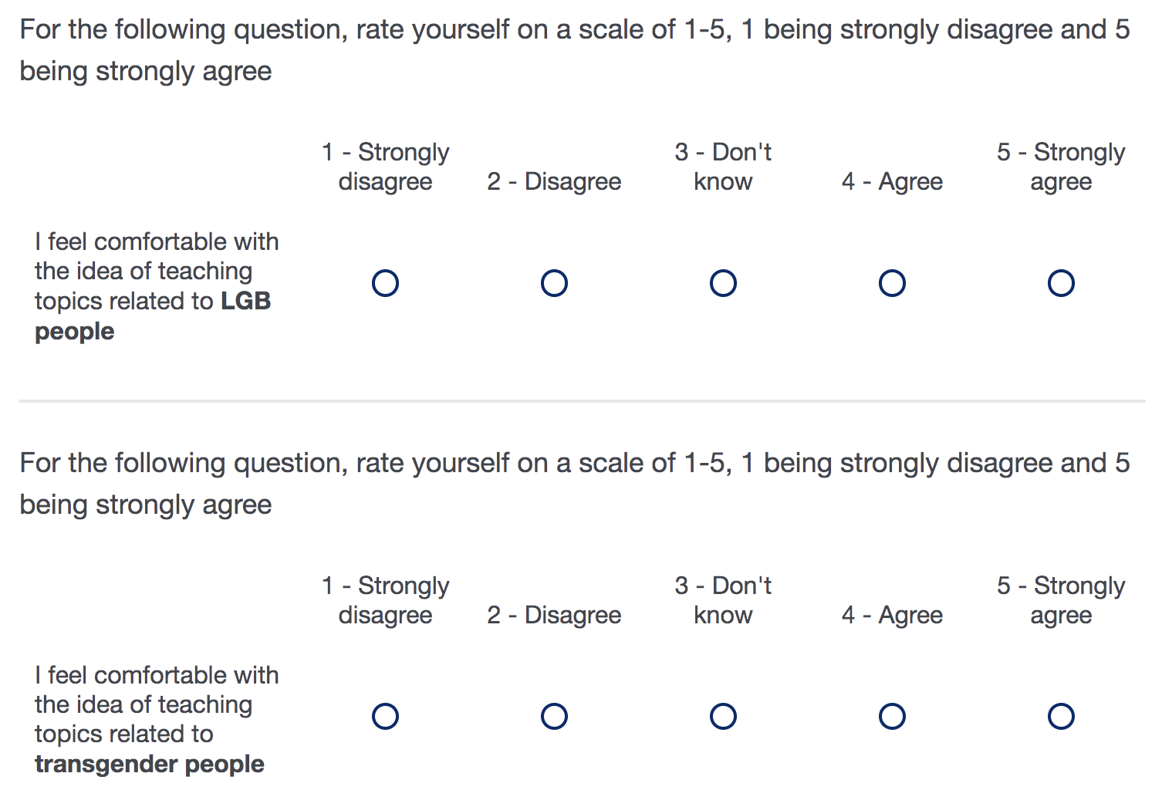
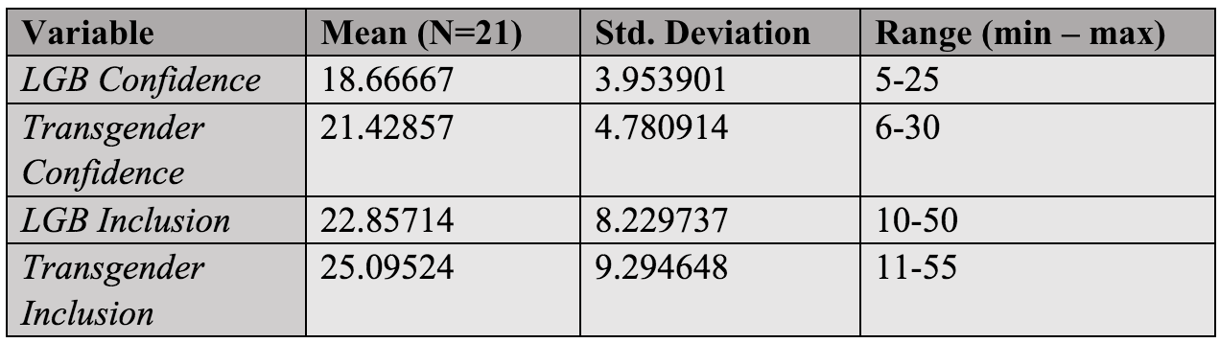
Confidence and Inclusion of LGBTQ+
Health-Related Content in University Curriculum
Carley Kanter & Kristen D. Clark, PhD, RN, Faculty Advisory
Department of Nursing, University of New Hampshire
Introduction
Results
Discussion
The issue: the lesbian, gay, bisexual, transgender, queer, plus (LGBTQ+) adult population faces high rates of disparities and discrimination within the health care system^{1,2,3}
  Higher rates of substance use disorders, mental health disorders, and physical health problems than heterosexual and cisgender adults^{1,2}
  16% of LGBQ patients and 33% of transgender patients report discrimination by health care providers^{3,4}
  18% of LGBQ patients and 23% of transgender patients reported avoiding health care due to anticipated discrimination^{3,4}
Health care students report they have not received the tools they need to comfortably care for this population in practice⁵
On average, only 2.12 hours of LGBTQ+ teaching is spent in four years of a nursing program⁶
Almost one third of respondents identify as a member of a sexual minority (Table 2)
100% of respondents reported to be white
Age of respondents ranged from <20 to 50+ years of age (Table 3)
40.9% of survey results from nursing faculty
Statistically significant positive linear correlation between confidence and inclusion
    As faculty confidence increases so does faculty inclusion (r = 0.7194 and p value < 0.01)
Paired t test indicates there is a statistically significant difference in faculty inclusion of LGB content compared to transgender content (t = 4.1904 & p < 0.01)
Table 2. Demographics
Table 3.
Figure 2.
Research Aim
Key finding: Increasing faculty confidence may increase faculty’s inclusion of this content in the curriculum
Faculty who identify as members of the LGBTQ+ community may have more confidence teaching and including the material than those who are not⁶
    Difference in inclusion of LGB content compared to transgender content may be related to faculty’s confidence level of each population
The health care community and educators must address this gap in LGBTQ+ content inclusion
Recommended techniques to improve confidence among faculty:
    LGBTQ+ diversity training and professional development workshops⁷
    Targeted sessions focused on opportunities for curriculum inclusion,⁷ such as:
    Collaborate with LGBTQ+ community members to develop inclusive curriculum⁸
    Panel discussions⁸
    Lecture, simulations, case studies that include and NOT pathologize LGBTQ+ people⁸
    UNH Safe Zones trainings
Identify whether the degree of confidence in teaching LGBTQ+ health content is related to the implementation of this material into educators’ curriculum
Methods
Developed Qualtrics survey approved by the Institutional Review Board
Distributed to faculty in UNH College of Health and Human Services & Psychology Dept.
Data includes faculty who taught classes between 2020 and 2022
Confidence and inclusion measured by Likert scale
Stata software used for analysis
Ran correlation analysis for relationship between confidence and inclusion
Paired t test analyzed for difference in transgender and LGB content inclusion
Confidence
Inclusion
Table 1. Survey Sample Question
Figure 1. Correlation Description
Table 4. Results
Acknowledgments
I would like to thank Dr. Kristen Clark for overseeing this study and guiding my research as well as Chloe Kilkelly for collaborating on the survey.
Thank you to the faculty members who participated in the study and Dr. Kerry Nolte for leading the honors nursing program.
.
Range Key: minimum = lowest possible confidence/inclusion,
maximum = highest possible confidence/inclusion
References
1. Gonzales, G., & Henning-Smith, C. (2017). Health disparities by sexual orientation: Results and implications from the Behavioral Risk Factor Surveillance System. Journal of community health, 42(6), 1163-1172.
2. McCann, E., & Brown, M. (2018). Vulnerability and psychosocial risk factors regarding people who identify as transgender. A systematic review of the research evidence. Issues in Mental Health Nursing, 39(1), 3-15.
3. Casey, L. S., Reisner, S. L., Findling, M. G., Blendon, R. J., Benson, J. M., Sayde, J. M., & Miller, C. (2019). Discrimination in the United States: Experiences of lesbian, gay, bisexual, transgender, and queer Americans. Health Services Research, 54(6), 1454–1466. https://doi.org/10.1111/1475-6773.13229
4. James, S., Herman, J., Rankin, S., Keisling, M., Mottet, L., & Anafi, M. A. (2016). The report of the 2015 US transgender survey.
5. Greene, M. Z., France, K., Kreider, E. F., Wolfe-Roubatis, E., Chen, K. D., Wu, A., & Yehia, B. R. (2018). Comparing medical, dental, and nursing students’ preparedness to address lesbian, gay, bisexual, transgender, and queer health. PLoS One, 13(9), e0204104.
6. Lim, F., Johnson, M., & Eliason, M. (2015, May). A National Survey of Faculty Knowledge, Experience, and. . . : Nursing Education Perspectives. Nursing Education Perspectives. Retrieved October 15, 2021, from https://journals.lww.com/neponline/Abstract/2015/05000/A_National_Survey_of_Faculty_Knowledge,.3.aspx
7. Booker, K. C., Merriweather, L., & Campbell-Whatley, G. (2016). The Effects of Diversity Training on Faculty and Students' Classroom Experiences. International Journal for the Scholarship of Teaching and Learning, 10(1), n1.
8. McNiel, P. L., & Elertson, K. M. (2018, April 20). Advocacy and awareness: Integrating LGBTQ Health Education into the prelicensure curriculum. Journal of Nursing Education. Retrieved October 12, 2021, from https://journals.healio.com/doi/10.3928/01484834-20180420-12.
Contacts
      For more information contact: Carley Kanter: carley.kanter@unh.edu

