Slide 1

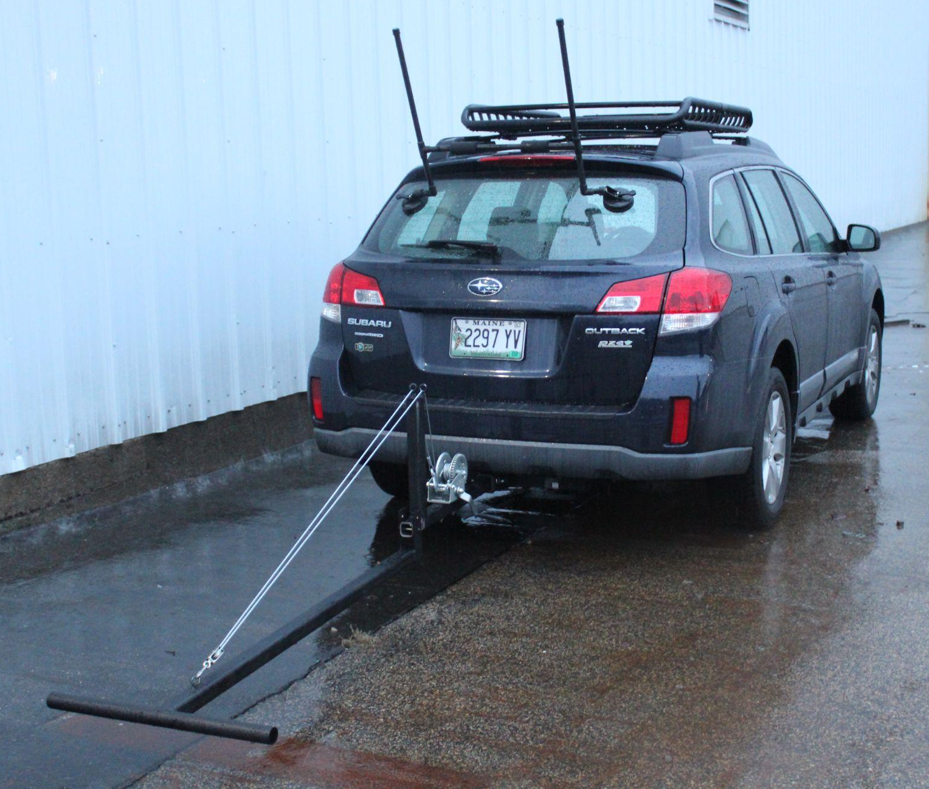
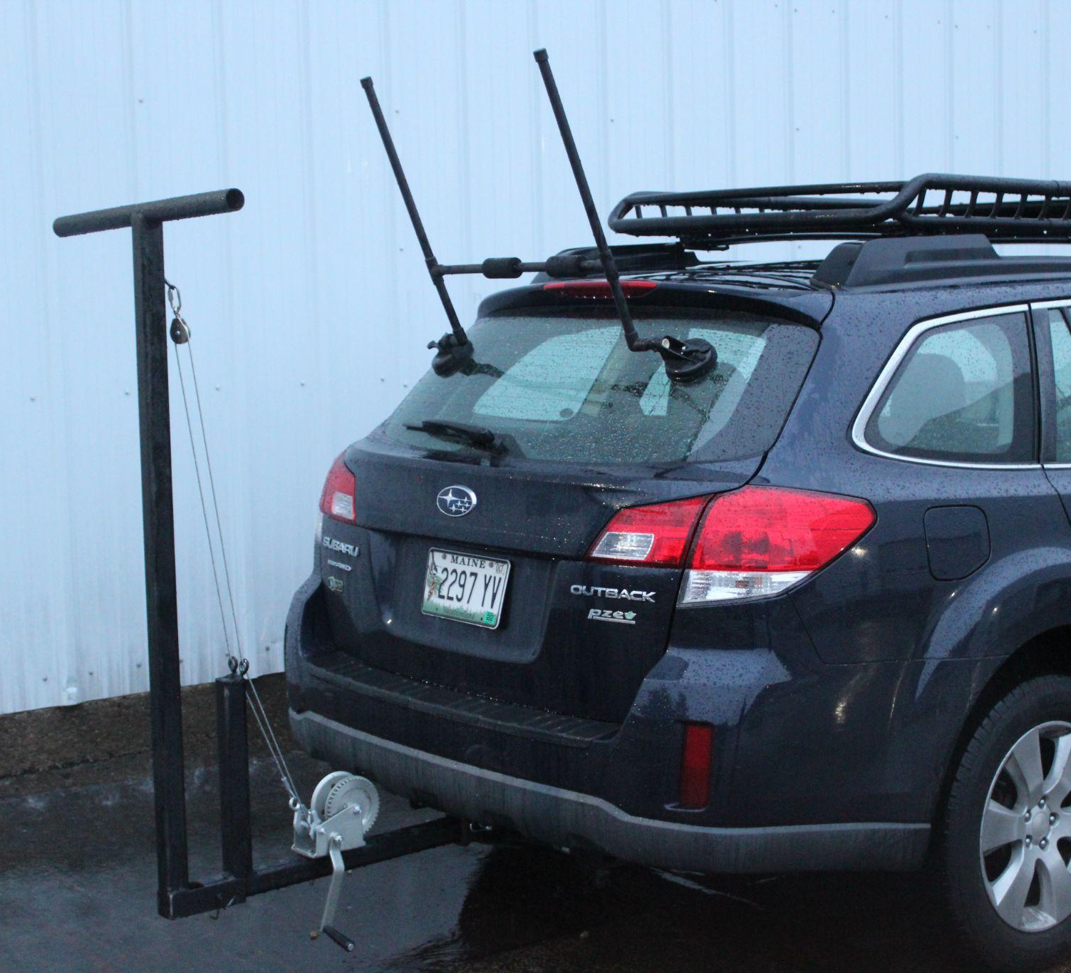
Mechanical Kayak Loading System
Ruben Abounaja, Colin Gilmore, Jack Kennefick, Alex Robacher, Chase Wescott,
Department of Mechanical Engineering, University of New Hampshire
Introduction
Results
Discussion
The goal of this project was to build and test a working prototype of a mechanical kayak loading system. The system loads kayaks of any size onto and off of any commercially available kayak roof rack and affix to any make or model of automobile that has a trailer hitch. The final prototype consists of a trailer-hitch-mounted, winched lever arm and a roller guide that suctions to the rear window or roof.
A working prototype is shown in the figures below. This prototype loads any kayak onto any existing, commercially available roof racks. To load a kayak, the operator would lower the lever to the position shown in Figure 1. They would then attach the roller guide to the rear window and drag the kayak’s bow up into the guide. The operator would winch the lever up into the vertical position shown in Figure 2. They would then slide the kayak forward if needed, and strap down their kayak to existing racks. To lower the kayak, the operator would perform the same steps in reverse.
This prototype demonstrates the final design’s feasibility and satisfies the design requirements. Namely, it loads kayaks as intended and has low fabrication cost ($183 in materials). However, several improvements could be made to the prototype through further design refinement:
Use lighter metal for lever
Make lever height adjustable
Add second roller for taller cars
Add hitch adapter for 1” hitches
Research & Development
Customer Discovery
  Many kayakers struggle to lift kayaks onto their car alone, especially the elderly or short-statured people
Market Research
  Current products are not compatible with existing roof racks that the kayaker may own
  Current products are prohibitively expensive (typically around $600)
Design Selections
  The final design was made to fit a 2012 Outback
    This prototype is not universal, but is a successful proof-of-concept
Construction
  The lever piece was made of 2” steel square tubing and a commercially available winch
  The roller was made of ¾” pvc with commercially available automobile suction cups
Figure 1: Lowered Position
.
Figure 2: Raised Position

