Slide 1



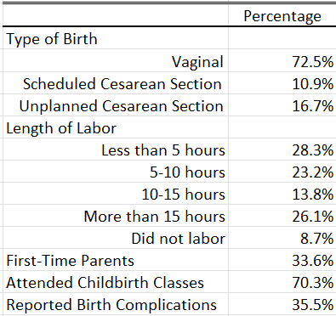
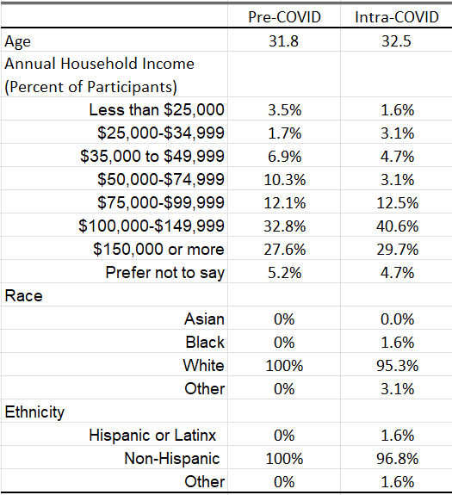
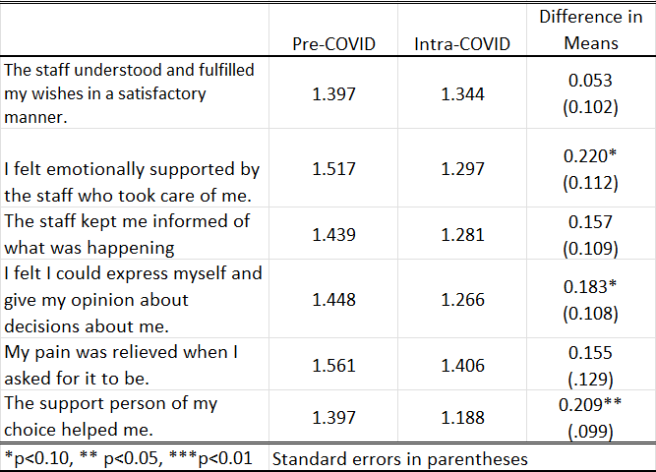

A Comparison of Perceptions of Labor Support
Before and During the COVID-19 Pandemic
Sarah Krein
Dr. Alyssa O’Brien, PhD, RN, Faculty Advisor
Department of Nursing, University of New Hampshire
Background
Data Analysis
Discussion
A negative birth experience puts birthing individuals at greater risk for postpartum depression (3).
Common reasons for birth dissatisfaction include inadequate support during labor and discrepancy between birth expectations and actual experiences (7).
Continuous labor support is correlated with increased patient satisfaction (4)
The COVID-19 pandemic altered many hospital policies to restrict the number of allowed support persons, potentially altering the experience of birth during this time (1, 6).
Statistical analysis of completed surveys conducted with Strata 16, tables edited with Excel.
Descriptive statistics describe sample demographics and labor/birth characteristics between Pre-COVID and Intra-COVID respondents – see Table 1 and Table 2.
Regression analyses between labor support and birth outcomes were not statistically significant and were excluded.
Student’s T-Test determined differences in labor support experience for birthing individuals in the Pre-COVID and Intra-COVID respondent groups – see Table 3.
Open-ended responses were reviewed for commonly reported themes – see Graphic 1.
These results indicate that protected time as a family with fewer visitors in the room may have allowed partners to focus more energy on their significant other during birth, and potentially allowed couples to feel more trusting of and supported by their nurse.
  Mothers may also have had better experiences because they were not required to worry about anyone other than themselves and their baby.
The high means in both groups for the outcomes listed in Table 3 indicate that staff and support persons were generally effective in fulfilling the wishes of birthing individuals during labor.
Given the homogeneity of the study sample, these findings are likely not representative of the population of birthing individuals as a whole. However, these similarities also show the significant difference found in feelings of partner support were likely due to the pandemic. Similar research should be completed using a more diverse population.
Significant health disparities exist in the United States which may alter birth experiences and outcomes in a more diverse sample.
  Social determinants of health, structural racism, psychosocial and environmental stressors, poor access to high-quality care, and lack of adequate discharge transitions disproportionately affect impoverished families and families of color, leading to their increased prevalence of pre-term birth, low birth weight, and neonatal morbidity and mortality (2) (5).
Purpose
Results
Identify factors that influenced supportive relationships in the experiences of individuals giving birth.
Identify how the COVID-19 pandemic influenced support practices during the birth experience.
Using this convenience sample and the survey questions asked, no direct relationship was found between labor support practices, the COVID-19 pandemic, and birth outcomes. Based on this, despite the pandemic, mothers felt supported during birth.
It is possible no significant relationships were found due to the homogenous sample consisting of mostly white, non-Hispanic women from households earning over $75,000 annually who had uncomplicated vaginal deliveries. There are also many other factors that could influence birth experience besides support.
Small differences were noted at the 10% level, with participants in the Intra-COVID group reporting slightly greater feelings of emotional support by staff and of being able to express their opinions about decisions in their care compared to the Pre-COVID group.
Only one outcome had a significant difference at the 5% level, with the Intra-COVID group reporting feeling more supported by their support persons than the Pre-COVID group.
Table 3: T-Test Correlation Table
Sample
Clinical Implications
Convenience sample of individuals who gave birth in the last five years.
Table 1: Sample Demographics
Table 2: Labor/Birth Characteristics
Themes From Free Response About Birth Experience During
COVID-19
Negative feelings regarding not being allowed visitors, especially other children and mothers
Enjoyed not being allowed visitors, citing having more time for bonding and rest
Disliked having to wear a mask during labor and/or pushing
Unfortunate they were unable to leave their room/unable to move freely during labor
Disliked being required to attend prenatal appointments alone
Negative feelings of uncertainty surrounding giving birth during the pandemic
Education provided to pregnant individuals prenatally on the benefits of rest and family bonding during the initial postpartum period could help expectant parents to consider their preferences for visitors during and after birth.
Nurses should consider their role in guiding partners in how to support their significant others during birth to promote positive birth experiences.
Graphic 1
Methods
138 participants recruited through social media, flyers, and word of mouth.
Participants completed a 12-minute Qualtrics survey containing the following:
Informed consent and three inclusion criteria questions.
26 questions based on expert consensus and the Questionnaire for Assessing Childbirth Experience (QACE), a valid and reliable instrument.
17 questions related to demographics and general birth information.
Two free-response questions asking participants to describe:
  Any other factors important to their birth experience.
  The affect of the COVID-19 pandemic on their birth experience if they gave birth March 2020 or later.
For any additional information or questions, please scan the QR-code.
References
Arora, K. S., Mauch, J. T., & Gibson, K. S. (2020). Labor and delivery visitor policies during the COVID-19 pandemic: balancing risks and benefits. JAMA, 323(24):2468–2469. doi:10.1001/jama.2020.7563
Beck, A. F., Edwards, E. M., Horbar, J. D., Howell, E. A., McCormick, M. C., & Pursley, D. M. (2020). The color of health: how racism, segregation, and inequality affect the health and well-being of preterm infants and their families. Pediatric research, 87(2), 227–234. https://doi.org/10.1038/s41390-019-0513-6
Bell, A. F., & Andersson, E. (2016). The birth experience and women’s postnatal depression: A systematic review. Midwifery, 39, 112–123. https://doi.org/10.1016/j.midw.2016.04.014
Bohren, M. A., Hofmeyr, G. J., Sakala, C., Fukuzawa, R. K., & Cuthbert, A. (2017). Continuous support for women during childbirth. Cochrane Database of Systematic Reviews 2017, 7. DOI: 10.1002/14651858.CD003766.pub6.
Burris, H. H., & Hacker, M. R. (2017). Birth outcome racial disparities: A result of intersecting social and environmental factors. Seminars in perinatology, 41(6), 360–366. https://doi.org/10.1053/j.semperi.2017.07.002
Gutschow, K., & Davis-Floyd, R. (2021). The impacts of COVID-19 on US maternity care practices: a followup study. Frontiers in sociology, 6, 655401. https://doi.org/10.3389/fsoc.2021.655401
Webb, R., Ayers, S., Bogaerts, A., Jelicic, L., Pawlicka, P., Van Haeken, S., Uddin, N., Xuereb, R. B., & Kolesnikova, N. (2021). When birth is not as expected: a systematic review of the impact of a mismatch between expectations and experiences. BMC Pregnancy and Childbirth, 21:475. https://doi.org/10.1186/s12884-021-03898

