Slide 1
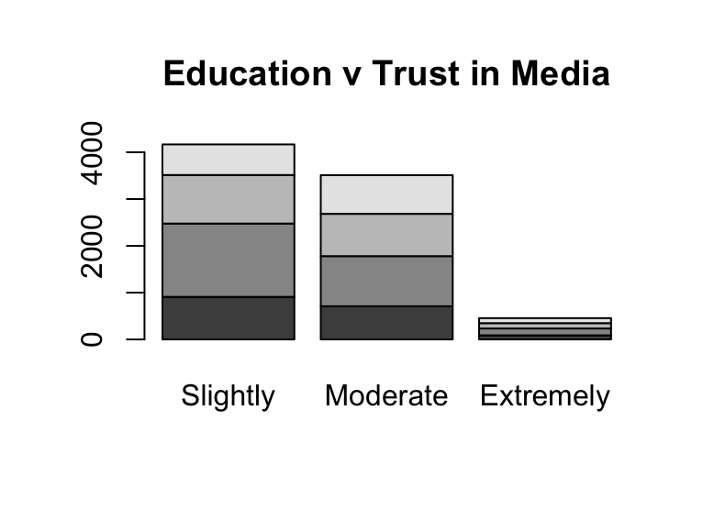
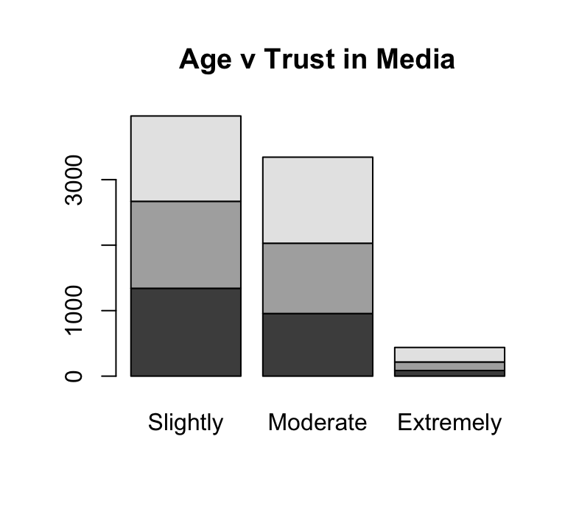

How Much Trust Does Gen Z Have in News Media?
Hannah Brinkman
Department of Political Science
University of New Hampshire
Findings: Initially, it was found that Gen Z would have more trust due to their high productivity online and with online news sources/media. This was before the control variables, such as: education and age were examined. Those with a low education or who are slightly educated were more likely to have more/moderate trust in the media. This is because they tend to have no individual stance on a particular topic and therefore, believe everything they see or are fed by others. In comparison, those more educated and with a higher educational degree were to have little trust in the news media. I also ran a crosstab/cross comparison between age and media trust. I had found those younger in age (under 40) had a lack of trust in news media compared to those older (Over 60).
Introduction: In recent years it has become more difficult to truly know if what you read and see on the news is real. Since the late 90's there have been many advancements in technology, and it is quite easy to fall for the media's clickbait and fake news. With thousands of articles, social media platforms, podcasts, and websites to click on, it becomes difficult to know who to trust. With this newer and younger generation, this poster will examine how must trust Gen Z, has in news media.
Variables examined:
Independent : People trust
Dependent: Media Trust
Control: Age & education
Hypothesis: In comparison to those older, Generation Z has little trust in news media.
Conclusion: These findings suggest that Gen Z has a lack of trust in news media. However, it is also determined by one's education and age. The control variables factor into how much trust is had in the news media. It is indicated that the younger generations are more educated and know what is or could be fabricated in the media. I also looked at the amount of trust people have among other individuals, and those under 40 trusted people less than those over 60. Further research could be done to see why this is so, and if gender plays a factor as well. Overall, it is found that Gen Z and those younger do not have as much trust as older generations. This is important in furthering educational outlets to alert the public on news.
Literary Review: Research in this study shows that those younger in age and born in the Generational Z era (1997-2012) have little to no trust in news media compared to those older. In an article by Hanna Reinkkainen and the idea of organizational trust, she says that younger generations have more trust in non-governmental media platforms due to their high participation online. However, after conducting some individual research it is found older generations have more trust in these governmental news outlets. It is also found that education has an impact on trust.
Sources and Methods: All data was used and gathered from the 2020 ANES survey studies. The data analysis was performed in Rstudio, which is a free and open –source software used for scientific research, and technical communication. In order to test my hypothesis, I compared the trust people have in news media as well as in other people. I then cross compared this trust in media with education and age.
References: Reinikainen, Hanna, et al. “Generation Z and Organizational Listening on Social Media: Article.” Media and Communication, 19 May 2020, www.cogitatiopress.com/mediaandcommunication/article/view/2772.
Brosius, Anna, et al. “Generational Gaps in Media Trust and Its Antecedents in Europe.” The International Journal of Press/Politics, 2021, p. 194016122110394., doi:10.1177/19401612211039440.
Das, Ranjana. “Special Issue: Audiences: A Cross-Generational Dialogue Edited by Ranjana Das.” The Communication Review, vol. 16, no. 1-2, 2013, pp. 1–2., doi:10.1080/10714421.2013.757140.
Literature Review
Data analysis
Materials and Methods
Variables examined:
Independent variable: Trust in people
Dependent variable: Trust in media
Control variable: age, education
Hypothesis: In comparison to older generation, the younger generations, Gen Z, have more trust in news media.
References
Findings and Conclusions

