Slide 1
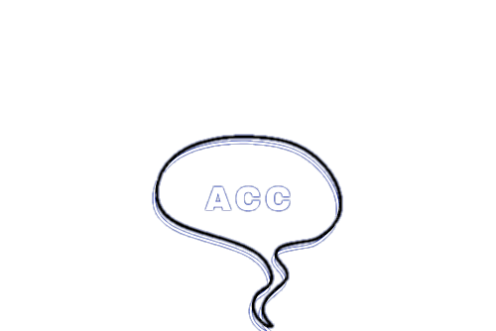

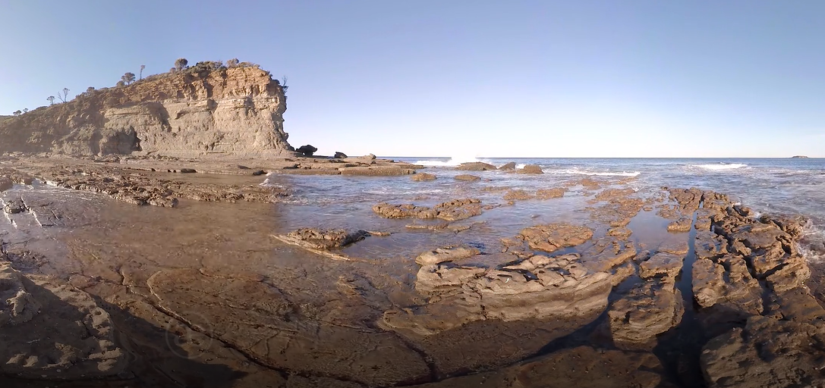
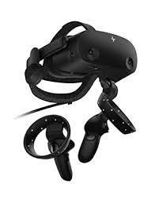
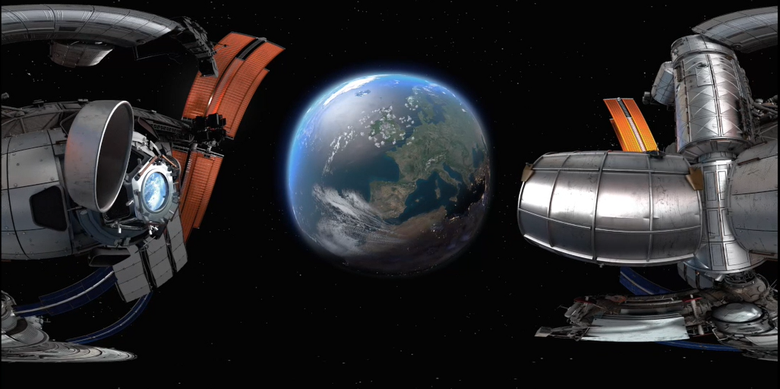
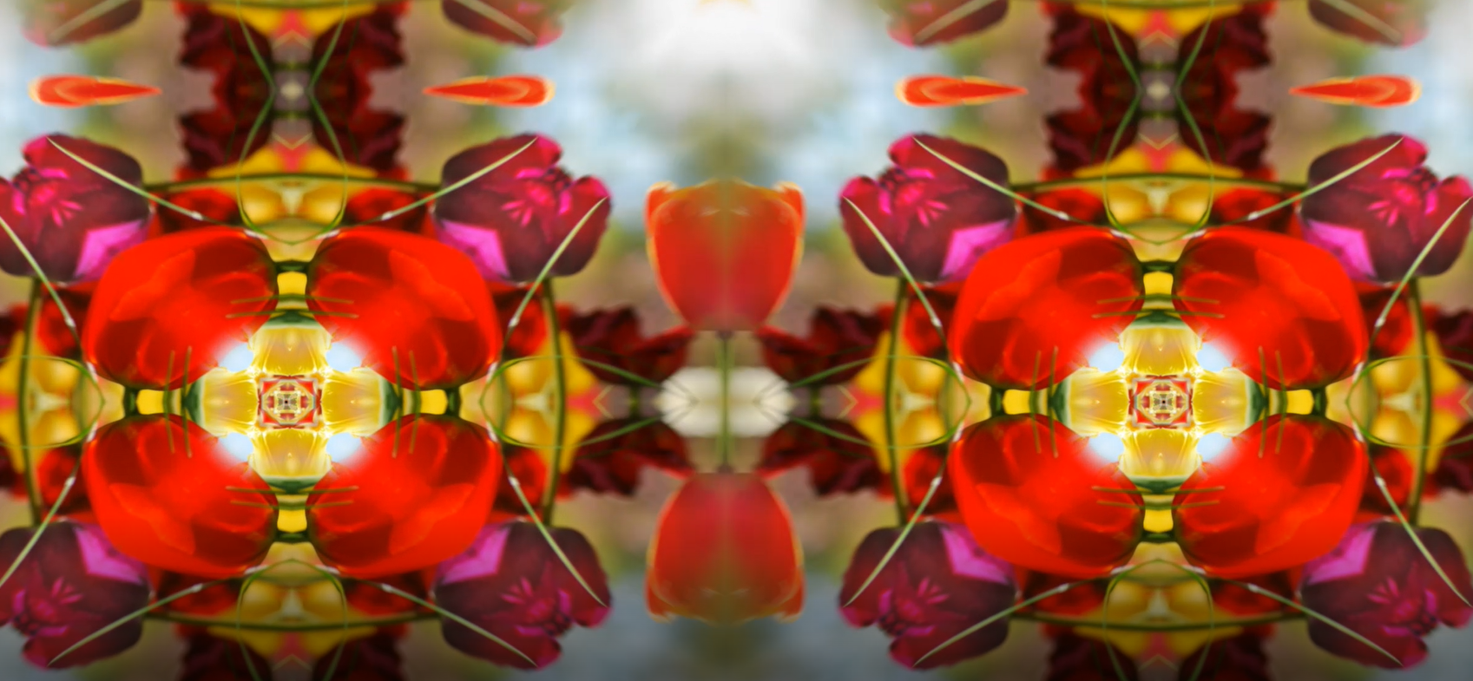
Recreating the Psychedelic Experience in Virtual Reality: Effects on Creativity and Phenomenological Thought Processes
Mya Urena, M. Cati Poulos, Vishal Kuvar, Caitlin Mills
University of New Hampshire, Department of Psychology
Background
Psychedelic trips create a dissociative state that promotes creative generation. Visual component of psychedelic trip can be simulated in virtual reality (VR).
Research Question
Can the recreation of the psychedelic experience in virtual reality stimulate creative generation?
Our Approach
Participants watch video in VR for 3 minutes then complete questionnaire.
Creativity Measures
Alternative Uses Task (AUT)
List as many possible uses for a brick that you can think of.
Response: Weapon, doorstop, paperweight.
Remote Associates Task (RAT)
Identify a fourth word that will relate to ALL the words: Carpet, alert, ink.
Response: Stain
Results
Conclusions
Ongoing study: No conclusive results yet.
Current project will:
Contribute to psychedelic research in VR.
Provide self-improvement methods through creative generation.
Nature Condition
VR Conditions
Space Condition
Future Directions
Employ a more accurate experimental condition (augmented reality technology).
Experimental Condition

