Slide 1

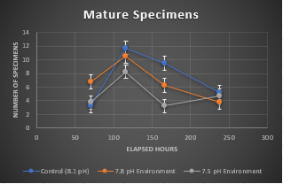
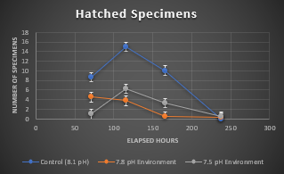
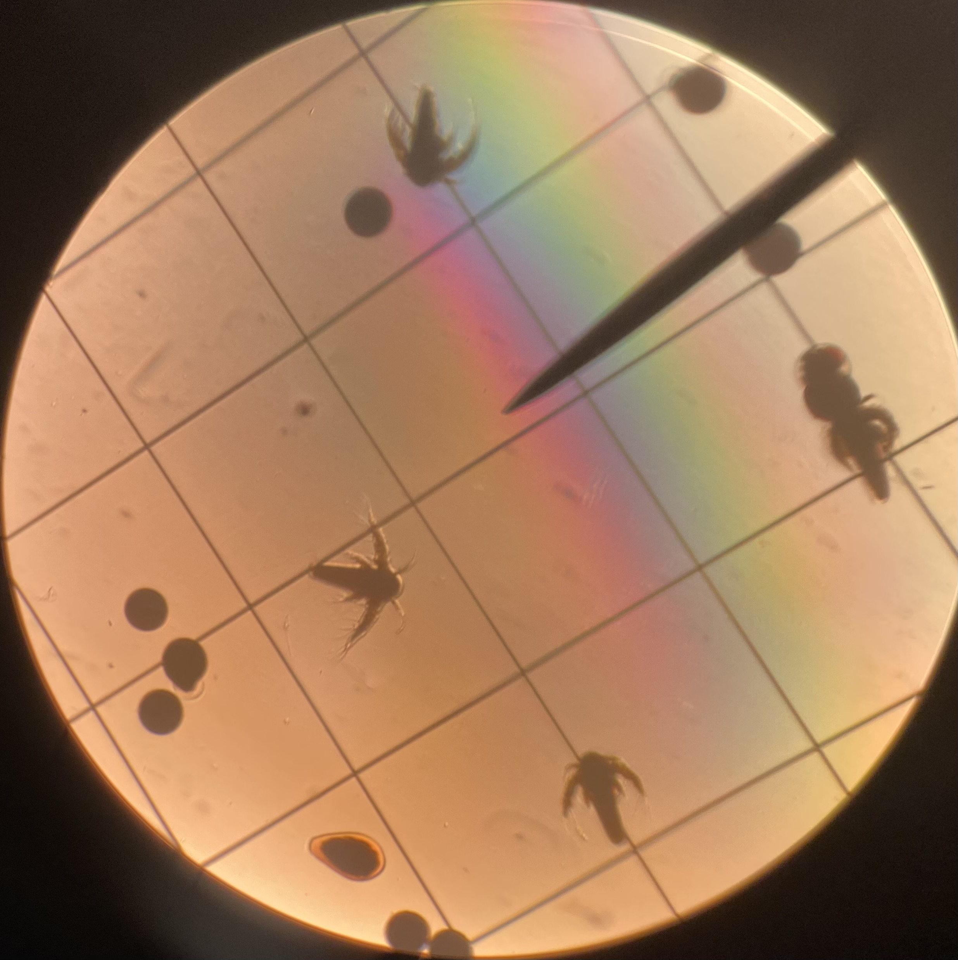
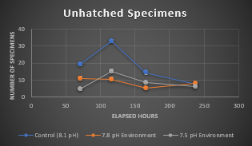
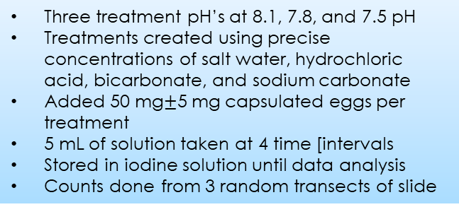
Artemia salina Survivability in Lowered pH Conditions
Research Conducted by Patrick Jackson, Connor Powley, Brooklyn Wallace, and Cole Capobianco
Advised by Dr. Kieran Curran
University of New Hampshire College of Engineering and Physical Sciences
Background
Experimental Design
Central Questions and Hypothesis
Our research centered around the long-term ecological effects of ocean acidification in the Atlantic Ocean. As carbon dioxide is absorbed into the ocean, the pH in the Atlantic has become more acidic, falling from 8.2 to 8.1 over the past century. This 0.1 pH decrease represents almost a 30% increase in the acidity of ocean water, and carbon emission trends suggest that the pH will continue to drop even more drastically.
Three treatment pH’s at 8.1, 7.8, and 7.5 pH
Treatments created using precise concentrations of salt water, hydrochloric acid, bicarbonate, and sodium carbonate
Added 50 mg$±$5 mg capsulated eggs per treatment
5 mL of solution taken at 4 time [intervals
Stored in iodine solution until data analysis
Counts done from 3 random transects of slide
How could lowered pH conditions in ocean waters affect survivability of sensitive organisms like Artemia salina?
We hypothesized that lowered pH will severely decrease the hatching success of marine organisms like Artemia salina, and will produce lower densities of mature specimens.
Results and Analysis
Implications
Data collection from three trials of every treatment
at each time point produced 108 data points
Specimens classified as “mature”, “hatched”, or
“unhatched” based on their appearance under a
microscope
Averages of each category taken from three trials
and graphed for Count vs. Elapsed Time (in hours)
Profound differences in hatching and maturing rates
shown between treatments after 116 and 166 hours
Bottleneck effect observed after 238 hours, where samples
provided less data overall, and treatments were less diverse
Greater number of deformities observed in specimens
between 166 and 238 hours
Very few nauplii observed in acidic treatments after 166 hours
and almost no nauplii in any treatments after 238 hours
Our findings show that low pH levels negatively affect Artemia salina survivability.
Die-offs of marine organisms in the base of food chain due to the change in pH could be catastrophic for larger marine animals and the fishing industry.
These findings should be used as an awareness of the dangers of ocean acidification.
Acknowledgements
Our sincerest thanks to Kieran Curran for his guidance and leadership through our research, and his charismatic attitude in seeing us succeed.
We are immensely grateful to Sean McKenna and the Rye Seacoast Science Center for their professional assistance and resources provided to our research.

