Slide 1

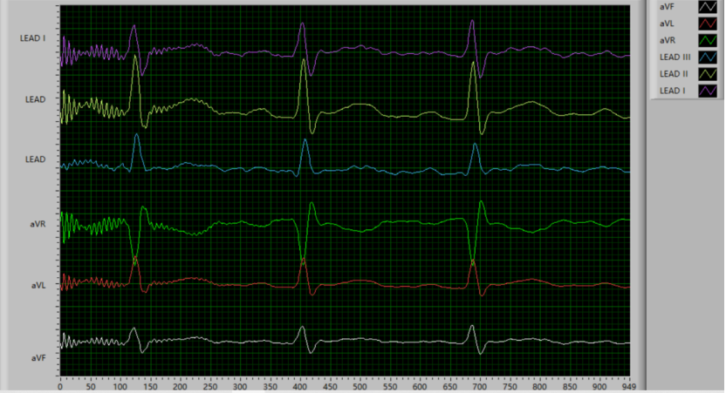
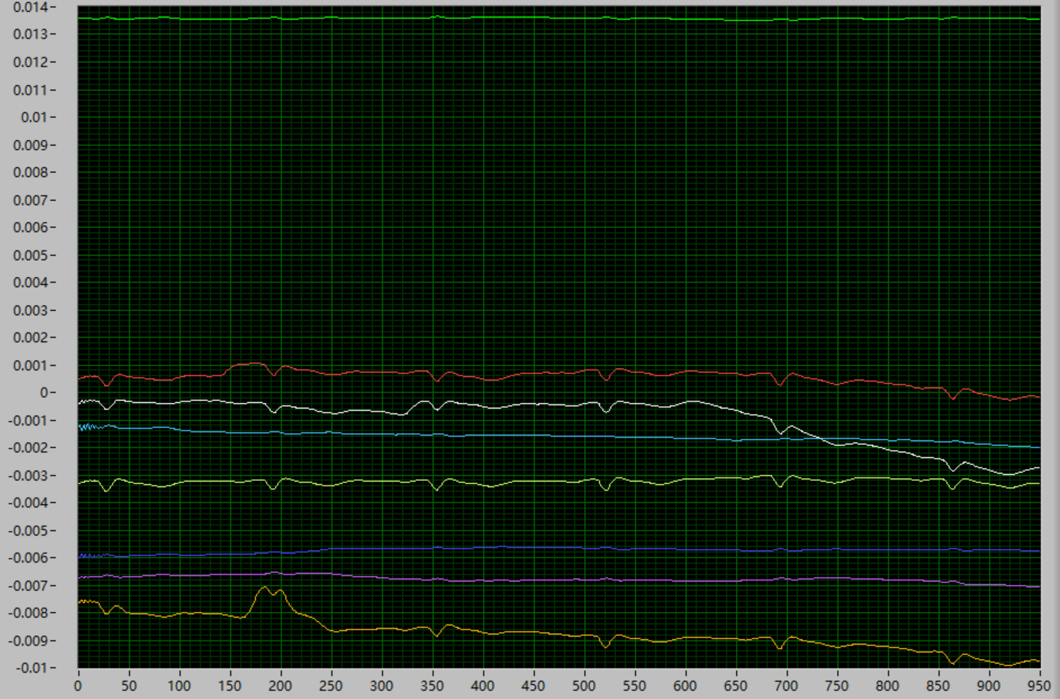
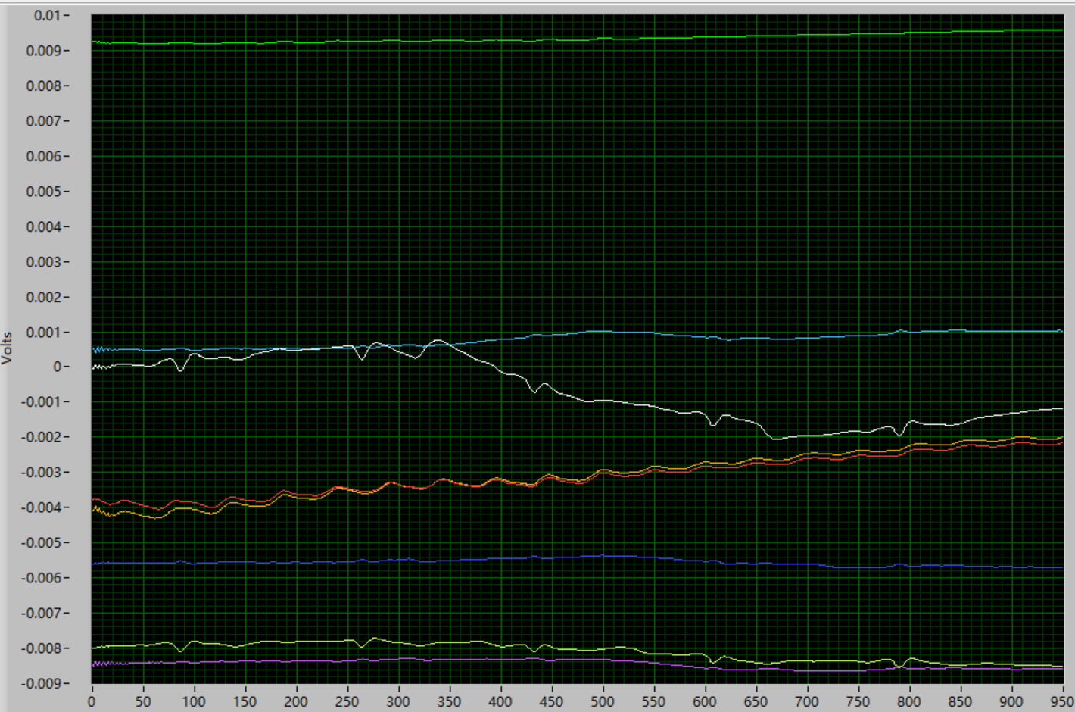
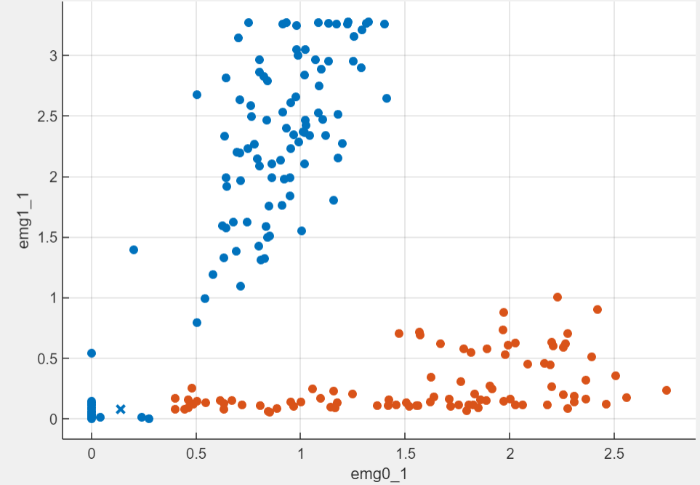
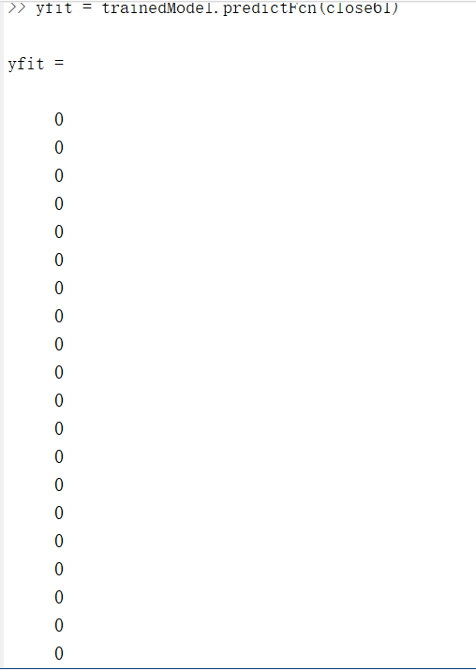
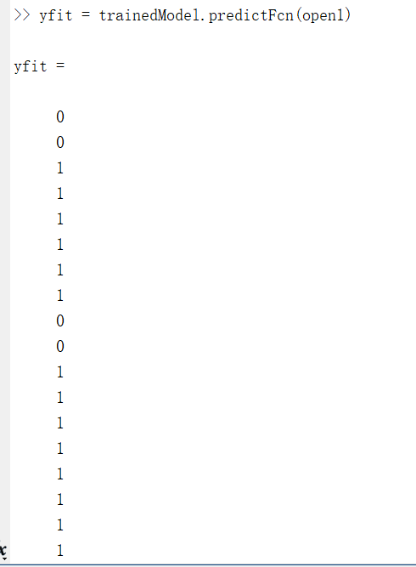
Gesture Recognition by Flexible Sensor Array
Jiawei Chen
Department of Electrical and Computer Engineering, University of New Hampshire
Introduction
Results and Problems
Discussion
Gesture Recognition: Computer to capture human gestures and recognize them.
EMG sensor: electromyography sensor used to measure small electrical signals generated by muscles
Goal: Using EMG sensor arrays and microcontrollers to collect signals from arms and make computer to realize data and recognize what the gesture is.
ADS1298:
Collecting ECG signals and form a graph as practice.
Too hard to write code to transfer data from ADS1298 to computer by using microcontroller.
ADS1299:
Has library, it’s much easier to write code.
The signal is not stable, the device is too sensitive
MyoWare Muscle Sensor:
It’s easy to use and the code used to transfer data is much easier to write. After the data was transferred to Matlab in the computer, there is an app called classification leaner. It can be used to train data. After get the trained model, the last step is give the model one input and let it to recognize what it is.
In this case, there are two gestures, one is opening hand—”1”, another is closing hand—”0”.
Blue points are “0”. Red points are “1”.
ADS1298: ECG graph is clear and good. Multiple channels can give high accuracy data. However, when I tried to use SPI communication to transfer data, the code is too hard for me.
(2021.11 -2021.12)
Methods
ADS1299: This device is really hard to understand how to connect EMG sensors. After long time researching, found the method, and the data measured is correct, but the data is not stable, It’s too sensitive that I cannot get correct EMG graph. (2022.1-2022.2)
Connect the device which used to deal with the front end of the signal. The device can collect data by connecting with EMG sensors. Then we add a microcontroller to our device to transfer data. At the end, we use our computer to train collected data and predict the output if we give other signal data of gestures.
ADS1298 and ADS1299
Pros: Multiple channels; more data; higher accuracy.
Cons: Not stable, too sensitive, have to add notch filters and Low or High Pass filters. They are too susceptible to external influences. The instrument operation connection is too complex.
MyoWare Muscle Sensor:
Pros: More stable, it’s easy to use.
Cons: One channels for one device; Lower accuracy.
Microcontroller:
ESP32
MyoWare Muscle Sensor: The hardest part is also coding. ESP32 supports WiFi to do the data transmission. Writing some code to program the esp32 and using WiFi to connect ESP32 to Matlab, then the Matlab can receive the data from sensors. (2022.3-2022.4)
Future Work
As the topic of project said.
Adding sensor array: on the premise of ensuring the stability of data, using more channels to collect data to increase the accuracy.
Using Flexible printed circuit: in order to put more sensor in one device.
.

