Slide 1




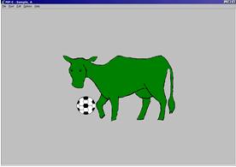
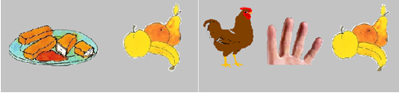
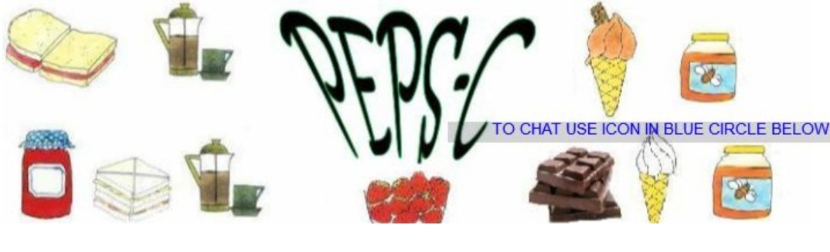
Assessing how adults produce and understand
the melody and rhythm of speech in English
Rachel Courter
Honors Thesis Advisor: Dr. Jill Thorson
Dept. of Communication Sciences and Disorders, CHHS
Communication, Acquisition, and Translational Studies Lab
Introduction
Methods
Discussion
Prosody is the melody and rhythm of speech which is vital in understanding language and diagnosing certain speech disorders ([1]).
Strong need for a clinical tool to analyze prosodic features as it is a principal factor in determining a delay or disorder ([2]).
Few prosodic assessments exist:
Prosody-Voice Screening Profile (PVSP)
Prosody Profile (PROP)
  PVSP & PROP: limited normative data & lack receptive analysis ([2], [4])
Profiling Elements of Prosody in Speech-Communication (PEPS-C)
  Assesses 7 prosodic abilities
  Understanding & expression tasks
  Populations studied: children and adults who are typically developing and those with ASD, Williams syndrome, SLI, and other communication difficulties ([5], [6]).
Study Aims
Aim 1: To examine the expressive and receptive prosodic abilities in adults when assessed by the PEPS-C.
  Hypothesis 1: PEPS-C will provide data concerning prosodic function and form and identify areas of difficulty.
Aim 2: To explore the effectiveness of the PEPS-C assessment when administered to a neurotypical adult population.
  Hypothesis 2: While the test claims that adults should score within a typical range, I hypothesize that specific tasks may lack ecological validity and show scores that are lower than actual ability level (e.g., lexical stress).
Participants
No current speech/language deficits
Native speakers of American English
18 + years of age
Normal or corrected-to-normal vision/hearing
23 participants (22 f, 1 m)
Procedure
Consent & demographic forms
Audiogram & vision screening
PEPS-C (v2015) administration
  Vocabulary & image check
  14 tasks (7 understanding, 7 expression)
Follow up survey to gather data about experience
Analysis
Automatically scored PEPS-C
Audio recorded for reliability testing and follow up acoustic analyses
All expression tasks spliced and labeled in Praat acoustic software
Importance of developing a prosodic assessment that best captures prosodic ability across domains.
Results from an adult population indicate that one area of focus for future adaptation may be lexical stress receptive and expressive tasks as they were significantly different in comparison to the performances of the phrase, boundary, and contrastive stress tasks.
Future Directions: Conduct acoustic analysis of expressive tasks.
Limitations: COVID-19 impact on data collection; potential administrator bias.
Broader Impact:
  Informs our understanding of how the PEPS-C could be used as a diagnostic tool for adults and children.
  Improvement of prosodic assessments for future diagnosis of specific speech or language differences.
Features | Definition
Speech Melody | Intonation (e.g., rising & falling pitch)
Phrasing | Creates units within spoken language
Rhythm | Timing, syllables, and stress
Tempo | Speed & rate of speech
Lexical Stress | Emphasis placed on a particular syllable
Affect | Emotion, like or dislike, sarcasm, irony
Example Receptive Tasks
bull’s eye
bullseye
‘bull’s eye’, the eye of a bull
‘bullseye’, the center of a target
Example Expression Tasks
Phrase Stress Task
Acknowledgements & References
Special thanks to my advisor, Dr. Jill Thorson, my committee member Dr. Don Robin, and the members of the CAT Lab at UNH for their help with preparation for this event.
IMprint (noun) or imPRINT (verb)
Prompt: The blue cow has the ball.
→ The GREEN cow has the ball
chicken fingers, and fruit vs. chicken, fingers, and fruit
[1] Thorson, J. C. (2019). Prosody. The SAGE Encyclopedia of Human Communication Sciences and Disorders, 1489–1491. [2] McSweeny, J. L., & Shriberg, L. D. (2001). Clinical research with the prosody-voice screening profile. Clinical Linguistics & Phonetics, 15(7), 505–528. [3] Terzi, A., Marinis, T., & Francis, K. (2016). The interface of syntax with pragmatics and prosody in children with autism spectrum disorders. Journal of Autism and Developmental Disorders, 46(8), 2692–2706. [4] Diehl, J. J., & Paul, R. (2009). The assessment and treatment of prosodic disorders and neurological theories of prosody. International Journal of Speech-Language Pathology, 11(4), 287–292. [5] Peppé, S., & McCann, J. (2003). Assessing intonation and prosody in children with atypical language development: The PEPS-C test and the revised version. Clinical Linguistics & Phonetics, 17(4–5), 345–354. [6] Wells, B., & Peppe, S. (2003). Intonation abilities of children with speech and language impairments. Journal of Speech, Language, and Hearing Research, 46(1), 5–20. [7] Peppé, S. (2015). PEPS-C: a test of prosodic ability. PEPS-C. http://www.peps-c.com/peps-c-2015.html
Lexical Stress Task
Contrastive Stress Task
Boundary Task - Receptive
Results
Independent Variables: Task (lexical stress, boundary, etc.) and Response (expressive or receptive)
Dependent Variable: Proportion correct
Two-way repeated measures ANOVA:
  Significant task by response interaction F(3,66) = 6.632, p = .001
Simple main effects for task & response:
  Understanding tasks were performed with significantly less accuracy in comparison to expression tasks
  Boundary tasks had the highest accuracy followed by contrastive, phrase, and then lexical stress
  All expressive comparisons were significant except phrase vs contrastive stress
  Lexical stress understanding showed significantly worse performance than expressive
  Lowest performing task was lexical stress understanding
*
Task:
Response:
Pairwise Comparisons: Expression | Mean Difference | p
Lexical vs Phrase | .000 95% CI [-.090 to .090] | 1
Lexical vs Boundary | -.092 95% CI [-.160 to -.025] | .004
Lexical vs Contrastive | -.068 95% CI [-.120 to -.016] | .006
Phrase vs Boundary | -.092 95% CI [-.167 to -.018] | .010
Phrase vs Contrastive | -.068 95% CI [-.167 to .031] | .350
Boundary vs Contrastive | .024 95% CI [-.026 to .075] | 1
Pairwise Comparisons: Understanding | Mean Difference | p
Lexical vs Phrase | -.114 95% CI [0.200 to -.028] | .005
Lexical vs Boundary | -.187 95% CI [-.270 to -.105] | .000
Lexical vs Contrastive | -.149 95% CI [-.227 to -.072] | .000
Phrase vs Boundary | -.073 95% CI [-.134 to -.012] | .012
Phrase vs Contrastive | -.035 95% CI [-.098 to .027] | .684
Boundary vs Contrastive | .038 95% CI [.008 to .068] | .007
Pairwise Comparison | Mean Difference | p
Lexical Understanding vs Expression | -.101 95% CI [-.155 to -.046] | .001
Phrase Understanding vs Expression | .014 95% CI [-.055 to .082] | .685
Boundary Understanding vs Expression | -.005 95% CI [-.023 to .013] | .539
Contrastive Understanding vs Expression | -.019 95% CI [-.062 to .024] | .374
PEPS-C Task of Interest | Example
Lexical Stress | REcord (noun) VS reCORD (verb)
Phrase Stress | bull's eye VS bullseye
Boundary | chocolate cake & milk VS chocolate, cake, & milk
Contrastive Stress | GREEN cow VS green COW
Notes:
of

