Slide 1

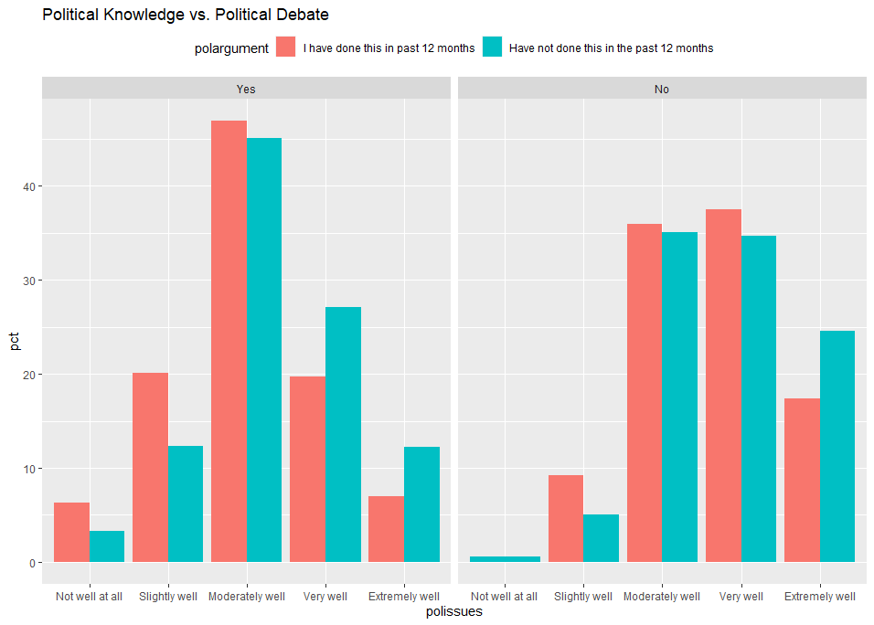
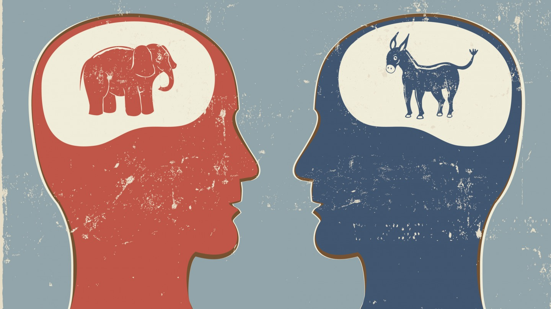

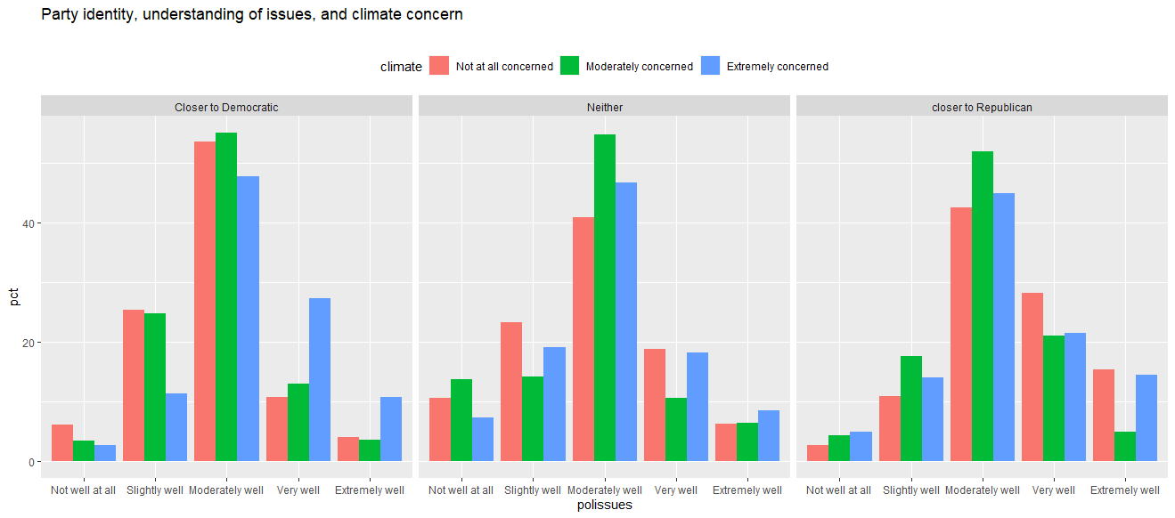
Political Polarization vs. Knowledge on Important Political Issues
By Steven MacDonald – POLT 595
Introduction
Sources and Methods
All Data was recorded from the 2020 American National Election Study. A random sample of people were taken regarding their knowledge on important political issues. This sample consisted of 7,418 respondents.
The data analysis was conducted in R Studio, a downloadable coding and programming software where one can obtain important data and graphics. In this project this graphic reflects people’s knowledge on important political issues ranging from those not concerned to extremely concerned. Respondents are then compared to whether they have gotten into a political argument/debate within the last year or not and where they fall based on their political knowledge. Other control variables were added to test the hypothesis including respondents' views on the issue of climate change.
In recent years, political polarization has become much of a prominent issue in the United States. Important political issues that people support or are against seem to be the main ingredient fueling this polarization. Political polarization, alludes to the fact that people are firm in their political beliefs and this tendency only increases overtime. Some believe that it is a bottom-up approach, meaning that it is the people themselves who have become politically polarized, and politicians want to appeal to their constituency and then on the other hand some believe that it is a top-bottom approach and politicians are the ones influencing the opinions of the public. While there are conflicting viewpoints on this matter most studies tend to believe it is more so the people who are very concerned about important political issues, such as climate change, abortion etc.
Variables Examined
Independent Variable: Important Political Issues
Dependent Variable: Political Polarization
Control Variable: Views on Climate Change, Degree of Closeness to a party, People who have attended political events, Participation in political debate
Hypothesis
In a comparison of individuals, people tend to be more politically polarized based on their level of knowledge on important political issues.
Sources and Methods
All Data was recorded from the 2020 American National Election Study. A random sample of people were taken regarding their knowledge on important political issues. This sample consisted of 7,418 respondents.
The data analysis was conducted in R Studio, a downloadable coding and programming software where one can obtain important data and graphics. In this project this graphic reflects people’s knowledge on important political issues ranging from those not concerned to extremely concerned. Respondents are then compared to whether they have gotten into a political argument/debate within the last year or not and where they fall based on their political knowledge. Other control variables were added to test the hypothesis including respondents' views on the issue of climate change.
Literary review
This research question has been explored by other academics who have studied the correlation between the most prominent political issues and political polarization. Karen Herne has observed that it seems to be a bottom-up approach where people outside of political elites are the ones who are within social proximity and frequently want to interact with people who think like them. People who also identify with a major party tend to hold more extreme views and that people with voluntary associations are more homogeneous with respect to social class, race ethnicity and religious orientation today than in the past (Herne)
In another perspective Jan-Willem Prooijen holds a different perspective in “The psychology of political polarization” believes it is a top-down approach whereas government officials frequently report suspicions of interference in national elections, fake news alternative facts and conspiracy theories that fuel political polarization. Three aspects that she mentions this led to is political extremism that promotes political polarization, populism (Ongoing struggle against ‘corrupt elites’ and ‘the noble people’ and political polarization in policy issues such as climate change not being a real threat vs. those who support regulation to decrease CO2 emissions
Conclusion
The results of this project can be interpreted in a variety of ways. Those with an extreme level of knowledge of important political issues are more polarized than those with not as well of knowledge for important political issues, but a higher rate of respondents seem to be more politically polarized who have a moderate level of knowledge. It seems as though political knowledge at a moderate level is consistently more polarized than those with an exceptional level, even when the control variables of political debate and views on climate change are introduced.
Bibliography
authors, A., Herne, K., Additional informationFundingThis work was supported by Academy of Finland (Grant no: 285167) Åbo Akademi University Foundation (Center of Excellence Funding)., N. A., & ReferencesAndersen, N. A. (2019, February 20). The influence of political knowledge on opinion polarization in citizen deliberation. Taylor & Francis. Retrieved April 7, 2022, from https://www.tandfonline.com/doi/full/10.1080/2474736X.2019.1702887
Prooijen, Jan-Willem van. The Psychology of Political Polarization. Routledge, 2021.

