Slide 1


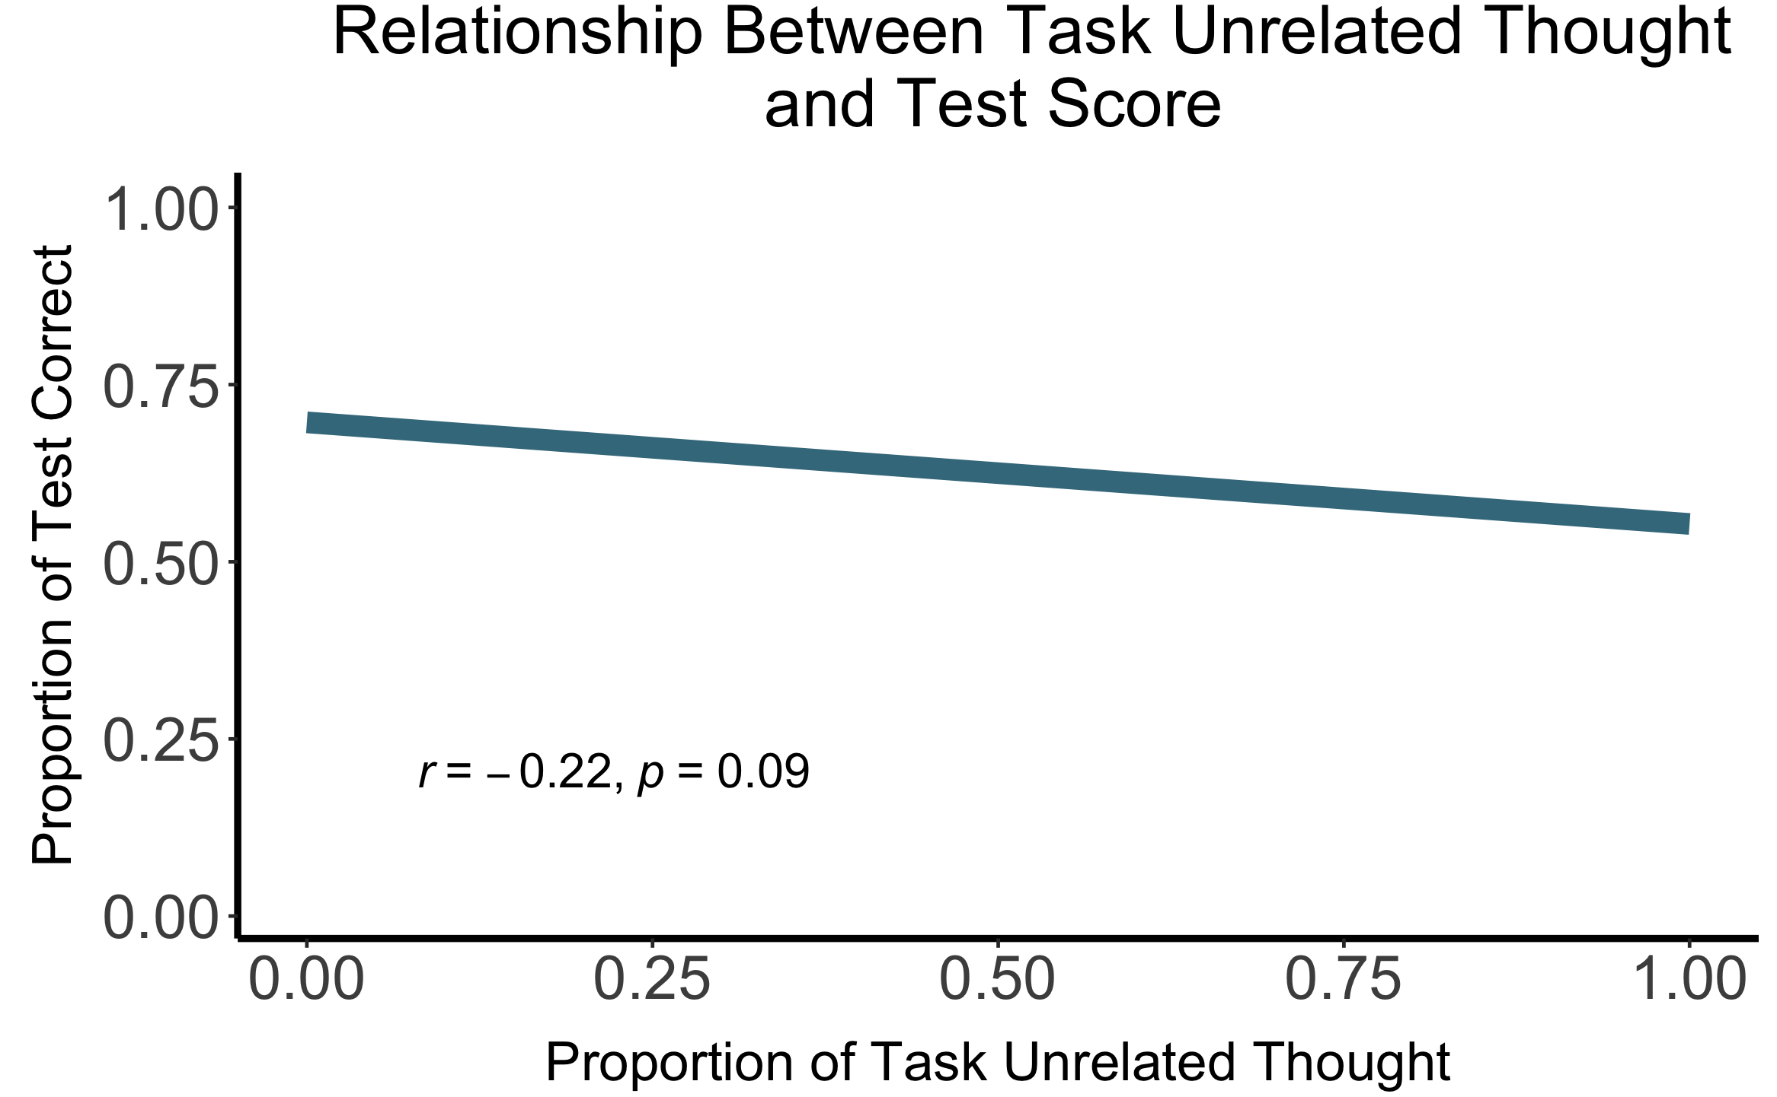
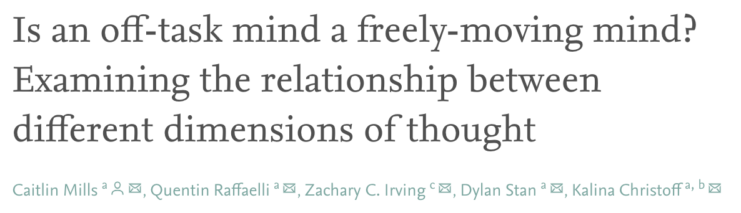
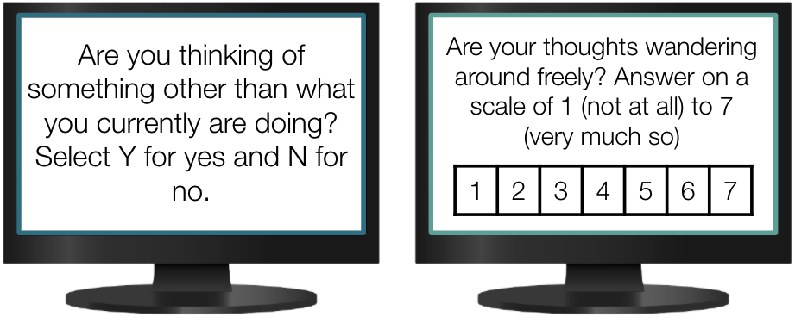
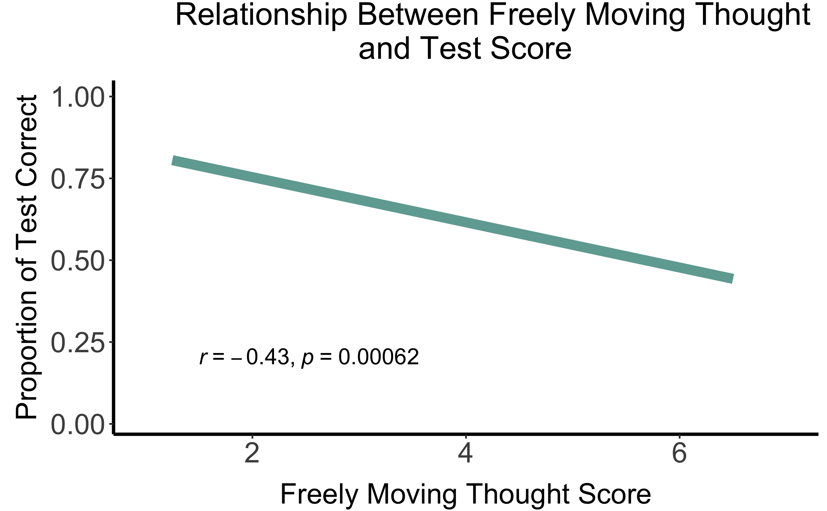
Freely Moving Thought’s Relationship with Testing Ability
William A. Bauer, Kaleb C. Ducharme, Alyssa S. Hall, Julia R. Priest,
Amanda L. Wittemann, Aaron Y. Wong, Shelby L. Smith, & Caitlin Mills
University of New Hampshire; Department of Psychology
Affect, Cognition and Computation Lab
Introduction
Results
Wong et al. (under review), found task unrelated thought is negatively related to learning outcome (r = -0.27)
Research Question
Does freely moving thought have a similar relationship?
Task Unrelated Thought (TUT): when thoughts shift away from one’s current task
Freely Moving Thought (FMT): occurs when spontaneous thoughts move freely from one thing to another
Methods
87 Participants
(M_{age} = 19.24; range: 18-25)
Read a text about life expectancy of humans
Probed 4 times about TUT and FMT during reading
Comprehension of text was assessed through an 8-question multiple choice test
Discussion
FMT explained 18.5% of variance with test performance and TUT explained 4.8% of variance
Majority of past and current research focuses on the relationship TUT has on comprehension
Finding a way to reduce FMT and TUT together could potentially help raise test performance
Notes:
TUT is related to performance
how are mind wandering and test comprehension related
-has been shown to be bad
explain FMT similar to TUT, is also worse?
why they matter
TUT- when thoughts shift away from one’s current task
FMT- occurs when spontaneous thoughts move freely from one thing to another
so this is typically what i use for FMT:
1:36
At the present moment, is your mind moving about freely?
Your thoughts move freely when:
• They seem to wander around, flowing from one thing to another
• There is no overarching purpose or direction to your thinking. Although there may still be some connection between one thought and the next
• Images and memories seem to spontaneously come into your mind
• Your attention lands spontaneously on things in your environment
• Your mind may spontaneously drift between things in the external environment and internal images so it may go back and forth.
• It feels like your thoughts could land on pretty much anything
• Your thoughts seem to flow with ease
Please indicate your answer below by circling a number between 1-7 (1 = Not at all; 7 = Very much).
1:38
This is from a paper I have for TUT: “Please rate whether your thoughts just before this message were on-task (1) or off-task (2). Indicate your answer using the keyboard (1 or 2).” A description of off-task thought was given for participants’ reference before the study began: “Your thoughts are off-task when 1) you are thinking about anything that is going on in your external environment, 2) you are focusing on internal things, like planning, memories, or imagining future events, or 3) you are focusing on any sensations in your body.”
Add to poster: FMT explained x % of variance and TUT explained x % of variance

