Slide 1
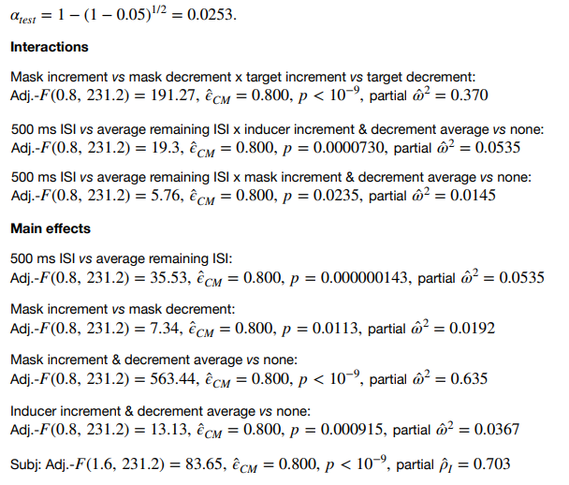
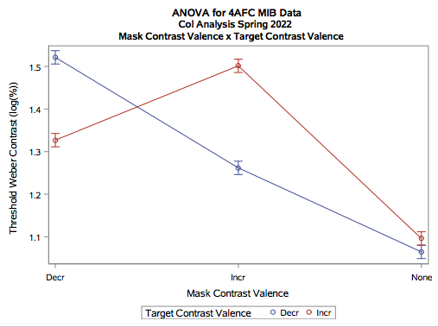
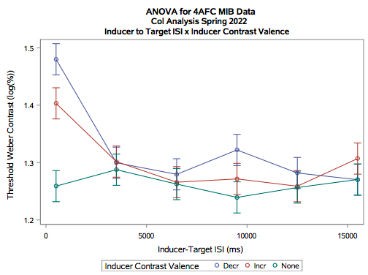
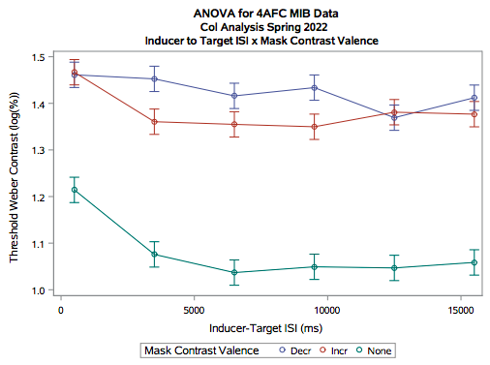
MOTION-INDUCED BLINDNESS USING INCREMENTS AND DECREMENTS OF LUMINANCE
Megan Kelley, Noah Ryder, Skye Tautkus
University of New Hampshire; Program in Neuroscience, Department of Psychology
Introduction
Results
Try to envision an imaginary square that takes its shape from four stationary dots. In the background, several small moving dots move quickly in random directions. After about four or five seconds, one or more of these dots will appear to vanish. Motion-induced blindness (M.I.B.) is a phenomenon in which stationary elements disappear when other elements of a scene are in motion. Increment and decrement targets and motion masks were presented on a gray background in this experiment. A weighted up-down method of adaptive testing was used in which each correct response leads to a decrease in signal level, allowing for objective measurement of contrast threshold during the occurrence of M.I.B.
Methods
Participants sat in a dark room with their head propped on a chin rest. They were directed to stare at a cross in the center of a yellow screen for 300 seconds so their eyes adjusted to the light. Four inducer dots then appeared around the center point and the mask began to move over the targeted areas. The inducers were extinguished and then the targets flashed at varying inter-stimulus intervals (ISI) at one of the four inducer locations with varying increment or decrement contrasts depending on the hit rates of the participant. Participants indicated the location of the target flashes.
Conclusions
The ON-OFF channel distinction, initially defined in the retina, impacts Motion Induced Blindness (MIB), which is largely controlled by higher cortical areas, since mask target contrast valence matching is more effective than when ON-OFF channels are not matched.
We are more sensitive to decrements than increments, as evidenced by decrement afterimages influencing thresholds more strongly than increment afterimages.
The weighted up-down method has objectively demonstrated that having a motion mask increases threshold for an individual to detect the target.
Threshold contrast for both decrements and increments were higher when mask and target contrast valences equaled one another than when they did not equal one another.
At 500 ms, the afterimage caused a higher threshold contrast for decrement than increment or no contrast valence. By 3.5 seconds, the afterimage was gone. Threshold contrast levels lowered significantly for both increments and decrements at longer ISIs.
At 500 ms, threshold contrast was substantially higher for increment and decrement masks, relative to when there was no mask. Increment mask threshold contrast slightly dropped by 3.5 seconds, yet stayed relatively constant, as did decrement mask threshold contrast. Increment and decrement threshold contrast remained significantly higher than when there is no mask at all ISI’s.

