Slide 1

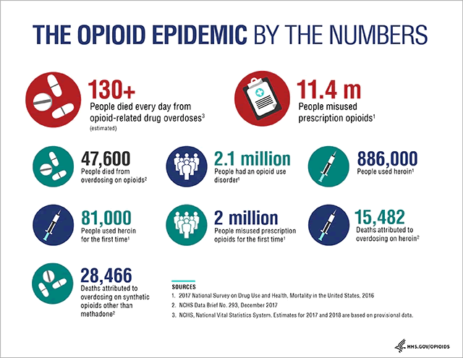
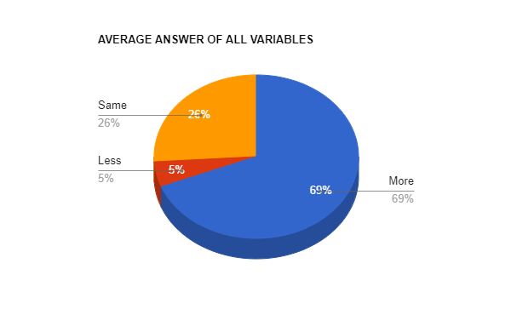
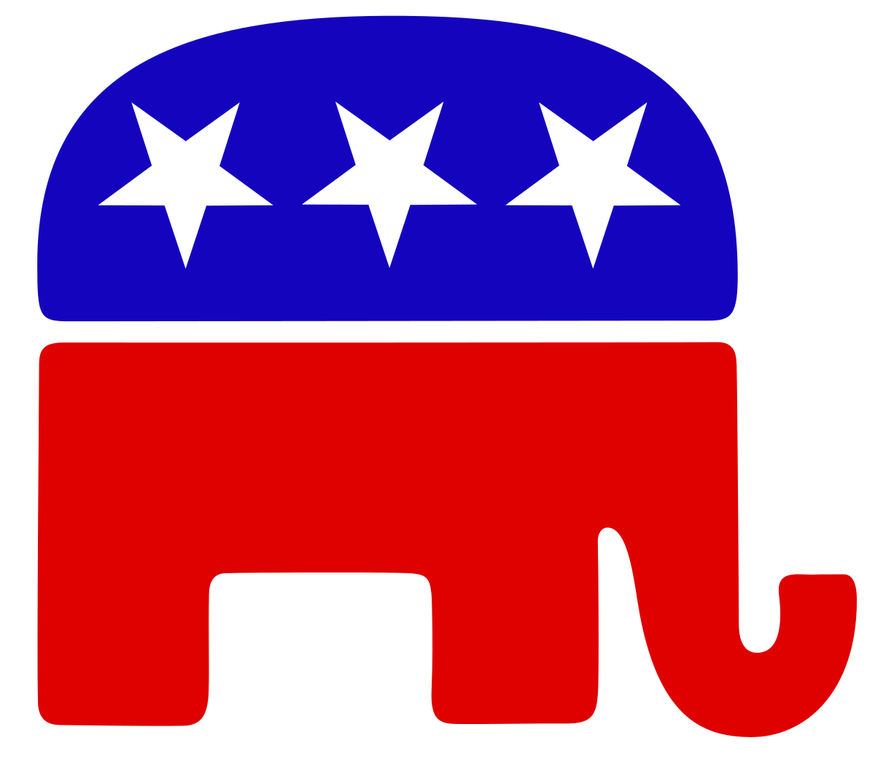

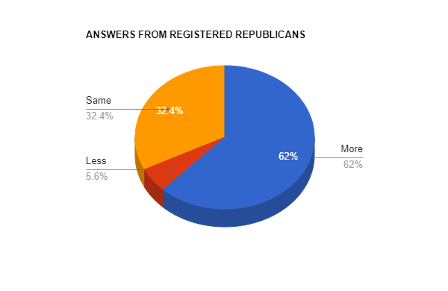
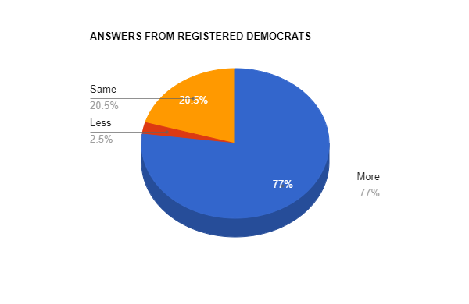
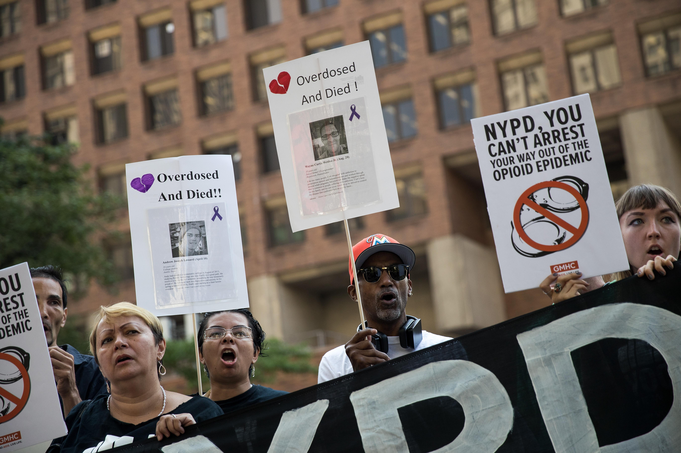
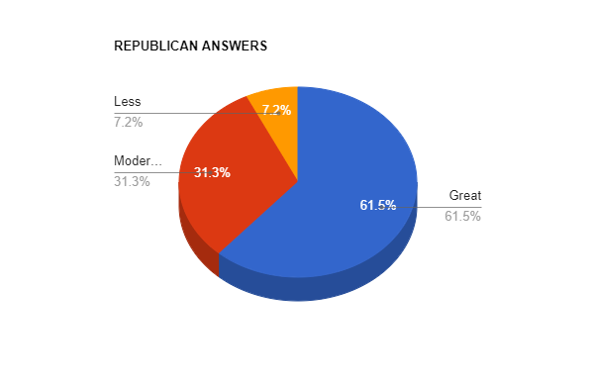
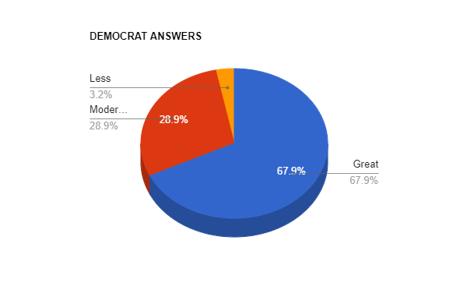
Www
Attitudes Towards the Government’s Role in Solving the Opioid Crisis
Nicklas Suga
Department of Political Science, University of New Hampshire
Results
Methods
Question Asked: Should the federal government do more or less about opioid drug addiction.
Variables Used:
1. Racial Identity, 2. Gender Identity, 3. Party Affiliation, 4. Highest Level of Education Attained, 5. Voter Registration Status
(The Question and the Variables were all taken from the ANES 2020 Dataset.)
Introduction
Overall as I was looking at the data a very clear pattern was emerging. Almost all the different groups had around the same amount of people saying the government should do more, less, or the same amount. Most of the groups would only deviate from the averages by 1-2%.
Opioid pain relievers are a type of pharmaceutical drug that has been found to have heavily addictive properties.
The addictive nature of opioids has led to them being misused both for those who they were prescribed to, and those who use non-pharmaceutical opioids such as heroin. Often the case being that those who can no longer afford the pharmaceutical version would use drugs such as heroin instead.
In 2017 the Opioid Crisis was officially declared to be a public health emergency by the HHS (Health and Human Services). The HHS also announced it’s 5-Point Strategy to Combat the Opioid Crisis.
The two most significant outliers were Republicans and Democrats.
Conclusion
Overall, my data analysis showed that people’s opinions on the government’s role in the opioid crisis are relatively uniform across different demographic groups.
The biggest differences came in the form of the two major political parties.
However, even those differences were relatively minor. It is clear the opioid crisis is understood to be a problem by many, and most people want the government to do more about it.
The question becomes, what should be done about it?
Differences Between the Parties
Literature Review
Republicans had the least amount of people saying that the government should do more about crisis. Which is understandable, given the small government slant of the republican party.
Conversely the democratic party often advocates for more government action so it is logical that registered democrats would support more intervention in this crisis.
Overall, racial minorities are disproportionately are experiencing the consequences of the opioid crisis.
People with disabilities and those who have not attained a higher education than a high school diploma also are disproportionately affected.
There are major differences in how different groups are perceived for having drug addictions. For example, historically drug use has been less stigmatized when white and upper-class people are the participants, as opposed to lower class and nonwhite people.
Differences Continued
Hypothesis
The differences between the parties became more apparent when I looked further. Even amongst those who answered “more” there were differences in the degree to which they wanted more to be done.
Republicans supported were more likely than Democrats to support moderate action as opposed to great action.
I hypothesized that in a comparison of groups those who were registered with the democratic party would be the most likely to support an increased government role in solving the opioid crisis than would any other of the groups I was measuring with.
Bibliography
https://www.hhs.gov/opioids/about-the-epidemic/index.html
https://unh.primo.exlibrisgroup.com/permalink/01USNH_UNH/1d2fkh4/cdi_proquest_journals_2499661958
https://unh.primo.exlibrisgroup.com/permalink/01USNH_UNH/1d2fkh4/cdi_proquest_miscellaneous_2341627231
https://unh.primo.exlibrisgroup.com/permalink/01USNH_UNH/1d2fkh4/cdi_webofscience_primary_000450355400006CitationCount

