Slide 1

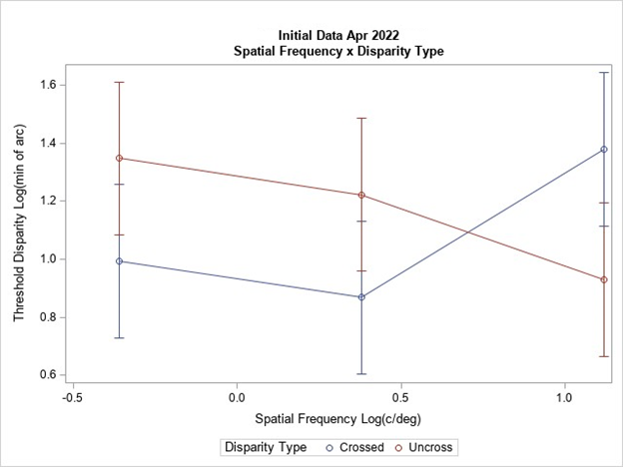
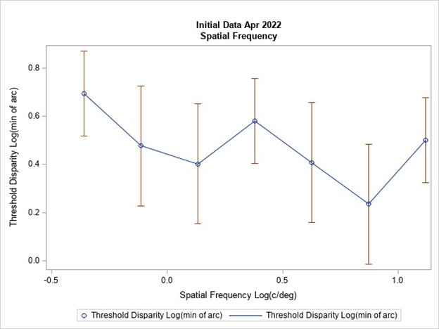
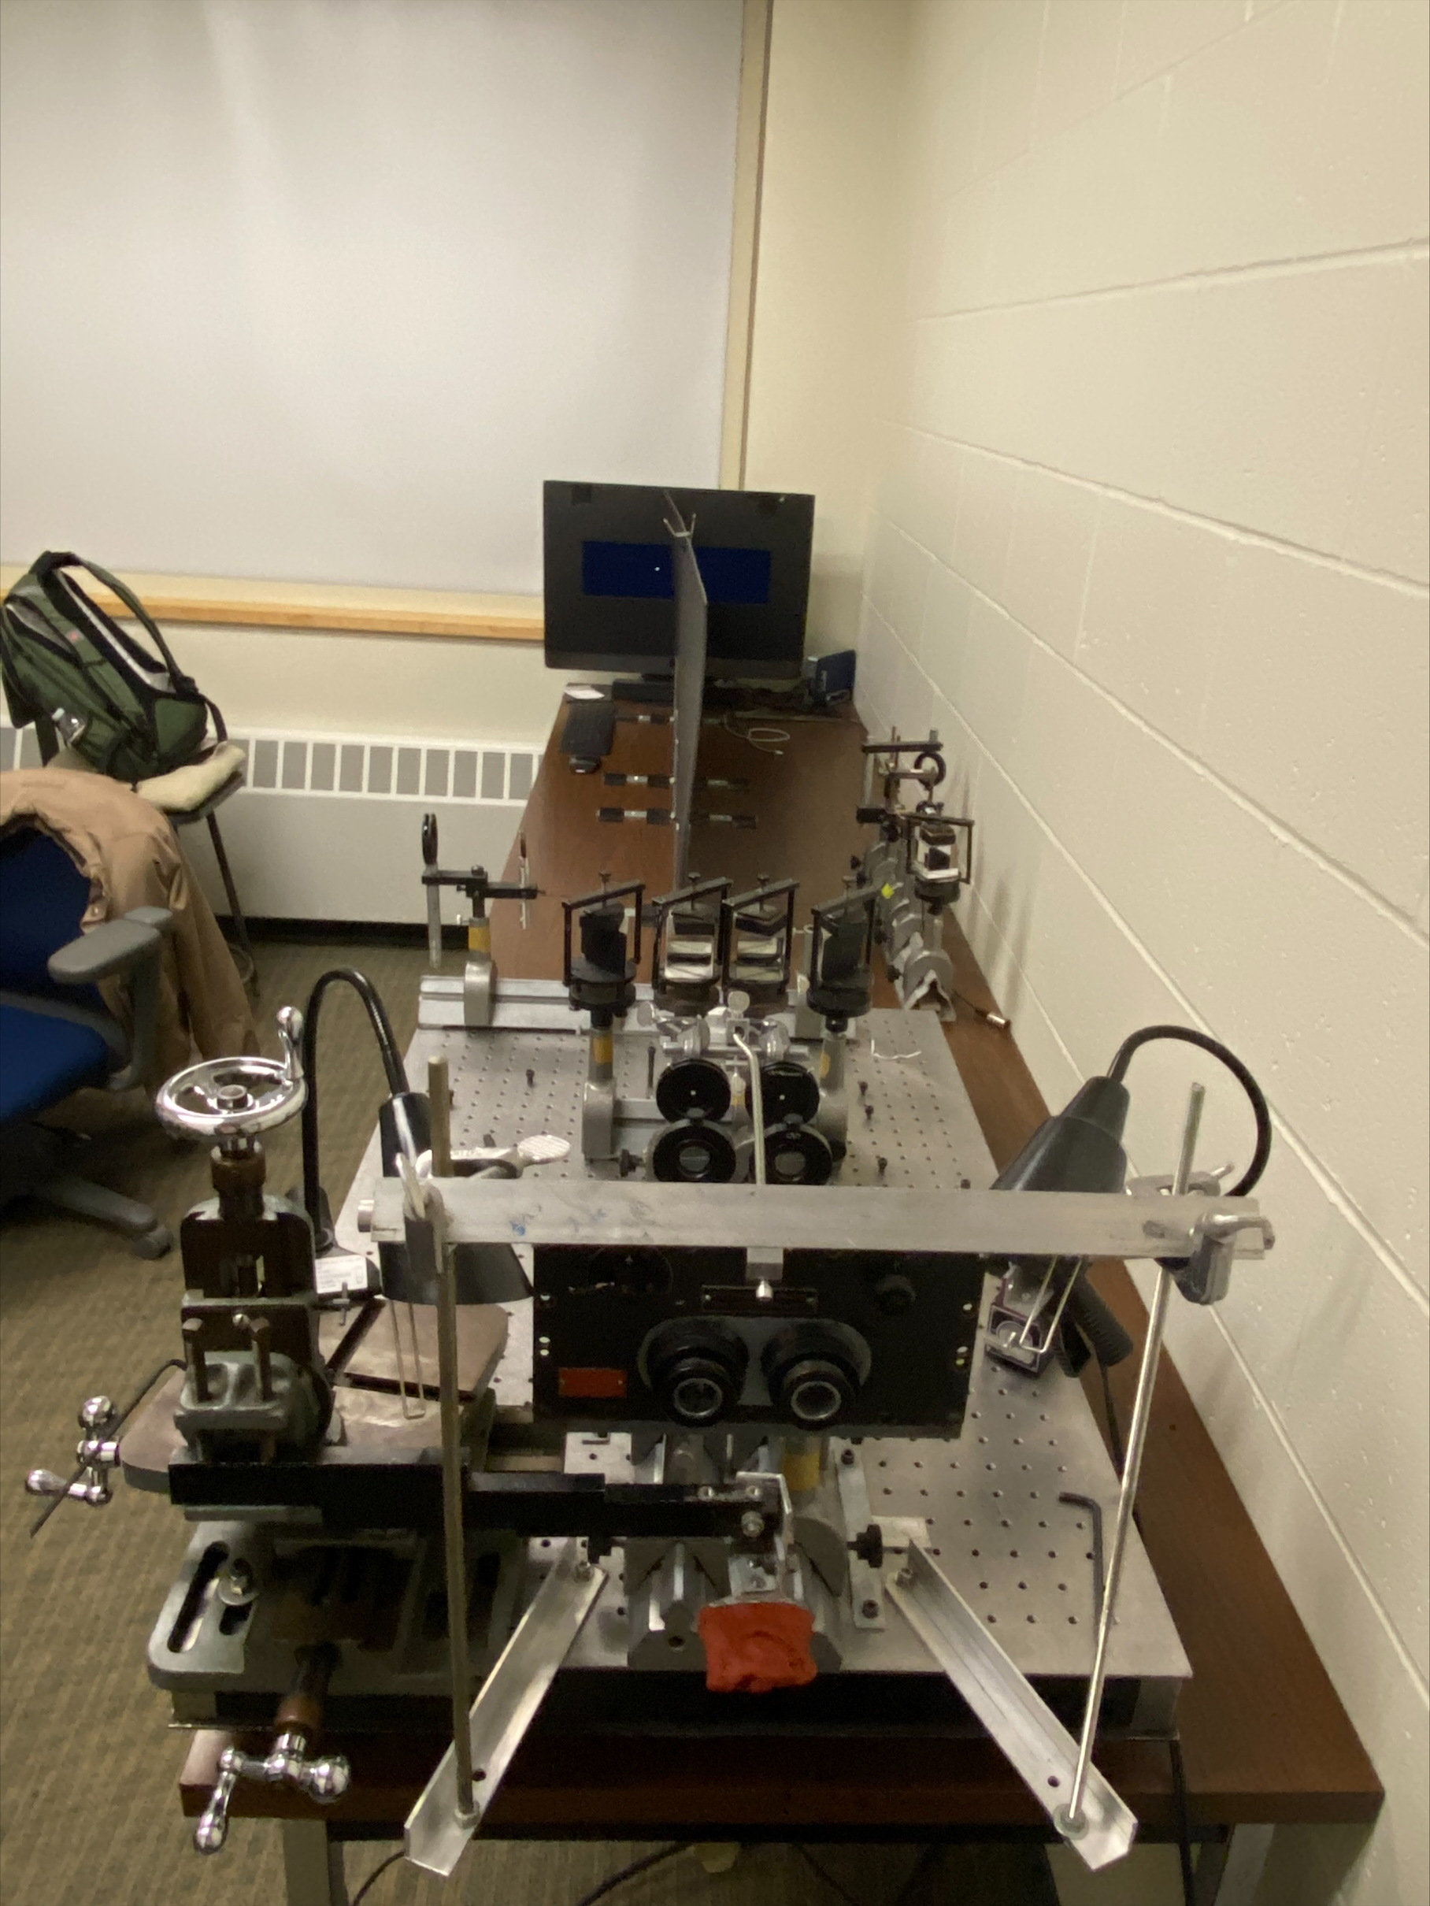
Spatial Frequency Effects on Stereo Acuity
Yifang Chang, Kaylyn Dickinson, Georgia Gempler, Emily Komerska, Andrew J. Kitt, and Wm Wren Stine
Psychology Department, University of New Hampshire, Durham, NH
Introduction
Previous studies indicate that spatial frequency affects stereo acuity. A study conducted by Schor and Wood in 1983 used Fechner’s Method of Adjustment to measure the effects of spatial frequency on stereo acuity, using stimuli generated from differences of Gaussians, presented on oscilloscopes. The resultant threshold curves could be used as a control from which to compare similar spatial frequency analysis of random dot stereograms if the Schor and Wood experiment can be replicated on equipment that can also display spatial frequency filtered stereograms. This experiment attempts to replicate Schor and Wood’s study using computer generated stimuli.
Results
Schor and Wood found that stereoacuity was peak and constant for spatial frequencies from about 19.2 c/deg to about 2.4 c/deg, with a steady decline for spatial frequencies below 2.4 c/deg, for both crossed and uncrossed conditions. Our data, however, fail to show this. The graphs shown range from .44 to 13.16 c/deg. Although the lines suggest patterns in means, the overlap in error bars suggest a tremendous amount of variability across all conditions.
Definitions
Method of Adjustment: A system of threshold detection in which the subject has direct control over the variable.
Difference of Gaussians: A mathematical profile in which a broad Gaussian is subtracted from a narrow one such that the resulting difference will create an overall luminance that matches the background luminance.
Spatial Frequency: How far apart repeating patterns appear to be, expressed in terms of cycles per degree of visual angle.
Weighted Up-Down: A system of threshold detection in which the direction of a variable’s adjustment is determined by the success or failure of the subject’s prior response.
Discussion
Although Schor and Wood’s 1983 results arose from a very small number of subject (N = 3), they have replicated well, with over 200 academic citations. Our failure to replicate suggests there exists a problem with our methods. Possibilities include: programming issues (improper calculations of stimuli or looping of stimulus progression), insufficient visual information for subjects to maintain the focal plane, methodology that doesn’t translate well to computers, or some other unknown or unforeseen aspect. Future development will require a more careful review of the methods used by others who have successfully replicated Schor and Wood’s results.
Methods
Alternating pairs of Differences of Gaussian-based stimuli of a range of spatial frequencies were presented randomly to subjects in both crossed and uncrossed conditions; one of the pair with disparity and one without. Subjects were asked to identify which stimuli had disparity (apparent depth), with disparity between presentations adjusted using a Weighted Up/Down algorithm.
Images created on Matlab were presented on an Apple Macintosh desktop computer through a Maxwellian view system. The two-alternative forced choice method utilized allowed for analysis through calculation of mean reversals to establish thresholds, and further, through probit analysis.
References
Kaernbach, C. “Simple adaptive testing with the weighted up-down method.” Perception & Psychophysics 49.3 (1991): 227-9
Schor, C. M., & Wood, I. "Disparity Range for Local Stereopsis as a Function of Luminance Spatial Frequency.” Vision Research 23.12 (1983): 1649-654
Notes:
E15JCY15- Psychology Department
-Stereoacuity: how good you are at stereopsis
-local stereopsis: DOG
-global stereopsis: RDS
-spatial frequency: light across spatial dimension, graphing amount of light across space
-creates black and white bars
-Maxwellian view system: controls amount of light entering the pupil and also aligns the subject (using bite bar)
-Method of constant stimuli: all possible permutations are presented randomly and data is statistically analyzed after
-Define crossed and uncrossed disparity

