Slide 1

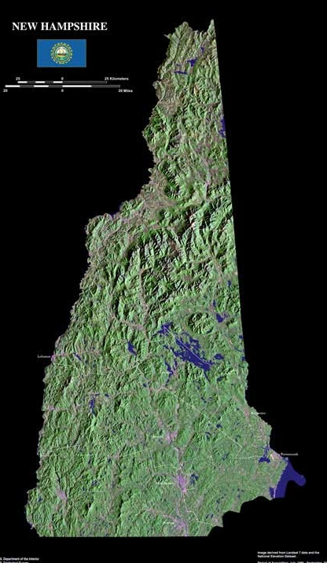
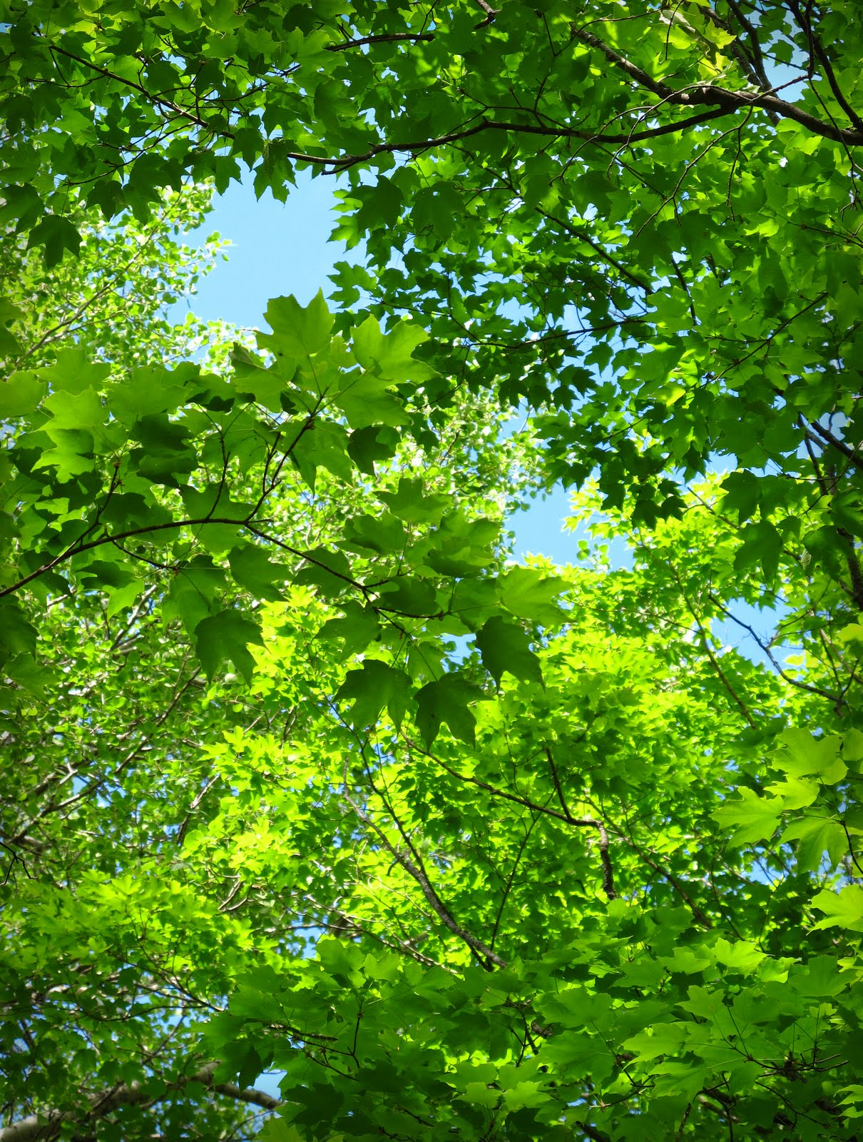
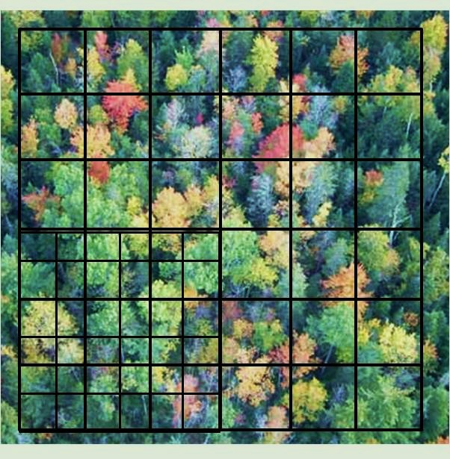
Economic but Effective: Camera Point Method Provides Robust Estimation of Leaf Area Index in Northern Forests
By: Paul Pellissier, Andrew Ouimette, Lucie Lepine
--Abstract--
--Results--
Leaf Area Index (LAI) is a central, but difficult to measure parameter crucial in the estimation of many ecosystem functions.
This study proposes a new method that has proven to be a better at estimating LAI in northern forests than existing methods.
--Methods--
Striving Towards Accurate LAI:
For each plot, LAI was calculated over the entire hectare by varying the number of camera points used in the calculation from 135 to 1230. The results are shown in figure 5. Here we see that as the sample size increases the variance around the mean LAI value decreases. Additionally, there seems to be an asymptotic relationship between the gained accuracy in LAI and the number of camera points necessary to produce this gain. This relationship suggests a threshold near 500 camera points past which estimate accuracy increases only slightly relative to the effort needed to affect this change. This threshold value may prove important in future applications of this technique.
Site Description:
This study was conducted at the Bartlett Experimental Forest, located within the White Mountain National Forest near Bartlett, New Hampshire (44⁰03’ N, 71⁰17’ W)(figure 3). The experimental forest was established in 1931 for the study of ecology and forest management practices.
Four, one hectare plots were established and selected to represent a gradient of species composition ranging from broad leafed deciduous to coniferous evergreen dominated stands. Stand age at all plots was between 75 and 100 years old.
--Introduction--
Bartlett Experimental Forest
What is Leaf Area Index?
Leaf Area Index (LAI) is the ratio of leaf area (m²) per unit ground area (m²). It can also be thought of the number of leaf layers above a horizontal ground surface, with zero representing bare ground. Due to the pivotal role that leaves play in the Earth system, LAI is a central, but difficult to measure parameter crucial in the estimation of many ecosystem functions. These functions include: gross primary production, evapotranspiration, microclimate, nutrient dynamics, herbivory/food webs, as well as many others (Asner et al., 2003) . The importance of obtaining accurate measurements of LAI is compounded when working at larger scales. In this light, the relative inability to accurately estimate LAI represents a weakness for many ecosystem and climate models.
The Camera Point Method:
Camera point method has proven to be a simple and reliable way to assess forest canopy height profiles (Aber ,1979; Smith and Martin, 2000) (figure 2). The method involves a standard SLR camera equipped with a telephoto lens and a gridded eyepiece. Mounting the camera on a
Figure 3: Site location within New Hampshire.
Field Survey:
tripod, the lens is pointed straight up and acts as a rangefinder, while the grid on the viewfinder serves as an optical quadrat. Focusing the lens on the leaf which is covered by each quadrat intersection, the observer is able to identify the species of leaf and the height above the lens mount at which the leaf resides (figure 1). Leaves that are sighted higher in the canopy are given more weight in analysis, due to the fact that they tend to be systematically obscured by lower leaves. The true value of this technique lies in the versatility of the data collected. While rather basic, the data produced from camera point surveys are useful in the estimation of a number of ecosystem parameters. Many of these parameters are otherwise difficult or costly to determine and therefore underrepresented in the literature.
At each plot a survey grid was established on a sixteen meter grid interval. One corner was further divided at eight meter intervals (figure 4). The sixteen meter interval
was chosen for use in remote sensing analysis (not shown). At each intersection within the survey grid a set of fifteen camera point observations were made, one for each intersection in the optical quadrat (figure 1). For each observation, location, species, and height of the leaf were recorded. Additionally, if the quadrat intersection (camera point) landed on a branch, trunk, or on open sky it was recorded as such. Using this sampling method produced a total of 1230 camera points per plot.
Figure 5: Normalized LAI values of four forested plots calculated with different numbers of camera points. Note the accuracy gained through the inclusion of more camera points.
In order to evaluate the effectiveness of this technique, LAI values produce by three additional methods (Li-COR’s LAI 2000,Hemispherical photography, and Litterfall estimation) were compared to those of camera point for each plot. Furthermore, the mean LAI and variance within of the existing methods was also calculated (table 1). For all plots studied, the camera point LAI was well within the variance of the excepted methods and more often then not, offered a better prediction the mean value than any of the existing methods.
Figure 1: A forest canopy as seen through the viewfinder.
Figure 4: Plot layout with 8m grid superimposed on the larger 16m grid.
Table 1: LAI method comparison between three professionally excepted methods and the camera point method. Mean and variance of the existing methods are also shown. Note that for all plots camera point LAI values are with the variance and in three of the four plots best predicts the excepted mean. * indicates values not included in mean and variance calculation.
Data Analysis:
Once collected the plot level data were binned by height, in two meter increments, and by species. An estimate of LAI and vertical distribution of foliage was then calculated according to the equation,
y=ln(N_{h1}/N_{h2})
where y is LAI, h is the region of the canopy involved (in this case between two heights h1 and h2) and N is the is number of camera points sighted above a respective height (Aber 1979). For example, if we were to measure the whole canopy, H1 would be zero and H2 would be the top of the canopy. N_{h1} would then be the number of camera points that surveyed a leaf and N_{h2} would be how many camera point hit open sky. Using the same logic, segmenting the canopy into intervals and calculating the LAI for each interval produces an estimate of the vertical distribution of foliage throughout the canopy.
The camera point method was previously thought to be a poor estimate of LAI due limitations inherent in the equation above. These limits include (1) the relationship that the sample size has with the total possible LAI, and (2) the assumption that leaves are randomly distributed in the horizontal direction. Limitation 1 can be dealt with by simply increasing the sample size to a number such that the maximum predictable LAI is greater than the actual LAI of the forest in question. Additionally, increasing the intensity of sampling is also likely to better represent non random patterns in leaf distribution such as also canopy gap fraction and leaf clumping.
Existing LAI Method’s Predictions
Plot | LAI-2000 | Hemiview | Litterfall | Mean | Variance | Camera Point
14Z | 4.90 | 2.63 | 1.62 | 3.05 | 2.82 | 3.09
B2 | 4.87 | 2.56 | 3.29 | 3.57 | 1.40 | 2.95
32AF | 4.07 | 1.79 | 3.46 | 3.11 | 1.39 | 2.99
32P | 10.9* | 2.48 | 3.41 | 2.95 | 0.43 | 2.66
Future Efforts:
As this was conducted as a pilot study, further efforts will concentrate on surveying more plots. These plots should include near monocultures of both broad and needle leaved species as well as highly mixed stands. Additional energy will also focus on the further development of the number of camera points to accuracy threshold value and overall method development.
Figure 2: An example of a canopy height profile produced from camera point sampling
References Cited:
Aber, John D. 1979. "A Method for estimating foliage-height profiles in broad-leaved forests." Journal Of Ecology 67, no. 1: 35.
Asner, Gregory P., Jonathan M. O. Scurlock, and Jeffrey A. Hicke. 2003. "Global synthesis of leaf area index observations: implications for ecological and remote sensing studies." Global Ecology & Biogeography 12, no. 3: 191-205.
Smith, Marie-Louise, and Mary E. Martin. 2001. "A plot-based method for rapid estimation of forest canopy chemistry."Canadian Journal Of Forest Research 31, no. 3: 549
Prepared for the 2012 University of New Hampshire Undergraduate Research Conference

