Slide 1



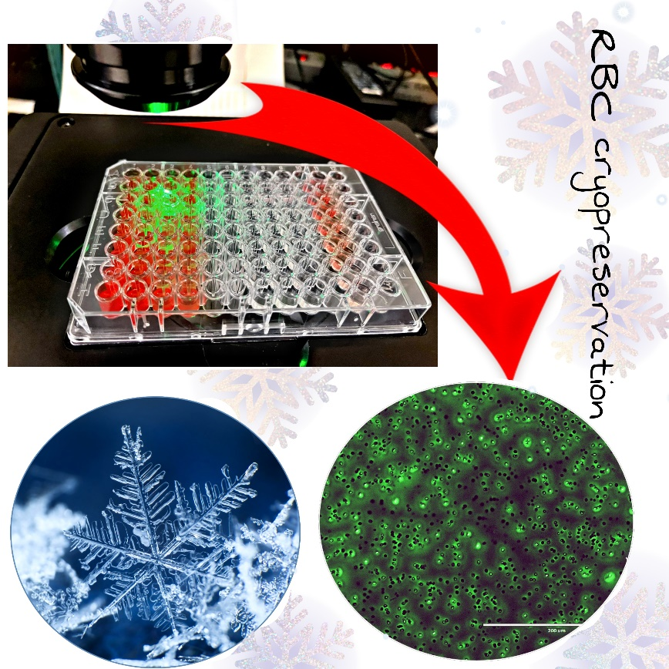
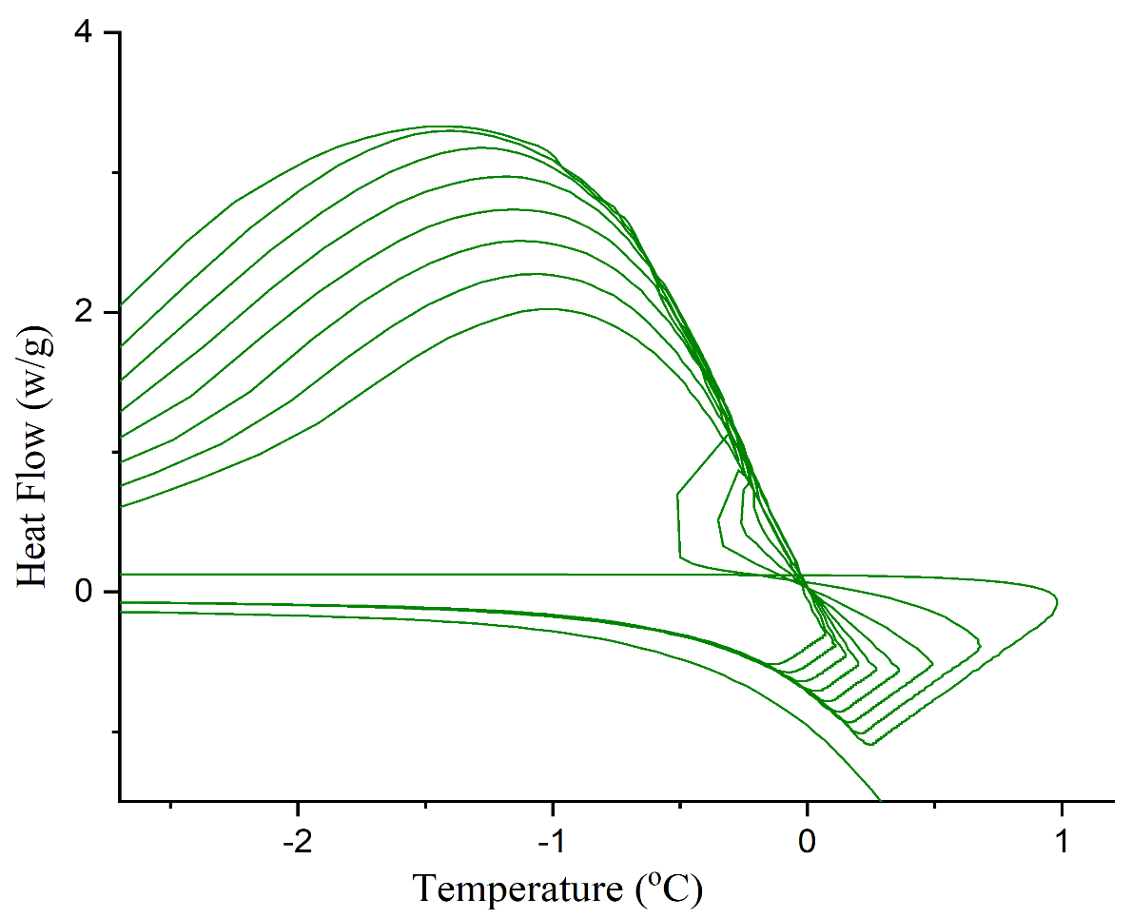
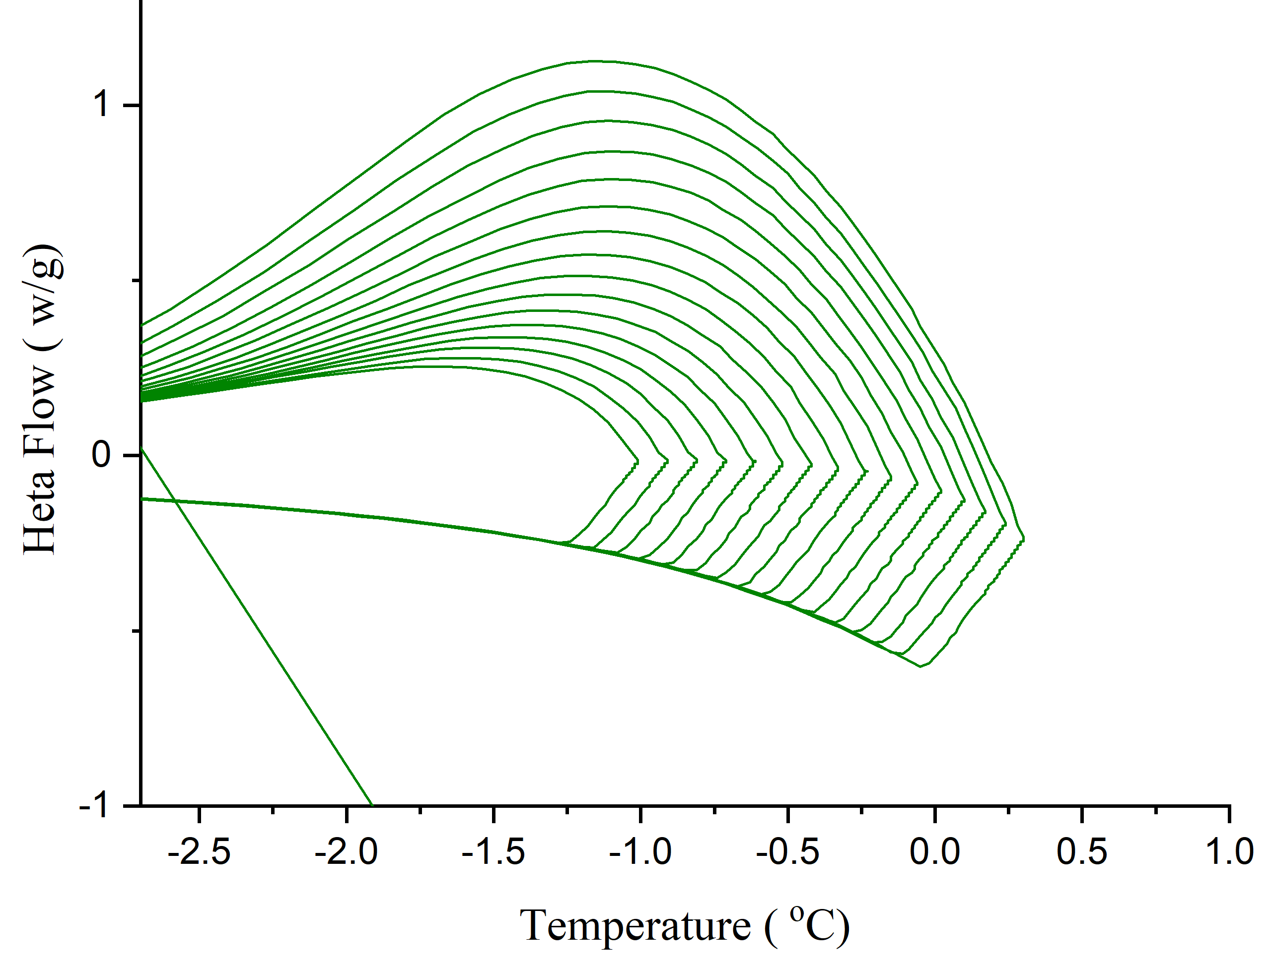
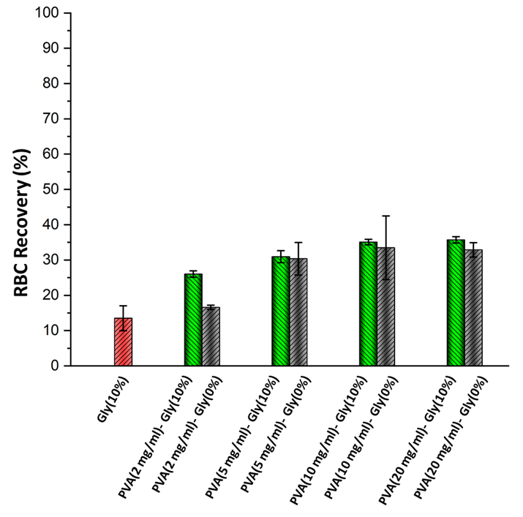
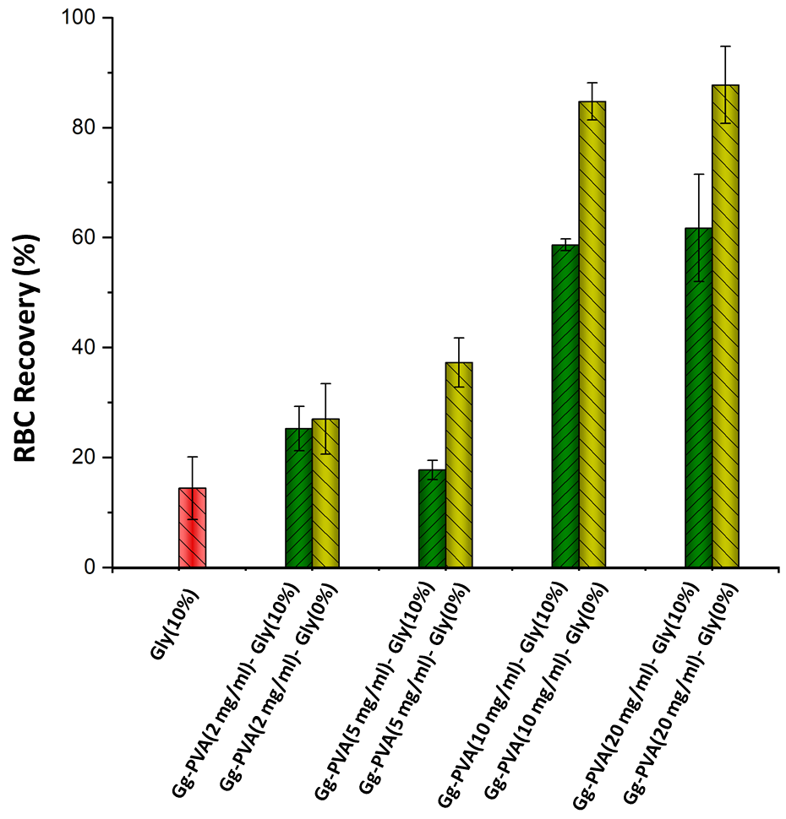

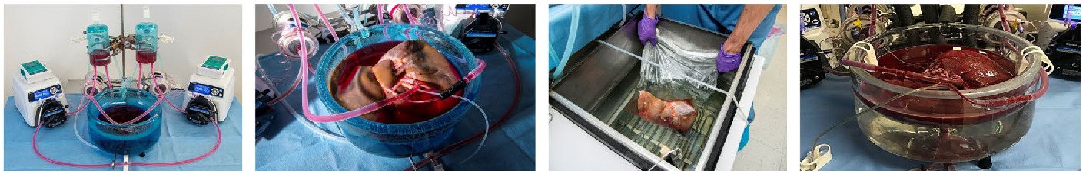
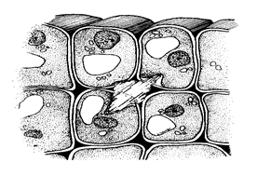
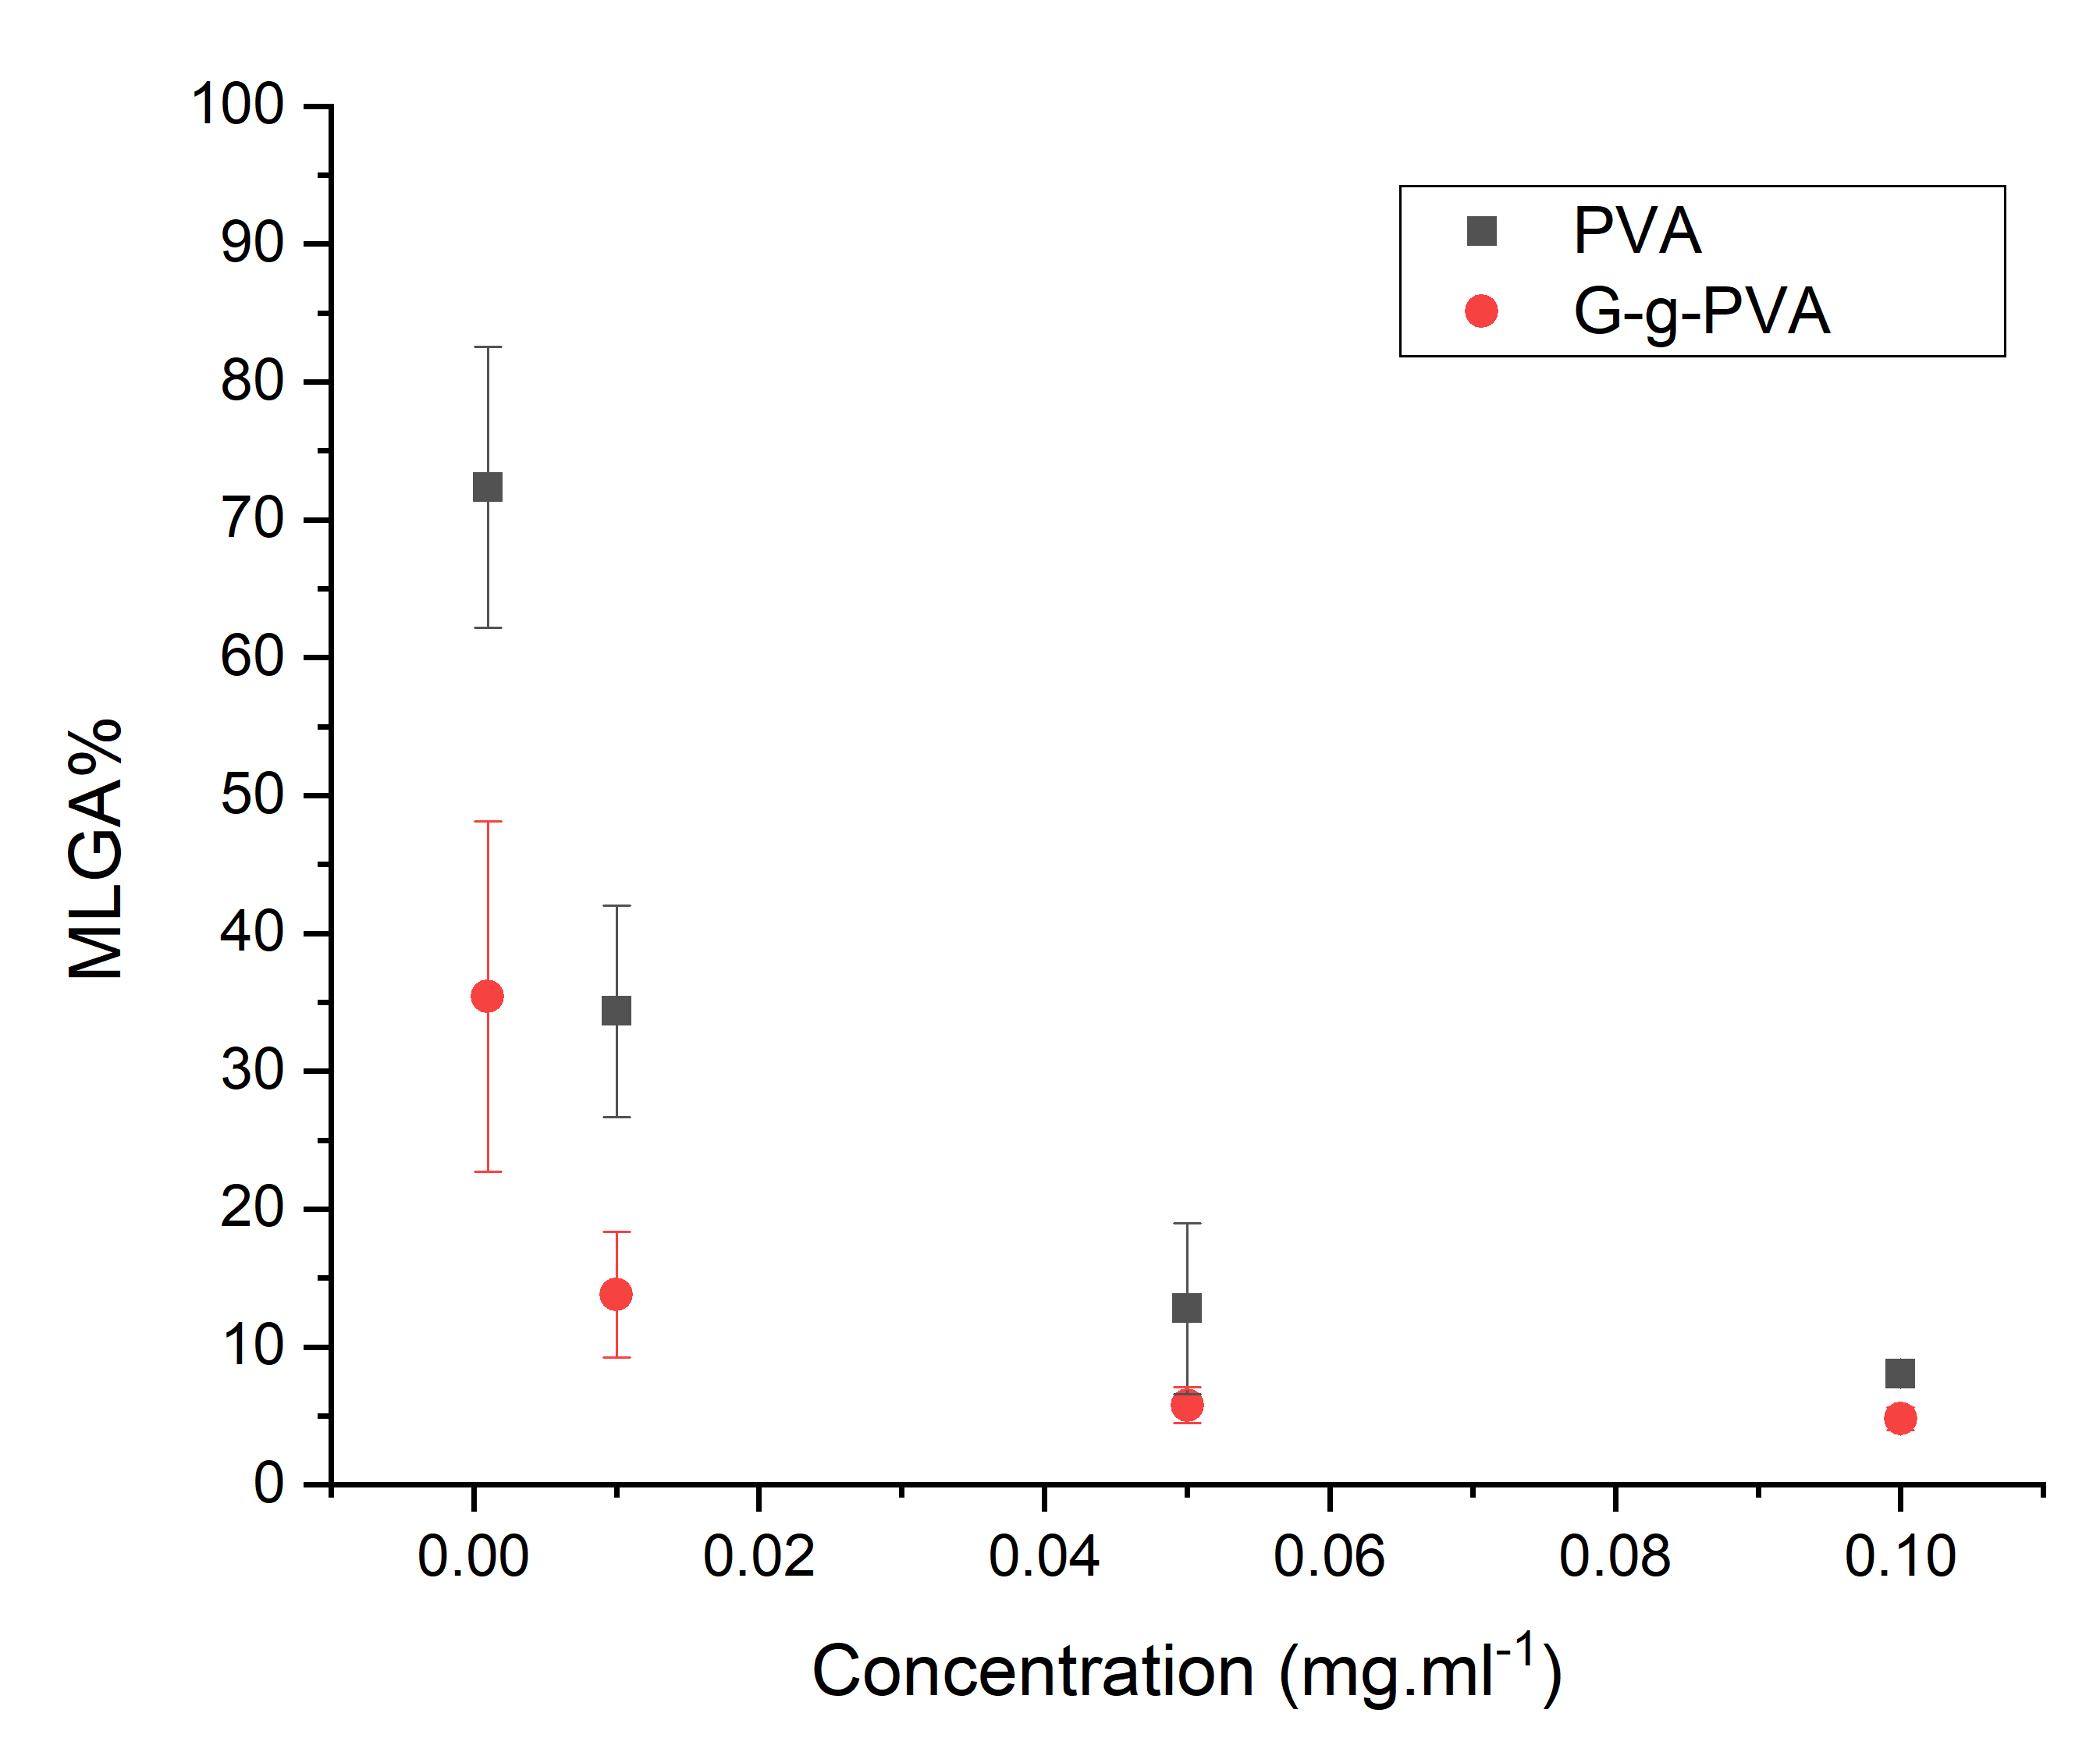
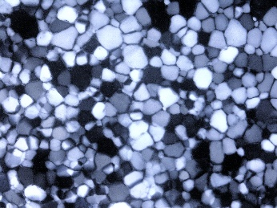
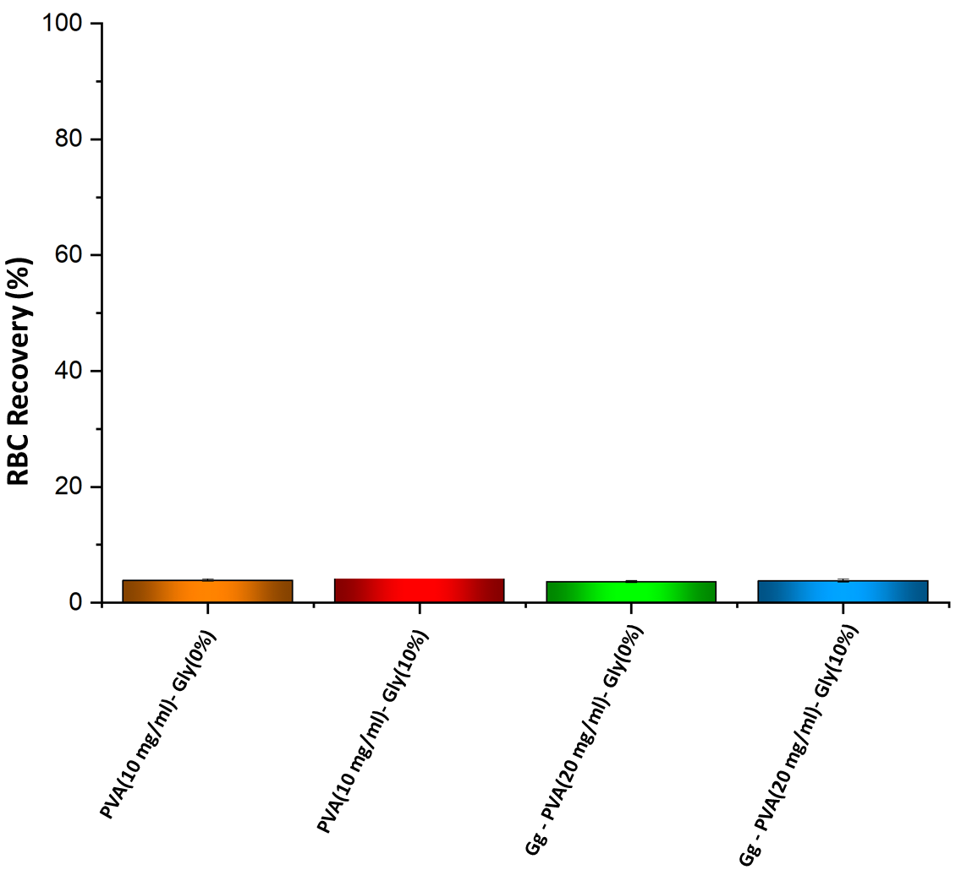
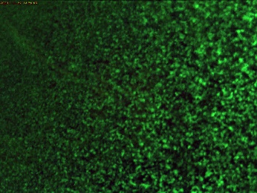
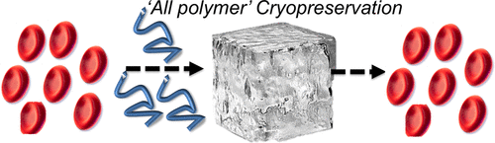
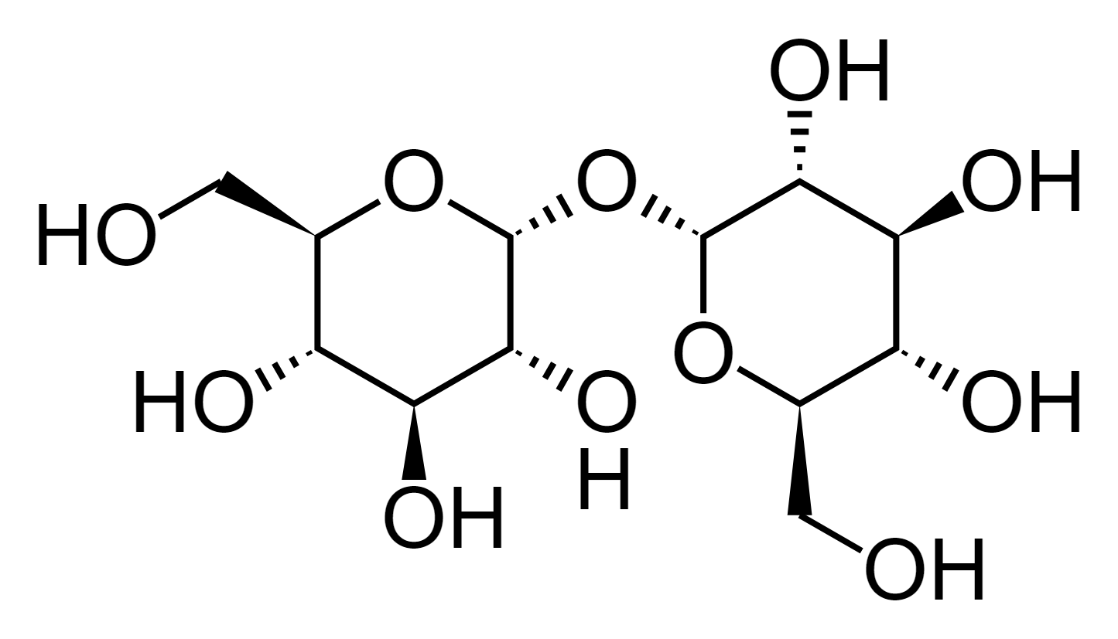
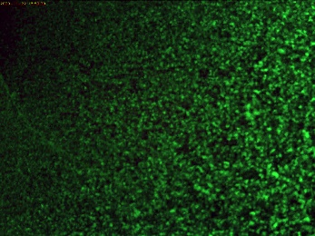
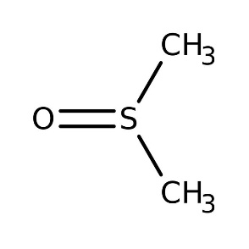
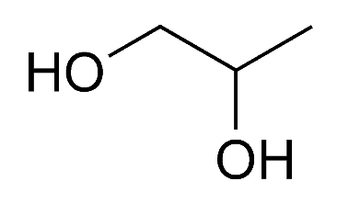
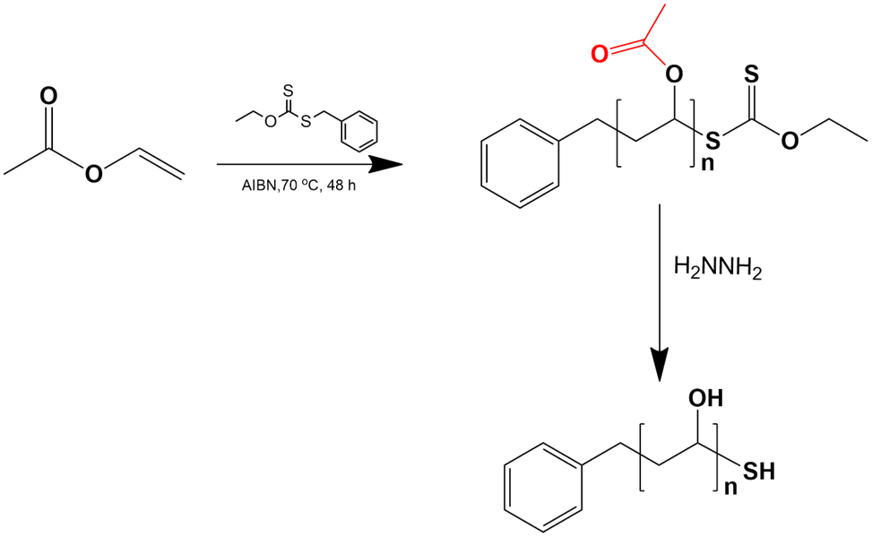
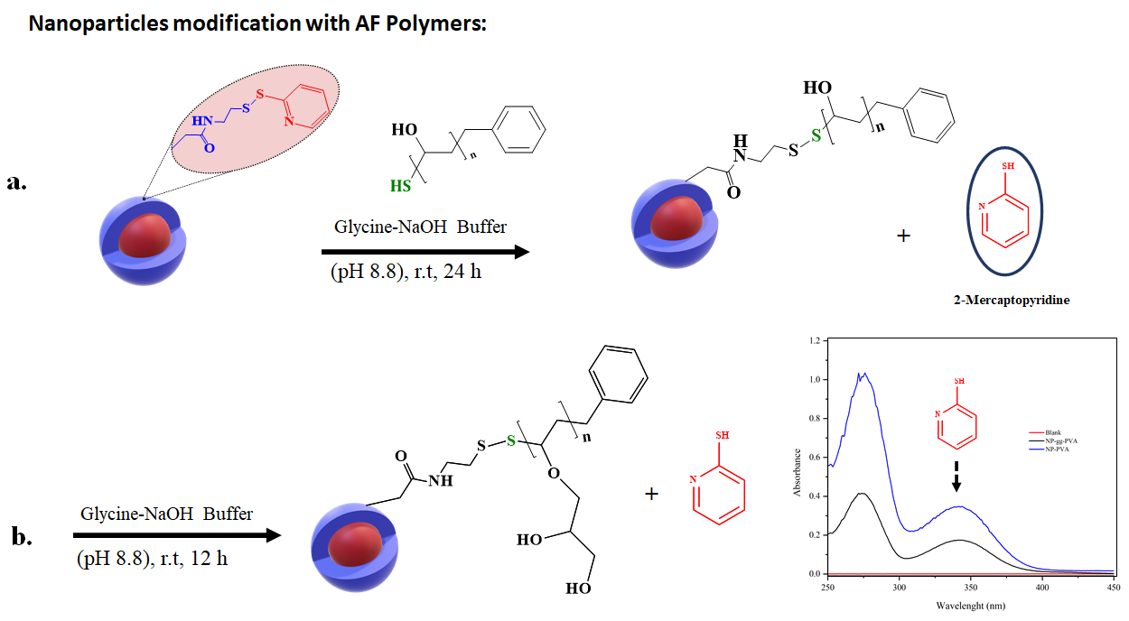
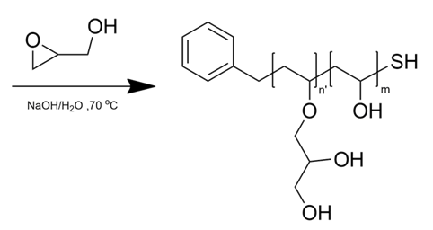
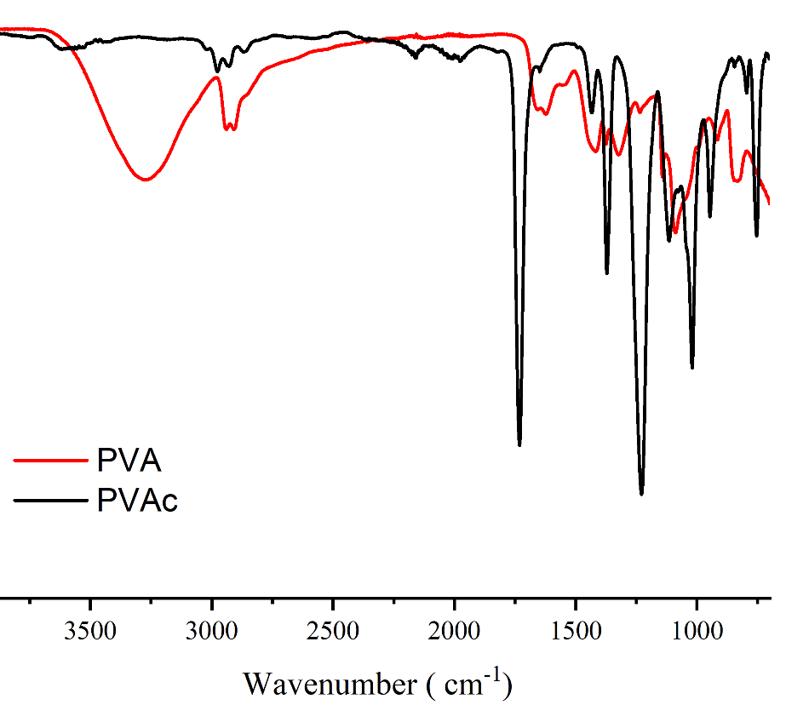
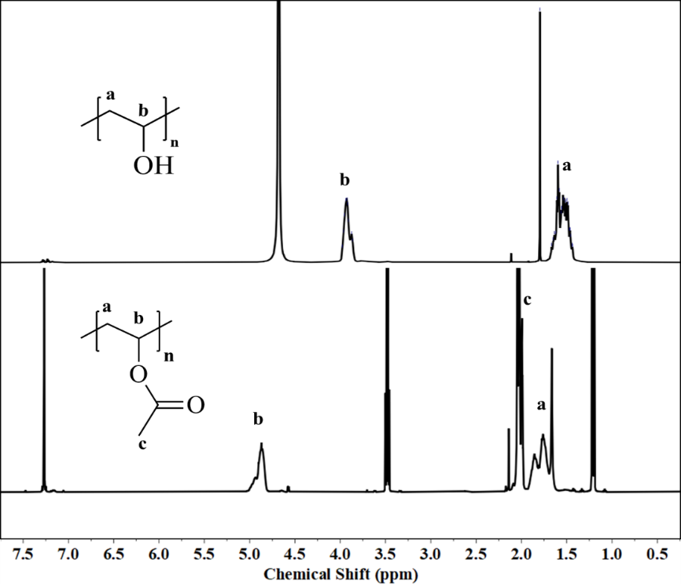
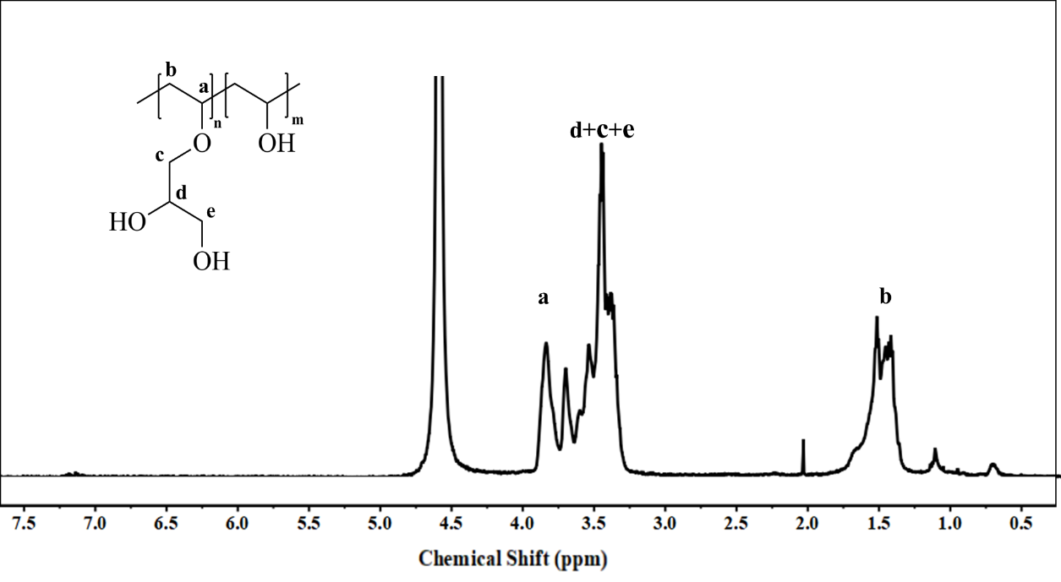
Cryopreservation of Red Blood Cells Assisted by Ice- Recrystallization-Inhibiting Polymers
Mohammad Mousazadehkasinª, Shannon Tessier^{b}, John Tsavalasª
Department of Chemistry, University of New Hampshire, Durham, NH 03824 - Center for Engineering in Medicine & Surgery at Massachusetts General Hospital
Introduction
Ice Recrystallization Inhibition (IRI), Thermal hysteresis (TH) & Cytocompatibility
BRC cryopreservation assisted by polymers
Current cryopreservation protocols for cells mostly rely on the addition of a high concentration of small molecules such as DMSO as cryoprotective agents (CPAs). Small cryoprotective agents at higher concentration are cytotoxic, do not protect against all mechanisms of cell death and they can bring higher cost to completely remove after thawing.
Polymers with ice recrystallization inhibition activity (IRI) have been found as a promising candidate to reduce the concentration needed of small cryoprotective agents¹.
Mechanical damage caused by ice crystal growth considered as one the most important reasons for RBC hemolysis. Cryopreservation of RBCs (1/20 DF) with 1 ºC/min cooling rate to -80 ºC
Splat assay instrument applied to determine IRI activity of the polymers. TH measured by DSC and Biocompatibility of the polymers on RBC (with and without glycerol) has been tested over 5 days incubation at 4 °C.
(21.2 KDa)
(32.1KDa)
THA = Th – To
THA = 1.17 ± 0.1
Cell/Organ preservation
PBS
t=0
t = 60 min
G-g-PVA (0.01 mg/ml) @-7 ºC
RBC recovery percent with PVA and PVA/Glycerol (right) with Gg-PVA and Gg-PVA/glycerol in PBS buffer.
(RBC Cryopreservation using antifreeze polymers)
(CPAs)
Polymer Synthesis and Characterization
Nanoparticles functionalized with antifreeze polymers
Next Steps
Poly(vinyl acetate) synthesized using RAFT polymerization followed by hydrolysis to obtain Poly(vinyl alcohol) (PVA). Gg-PVA was synthesized through post polymerization of PVA with Glycidol.
Colloidal nanoparticles surface functionalized with PVA and Gg-PVA structures to study dimensional variation impact on antifreeze activity.
Studying common small molecules as cryoprotective agents and its impact on IRI activity of antifreeze polymer.
RBC cryopreservation assisted by antifreeze polymer with optimized protocol.
Solvent free cryopreservation of Cells using PVA ,Gg-PVA and nanoparticles modified with antifreeze polymers.
References
Stubbs, Christopher, et al. "Combinatorial biomaterials discovery strategy to identify new macromolecular cryoprotectants." ACS Macro Letters 9.2 (2020): 290-294.
Hakim, Aaron, et al. "Crystal structure of an insect antifreeze protein and its implications for ice binding." Journal of Biological Chemistry 288.17 (2013): 12295-12304.
Mousazadehkasin, Mohammad, and John G. Tsavalas. "Insights into Design of Biomimetic Glycerol-Grafted Polyol-Based Polymers for Ice Nucleation/Recrystallization Inhibition and Thermal Hysteresis Activity." Biomacromolecules 21.11 (2020): 4626-4637.
Deller, Robert C., et al. "Glycerol-free cryopreservation of red blood cells enabled by ice-recrystallization-inhibiting polymers." ACS Biomaterials Science & Engineering 1.9 (2015): 789-794.
PVA
Gg-PVA
Acknowledgements
This research is supported by CIBBR through a grant from NIGMS (P20GM113131) at NIH.
Massachusetts General Hospital (MGH).
University of New Hampshire, Chemistry department.
Figure 12. General schematic representation of a 3D porous network manufactured from the directed assembly of pre-structured microparticles.

