Slide 1


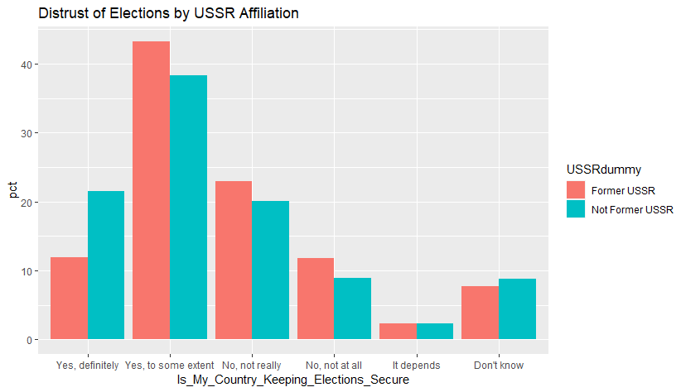

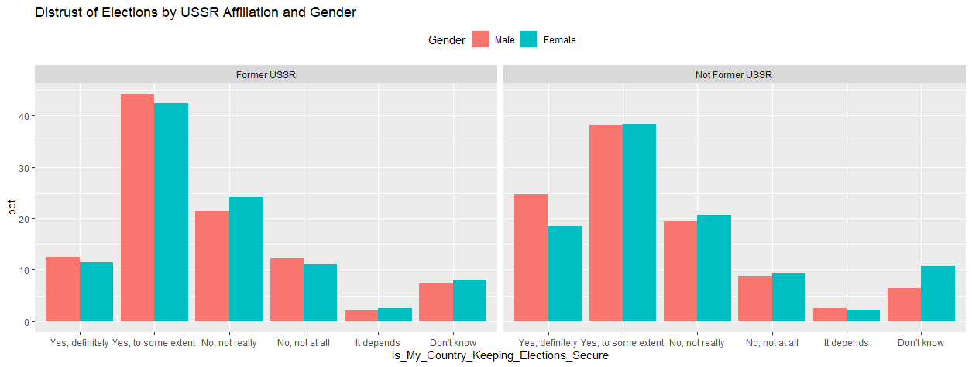
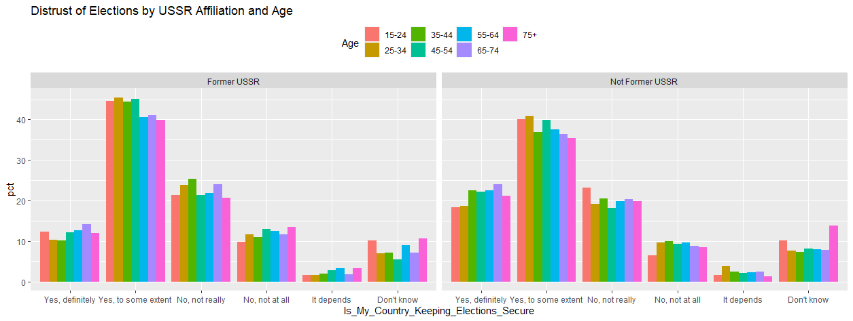
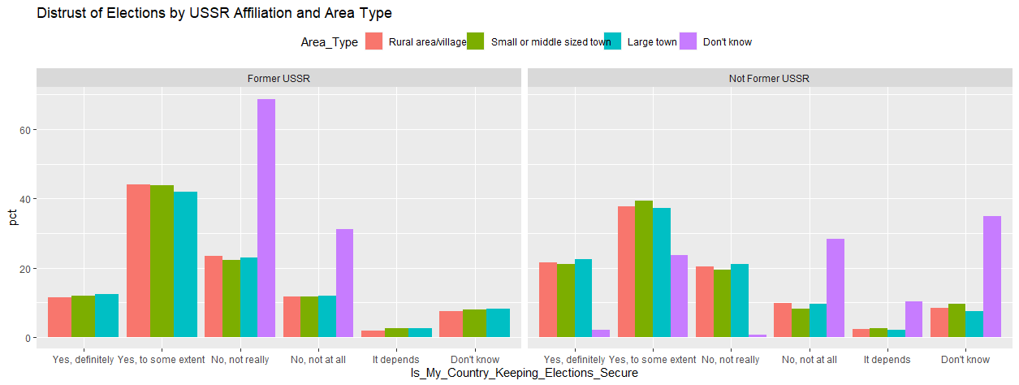
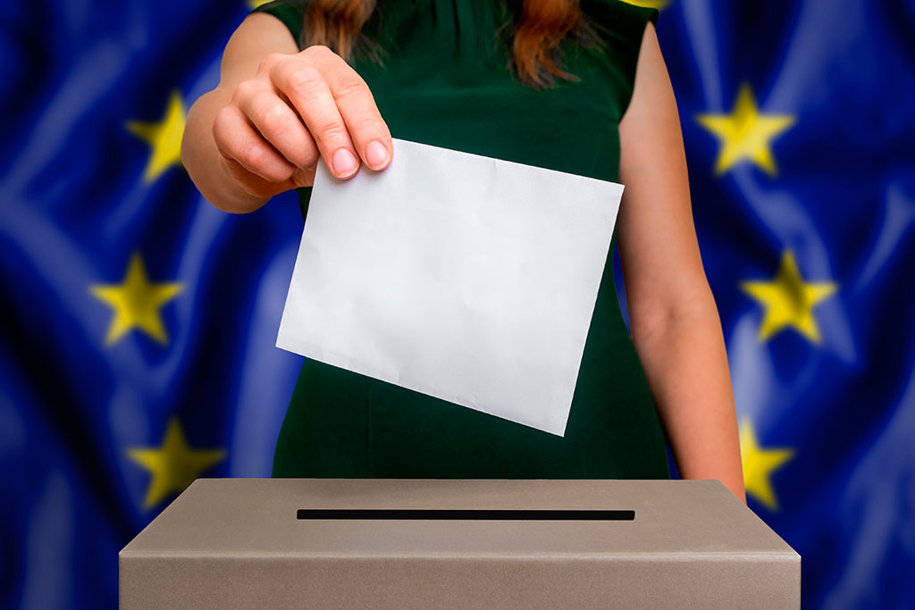
Losing Faith: European Distrust of National Election Processes
Adam Dapolite, Political Science and International Affairs Dual Major
Department of Political Science, University of New Hampshire
Introduction
Distrust in our elections has become a rising trend worldwide in recent years. From the assault on America's Capitol Building on January 6, 2021, to fears of interference in the upcoming Australian national election, distrust in election processes is taking place globally in both highly visible and concealed ways. This study focuses on European distrust in national elections and attempts to give reason to this issue.
Data Analysis
Sources and Methods
Data for this research was collected from the Eurobarometer dataset Democracy and Elections (2018). The data was then analyzed using RStudio, a free, open-source statistical computing and graphics program.
Variables
In this study, the Independent Variable was represented by the respondent's nationality, while the Dependent Variable was represented by the individual's distrust in their national elections. Control variables included age, gender, and type of area a person resides in (village, town, etc.)
Literature Review
In addition to examining data from Eurobarometer, this study also consulted works written by Matthias Benz and Alois Stutzer, David Fidler, Thomas Hale and Mathias Koenig-Archibugi, and Karol Zyczkowski. These authors are all in agreement with the fact that European's trust in their national elections has declined in recent years, most significantly after the 2016 American Presidential Election.
Conclusion
After an examination of the results, it is clear that my hypothesis was incorrect. Distrust of elections did not have a strong correlation with any of the other variables I controlled for. As a result, further research on this topic examining different variables than the ones present here is required to explain this complex phenomenon.
Hypothesis
In a comparison of European voting-aged individuals, those being from a nation that was formerly aligned with the Union of Soviet Socialist Republics (USSR) are more likely to distrust their national elections than those not being from a nation that was formerly aligned with the USSR.
References
Benz, Matthias, and Alois Stutzer. “Are Voters Better Informed When They Have a Larger Say in Politics?: ‘Evidence for the European Union and Switzerland.’” Public Choice, vol. 119, no. 1/2, Kluwer Academic Publishers, 2004, pp. 31–59, https://doi.org/10.1023/B:PUCH.0000024161.44798.ef.
Fidler, David P. Transforming Election Cybersecurity. Council on Foreign Relations, 2017, http://www.jstor.org/stable/resrep29928.
HALE, THOMAS, and MATHIAS KOENIG-ARCHIBUGI. “Are Europeans Ready for a More Democratic European Union? New Evidence on Preference Heterogeneity, Polarisation and Crosscuttingness.” European Journal of Political Research, vol. 55, no. 2, Blackwell Publishing Ltd, 2016, pp. 225–45, https://doi.org/10.1111/1475-6765.12136.
Zyczkowski, Karol. Institutional Design and Voting Power in the European Union. Routledge, 2011, https://doi.org/10.4324/9781315588841.

