Slide 1

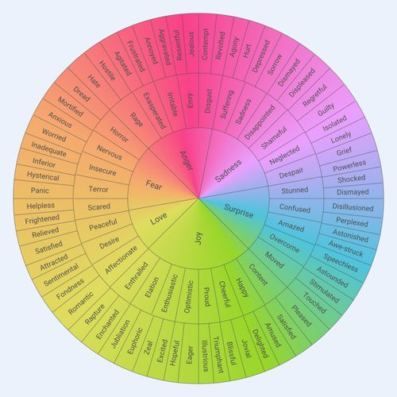
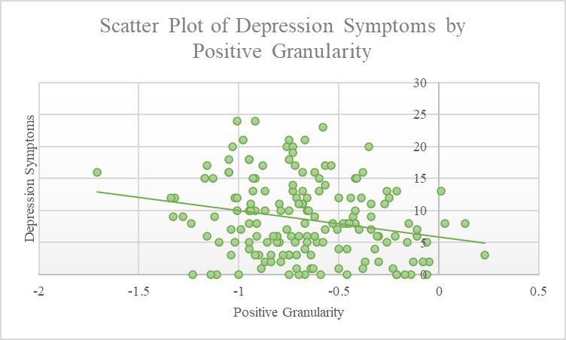
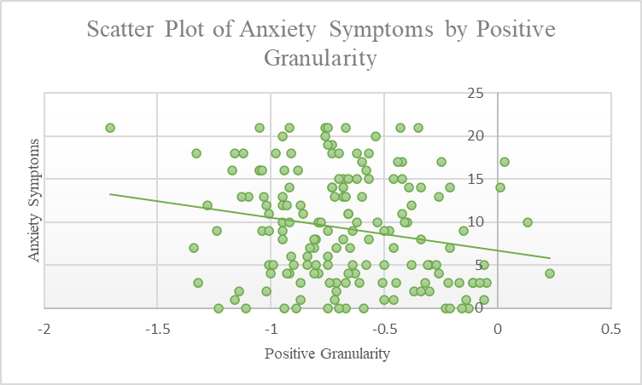
The Relationship Between Emotional Granularity and Mental Health
Hannah E. Sheets¹, Lindsey Broadhurst¹, Amir Robertson¹, & Kristen Petagna¹
University of New Hampshire¹
Introduction
Emotional granularity refers to the ability to make specific distinctions between similar emotions, and the ability to put one’s feelings into words with specific word choice¹
Individuals with lower emotional granularity may not differentiate similar emotions from one another (e.g., anxious v. worried) and generalize their emotions, while individuals higher in emotional granularity can distinguish between these terms¹
Lower levels of emotional granularity for negative emotions specifically have been shown to be related to higher levels of depression ²
Prediction: Lower levels of negative emotional granularity will be related to higher levels of depression and anxiety symptoms
Methods
Participants
      166 participants completed the study
  Mean Age = 19.24 (Std. Dev. = 1.79)
  98.3% people said English is their first language
  77% identified as women
  97% identified as White
Measures:
Emotional granularity:
    7-day experience sampling protocol
    Prompted 8x at random per day
    Report current experience of 16 emotion terms
    Emotional granularity was assessed using patterns of emotion term co-endorsement across experience sampling prompts (using intra-class correlation coefficients).
  Anxiety Symptom Severity: GAD-7³
    Participants were asked “Over the last two weeks, how often have you been bothered by the following problems?”
    Response options: “not at all” to “nearly every day”
    Sample Item: “Not being able to stop or control worrying”
  Depression Symptom Severity: PHQ-8⁴
    Participants were instructed: “Over the last 2 weeks, how often have you been bothered by any of the following problems?”
    Response items include: “not at all” to “nearly every day”
    Sample Item: “Feeling down, depressed, or hopeless”
Analysis
Correlations were used to assess the association between emotional granularity and anxiety and depression.
Results
  Results indicated a significant negative relationship between positive emotional granularity and depression symptoms (r (164) = -.228, p <.01).
  Results indicated a significant negative relationship between positive emotional granularity and anxiety symptoms (r (164) =
  -.203, p <.01).
  Results indicated no significant relationship between negative emotional granularity and depression and anxiety symptoms.
Discussion
These findings bring to attention the importance of emotion word differentiation and understanding, since better emotion differentiation may be a factor in limiting mental health disorder symptomology, such as anxiety and depression symptoms.
The brief length of the study did not provide enough time to show learning in emotional granularity and change in mental health status coinciding with said learning, but future studies could explore this.
Understanding the correlation between mental health disorders and emotional granularity could potentially be used to help treat individuals in therapy settings in the future, as well as predict predisposition for mental health symptoms.
References
Smidt, K. E., & Suvak, M. K. (2015). A brief, but nuanced, review of emotional granularity and emotion differentiation research. Current Opinion in Psychology, (3): 48 - 51. http://dx.doi.org/10.1016/j.copsyc.2015.02.007
Demiralp, E., Thompson, R. J., Mata, J., Jaeggi, S. M., Buschkeuhl, M., Barrett, L. F.,Ellsworth, P. C., Demirlap, M., Hernandez-Garcia, L., Deldin, P. J., Gotlib, I. H., & Jonides, J. (2012) Feeling blue or turquoise? Emotional differentiation in major depressive disorder, Association for Psychological Science, 23(11): 1410 - 1416. https://doi.org/10.1177/0956797612444903
Spitzer, R.L., Kroenke, K., Williams, J.B., et al. (2014). A brief measure for assessing generalized anxiety disorder: the GAD-7. Arch Intern Med , 166:1092–1097. https://doi.org/10.1093/occmed/kqt161
Kroenke, K., Strine, T.W., Spitzer, R.L., Williams, J.B., Berry, J.T., & Mokdad, A.H. (2008). The PHQ-8 as a measure of current depression in the general population. J Affect Disorder, 114(1-3):163-73. https://doi.org/10.1016/j.jad.2008.06.026.

