Slide 1
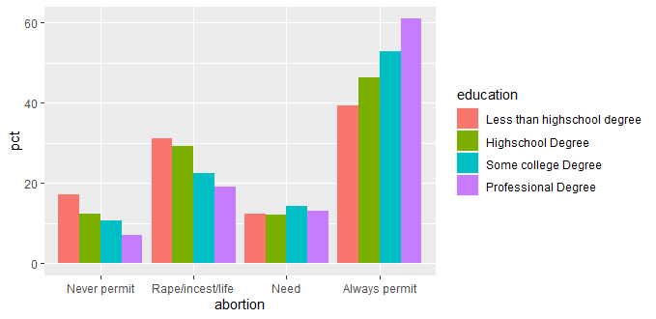

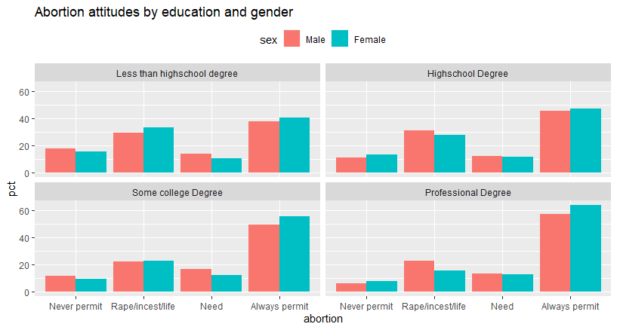
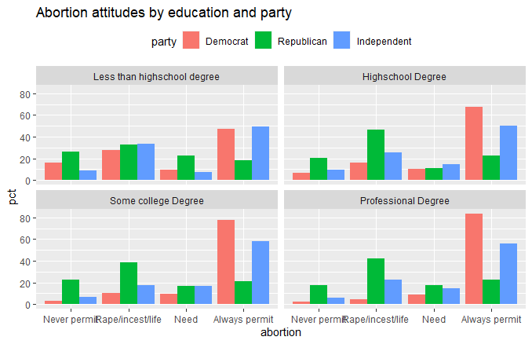

Placement On Abortion: Does Your Level of Education Recieved Play A Significant Role?
Hannah Marland, POLT 595, Department of Political Science
University of New Hampshire
Introduction: The issue of abortion has recently turned into a very political subject that sparks controversial debate. The analysis that I wanted to investigate was the relationship between level of education received and placement on abortion. I wanted to then test other variables such as sex and partyID to see if there was a more clear and correlated relationship.
Data and Analysis
Results and Conclusion:
The results of this study show an additive relationship between gender and highest level of education received.
Females with the highest level of education received are most likely to favor abortions.
- There is also an additive relationship between education level, gender and party ID. Female democrats with college and professional degrees are most likely to be in favor of abortions.
-Majority of respondents that say abortion should be permitted always, are male and female college graduates
- Supports hypothesis
In my hypothetis I predicted respondents with higher levels of education say abortion should always be permitted.
-Majority of respondents both male and female, say abortion should be permitted under certain circumstances, despite their education level.
Hypothesis:
In a study of individuals, respondents with higher levels of education received are more likely to be in favor of abortions under all circumstances.
Methods and Variables:
Placement on Abortions
Dependent Variable
- Never Permit, Permit in case of Rape/Incest, Permit in case of Need, Always permit
- V201366 in ANES codebook, pre-election
References:
User Guide and Codebook Full Release Anes 2020 Time Series ... https://electionstudies.org/wp-content/uploads/2021/07/anes_timeseries_2020_userguidecodebook_20210719.pdf.
Saad, Lydia. “Education Trumps Gender in Predicting Support for Abortion.” Gallup.com, Gallup, 7 May 2021, https://news.gallup.com/poll/127559/education-trumps-gender-predicting-support-abortion.aspx#:~:text=%22Education%20is%20a%20strong%20correlate,which%20abortion%20should%20be%20legal.
Sex
Independent Variable
- Female/Male
- V201600 in ANES codebook, pre-election
Highest Level of Education Received
Independent Variable
- Less than Highschool, Highschool Degree, College Degree, Professional Degree,
- V201510 in ANES codebook, pre-election
Using the ANES 2020 which surveys over 8,000 individuals pre-election, and 7,000 individuals post-election.
Variables include placement on abortion, sex, and highest level of education received.

