Slide 1
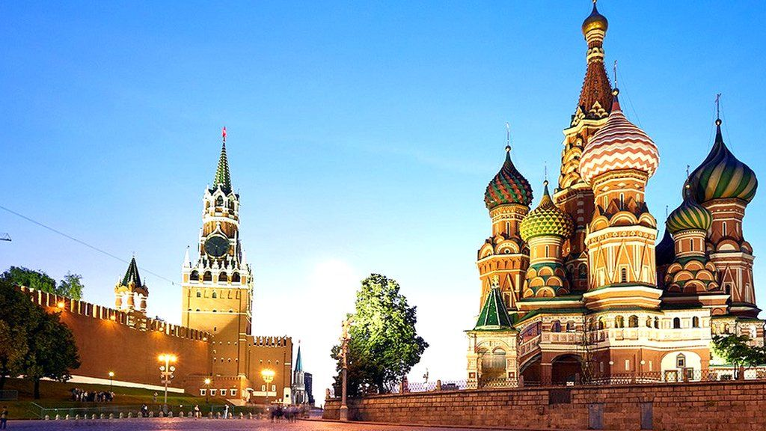
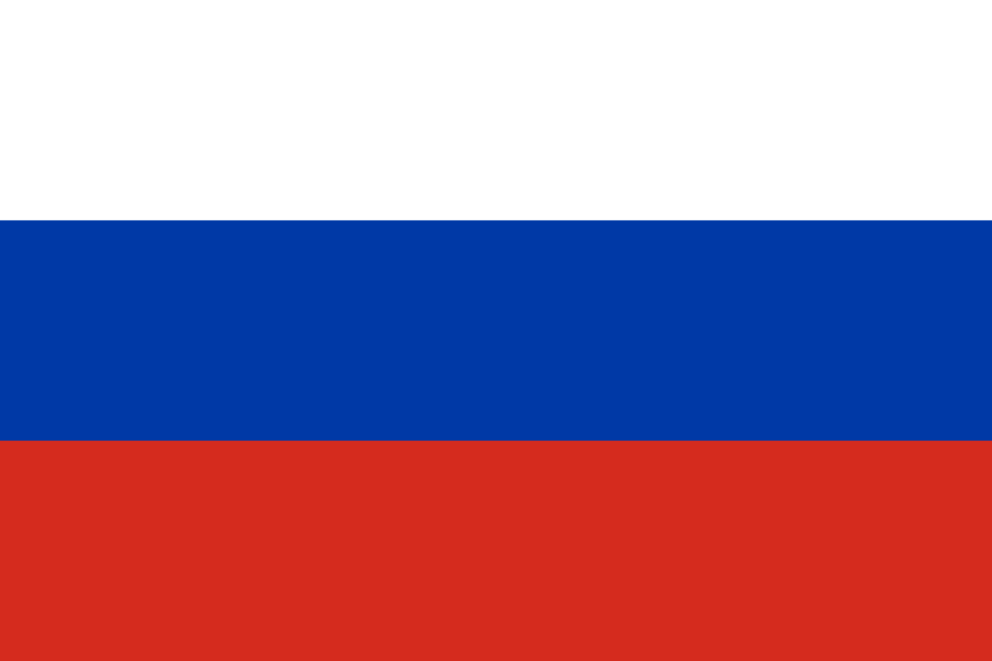
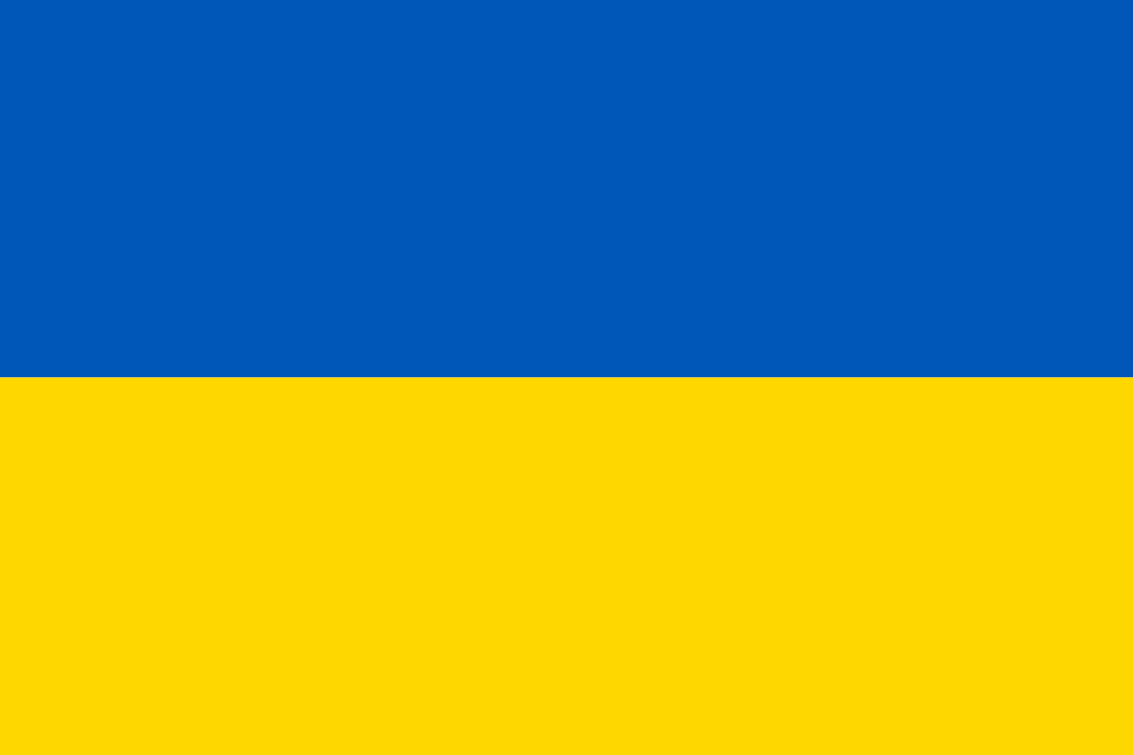
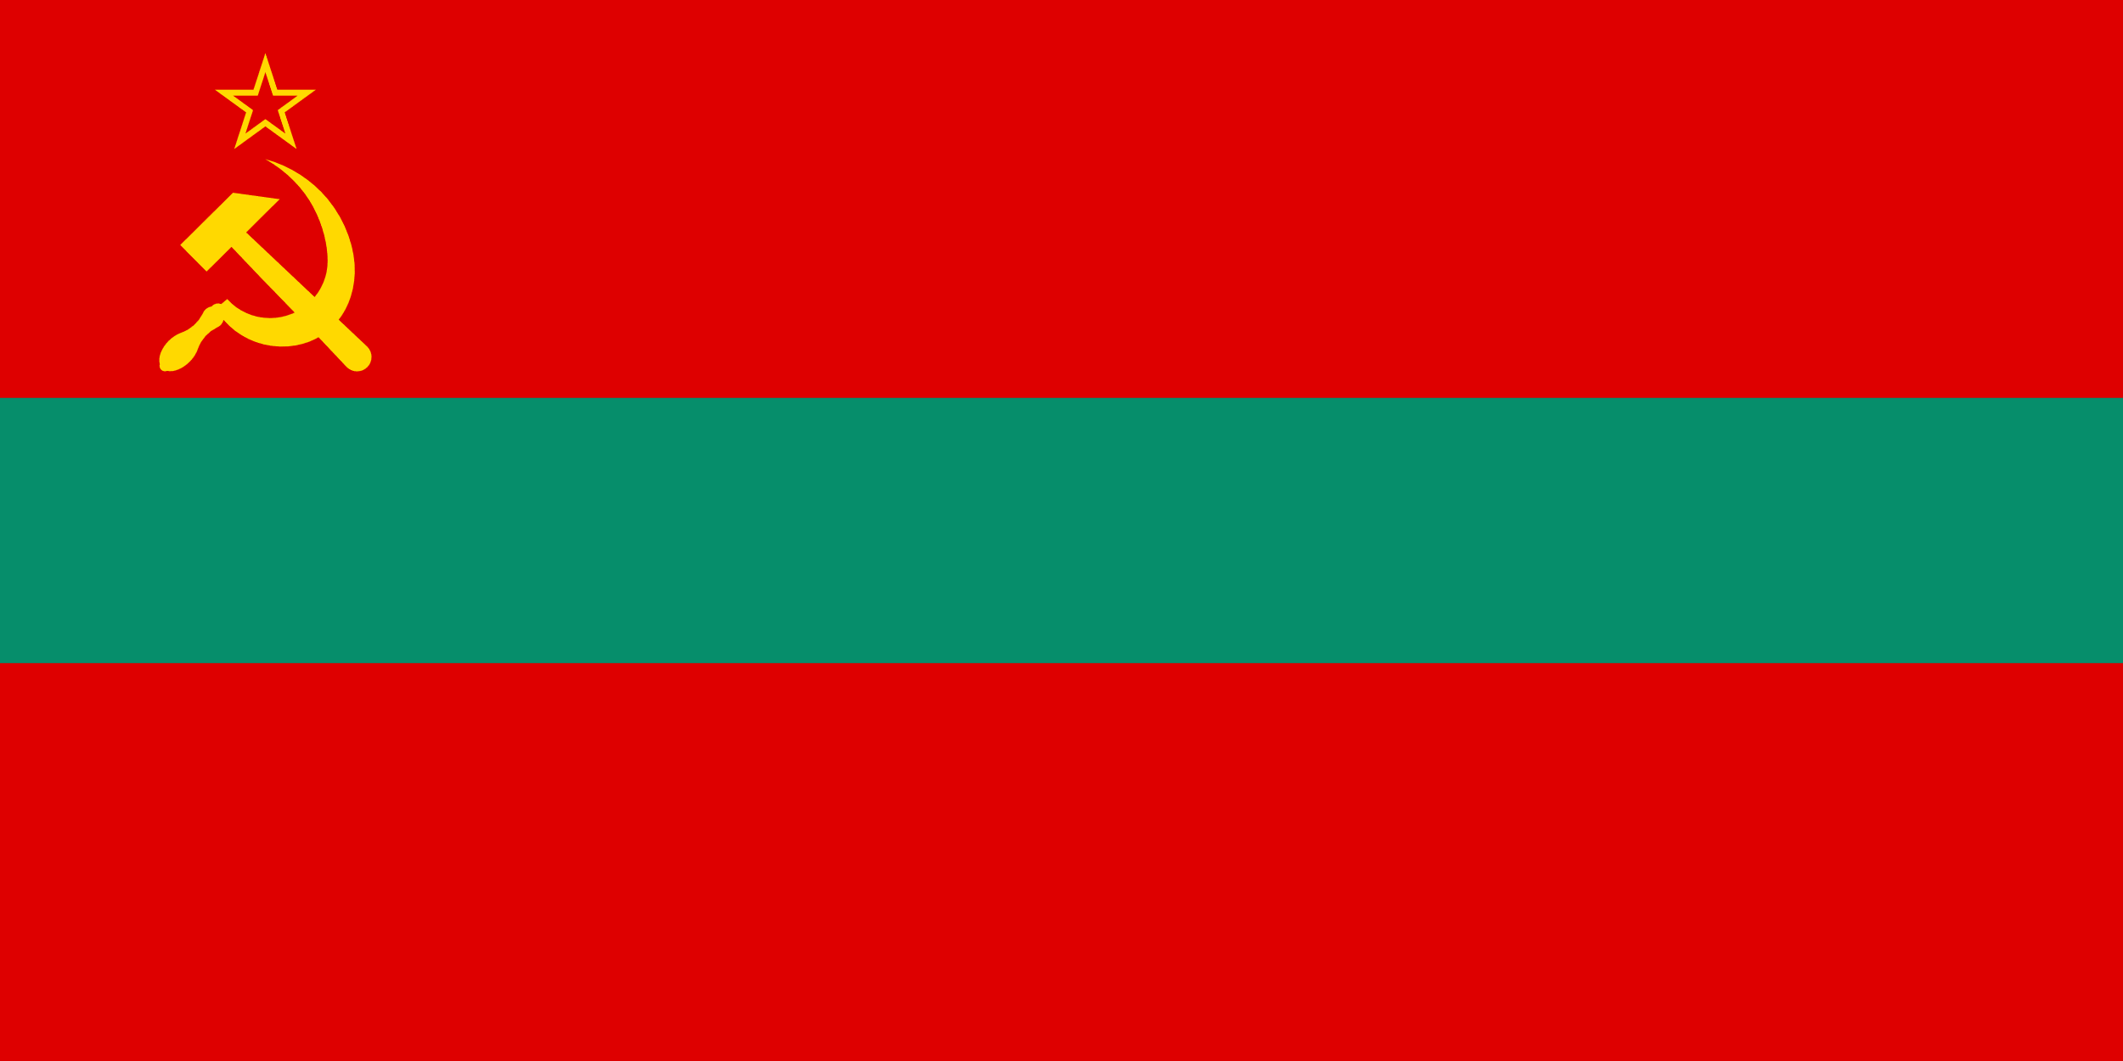
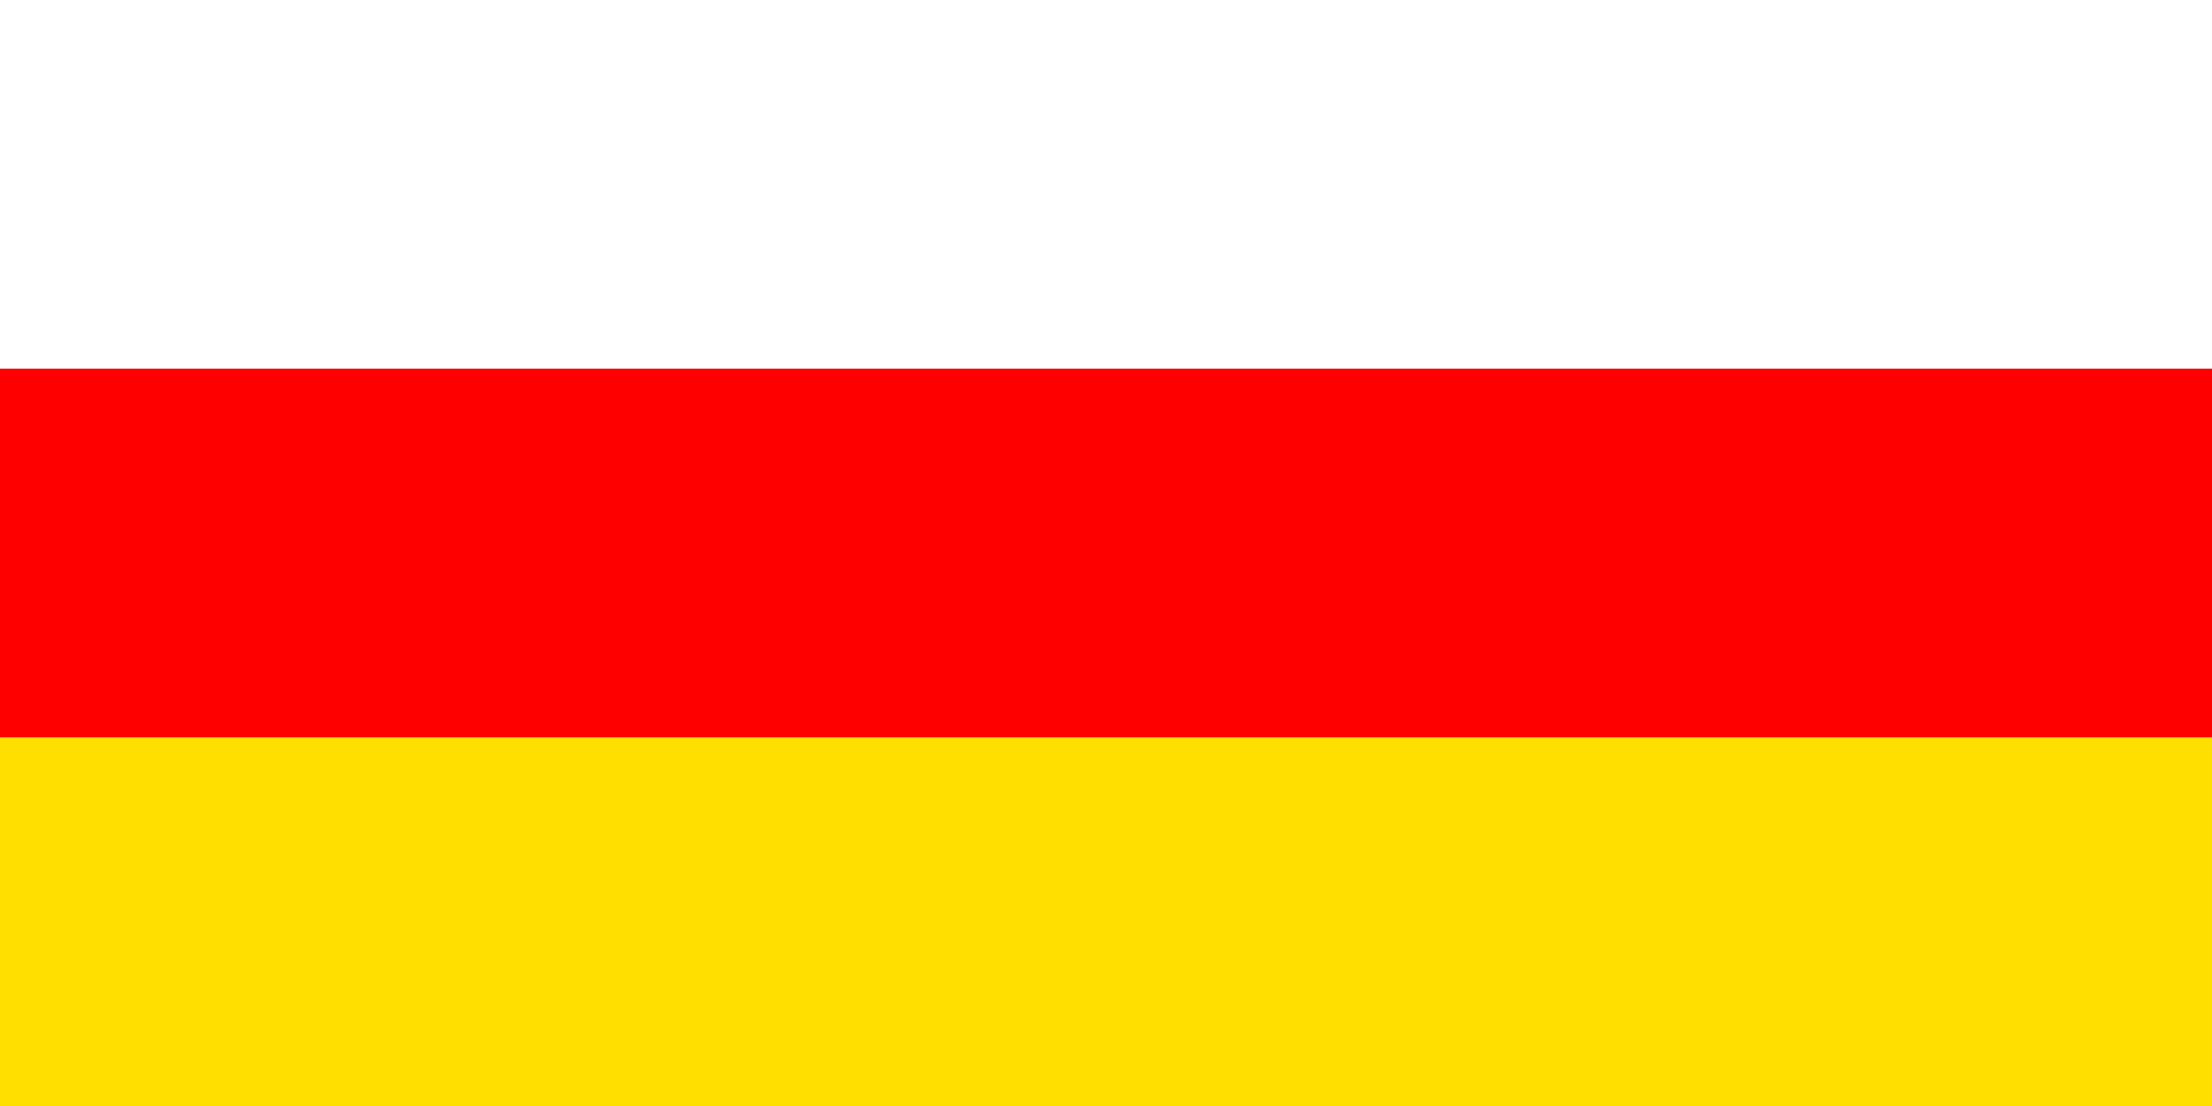
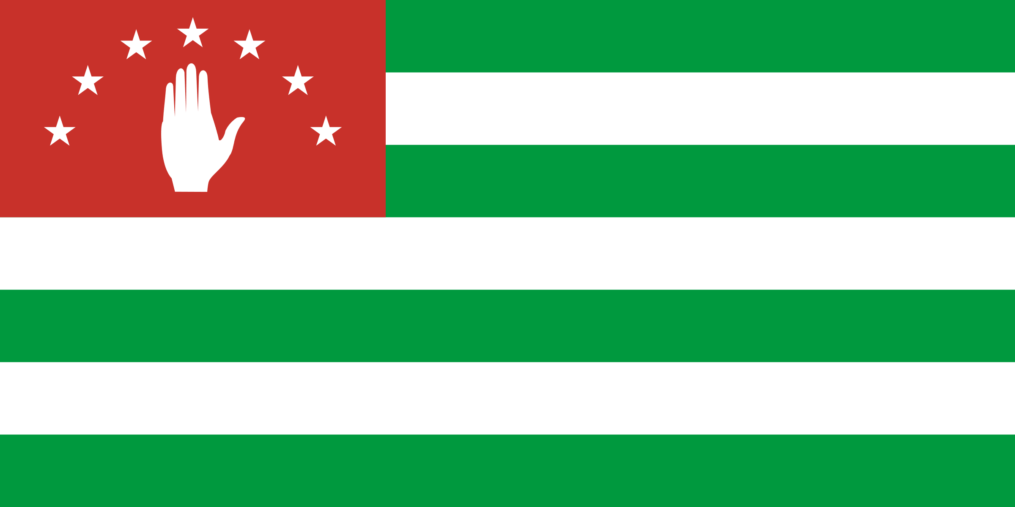
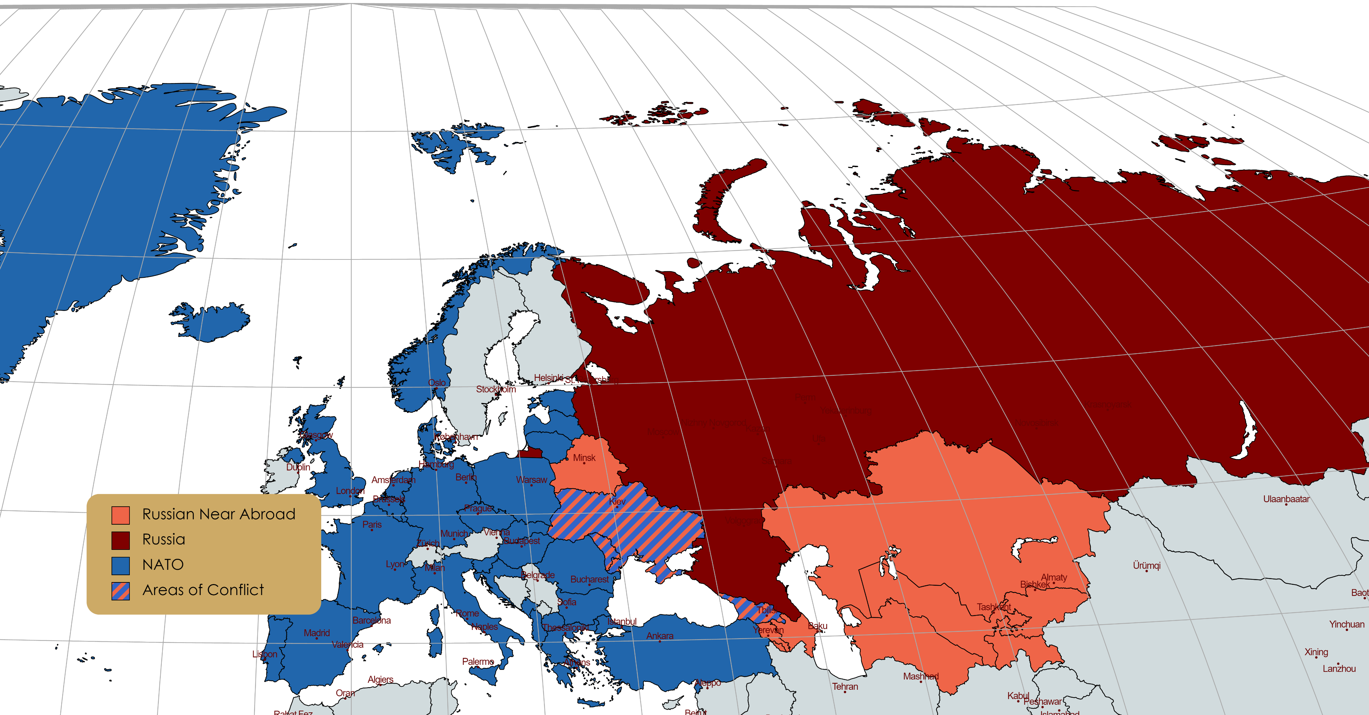
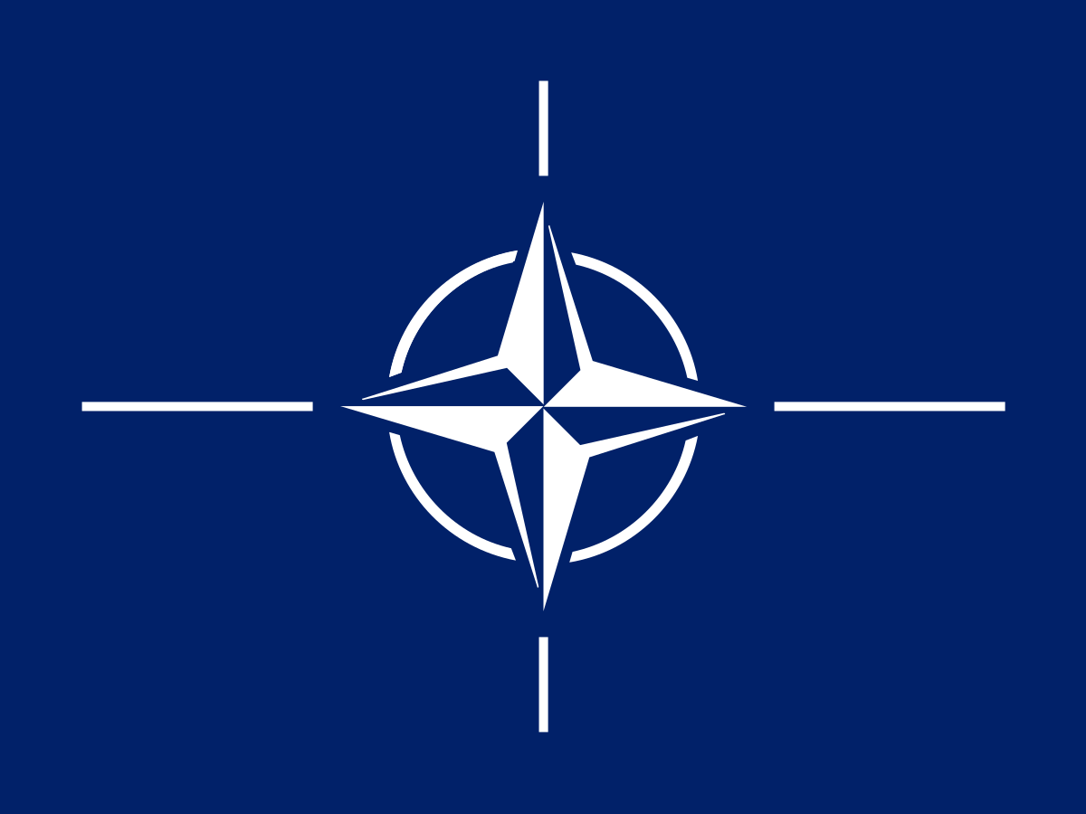
How Russian Insecurities Drive its Foreign Affairs
Important Historical Events
Frozen Conflicts & De Facto States
Russia’s Insecurities
The Russian Tsardom was born of Mongol rule, and would not let another invasion happen
Reformist Tsars in the 17th & 18th centuries, lead to the emancipation of the serfs in 1862
WWI provided the conditions for the Russian Revolution(s) and establishment of the USSR
WWII was a brutal war for the Russian people, and Russia is paranoid about a European invasion
  The peace deals of WWII made the USSR one of the two world superpowers, and established many communist puppets in Eastern Europe, and split a major threat in half
Due to a myriad of reasons the USSR collapsed in December 1991 into its 15 constituent republics
Moldova & Transnistria:
  Transnistria, is a small patch of land in Moldova across the Dniester River, made up of mostly ethnic Russians and Ukrainians. These separatists who felt disenfranchised were supported in their revolution by Russian troops in 1992.
Georgia, South Ossetia, and Abkhazia:
  A conflict between autonomous regions in Georgia, which escalated in 2008 after Georgia received a membership action plan from NATO. Russia used these two republics to weaken Georgia’s sovereignty.
Armenia, Azerbaijan, & Artsakh:
  A conflict frozen by the Soviets, over the Armenian majority region of Nagorno Karabakh. The recent fighting in 2020 saw Russia and Turkey oversee peace deals, and gain influence in the region
Ukraine, Crimea, and Donbass:
  Starting in 2014 over fears of a liberal, western aligned Ukraine prompted Russia to take Crimea, an area with many ethnic Russians. Russia also supported ethnic Russian separatists in Donbass
  Recently the conflict has become a full-scale war, after Russia’s ultimatum towards Ukraine failed
*Note: Many of the smaller ethnicities within the Soviet Union had their own ASSRs Autonomous Soviet Socialist Republics, within the SSRs and a few of them even became official SSRs
Military:
  Russia has a few major geostrategic insecurities
    It lies on the North European Plain, making it hard to repel European invasions
    It has limited sea access, and must pass through NATO, or NATO aligned countries to access international waters
    The South is very easy to cut off in an invasion and is a huge food producing region and population center
  Russia spends $61 billion, or 4.3% of its GDP on its military, which is the third highest spending as a percentage (after Saudi Arabia & Israel)
    For comparison, the US spends $778 Billion, or 3.7% of its GDP
  NATO is unquestionably Russia’s biggest fear, and views its expansion as an existential threat
Economic:
  Russia is extremely dependent on resources, especially oil and gas
    Oil and gas account for more than 50% of Russian exports
    Despite some of these countries being state owned Russia does not reinvest back into the country or diversify the economy
  Russian GDP per capita is ~$10,000 per person (~$26,000 adjusted for PPP)
    The UK’s is ~$41,000 per person and the US’s ~$64,500 ( ~$60,000 adjusted for PPP)
  More than 60% of Russia’s wealth is owned by 1% of it’s people, and has received a GINI coefficient of (Shorrocks 2021)
    However, some experts believe that this number is wildly underreported and believe there is more Russian wealth outside the country than inside (Kuznets, 2019)
  GDP growth has slowed down since the annexation of Crimea in 2014
Political:
  Russia is authoritarian, and essentially a one-party state, as United Russia has won every election since the 2000’s and has also maintained a majority or supermajority in the Duma
    This is done by spreading propaganda through state media, silencing opposition or critics, and will run token opposition
      Alexei Navalny was a prominent political figure in Russia, leading a political movement against Putin and even tried to run against him
      He was poisoned with a known KGB nerve agent in 2020
Country | # of ethnic Russians | % Russian Population
Ukraine | 8,300,000 | 17%
Estonia | 3,600,000 | 20%
Latvia | 490,000 | 25%
Kazakhstan | 320,000 | 25%
Many former Soviet republics have large numbers of ethnic Russians living in them, This is due to the heavy Russification of these places
These populations generally cause worry for these countries because the protection of ethnic Russians, abroad is a commonly used justification for Russia to invade on behalf of them
  This was evidenced by Russia’s official reason for annexing Crimea, as there were Russians being ‘oppressed’ by Ukraine
The Wild 90’s
“In the period between 1992–1998, Russia’s gross domestic product fell by half. During the Great Depression, the American economy shrank by 30.5%. The collapse of industrial production was even greater, declining 56% between 1992 and 1998. This did not happen even under German occupation” (Satter 2018).
Boris Yeltsin, who became president of the new Russian Federation, wanted price liberalization, and privatization of most state enterprises, and transform Russia to a liberal market economy with help from economists from Harvard
It was not considered that the lawlessness, and political chaos resulting from collapse of the USSR would have a very negative effect on the transition
Some people were able to become obscenely rich from the transition, usually employing shady tactics, or some either skirted around the law, or just broke the law
  For instance, factory owners would get money to pay workers, and would put it in their bank accounts
  Workers got money from the state to invest, but this wage theft meant many needed to sell their shares or vouchers to the owners who would buy the whole company
  Or they would sell stockpiles of equipment or materials on the global market and pocket the difference
Russia & The Future
While many thought the war in Ukraine would go much worse for Ukraine, they have been holding out very strong and are pushing back the Russians
Russia could still win the war, but certainly not favorably, and it will be expensive
  They may simply push for recognition of the independent Donbass, and Crimea, as well as a guarantee that Ukraine will not join NATO, and military disarmament at most.
Russia will tie itself closer to China, especially after getting cut off from western finances
Russia will also likely try to keep its influence over Central Asia and Belarus, by force if necessary
This conflict may push nations like Sweden and Finland closer to NATO
Shorrocks, Anthony, Davies James, Lluberas Rodrigo. Global Wealth Report. Zurich: Credit Suisse, 2021
Kuznets, Dmitry. “The top 1% controls a third of the wealth, and the poor are getting poorer. How Russia became one of the most unequal places on Earth.” Meduza, (2019) https://meduza.io/en/feature/2019/01/23/the-top-1-controls-a-third-of-the-wealth-and-the-poor-are-getting-poorer-how-russia-became-one-of-the-most-unequal-places-on-earth

