Slide 1

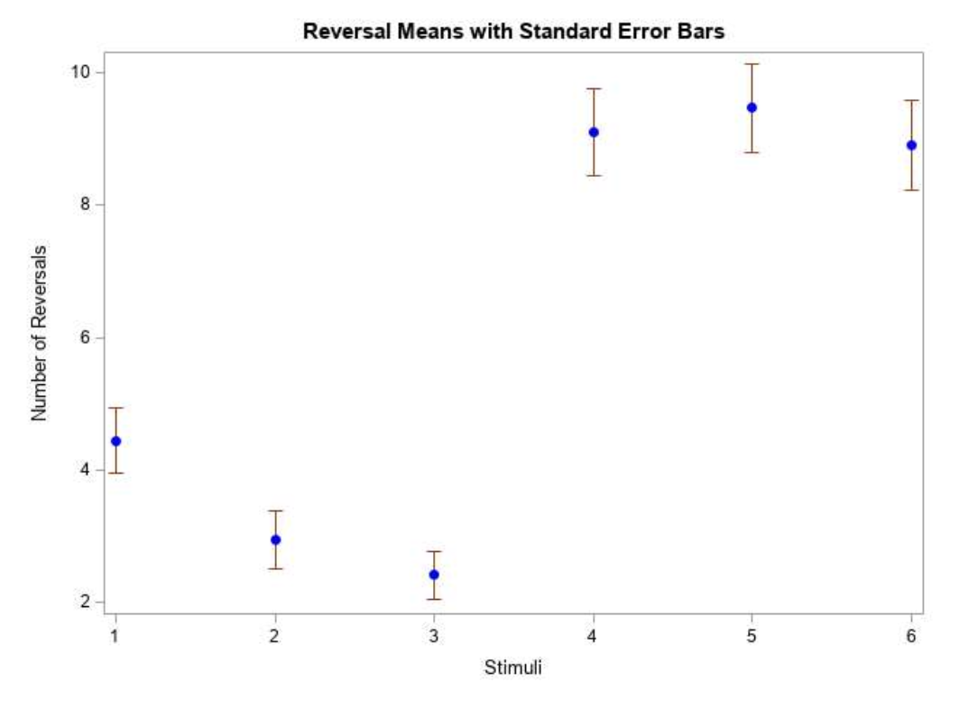
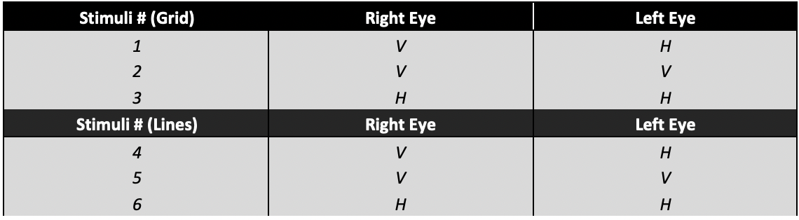
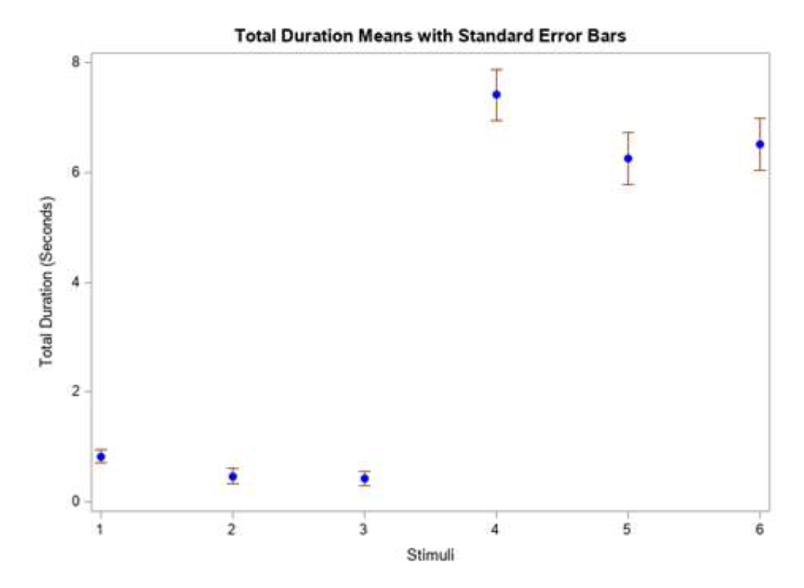
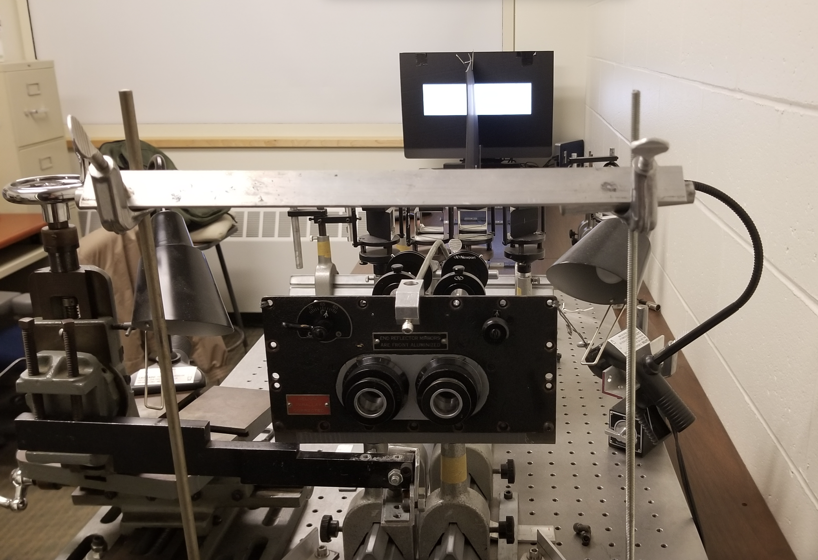
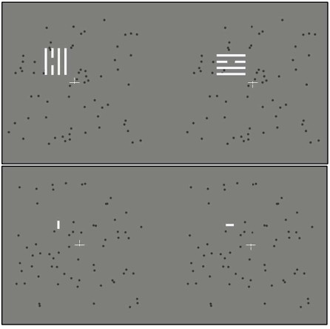
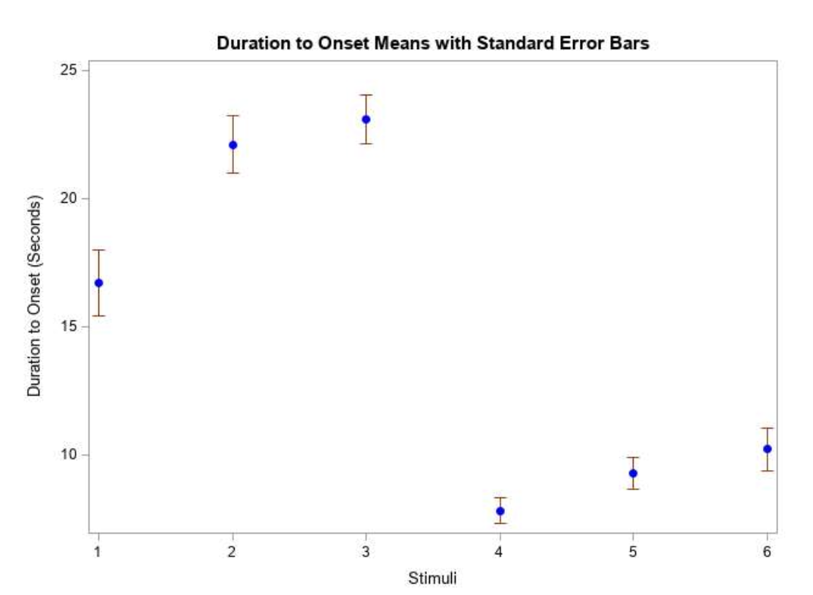
The Dynamics of Perceptual Filling-In and Motion Induced Blindness During Binocular Rivalry
Kaylyn Dickinson, Georgia Gempler, and Emily Komerska
Rebecca White, Faculty Advisor
Department of Psychology, University of New Hampshire
Introduction
Methods
Results
Conclusion
- Motion Induced Blindness (MIB): target vanishes when presented with global changes
-Perceptual Filling-In (PFI): gap within stimuli is "filled in"
-Binocular Rivalry (BR): perception of images in each eye alternates
-Common Mechanism Hypothesis: MIB and BR are modulated by common mechanism in brain
Maxwellian View Optical System
7 volunteers (normal or corrected to normal vision)
6 sets of stimuli
The current study points to there being no single common mechanism between these effects.
Due to the area being filled in not being completely surrounded by what it is getting filled in by, there was less PFI compared to MIB which is counterintuitive given the current literature.
Over-reporting of the PFI during rivalry.
In the future, new stimuli will be created to control for this.
Notes:
Recreating another study but not using color and including PFI in order to test all combinations of stimuli
No significant difference between rivalry and non-rivalry so not a common mechanism Hypothesis of a common mechanism between them
Repeated measures ANOVA - checked for normality and sphericity (violated) adjusted with chi-muller statistic. All pairwise comparisons. Controlled for family-wise value across all conditions

