Slide 1

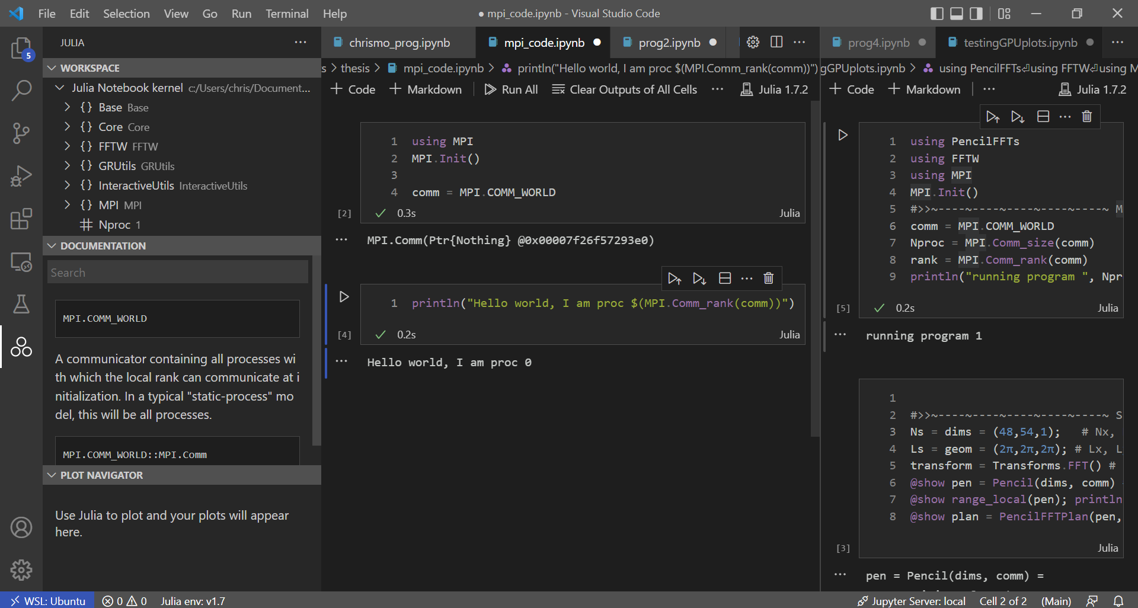
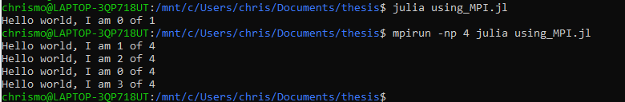

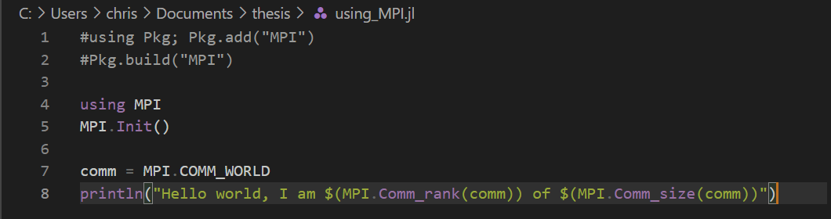
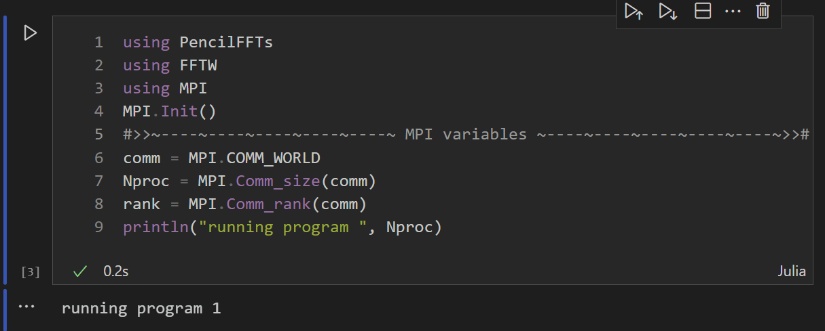
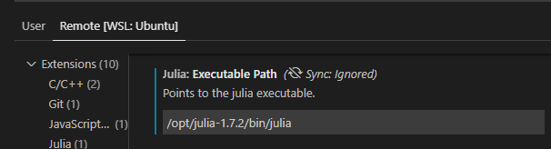
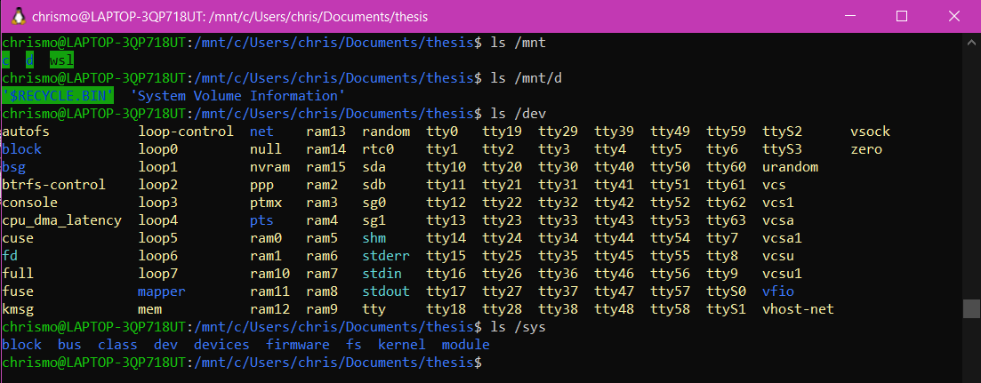
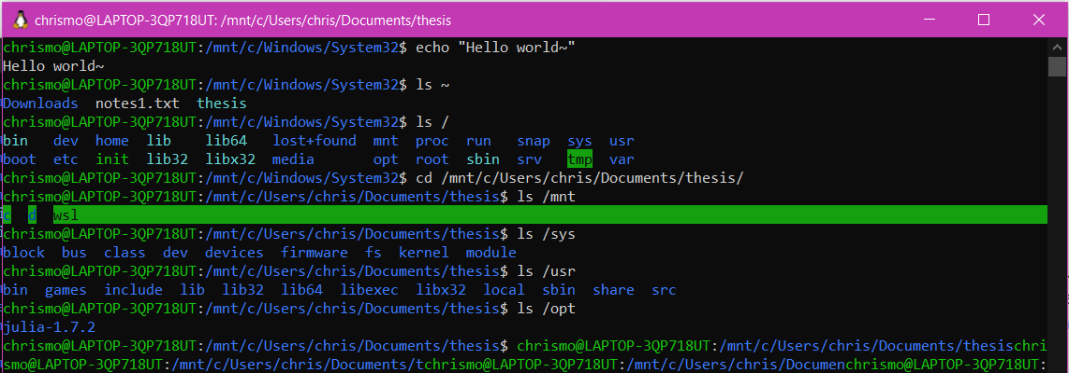
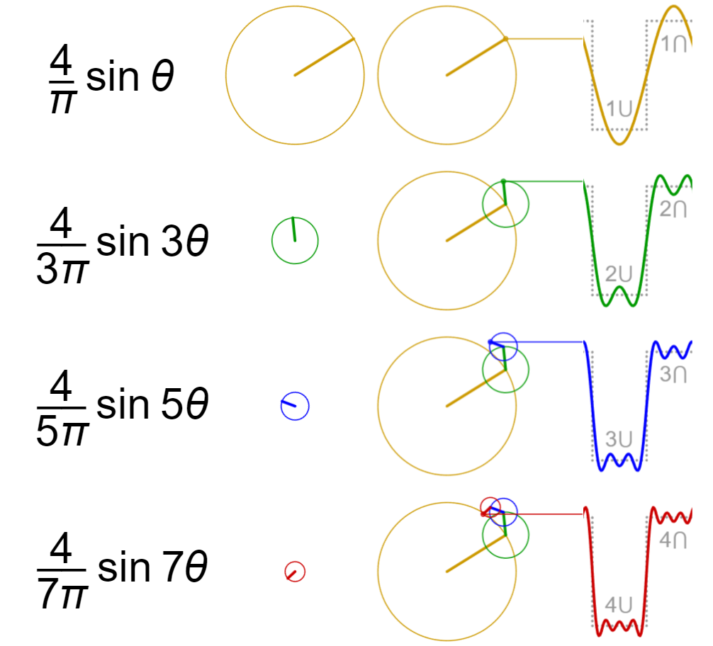
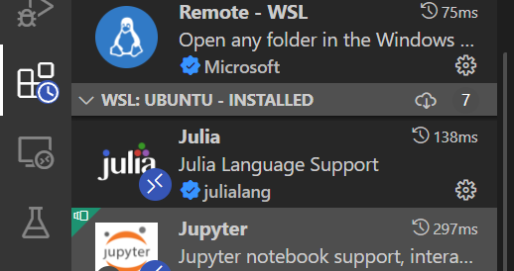
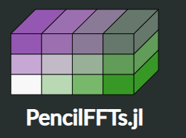
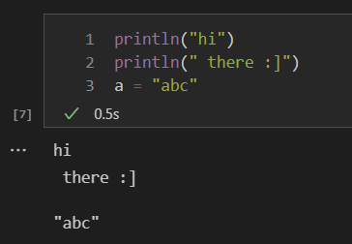
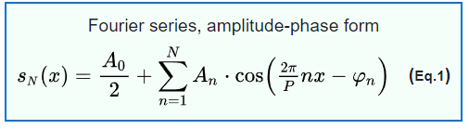
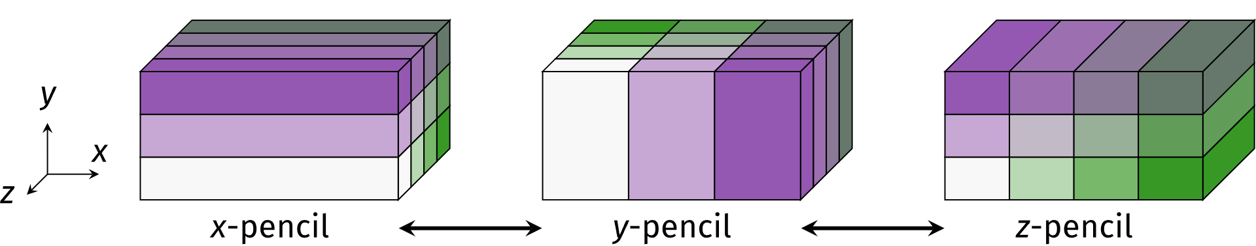
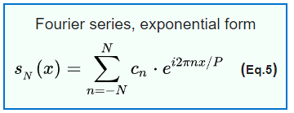
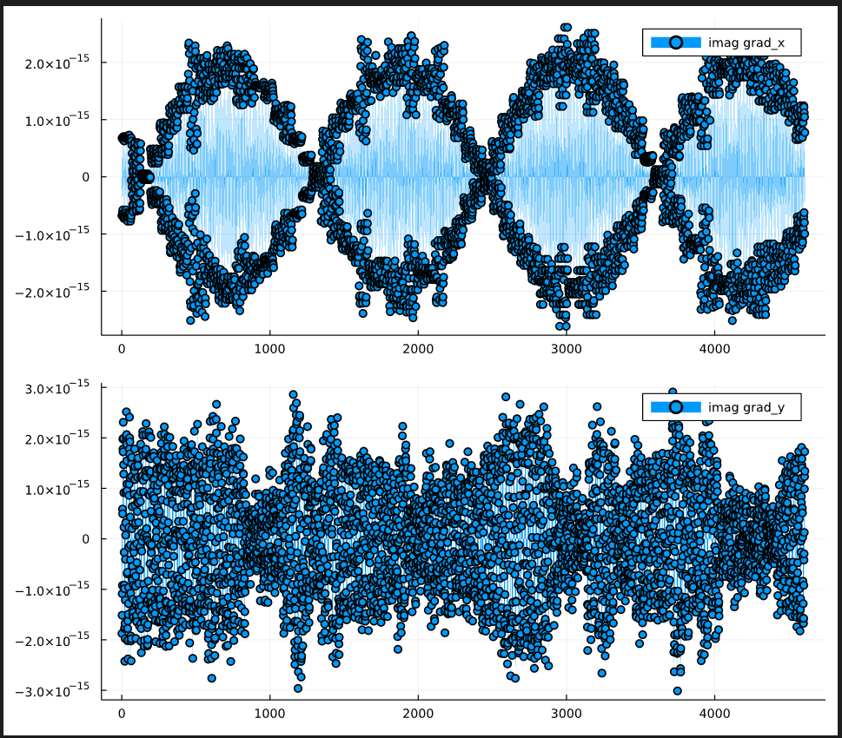
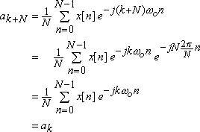

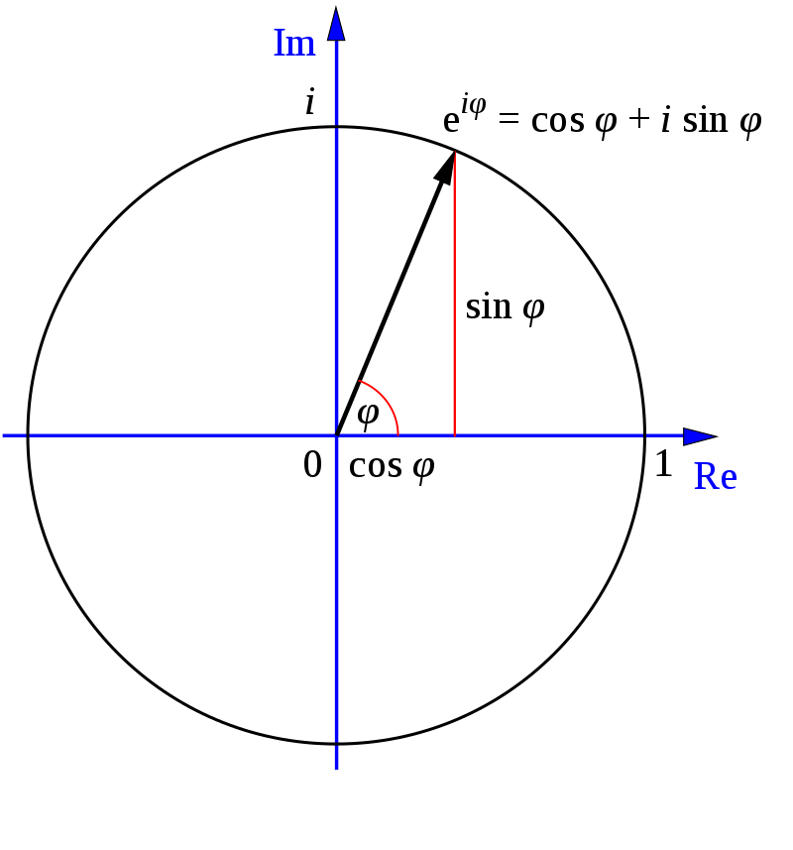
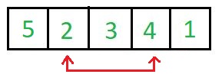
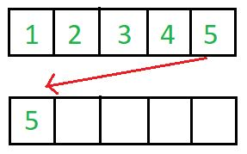
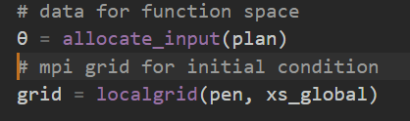
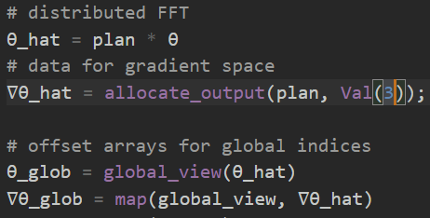
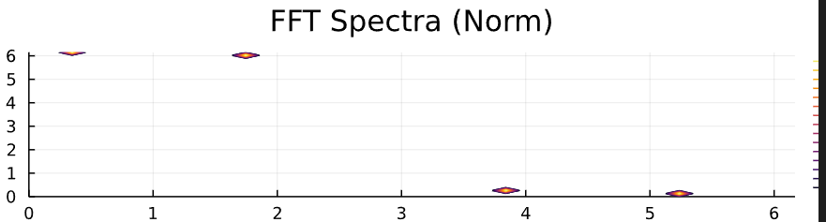
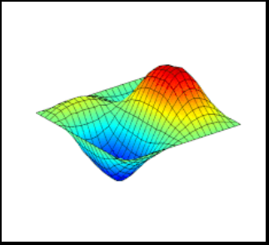
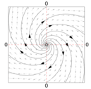
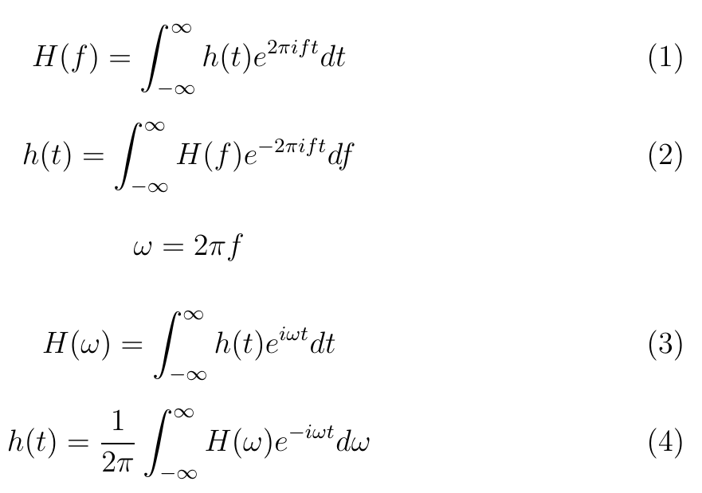

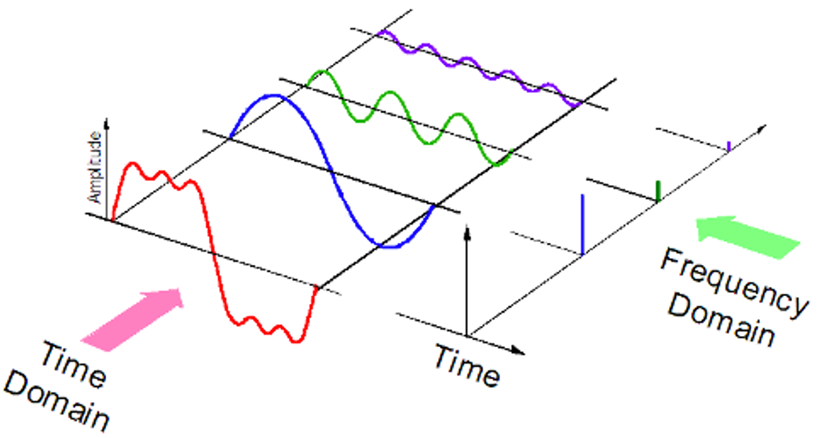

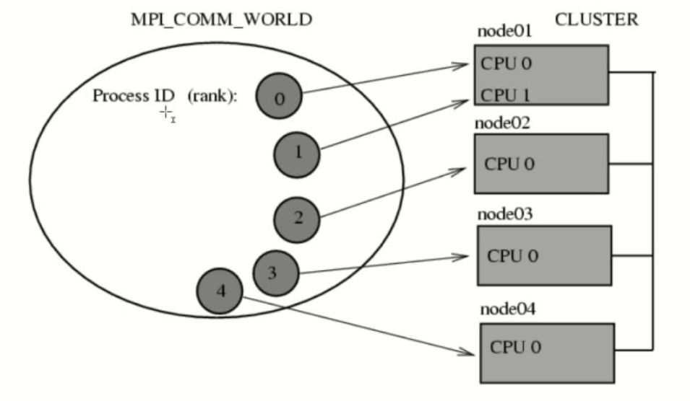
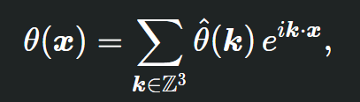
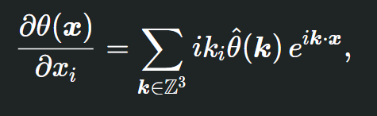

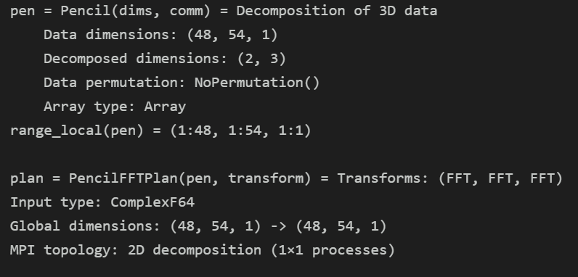


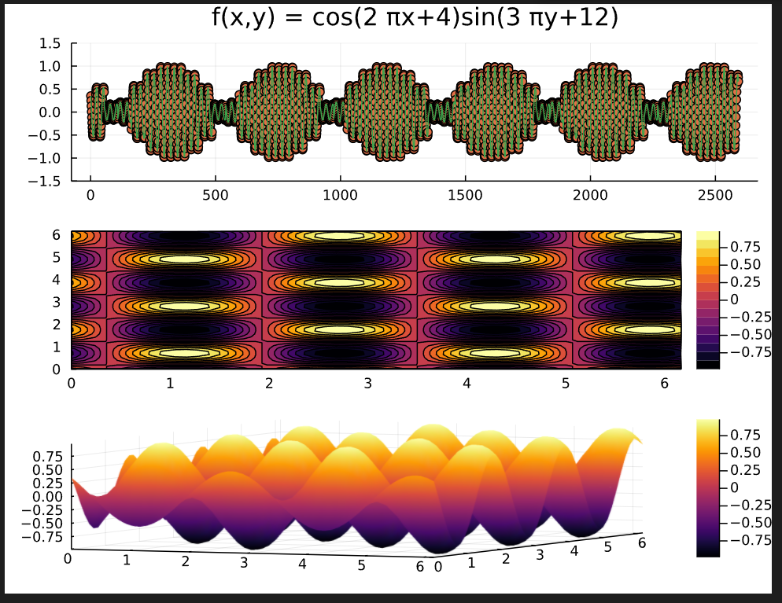
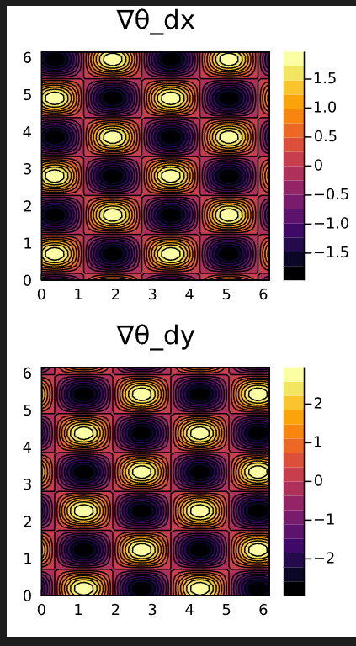
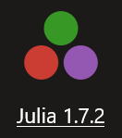


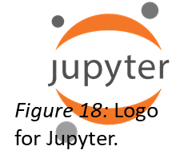
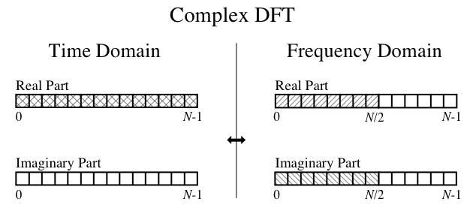
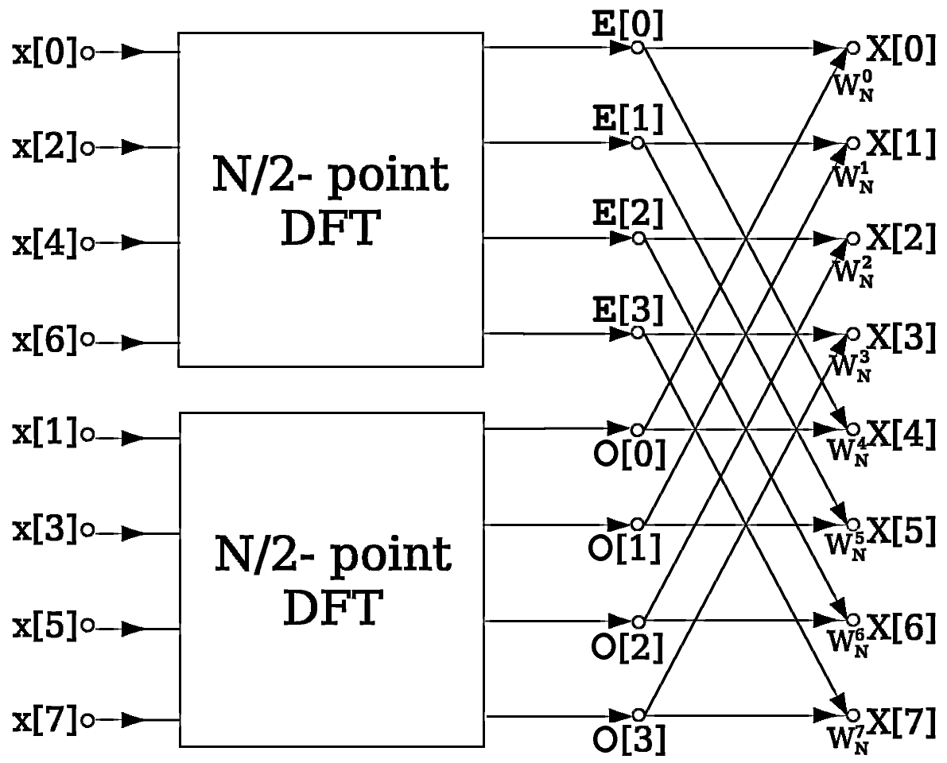
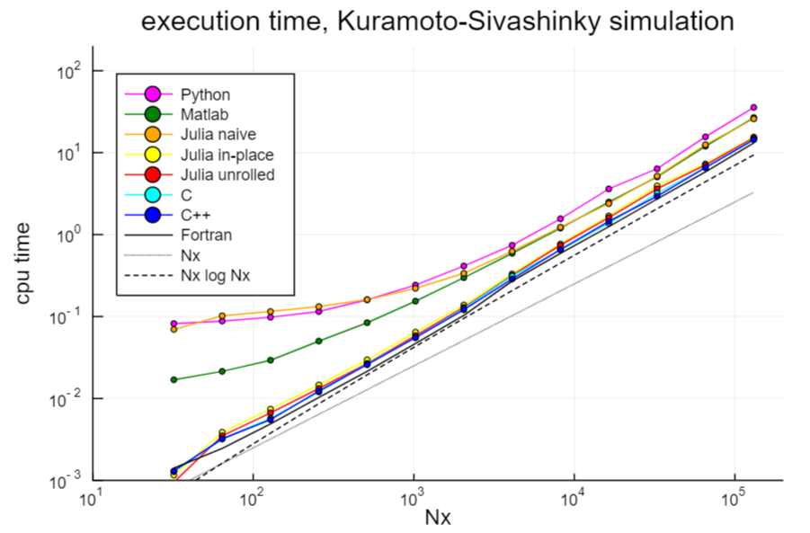
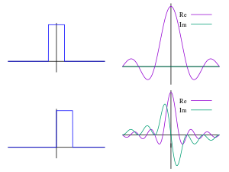
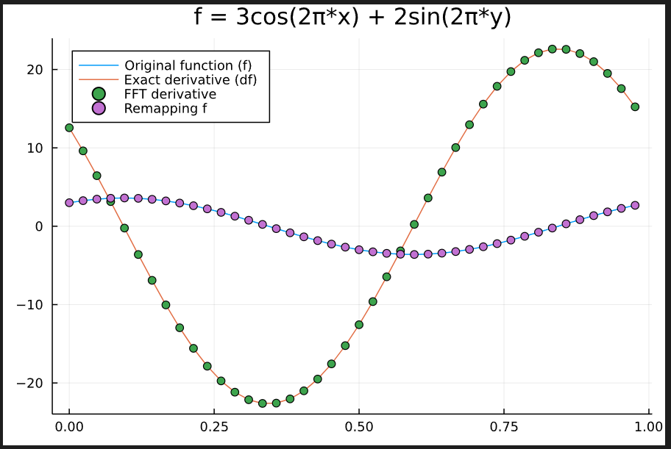
Parallelized Partial Differential Equation Solvers for Fast Fourier Transform Library
Christopher Mottola
Advisor: John Gibson
Scientific Computing –
Coalesces methods and ideas from the fields and subdisciplines of Computer Science, Applied Mathematics, and the Physical Sciences to resolve systems of equations and simulate them over time, which is computationally intensive.
Focuses on solving complex mathematical problems and modeling phenomena from different scientific domains (signal processing, audio engineering, tomography, fluid mechanics, particle physics, population dynamics, climate science, etc.).
Investigates techniques for solving Partial Differential Equations (PDEs), equations that enforce mathematical relationships between the partial derivatives of a multivariable function. For example:
The Julia Programming Language –
Julia was designed from the ground up (2009-2012) to be
very good at numerical and scientific computing.
Resolves the issue of performance-tradeoffs from slower dynamic languages for scientific computing; made possible through modern language design and compiler techniques.
High performance and multi-paradigm, combining features of imperative, functional, and object-oriented programming languages (Python, MATLAB, C++, etc.), and achieving computational speed (performance) close to C.
Dynamically-typed with multiple dispatch and just-in-time compilation.
Has code libraries for many domain-specific ecosystems, including biology, quantum physics, quantitative economics, machine learning, quantum computing, image processing, astronomy, nonlinear dynamics, and ecology.
Julia is a free and open-source project under MIT license. The source code is available on GitHub, and many tutorials are available online.
Research Question(s):
>> Understanding pattern formation: coherent structures in turbulence as dynamical solutions, equilibria to travelling waves; understanding why shapes arise, what properties they have.
>> Learning about spectral analysis, Fourier Transform algorithms, and parallel computing, while exploring implementations for Partial Differential Equations.
>> Reconciling existing libraries to provide a potent mathematical tool for multi-dimensional scientific computing.
>> Filling in gaps and functionality and developing usage code and documentation for the PencilFFTs.jl library.
Methods / Development:
Visual Studio Code (VSCode)
  Made by Microsoft for Windows, Linux, and macOS.
  Once downloaded, open VSCode and install the
  Remote Development extension pack for WSL.
  Within the “WSL: Ubuntu” remote environment,
  install the Julia extension for language support and
  the Jupyter extension for notebook support.
Windows Subsystem for Linux
  (WSL) can be installed by opening Windows Com-
  mand Prompt or PowerShell in Administrator mode,
  entering: wsl --install, and then rebooting the
  machine after it completes.
Julia 1.7.2
Can be installed through the WSL terminal:
wget https://julialang-s3.julialang.org/bin/linux/x64/1.7/
julia-1.7.2-linux-x86_64.tar.gz
Extract (unzip) the Julia installation archive files:
tar zxvf julia-1.7.2-linux-x86_64.tar.gz
Copy the directory and create a symbolic link to /bin:
sudo cp -r julia-1.7.2 /opt/
sudo ln -s /opt/julia-1.7.2/bin/julia /usr/local/bin/Julia
OpenMPI 4.0.3
  From within WSL: sudo apt update
  sudo apt install openmpi-bin libopenmpi-dev
  sudo apt-get update openmpi
  Update the system MPI binary within the working
  directory and build the Julia MPI package:
  julia --project -e 'ENV["JULIA_MPI_BINARY"]="system";
  using Pkg; Pkg.build("MPI"; verbose=true)’
  Export the Open MPI library to the Linux user’s start-up file:
  echo “export JULIA_MPI_PATH=/usr/lib/x86_64-linux-gnu/
  openmpi” >> ~/.profile
Parallel/Distributed Computing – [Allow a program to be split up into smaller processes, which are executed simultaneously with separate memory spaces.]
➔In parallel computing, resources and calculations are split up over different processor cores of the CPU.
➔For distributed computing, these process can be spread out on the same computer or multiple computers.
Message-Passing Interface (MPI) – [A standardized means of exchanging messages between multiple processes (nodes) running a parallelized program across distributed memory.]
VSCode provides a file explorer, search and replace functionality, source control integration, debugging, an extension ecosystem, a remote explorer, a unit testing framework, and a map of the resources in workspace environment.
The “workspace” contains memory for the library functionality that is being imported, as well as for variables from cells that have been run in the open notebook.
Multiple tabs and views can be open in the Visual Studio Code environment.
Figure 1: Solution to the 3D Heat Equation.
New Code and Markdown notebook cells can be created from the buttons at the top of Visual Studio.
The Julia Kernel for the Julia VS Code extension. A kernel is responsible for bootstrapping required resources into the system environment.
Figure 9 (above): Running a parallelized “Hello world” program in WSL. To use a number of processes greater than the number of CPU cores, run with the --oversubscribe flag.
Figure 10 (right): A Julia (.jl) file for printing out “Hello world” along with information about the local MPI process.
Figure 2: Logo for Julia.
Cells in a Jupyter Notebook can be executed and evaluated individually.
The MPI.Comm_rank function returns an integer corresponding to which local process is running from the MPI communicator’s group.
The MPI.Comm_size function returns an integer corresponding to the number of processes involved in a communicator. It is stored in the Nproc variable and then printed.
The Julia workspace window also provides a pane linking to library documentation for selected arguments.
For Julia notebooks, the standard is to only display the program output for the logic evaluated on the last line of a notebook cell. A print statement can get around this by simply printing the argument to the cell output unless a semicolon is at the end. To ensure output for a desired line, the “@show” annotation can also be specified.
Remote window running in WSL: Ubuntu
Figure 4: Snapshot of VSCode development environment.
Jupyter Notebook (.ipynb)
A notebook interface is a virtual programming environment that allows for running code more interactively, through the embedding of executable calculations and formattable markdown text into separate sections (cells) of the document, which can be run in any order selected. See Figure 3 for an example description of a notebook cell.
Figure 3: It is important also to update in the VSCode
settings the path to the Julia executable, so that Julia code can be run within the VSCode environment.
Figure 11: The code segment in this figure tells the Julia package manager what local libraries to load (PencilFFTs, FFTW, MPI) into the environment. The first time a library is specified, it must first be added to the local working area with: using Pkg; Pkg.add(“MPI”); Pkg.build(); MPI is unique in this case, though, because a separate MPI implementation (architecture) must be present for the Julia MPI library dependencies to bind to. I used Open MPI Project’s OpenMPI 4.0.3.
The code segment then initializes the Message-Passing Interface (MPI) to synchronize the distribution of the local process’s resources with any other processes that are being run in parallel as part of the global program. Running a Jupyter notebook only allows for one MPI process. In order run a program with multiple parallel processes, the code should be written in a Julia file (.jl) and run from the command line with MPI using the mpiexec or mpirun arguments (see Fig. 9,10).
Fourier Series and Spectral Analysis –
Fourier Transform –
Fast Fourier Transform (FFT)
* A powerful algorithm that enables high performance speedups in
multi-dimensional scientific computing.
-> Fast Fourier transforms are widely used for applications in engineering,
music, science, and mathematics
- There are several tweaks that can be made to these formulas in terms
of logic and symmetries to optimize the computation for a given system.
Fastest Fourier Transform of the West (FFTW)
FFTW is a C subroutine library for computing the discrete Fourier transform (DFT)
in one or more dimensions, of arbitrary size and of both real and complex data.
FFTW was originally developed in 1997 by Matteo Frigo and Steven G. Johnson
at the Massachusetts Institute of Technology (MIT) Laboratory for Computer Science.
A Fourier series is a mathematical representation of a periodic function as a sum of sine and cosine waves. (A periodic function repeats its values at regular intervals.)
Each constituent wave in the Fourier series has a different frequency, amplitude, and phase.
When summed together, they reproduce the original periodic waveform.
Spectral analysis involves the calculation and investigation of gradients, or differential distributions, of periodic phenomena, such as wave and surface oscillations.
The gradients are computed from sets of sequenced data.
Datasets may be collated as a function of one or more independent variables, such as the three Cartesian spatial coordinates (x, y, z) and/or time (t).
Figure 5: Exploring the local virtual environment filesystem in Windows Subsystem for Linux. The Linux command line interface (CLI) is written in the Bash language. The “ls” command lists the files in the local or specified directory. A related command is “cd”, which lets the user change directories to a passed directory argument.
Results / Data:
PencilFFTs.jl –
in-place vs. out-of-place (allocation)
Spectral coefficients
Calculating gradients, 1D, 2D, 3D,…
Challenges –
documentation
syntax
dimensionalities
Applications/Future Expansion –
++ performance tips, benchmarking
++ git pull request to code repository
-~>Heat Eq’n, Wave Eq’n
-~>Dynamical Systems
-~>Timestepping methods
Discretizing PDE’s w/
Parallelized FFTs
Julia library providing multidimensional FFTs and parallel transforms on MPI-distributed Julia arrays.
Figure 6: (Image adapted from Wikipedia): Four partial sums of a Fourier series produce increasingly accurate approximation of the square wave, as
each new term is added.
Figure 12: (From PencilFFT documentation) Illustration of a 2D decomposition of a 3D array over 12 MPI processes.
Spectral methods are a class of techniques for numerically solving PDEs by taking the sum of a set of basis functions (Fourier series) and determining the spectral coefficients that best satisfy the differential equation.
Figure 7: The Fourier Transform equations transform between <Time and Frequency > domains. (They are also used in quantum physics to transform between Position space and Momentum space.)
The Fourier transform is a linear operation. (f(x+y)=f(x)+f(y); f(cx)=cf(x).)
Equations (1) and (2) use frequency in the classical sense, as in the number of cycles (wave periods) that pass a fixed point along the path per a given time interval. For example, 1 Hz means 1 cycle per second.
Equations (3) and (4) use instead the angular frequency representation, replacing f with an omega (ω), usually measured in radians per second.
θ is the function,
∇θ is the gradient.
Figure 13: The images above show three examples of steps for a parallelized PDE-solving algorithm.
- The top right displays a heatmap of (the Euclidean norm of) the FFT transform’s spectral coefficients, from θ’s parameterization.
- In the top-left, out-of-place allocation is used for a vector field of the gradient, and global views are mapped to the data arrays.
- At the bottom is an example of solving (in-place) the partial derivatives of a 1D function, using Fourier operations with wavenumbers (k) and periodic boundary conditions (L) to perform differentiation.
Figure 17: Logos for Windows, Linux,
and Ubuntu (left to right).
Figure 19: Logo for VSCode.
(The equations above were produced in LaTeX.)
Figure 20: Logo for Open MPI
Figure 14: The program readout from creating a PencilArray object and
FFT plan.
Figure 8: (from Wikipedia) Shows the data decomposition and redistribution steps of the FFT algorithm. This factorization reduces the computational complexity of the discrete Fourier transform from O(N²) to O(NlogN), where N is the data size.
Figure 15: Plotting the known function and gradient values against those computed with PencilFFT transforms.
References/Resources:
¹William H. Press, Saul A. Teukolsky, William T. Vetterling, and Brian P. Flannery. (1992). Numerical recipes in C (2nd ed.): the art of scientific computing. Cambridge University Press, USA.
²Polanco, Juan Ignacio. (2021). PencilFFTs.jl: FFTs of MPI-distributed Julia arrays (0.12.4). Zenodo. https://doi.org/10.5281/zenodo.6094646
³Martin D. Maas. (2022). Tutorials>Numerical Computing in Julia>Using the Fast Fourier Transform. https://www.matecdev.com/about.html
⁴John F. Gibson. (2019). Benchmarking Julia on a PDE: the Kuramoto-Sivashinksy equation. Dept. Mathematics and Statistics, University of New Hampshire. https://github.com/johnfgibson/julia-pde-benchmark/blob/master/1-Kuramoto-Sivashinksy-benchmark.ipynb
⁵Amith KK. (2019). Setting up Visual Studio Code and WSL for MPI Development. Medium. https://amithkk.medium.com/setting-up-visual-studio-code-and-wsl-for-mpi-develoment-8df55758a31c
Figure 16: The mid-left portion shows three different views of a 2D periodic function (scatter/line plot slice, heatmap, contour plot);
the right portion displays two heatmaps, one each for the x and y partial derivatives (the gradient in terms of x and y).
Completed as part of my honors thesis project for interdisciplinary honors.
\Major area of study: computer science
\Minors in: applied mathematics, philosophy, physics
UNH URC Spring 2022

