Slide 1

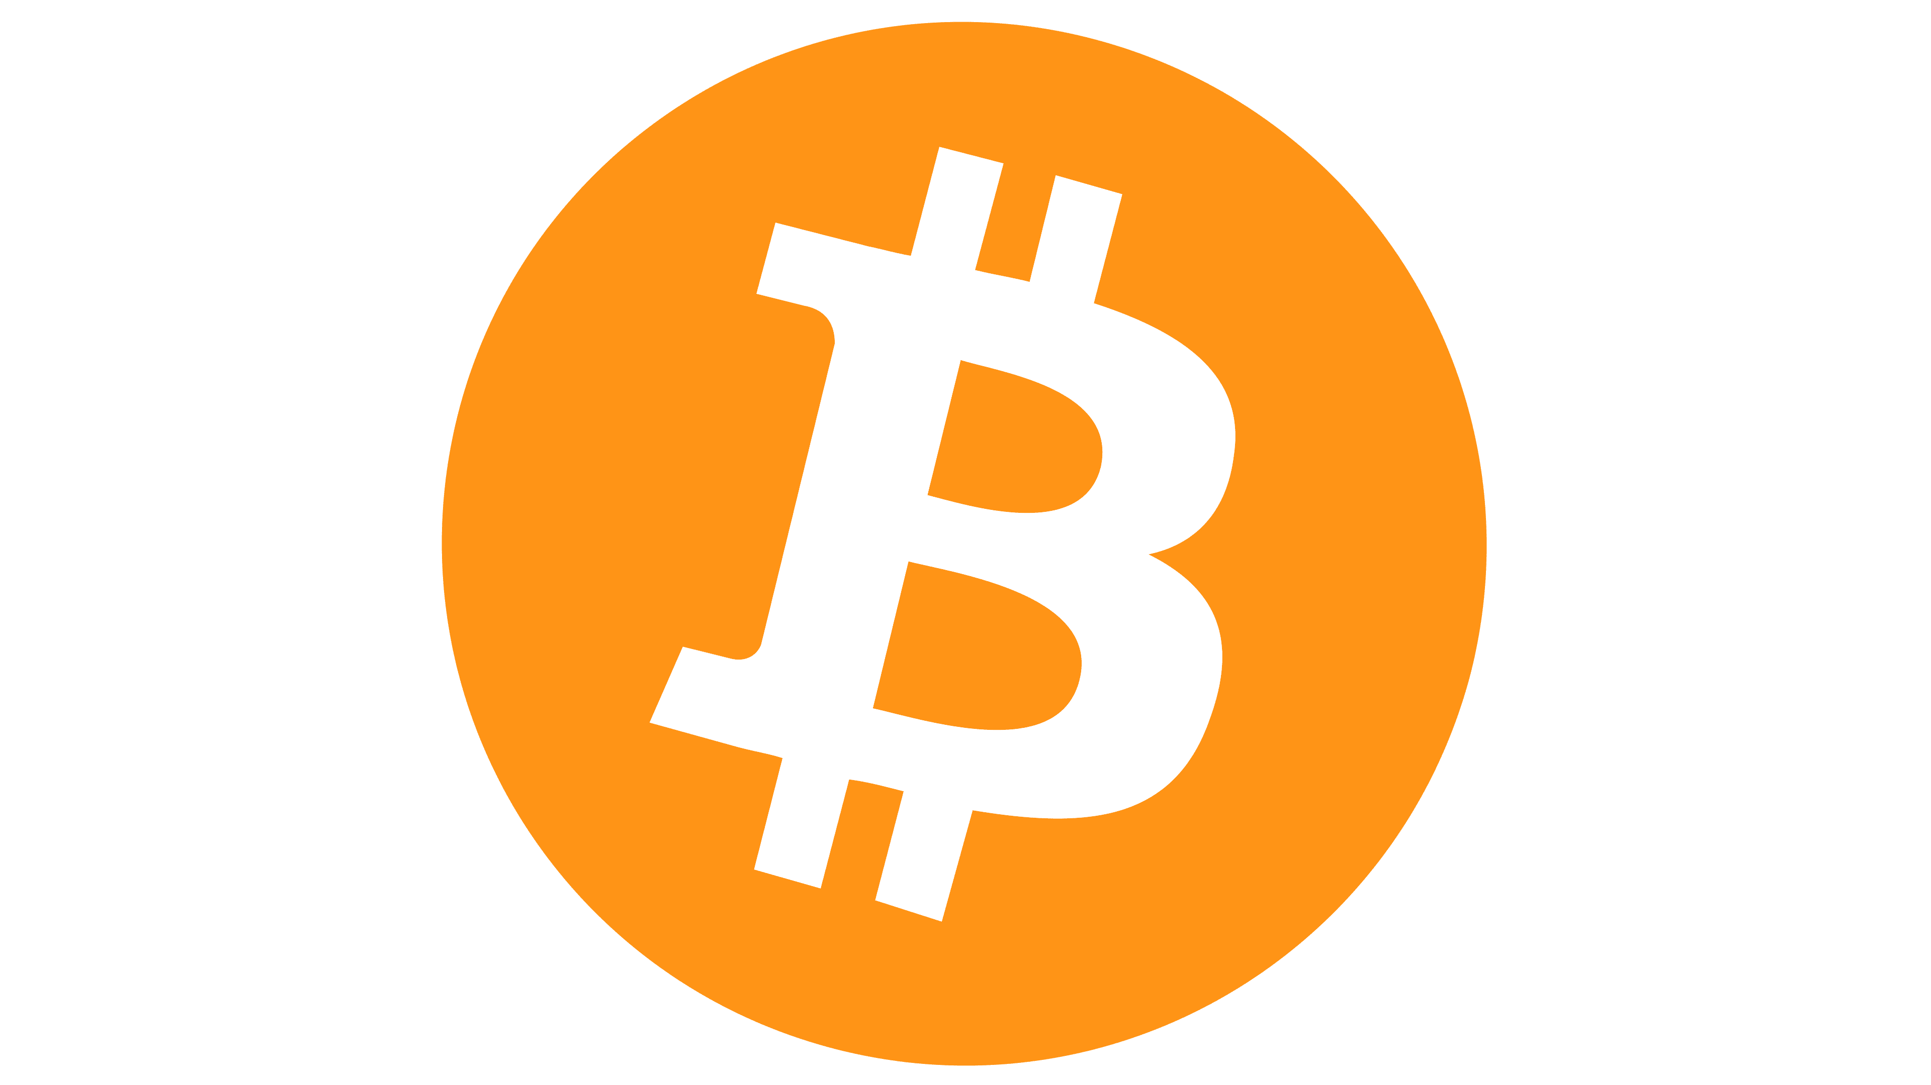





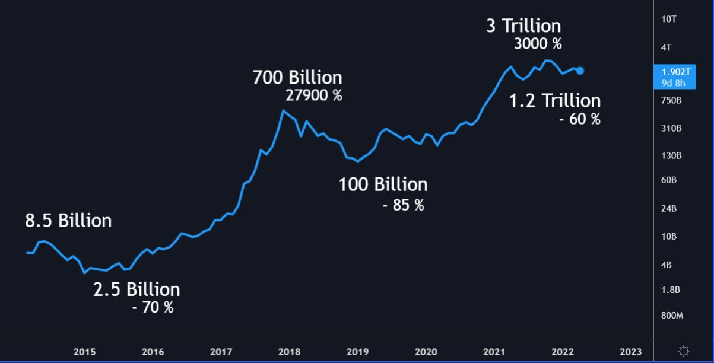
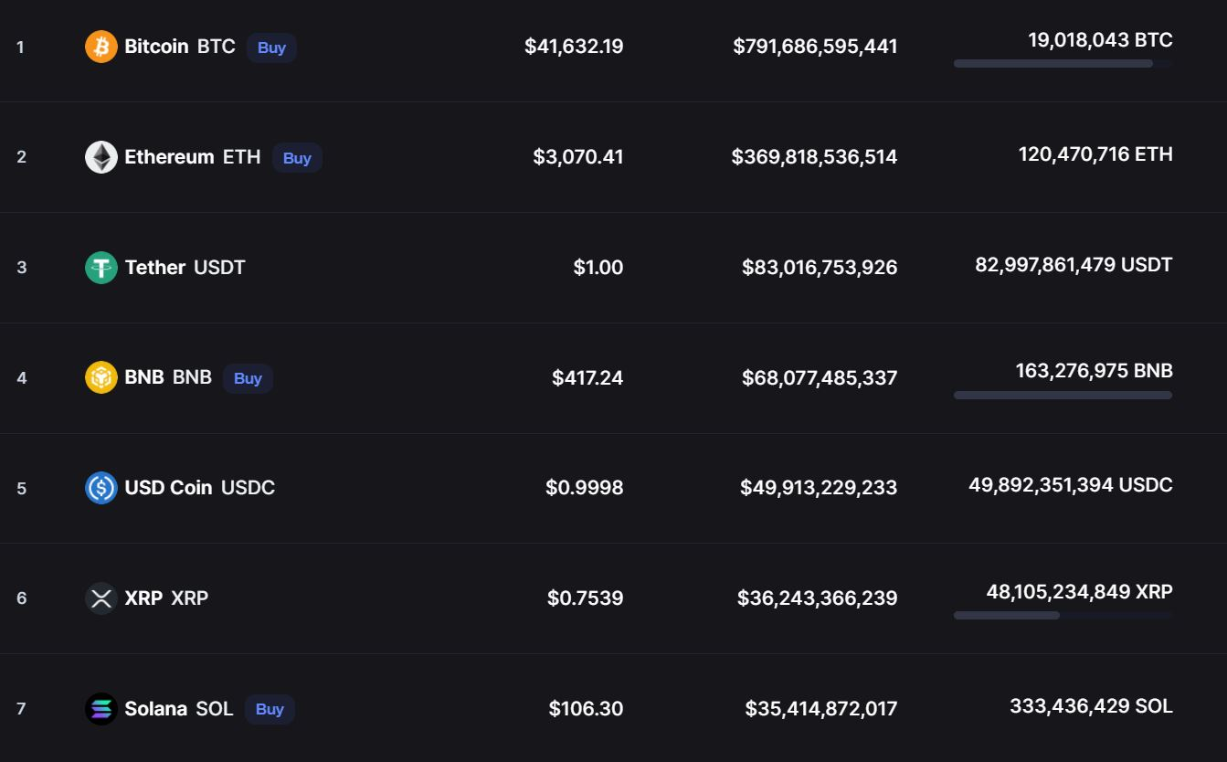
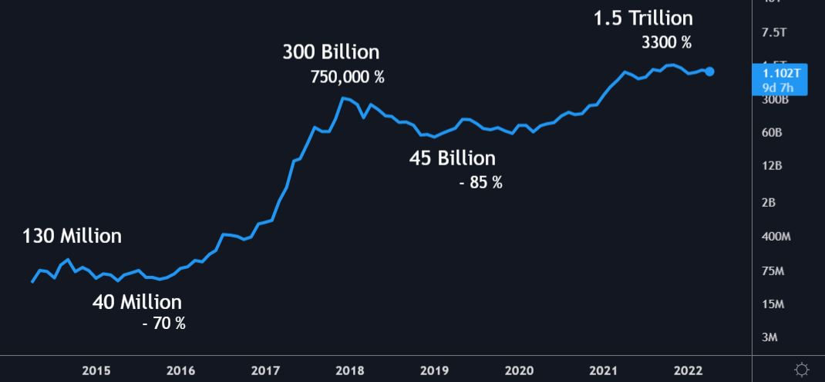
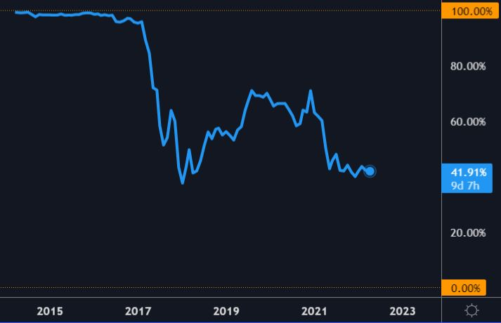
Developments of Cryptocurrency and its Growing Role in Our Financial System
Presented by: Lucas Schnare, B.S. Finance
Faculty Advisor: Zhao Zhao He
Research Questions
Cryptocurrency
Total market cap
Largest projects
How have improvements to utility changed money historically?
Known supply, fixed issuance policy
How do cryptocurrencies further improve on our financial system?
Lowers transactional costs
In what dimensions has this market grown and developed?
Improves security
What evidence is there that adoption is continuing?
Real time payments
Methodology
Send to anywhere on globe
Compare crypto to previous improvements
Available for anyone to use
Historical analysis of money
Analyze trends in data
Altcoin market cap
Bitcoin Dominance
Research current Fiat system
Open source
Any suggestions of continuation?
Trustless contracts, anonymous
History of currency
Notable Advancements
Statistics
Collectibles 40,000 BC
Standards of value
Over 97% of currency already exists in an online ledger
Necklaces, animal teeth, shells, etc.
Supply more controllable
Commodity money
Precious metals 1500 BC
Credit leads to paper notes
The US Dollar has lost 85% of its value since 1973
Conclusions & Prediction
Standard amounts of gold or silver
Transaction costs decrease
Currency can be anything used to transact value, it does not have to be issued by a government.
Coins 600 BC
Cryptography introduced to online payments
Standard fees for international payments total around 3%
Precious metals are minted as coins
Historically, technological advancements have caused money to evolve as they improve its utility.
Fiat currency (US) 1973
Fiat Currency
Cryptos with fees on the lower side fall significantly under 0.2%
Money backed by governments word
Relies on 3rd party
Cryptos are growing much faster than traditional assets, they improve money’s utility, and will eventually replace or be adopted by the financial system.
Cryptocurrency 2009
High transaction fees
Almost 10,000 crypto’s have been created since 2013
Public ledgers run on a blockchain
Historically poor store of value

