Slide 1

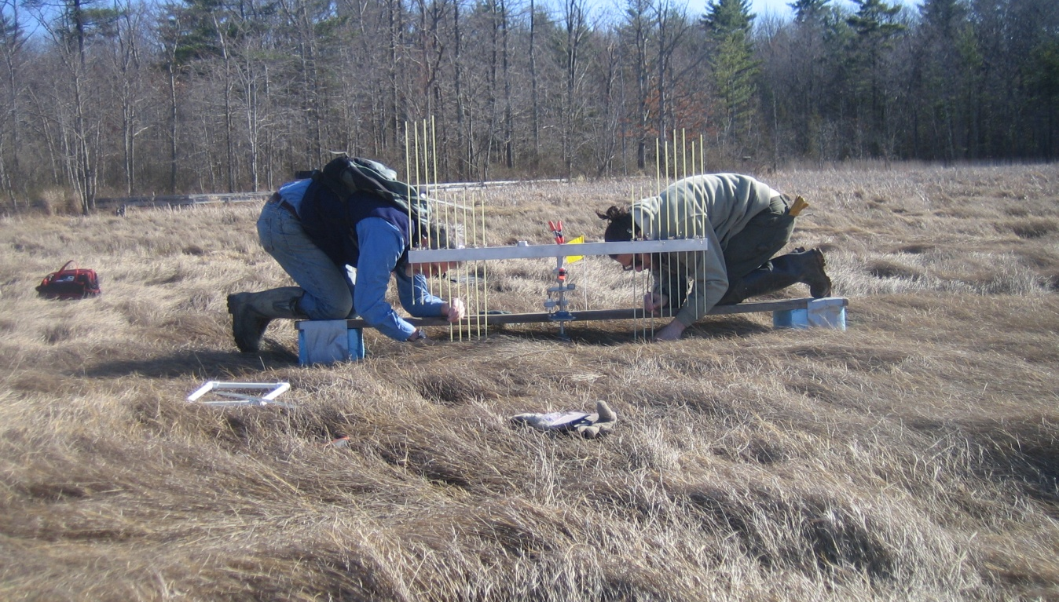
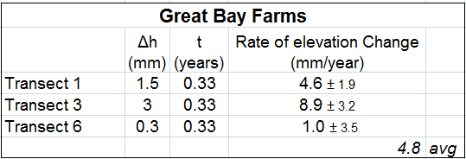
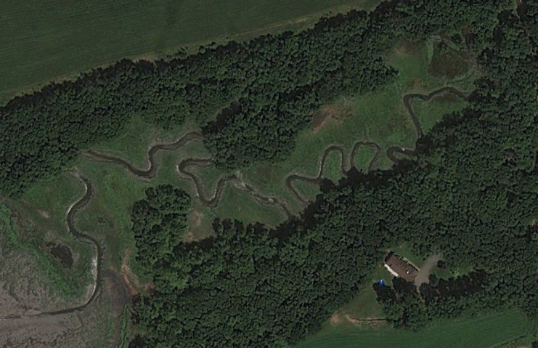
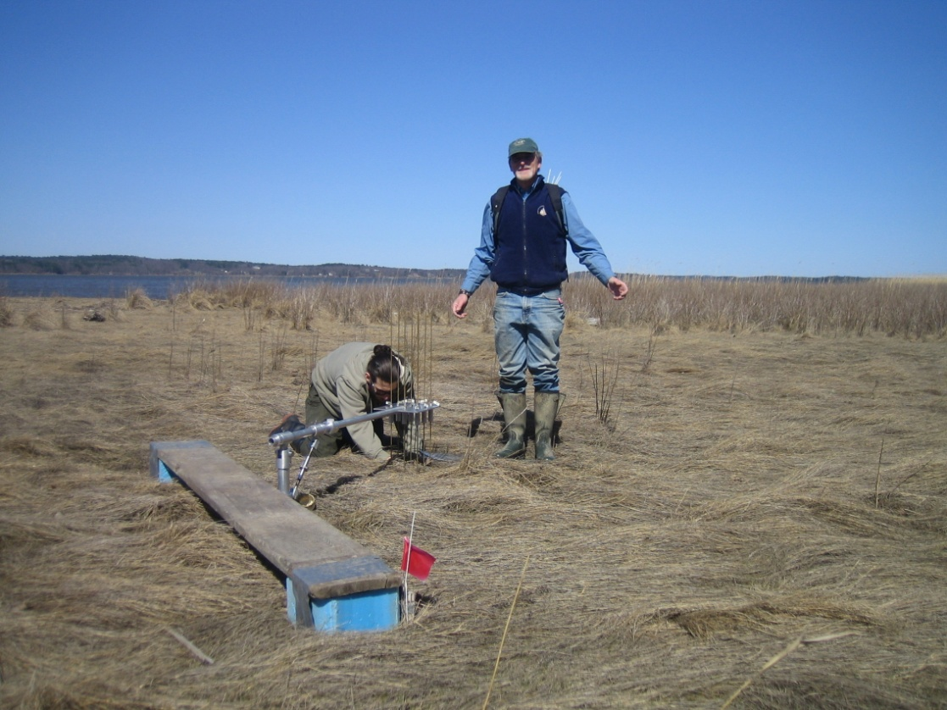
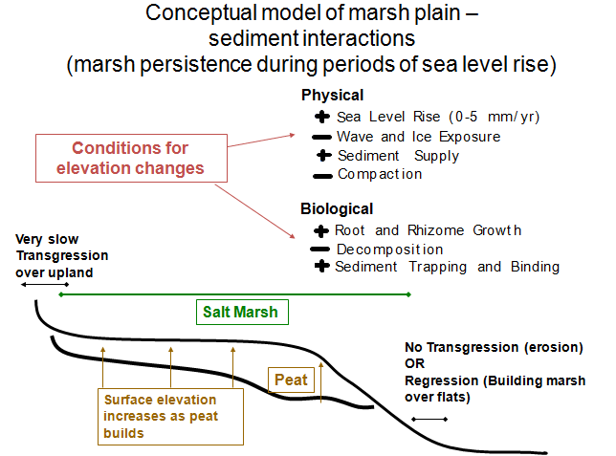
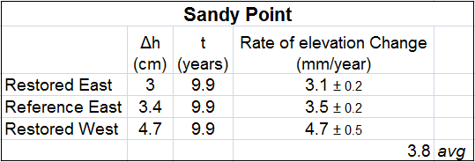
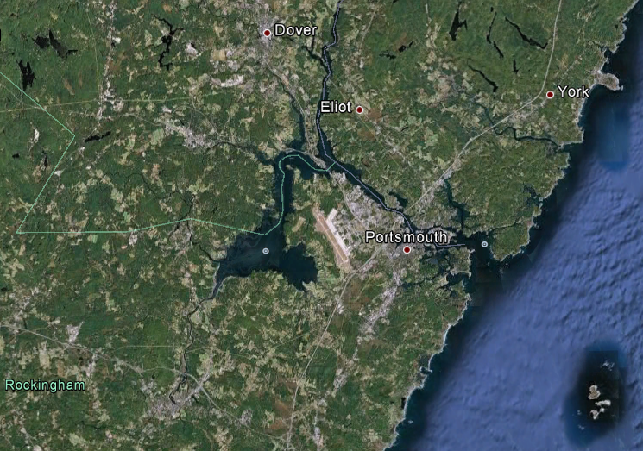
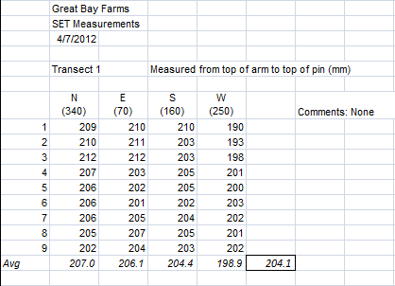
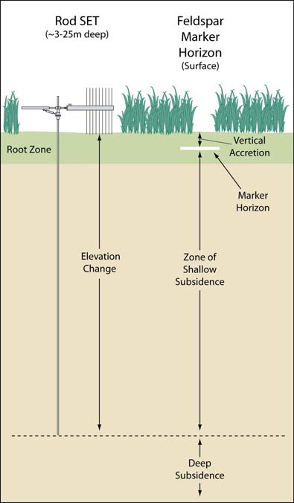
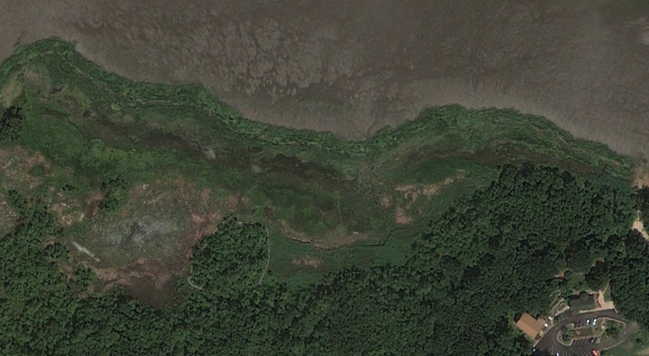

Analysis of Surface Elevation Tables (SET) of New Hampshire Salt Marshes
Spencer C. Tate & David Burdick, advisor
Department of Natural Resources and the Environment, UNH
Introduction
Research Sites
Methods
Results
Salt marshes, particularly in New England, are some of the most productive and valuable wetland ecosystems (Costanza et al. 1989). Salt marshes provide a multitude of ecosystem services including shoreline protection from erosion, water filtration, and sediment trapping. It is believed that salt marsh elevation is intimately linked to sea level elevation through the processes of accretion and erosion (figure 1). The Intergovernmental Panel on Climate Change (IPCC) predicts that greenhouse gas emissions will increase rates of sea level rise above natural levels over the next century. The question then becomes will salt marsh accretion be able to remain in-step with sea level rise (SLR) resulting in a landward migration or will coastal marshes eventually be eroded away, resulting in large-scale environmental, infrastructural, and economic damage. In order to better understand the rates of salt marsh sediment accretion and its relationship with SLR, precise measurements of salt marsh surface elevation are required (Cahoon & Lynch 2010). Two models of the Surface Elevation Table (SET) were used to measure rates of sediment elevation change. These rates of accretion or erosion can later be compared to rates of SLR.
SET benchmarks are located across the globe. The study sites we examined were located within New Hampshire’s Great Bay Estuary. Both study sites had existing SET benchmarks with previously archived data from known dates and are ongoing study sites maintained by staff from the Jackson Estuarine Laboratory, UNH.
The existing sites were located using a combination of GPS, crude maps, and soil probes.
Raised wooden planks were setup around the SET benchmark. The “scaffolds” allowed us to work immediately around the benchmark without impacting the study site with footprints and tools.
The SET was placed into the receiving head and the cantilevered arm was leveled using a turnbuckle. Leveling of the arm is crucial for precise measurements.
Measuring pins are inserted through the SET arm and are lowered to the marsh surface. Any plant material is moved aside in order to ensure contact with the sediment. This process is repeated for all nine pins in each of the four cardinal directions.
The summary tables below are a synthesis of the elevation change calculations. It should be noted that both sites fell within the “normal” range for elevation change over time.
The Great Bay Farms marsh had much more variability in regards to both change in elevation and rate of change in elevation, especially when compared to the Sandy Point marsh. Plant senescence, ice scour, and short sampling interval could be sources of error. The Sandy Point marsh had a much longer sampling interval and subsequently the changes averaged over 10 years resulted in lower error terms.
Site 1:
Great Bay
Farms
The length that the pin extends
above the SET arm was measured in centimeters and recorded by an
observer in a field book.
During the growing season
vegetation is quantified by estimating percent cover by species of the sampling site. This data can be used to categorize the sampling sites as ‘high marsh’ or ‘low marsh.’
Great Bay Farms is located on the eastern edge of the Great Bay Estuary in Newington, NH between mixed residential and agricultural land use.
Three SET sites along existing transects.
Installation in November; initial sampling date: December 5, 2011
Pins are then removed and the SET arm is rotated 90⁰. The arm is re-leveled and the process is repeated.
Once all measurements are taken at a certain benchmark the SET is moved to the next benchmark and the process is repeated.
All field data was then transposed and collated into a spreadsheet and the elevations were analyzed using statistical analysis software (JMP).
An example data table of an SET benchmark (Great Bay Farms, Transect 1) sampling can be seen below:
The 36 points surrounding the benchmark were averaged to yield one benchmark elevation to be compared with archived and future SET data.
Marker horizons were used to verify that our elevation change data was on the right order of magnitude.
Discussion & Conclusions
Using satellite derived measurements, the rate of SLR was determined by Nicholls and Cazenave to be 3.3 ± 0.4 mm per year from 1993 to 2009. One can see when comparing this SLR rate to the rates of salt marsh accretion that were calculated in this study, the theoretical model that predicts marshes can build at rates comparable to SLR is corroborated.
Although the limits and exact nature of the SLR/salt marsh elevation feedback relationship are still poorly understood, ongoing studies and regular measurements could help determine “tipping points” for the fate of these ecosystems. This is especially important when considering both the ecosystem services gained from tidal marshes and the location of major cities, ports, nuclear power plants, as well as private and federal property.
On a local level, the Great Bay NERR will use these data to guide management of reserve habitats.
On national and global levels, the data collected from these study sites will be used in conjunction with data collected around the world to help model the impacts of SLR on tidal marshes and their responses.
SET Apparatus
Traditionally, a feldspar marker horizon was used to study rates of accretion. Inherently, this does not account for decomposition or production below the marker..
The salt-marsh surface elevation table is an apparatus developed by Boumans and Day (1993) and promoted by the US Geological Survey (Cahoon and Lynch 2010) to accurately measure sediment elevation in wetlands.
Easily allows for minimal-impact determination of rates of elevation change caused by accretion, production, and subsidence.
Site 2:
Sandy
Point
Acknowledgments
My sincerest thanks to Chris Peters, M.S., Joshua Cain, and Perry Thomas for technical and logistical assistance.
- Once a benchmark is established in a wetland ecosystem, the SET user can return after selected time intervals (1 year, 5 year, 15 year) to measure the exact same points on the marsh.
Initial elevation data (h_{i}) can then be subtracted from final elevation data (h_{f}) order to determine a change in elevation (Δh).
By dividing the change in elevation by the return interval one can determine a rate of elevation change per unit time (t).
By measuring accretion rates with feldspar marker horizons placed adjacent to the SET benchmark at the time of installation, relative rates of subsidence can be measured.
References
- Finally, rates of elevation change were calculated for each of the benchmark sites by using the following equation:
(Δh)/t = Rate of elevation change
Where:
Δh = h_{f} – h _{i}
t = elapsed time
Cahoon, Donald R., and James Lynch. "USGS PWRC - SET Website." Patuxent Wildlife Research Center. U.S. Department of The Interior, U.S. Geological Survey, 23 June 2010. Web. 09 Feb. 2012. <http://www.pwrc.usgs.gov/set/>.
Chmura, G. L., and G. A. Hung. 2004 Controls on Salt Marsh Accretion: A Test in Salt Marshes of Eastern Canada. Estuaries 27:70-81
Costanza, R., S. C. Farber, and J. Maxwell. 1989. The valuation and management of wetland ecosystems. Ecological Economics 1:335-361.
Feagin, R. A., M. Luisa Martinez, G. Mendoza-Gonzalez, and R. Costanza. 2010. Salt marsh zonal migration and ecosystem service change in response to global sea level rise: a case study from an urban region. Ecology and Society 15(4): 14.
Nicholls, R.J., Cazenave, A.(2010). "Sea-Level Sea-Level Rise and Its Impact on Coastal Zones". Science Magazine 328 (5985): 1517–1520.
Sandy Point is located off of Depot Road in Stratham, NH and is part of the Great Bay National Estuarine Research Reserve (NERR).
Marsh is on the southern end of Great Bay.
Three existing SET sites with archived data from July, 2001 and August 2011.
A fourth SET was installed on March 15, 2012.

