Slide 1


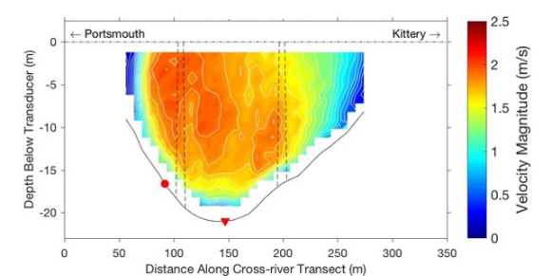
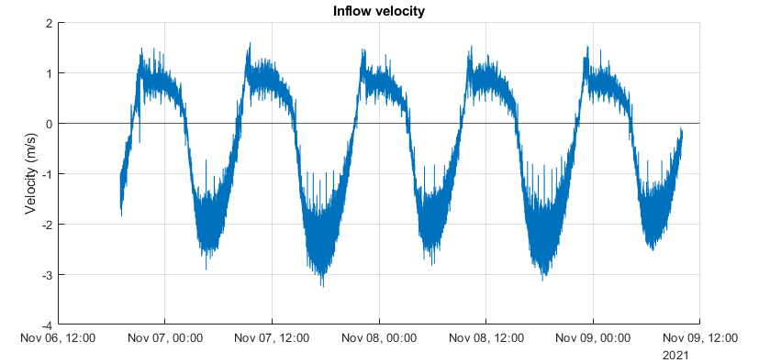
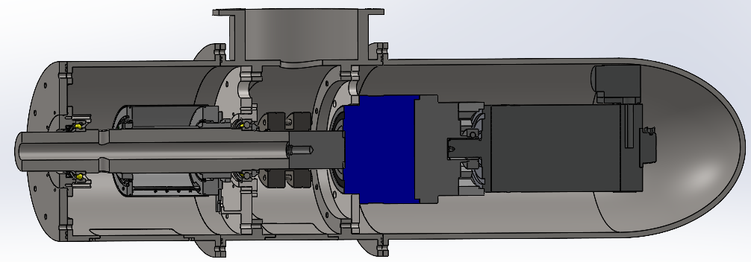
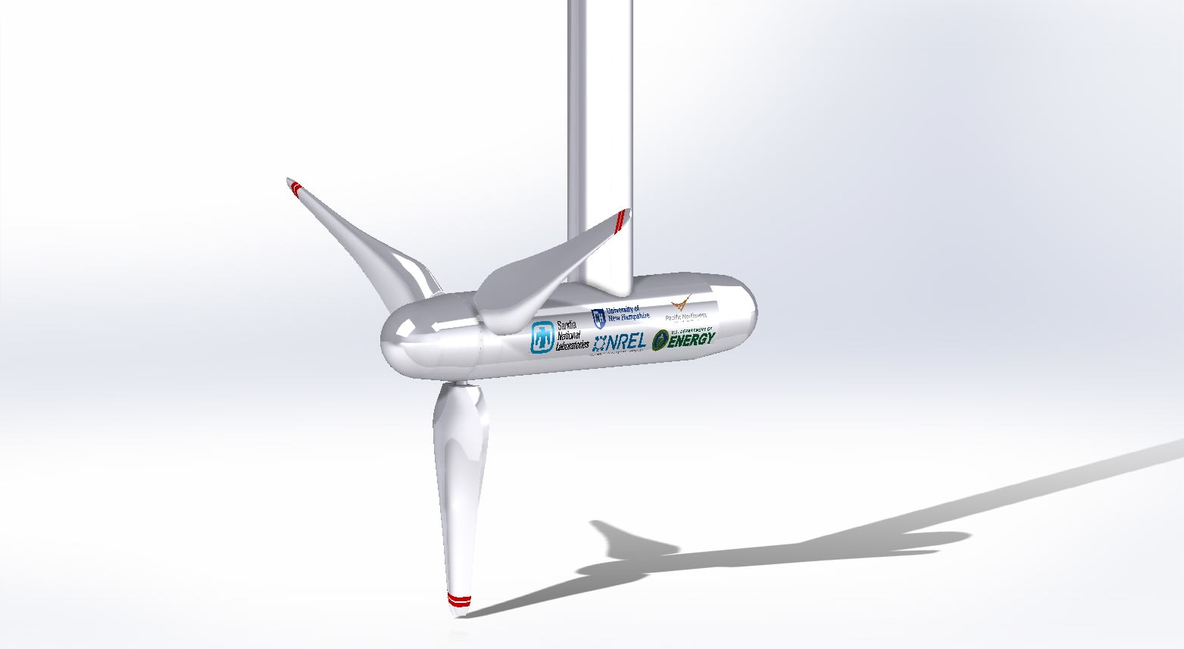
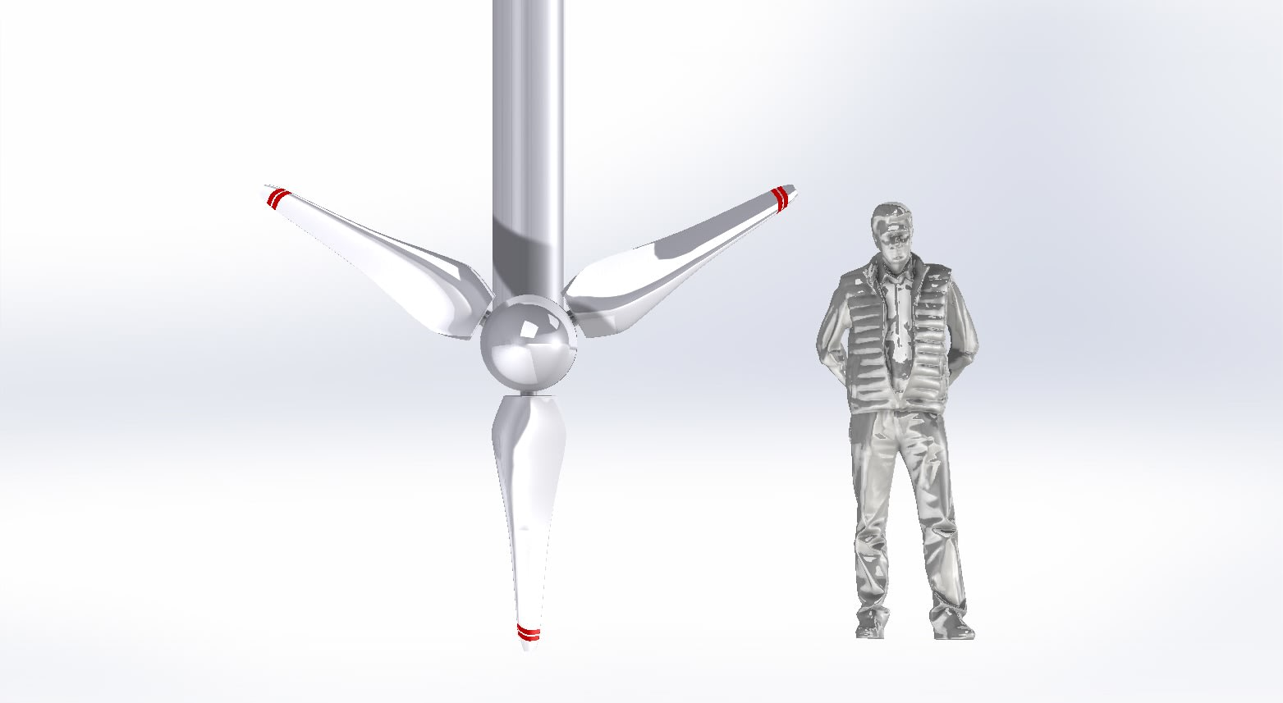
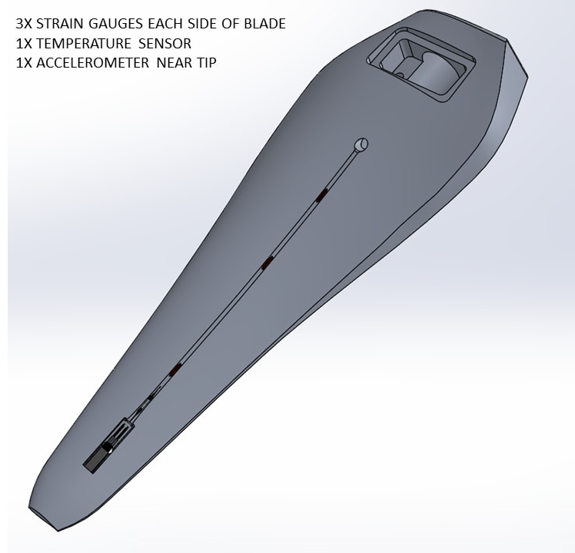
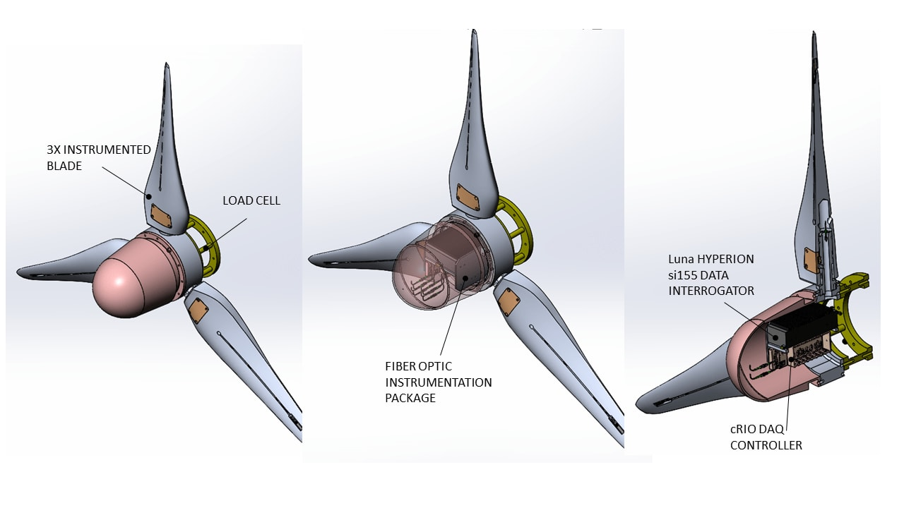

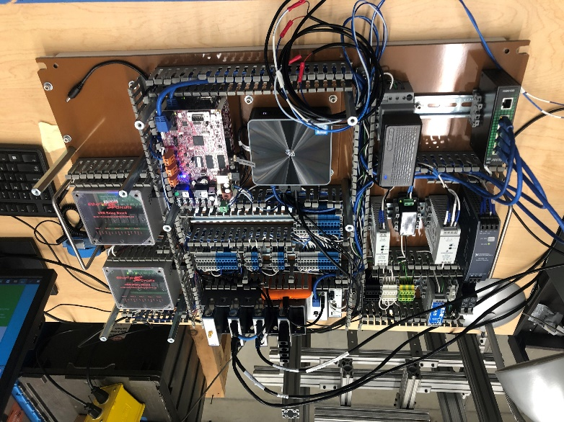
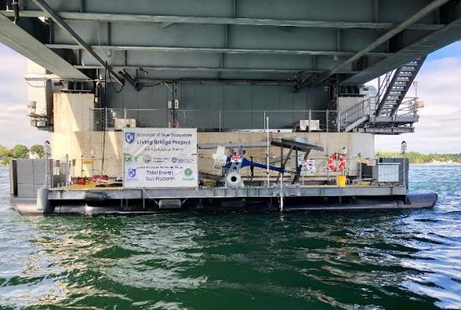
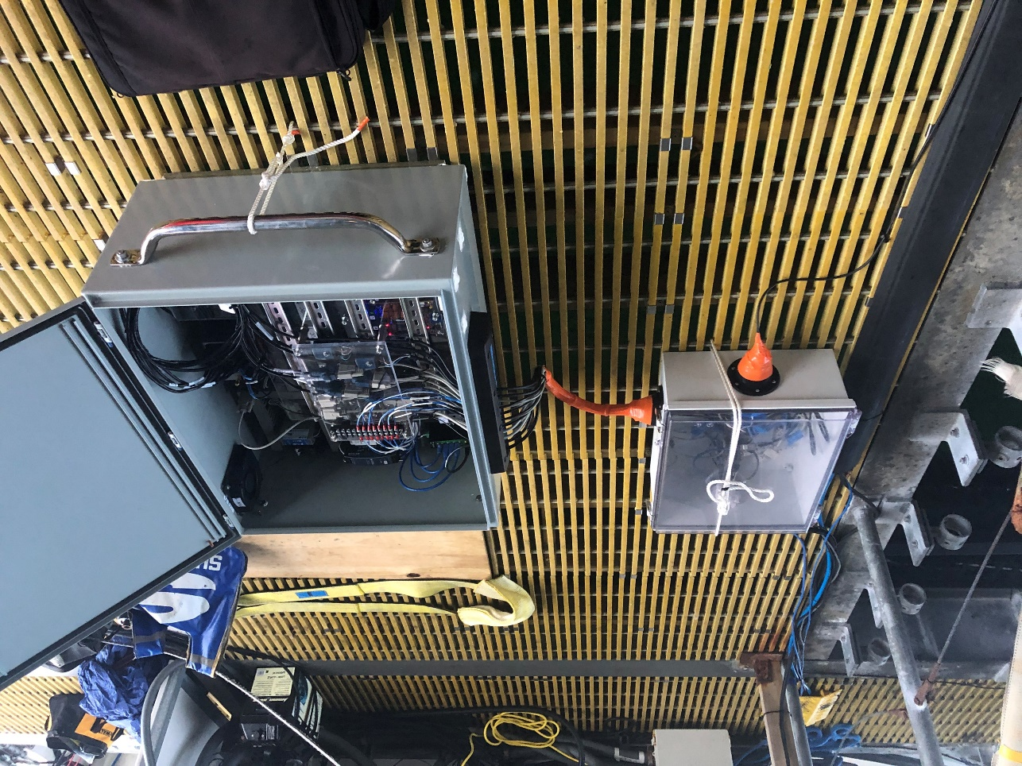







Characterization of an Open-Source Marine Hydrokinetic Turbine
Mason Bichanich¹, Martin Wosnik¹, Erin Bell¹, Vince Neary², Robert Cavagnaro³, Aidan Bharath⁴
¹Center for Ocean Renewable Energy (CORE), University of New Hampshire, ²Sandia National Laboratories, ³Pacific Northwest National Laboratory, ⁴National Renewable Energy Laboratory
Motivation and Strategy
Tidal Estuary / Energy Resource
Ongoing and Future Work
Tidal energy is an extensive, largely untapped source of energy around the world, but it remains under utilized due to the harsh conditions and high hydrodynamic loads associated with the marine environment
Tidal energy currently has a much higher levelized cost of energy (LCOE) when compared to other renewable sources, such as wind and solar.
There is not much publicly available data surrounding the interactions of relevant-scale MHKTs in a real tidal flow
The Memorial Bridge is located between Portsmouth, New Hampshire and Kittery, Maine
It crosses the lower Piscataqua River in the Great Bay Estuary (GBE) system, one of the most energetic tidally driven estuaries on the East Coast of the United States
Tidal currents over 3 m/s measured during spring ebb tides at site (Acoustic Doppler Velocimeter)
Nominal depth at site ~18 m, maximum tidal range ~4m
Designs of the rotor, hub, nacelle, power take-off (PTO), and tower are well underway, and various components have been purchased
Multiple design issues being considered: water sealing, galvanic corrosion, biofouling, general operation, modularity of design, safety and many others
After dry and wet testing in Chase Lab, we will be deploying the turbine in Summer/Fall 2023 to begin testing according to the IEC marine standards (TC 114)
Ongoing upgrades to the UNH MODAQ to accommodate addition environmental instruments as well as data from the turbine
Bridge Piers
UNH-CORE, in partnership with the United States Department of Energy (USDOE), is tasked with the design, fabrication, and testing of a 2.5-m fully instrumented marine hydro-kinetic turbine (MHKT)
Data regarding the structural health, tidal resource, and performance of the turbine will be collected and published in the open-source Portal and Repository for Information on Marine Renewable Energy (PRIMRE)
The data collected will help to inform the International Electrotechnical Commission's (IEC) standards for marine energy (TC 114)
test site
Spatial distribution of tidal current speeds at the Memorial Bridge at spring ebb tide
Inflow velocity at the Memorial Bridge sampled at 16 Hz with an ADV
Instrumentation / Data Acquisition
Turbine instrumentation and sensors measure blade strain and bending moments, acceleration, rotor thrust, shaft toque and rotational speed, while environmental sensors measure tidal current speed, platform motion, salinity, turbidity, and more
Data Dissemination
The data from all experiments and testing of various IEC measurement and load cases will be available through the open-source PRIMRE
This will be the first data set of this kind to exist in the public domain
This data will help inform MHKT design and reduce time and cost for turbine developers and thereby reduce LCOE of tidal energy
The project will use current versions of the IEC marine
energy standards and will inform future revisions
Rotor diameter = 2.5 m
Turbine Deployment Platform
Contact
UNH-CORE utilized USDOE funding for ocean renewable energy infrastructure to build a 15 m x 6 m floating Turbine Deployment Platform (TDP)
HDPE pontoons provide buoyancy, and a
galvanized steel frame provides structural
strength
The TDP is moored to the bridge pier via
custom pile guides and 6.7 m tall vertical
guide-posts
Turbines are deployed through a moon pool
(3.3 m x 5.7 m) via a turbine pitching
mechanism
In partnership with NREL, UNH developed a Mobile Data Acquisition System (UNH MODAQ, right)
DAQ system in the nose cone of the turbine records the blade strain
Designed and built by Patrick O’Byrne at UNH
Mason Bichanich, mason.bichanich@unh.edu
Sponsor Acknowledgement
Temporally synchronized data from turbine and environmental sensors — important for load and power characterization

