Slide 1
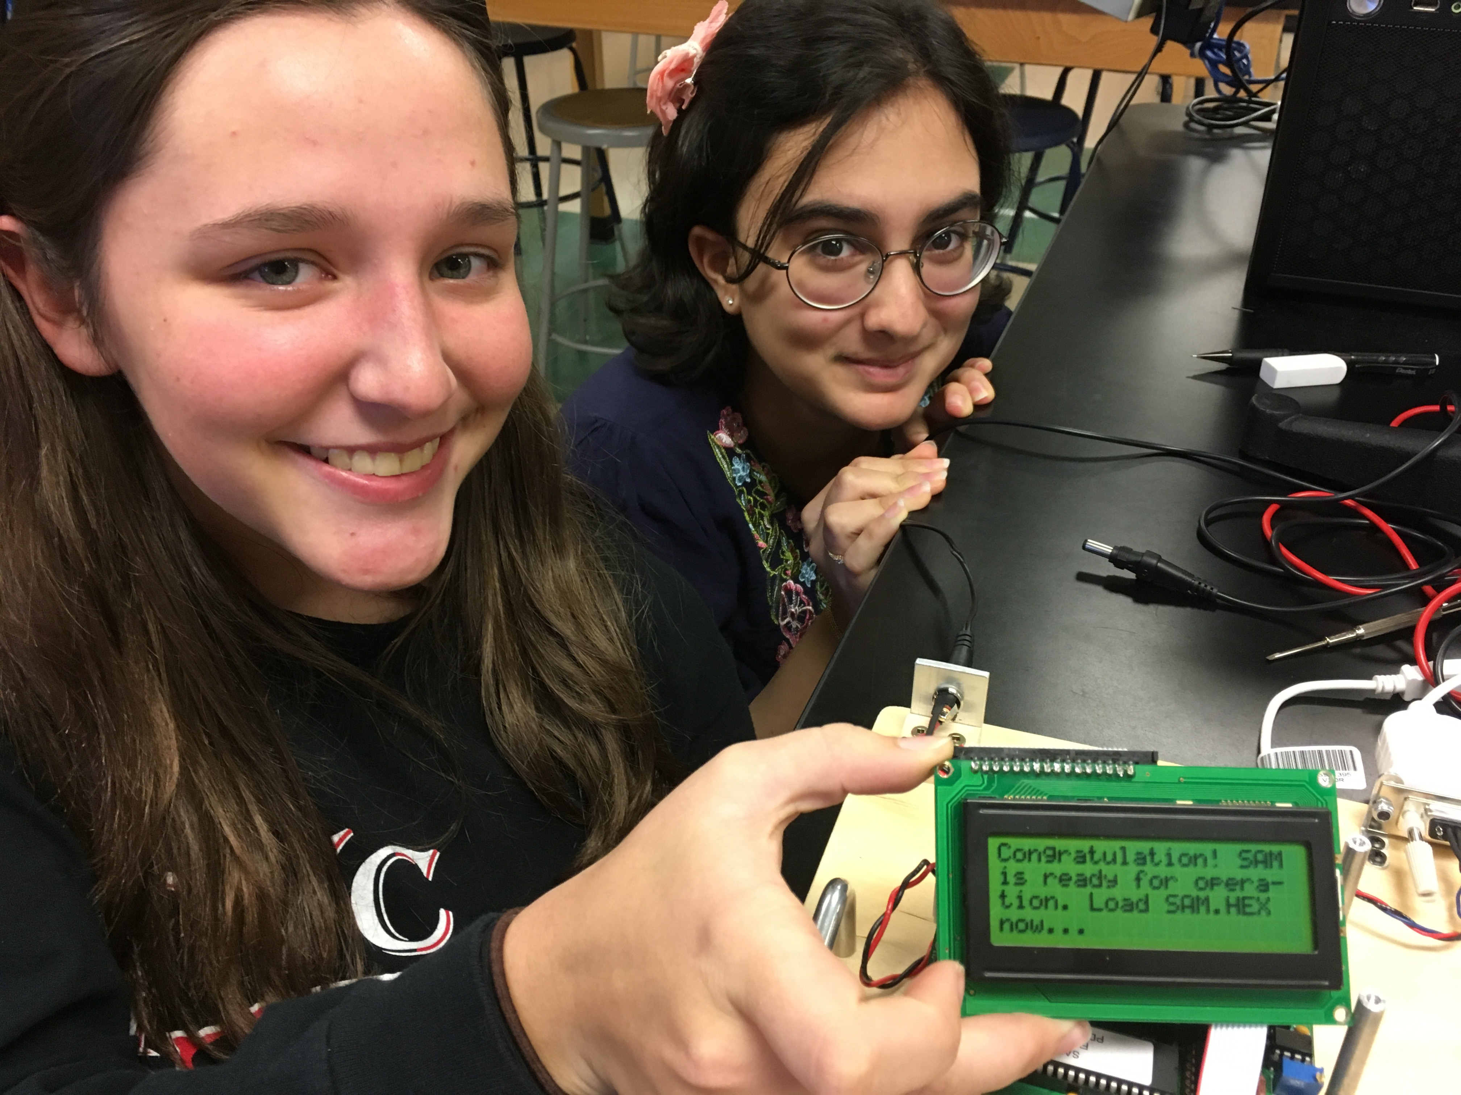
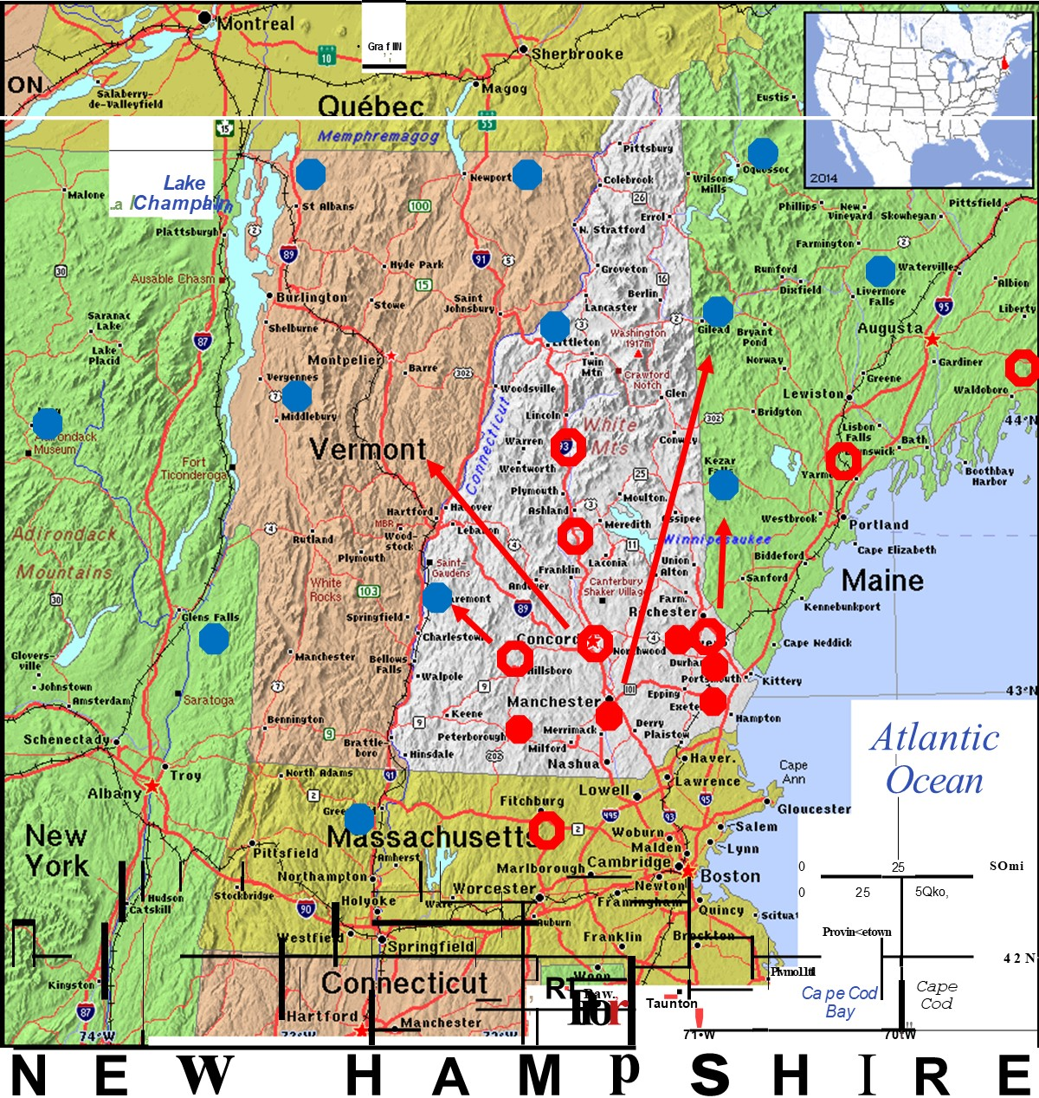
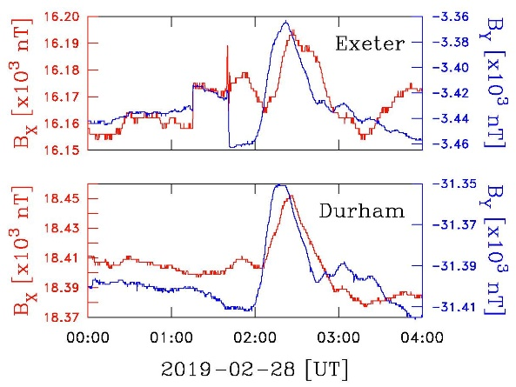
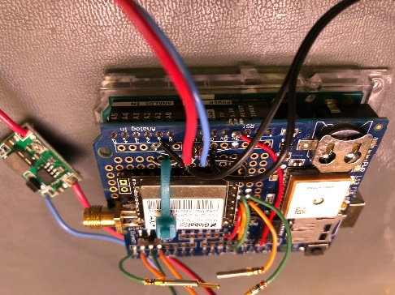
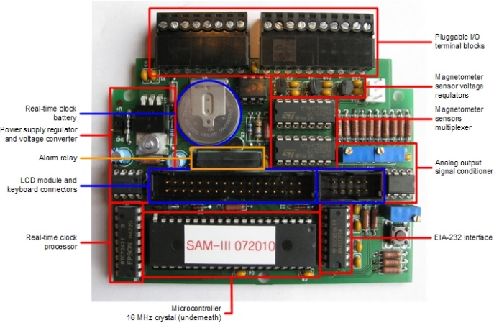
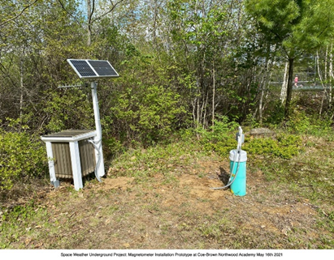
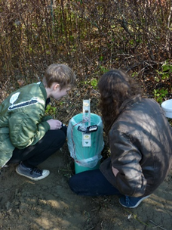
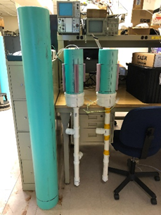
UNH Space Weather UnderGround
Charles W. Smith, Institute for the Study of Earth, Oceans & Space
University of New Hampshire
Charles.Smith@unh.edu (603-659-0386)
UNH is working with federal funding to build an array of ground-based fluxgate magnetometers across northern New England for the purpose of better understanding ionospheric current systems. High-school students are building the instruments and deploying them (when possible) near campus. The data is transmitted to UNH where the SWUG Data Center provides it to the scientific and educational community.
Our working mags do see related transients, but the goal is to time the coincidence and determine the propagation of disturbances across the surface.
1. Coe-Brown Academy in Northwood, NH
2. CONVAL High School in Peterborough, NH
3. Hillsboro-Deering High School in Hillsboro, NH
4. North Yarmouth Academy in Yarmouth, ME
5. Oyster River High School in Durham, NH
6. Phillips-Exeter Academy in Exeter, NH
7. Plymouth High School in Plymouth, NH
8. Souhegan High School in Amherst, NH
9. The Bromfield School in Harvard, MA
10. UNH in Durham, NH
11. Washington Academy in East Machias, ME
Winnesquam High School in Tilton, NH
+ 1 in New York, 2 in Mid-West, 1 in Maryland, and 3 in Georgia.

