Slide 1






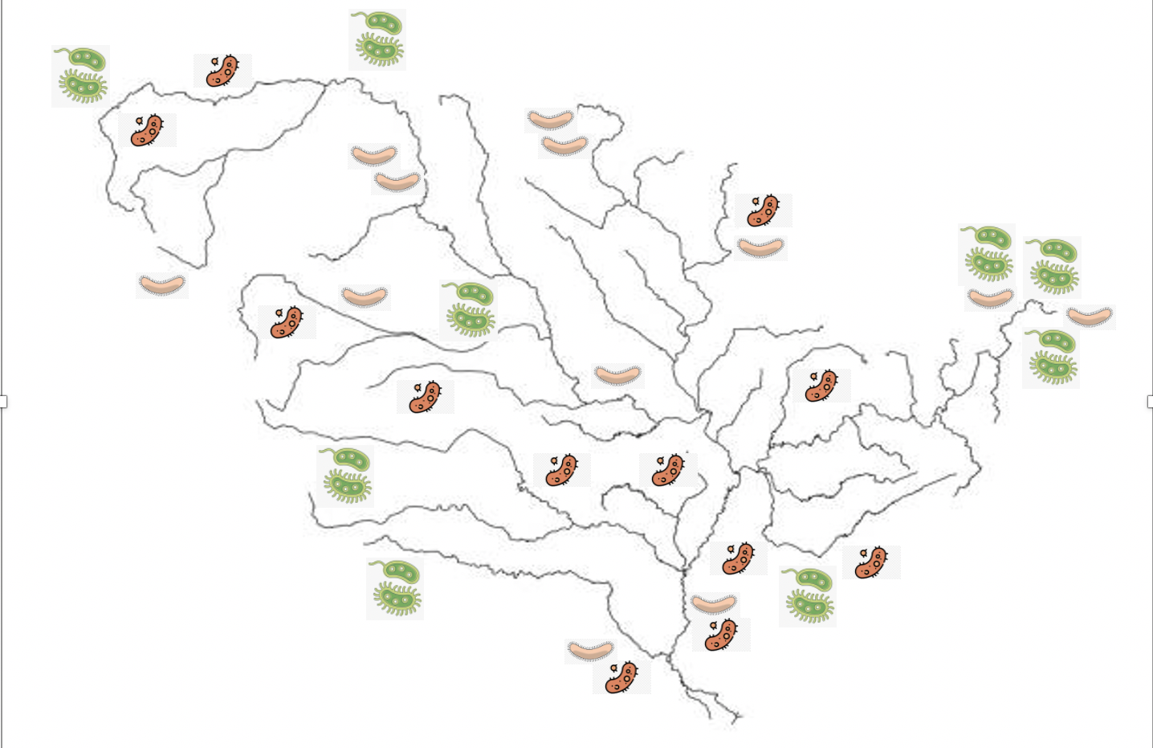
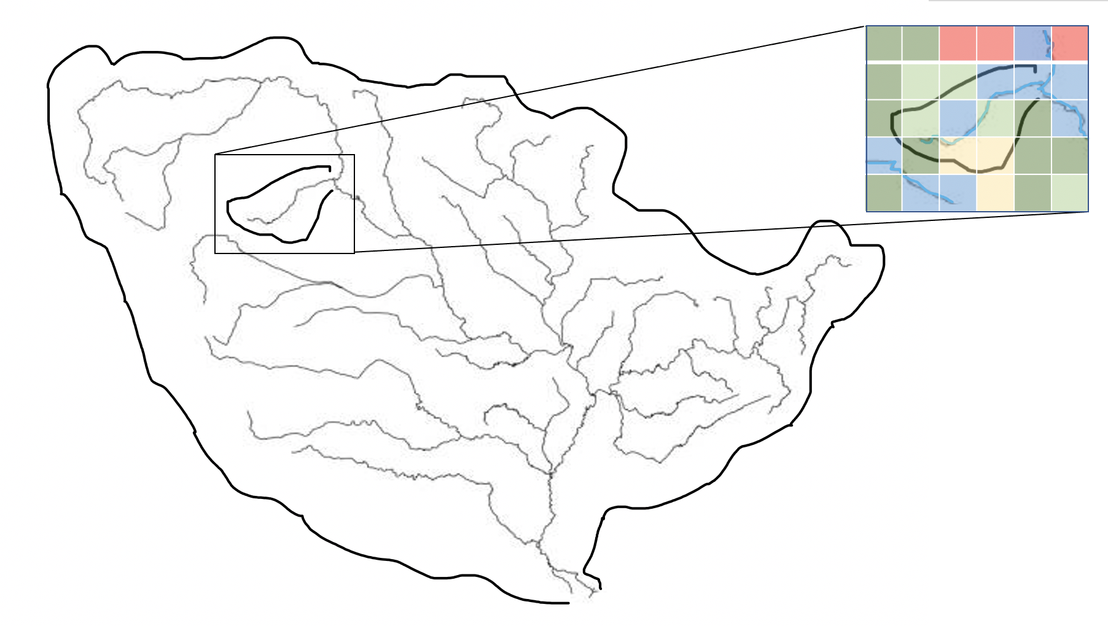
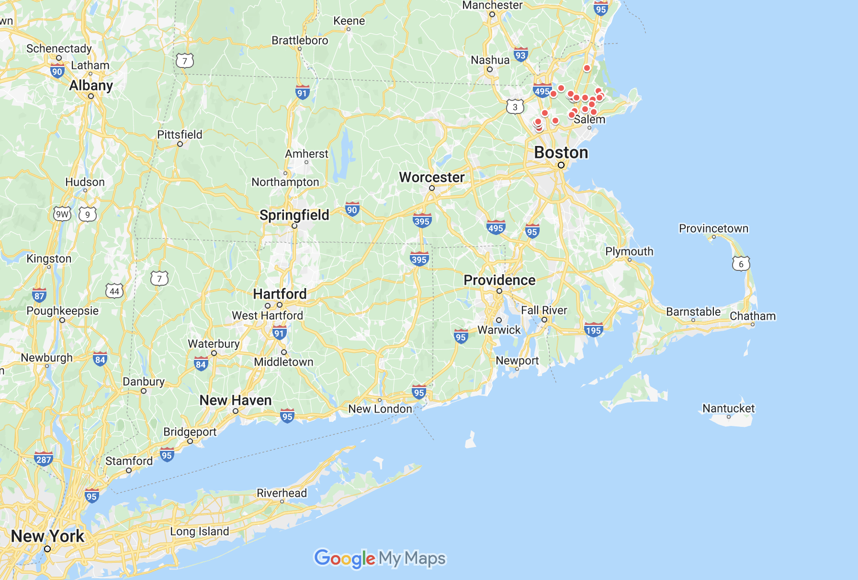
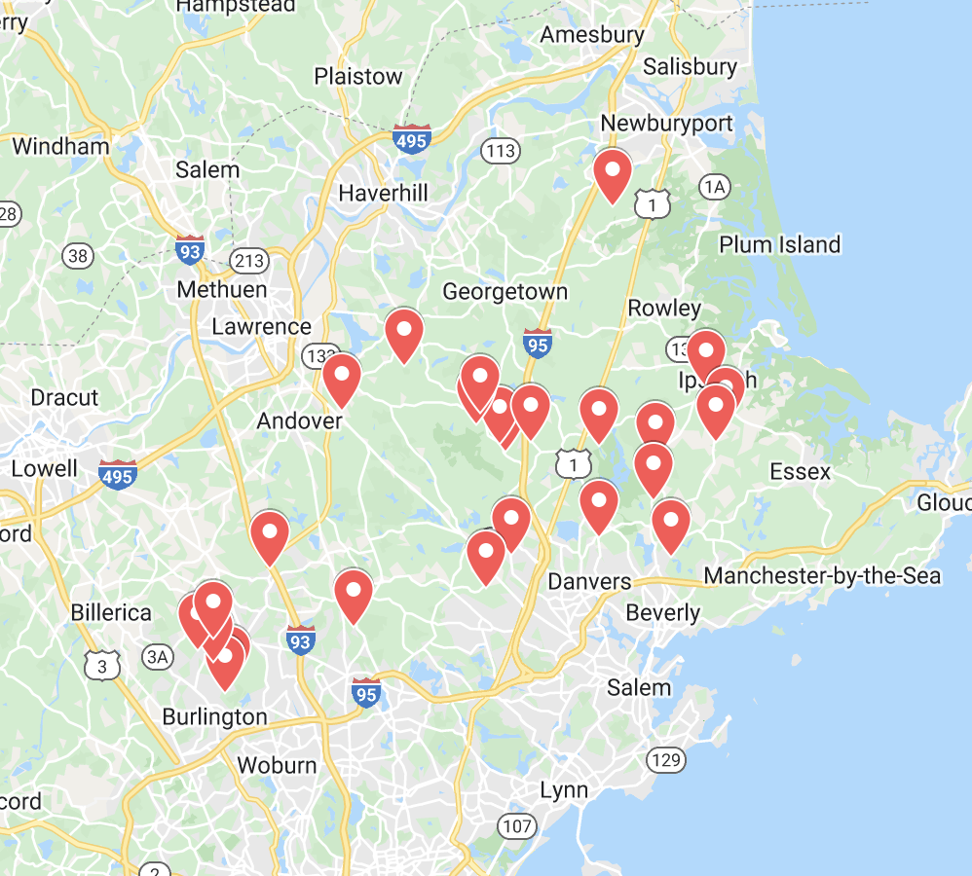
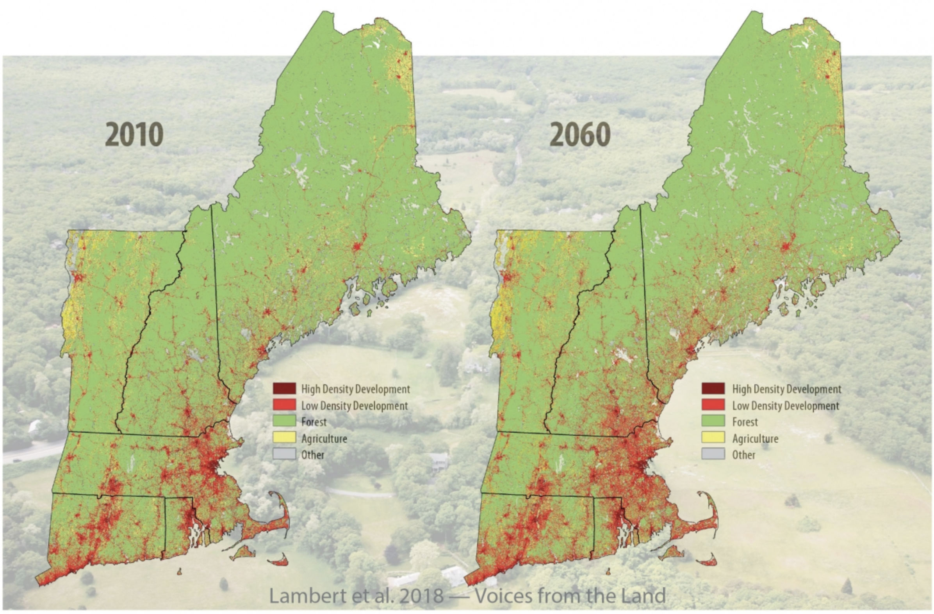
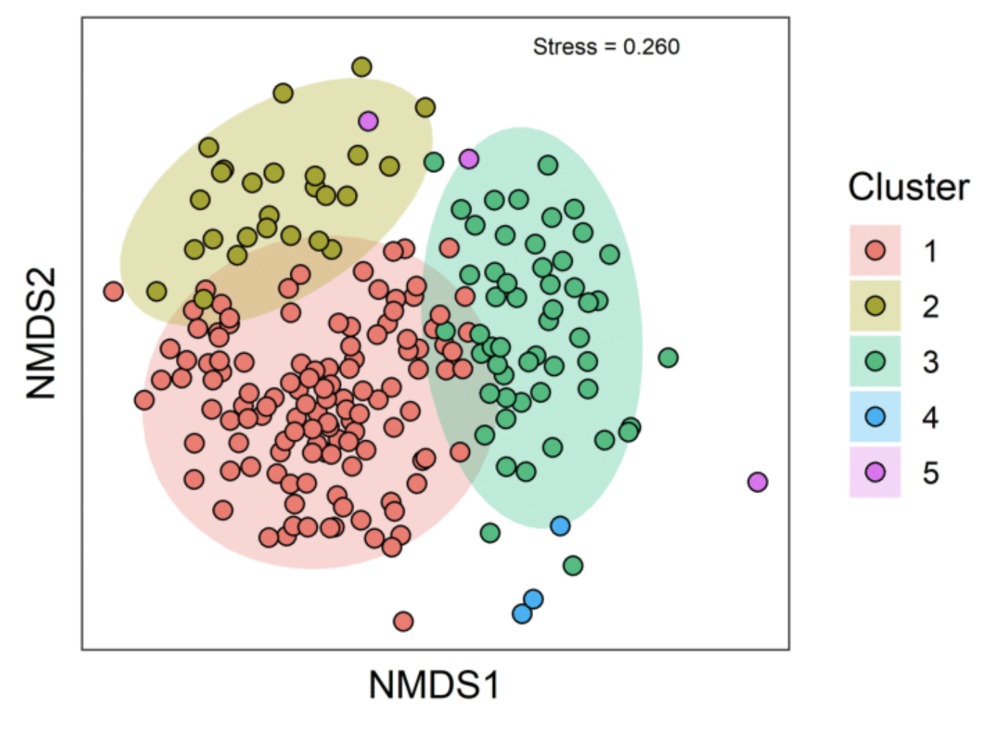
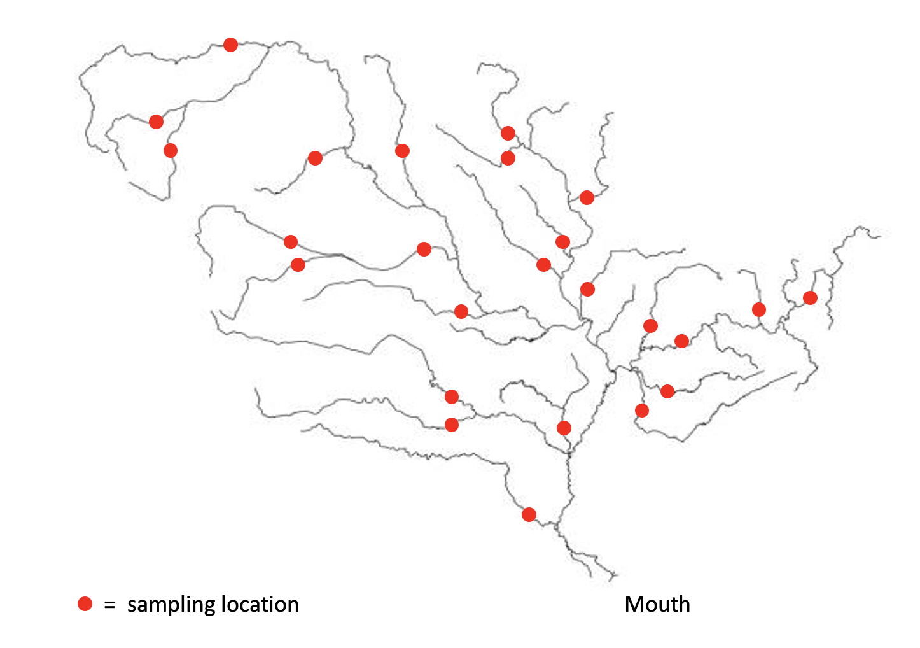
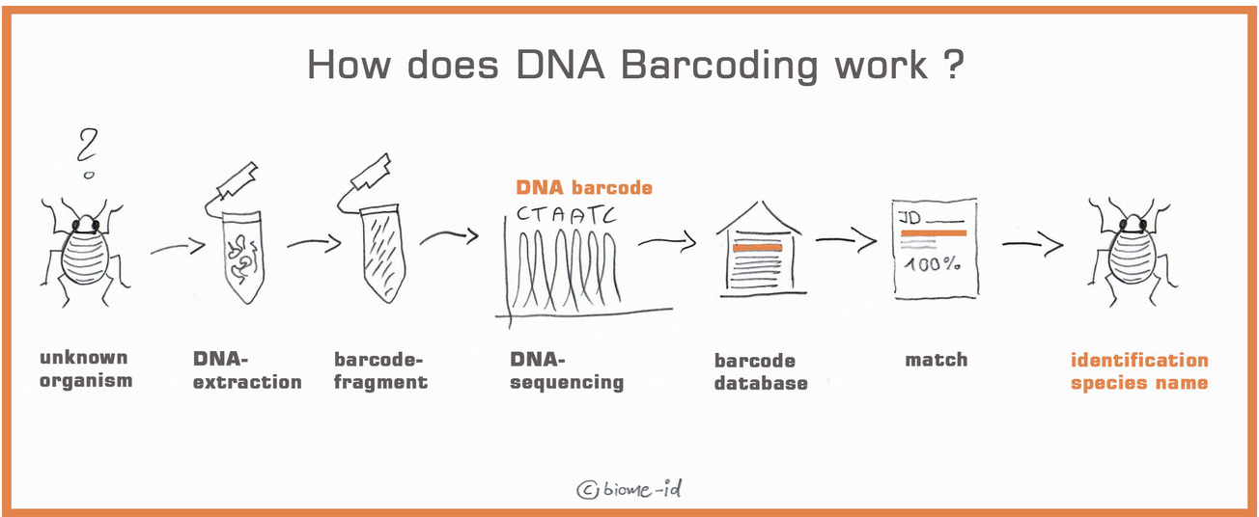
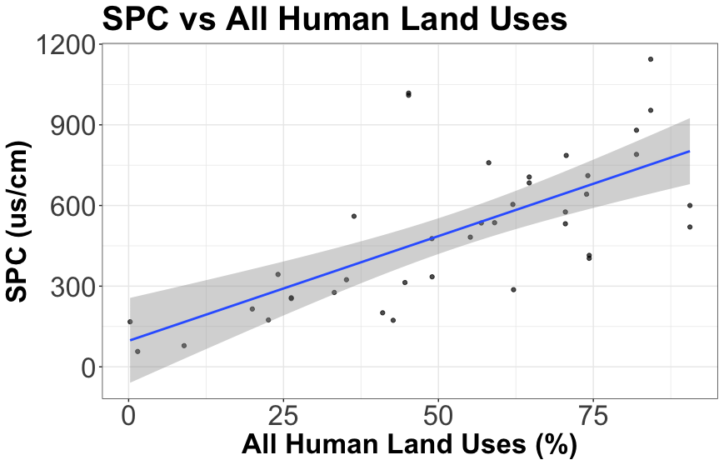
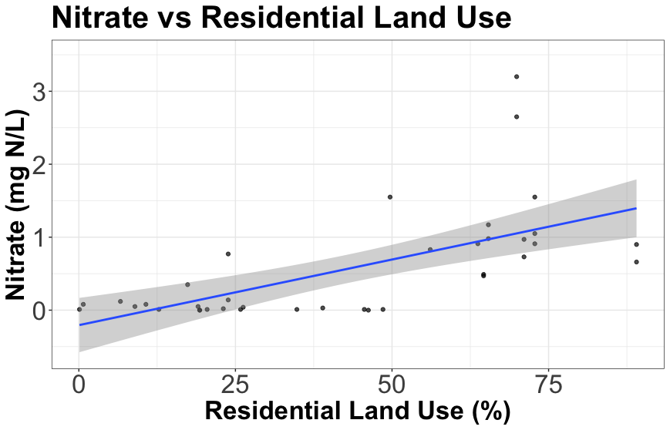
Relationship Between Stream Microbial Communities and Land Use in a Suburbanizing Watershed
Joshua Buonpane (joshua.buonpane@unh.edu), Wilfred Wollheim, Jessica Ernakovich, Adam Wymore, Lukas Bernhardt, Hannah Holland-Moritz
Department of Natural Resources and the Environment, University of New Hampshire
Background
Conceptual Model
Approach
Development is projected to increase in the next 40 years in New England and afar. Land use affects water quality and sediment chemistry in streams, which both influence benthic microbial communities. These microbial communities are also influenced by surrounding land use due to seeding of microbes. Thus, suburbanization is a potential mechanism for shifts in benthic microbial communities throughout watersheds.
25 headwater study sites in Ipswich River watershed
A
B
Headwater stream study sites range widely in chemistry and surrounding land use
Composite sampled sediment at each site for DNA barcoding
Source: Gillett et al, 2021
D
C
Research Question and Hypothesis
Conceptual model of the study design. (A) Benthic microbes are spatially heterogenous throughout a suburbanizing river network. (B) The hypothesized mechanism is unique land use surrounding the headwater streams within the watershed, which influences seeding, water quality, and sediment chemistry. (C) These differences inform sample site selection, such that we capture a wide range of variability. (D) Ordinating the microbial communities provides insight into microbial community structure throughout the watershed, which will inform future studies that examine the influence of microbial community structure on ecosystem function.
Q: How do benthic microbial communities vary with land use? Are they primarily related to seeding, water quality, or sediment chemistry?
H: Microbial communities will differ, with clusters corresponding with three distinct land use types: forested, suburban, and agricultural.
Source: biome-id
Surface water and sediment samples analyzed for chemistry
Use NMDS ordination to evaluate relative importance of land use and chemistry parameters
Preliminary Results
Implications
Next Steps
DNA from benthic microbes is actively being sequenced at UNH’s Hubbard Center for Genome Studies
Currently have data related to water quality in each stream
Land use in each headwater stream watershed has been classified
Understanding how benthic microbial communities vary with land use helps inform how communities will shift with land use changes
Match bacterial and fungal DNA sequences to database
Ordinate microbial communities using NMDS
Add headwater streams throughout New England (CT, MA, NH) to broaden scope (summer 2022)
PHASE II: Relate variations in benthic microbial communities to stream decomposition rates
Understanding shifts in the community will provide insight into how ecosystem function may change in the future.
Acknowledgements
Thank you to Al Searing, Ashif Hasan Abir, and Lara Munro for assisting with data collection; Ethan Manley for assistance with land use classifications; Sean Schafer, Melissa Knorr, Aneliya Cox, Lily Gilbert, Nathan Blaise, and Joshua Trombley for assistance with lab methods. Thanks to our funding sources and the entirety of the Water Systems Analysis Group (UNH WSAG) for support.
Source: Schimel and Gulledge, 1998
As expected, water quality varies widely with land use across the 25 headwater sites
This insight could better inform management practices and help improve understanding of the role of streams in carbon cycling

