Slide 1
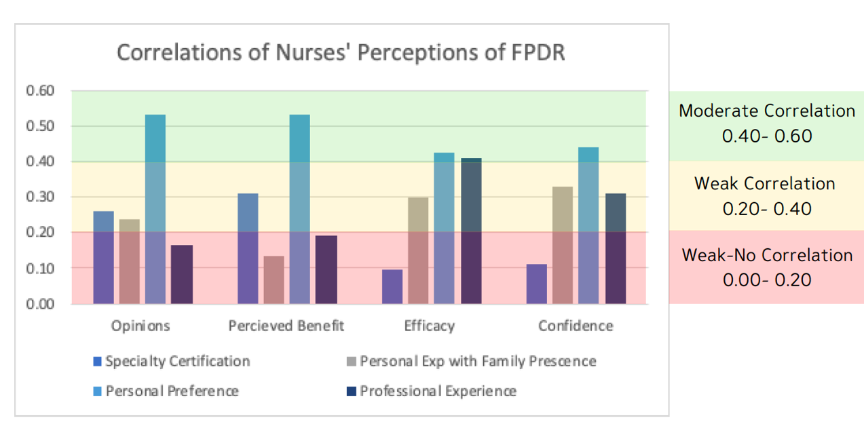
Nurses’ Perceptions to Family Presence During Resuscitation Events
Eileen Hollis, MSN, RN, CNL and Valerie Greene, DNP, RN, CEN
Background
Study aim:
Open-ended responses at the end of the survey allowed for respondents to write in reasons they would or would not invite family presence – A total of 5 themes were identified:
The AHA, AACN, AAP, and the ENA all recommend that healthcare facilities allow Family Presence During Resuscitation (FPDR) and encourage developing policies to support this practice [3,4].
Family members present during cardiopulmonary resuscitation (CPR) found the experience to help with their grieving process, aid in closure, and assist in comforting the patient [2,5].
Still controversial, as arguments include: Risk for adversely affecting communication between health care team and interfering with decision making or care [4,5].
Advantages to family presence include: Fostering trust and transparency between the family and the healthcare providers, promoting positive attitudes towards healthcare professionals and increasing collaboration [2,4].
To explore nurses’ perceptions of the benefits, barriers and confidence towards FPDR in the workplace.
Results
Participant demographics - 58 total respondents (29% response rate)
52% work in critical care (identified as ED or ICU/PCU) and 48% work on a medical-surgical unit.
Majority of respondents had 11-20 years of experience (37%).
Most hold a bachelor’s degree (58%), whereas 26% hold a master’s degree or higher.
51% hold a specialty certification, most commonly CCRN or PCCN.
Discussion
Problem
The results of our study found that nurses working in a community hospital setting were more likely to be influenced most by personal preference and experience on FPDR, rather than training/certification or work environment.
Nurses who would allow family to be present during their own resuscitation had the strongest correlation to all aspects of confidence, perceived benefits and efficacy.
Nurses who had previous personal and professional experience had greater confidence levels. Specialty certification did seem to have a greater effect on nurses’ perceived benefits of FPDR.
Limitations include small sample size, survey fatigue (distributed during the initial winter covid-19 surge), and drastic changes to hospital visitation policies amidst a pandemic.
Personal preference was the strongest influence on opinion of FPDR as well as confidence and perceived barriers, so it is suggested that initial interventions should be focused on reflection of opinion, as any other education on the topic would likely not be effective until these biases are addressed.
Many healthcare providers perceive risk and barriers to FPDR [1,2,6].
Nurses who perceive more benefits and fewer risks have been found to have greater self-confidence in their ability to manage family presence during resuscitation efforts [6].
Identifying perceived barriers to FPDR can begin to provide more family-centered care [5].
Methods
A convenience sample of 202 eligible registered nurses identified in designated units of the 100-bed community hospital.
Completely voluntary, electronic format using Qualtrics distributed to all eligible RN’s via an anonymous survey link.
The 61-item survey included 2 previously validated scales: Family Presence Risk-Benefit Scale (FPR-BS) and Family Presence Self-Confidence Scale (FPR-CS), developed by Twibell et al., (2008), demographic questions, and opinion questions [6].
Data was categorized into the following themes – Nurses opinions on FPDR, perceived benefits, efficacy, and confidence:
Favorable opinions of nurses around FPDR were associated with personal preference (r=0.53, 95% CI)
Nurses who held a specialty certification saw greater perceived benefit of FPDR (r=0.31, 95% CI).
Correlation between efficacy of FPDR practice was strongest with nurses’ personal preference (r=0.42, 95% CI) and professional experience (r=0.41, 95% CI).
Nurses’ confidence levels correlated significantly with personal experience (r=0.33, 95% CI) professional experience (r=0.31, 95% CI) and personal preference (r=0.44, 95% CI).
Recommendations
References
Education should be provided to staff including mock codes and simulation experiences of resuscitation events that include family presence
Development of a formal policy for staff to use as a resource during resuscitation events
FPDR added to the advanced directive so the patient’s preference would be known in advance
Balogh-Mitchell, C. (2012). Is It Time for Family Presence During Resuscitation in the OR? AORN Journal, 96(1).
Bradley, C., Keithline, M., Petrocelli, M., Scanlon, M., & Parkosewich, J. (2017). Perceptions of Adult Hospitalized Patients on Family Presence During Cardiopulmonary Resuscitation. American Journal of Critical Care, 26(2).
Brasel, K., Entwistle, J., & Sade, R. (2017). Should Family Presence Be Allowed During Cardiopulmonary Resuscitation? Ann Thorac Surg, 102(5).
Doolin, C., Quinn, L., Bryant, L., Lyons, A., & Kleinpell, R. (2010). Family presence during cardiopulmonary resuscitation: Using evidence-based knowledge to guide the advanced practice nurse in developing formal policy and practice guidelines. American Academy of Nurse Practitioners, 23.
Tudor, K., Berger, J., Polivka, B., Chlebowy, R., & Thomas, B. (2014). Nurses’ Perceptions of Family Presence During Resuscitation. American Journal of Critical Care, 23(6).
Twibell, R., Siela, D., Riwitis, C., Wheatley, J., Riegle, T., Bousman, D., Cable, S., Caudill, P., Harrigan, S., Hollars, R., Johnson, D., Neal, A. (2008). Nurses’ Perceptions of Their Self-Confidence and the Benefits and Risks of Family Presence During Resuscitation. American Journal of Critical Care, 17(2).

