Slide 1
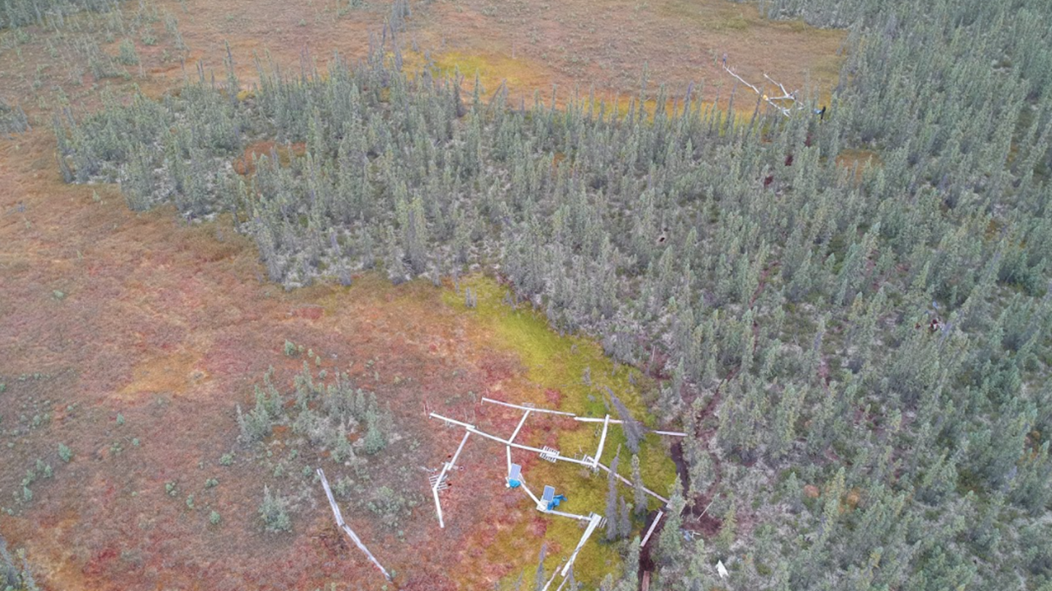

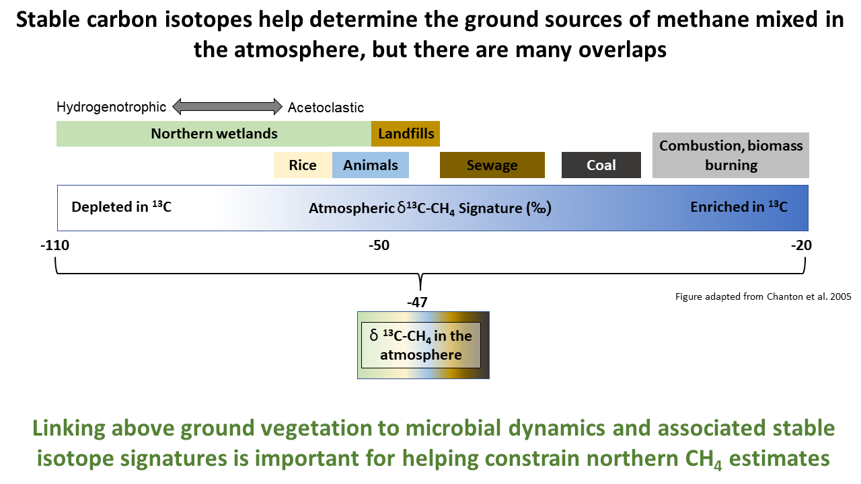
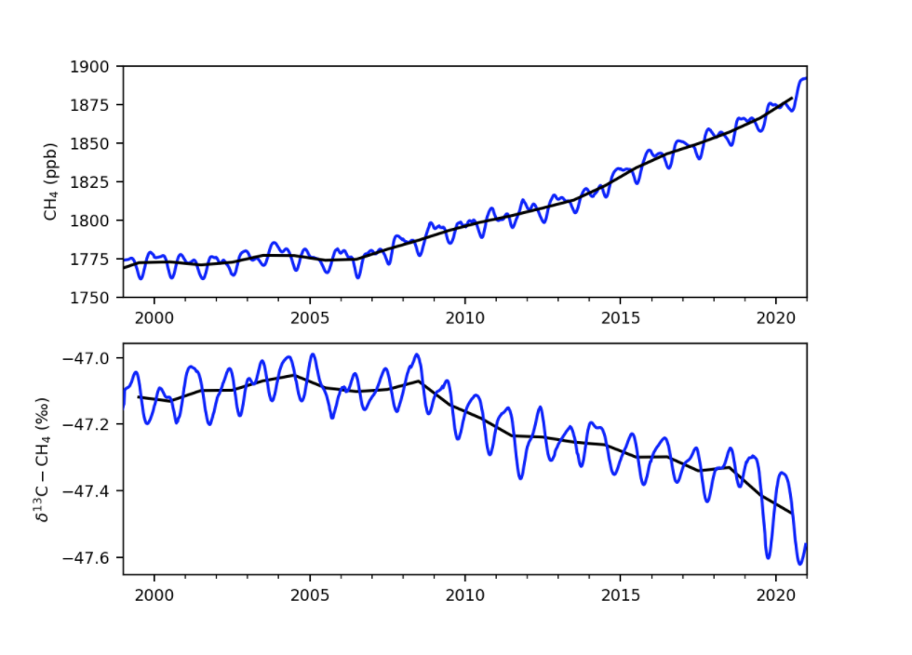
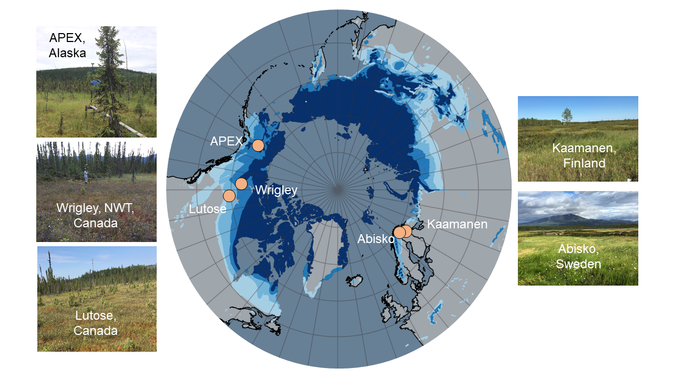









Integrating Microbial, Isotopic and Landscape-Scale Observations to Quantify Methane Emissions and Isotopic Fluxes from Global High-Latitude Peatlands
McKenzie Kuhn (mckenzie.kuhn@unh.edu) [1], C. McCalley, J. Shorter [3], C.Perryman [1], S. Burke [1], F. Sullivan [1], J. DelGreco [1], S. Hodgkins [4], L. J. Lamit[5], J., Deng [1], P., Crill [6], M., Palace [1], V. Rich [4], R. K., Varner [1]
[1] University of New Hampshire, [2] Rochester Institute of Technology, [3] Aerodyne Research Inc., [4]The Ohio State University, [5] Syracuse University [6] Stockholm University
Background
Why are isotopes important?
Northern peatlands are a globally significant source of methane (CH), yet annual CH emissions from peatlands remainhighly unconstrained as highlighted by differences between top-down and bottom-up emission models.
Northern peatland CH emissions are predicted to increase, although little is known about how microbial dynamics andδC-CH signatures from peatlands may shift, particularly as perennially frozen ground (permafrost) thaws and drypermafrost peatlands are converted to wet peatlands.
Porewater chemistry and methanogenic pathway relate to vegetation cover
Methane isotopes separate by dry and wet peatland types
AM
HM
100
Vegetation
Permafrost
Wetland
a
Wet
Lichen
Fen
a
75
Water
Forbs
Ecosystem Type
b
Vegetation Percent Cover
Moss
Bog
Dry
50
Sedge
Permafrost
Bog
b
Shrub
25
Sphagnum
0
Tree
Burn
a
-100
-80
-60
-40
-20
-10
0
1.03
1.05
1.07
0
Porewater
δ¹³C-CH₄ (‰)
Porewater δ¹³C-CH₄ (‰)
Porewater δ¹³C-CO₂ (‰)
Fractionation factor
NASA atmosphere CH₄ monitoring
Northern peatlands are a globally significant source of methane (CH₄), yet annual CH₄ emissions from peatlands remain highly unconstrained as highlighted by differences between top-down and bottom-up emission models.
Northern peatland CH₄ emissions are predicted to increase, although little is known about how microbial dynamics and δ¹³C-CH₄ signatures from peatlands may shift, particularly as perennially frozen ground (permafrost) thaws and dry permafrost peatlands are converted to wet peatlands.
Recent findings from the NASA team suggest the microbial signature of CH₄ is trending towards more microbially driver (figure to the left). This change could be driven by wetland emissions from the tropics or potentially from the Arctic.
AM
Fractionation factors indicate that the wet peatlands are likely driven by acetoclastic methanogenesis and are significantly different from the dry peatlands which are more likely driven by hydrogenotrophy.
20
-50
Depth below surface (cm)
-60
Emitted CH₄ Isotopes
40
-70
-80
60
HM
-90
Porewater and stable isotope emission correlation
Atmospheric Mixing Signature
0
Porewater
[CH₄] (µM)
-40
Dry peatlands
0.10
-50
Wet peatlands
-60
-63 (currently
used)
20
0.25
-68 (w/
peatland
types)
0.50
The data from 2020 are preliminary. Credit: Xin Lan, NOAA Global Monitoring Laboratory (https://research.noaa.gov/article/ArtMID/587/ArticleID/2769/New-analysis-shows-microbial-sources-fueling-rise-of-atmospheric-methane)
0.75
-60
-80
40
Emitted δ¹³C-CH₄ (‰)
δ¹³C-CH₄ Isotopic Flux (‰)
Depth below surface (cm)
-70
-100
Circumpolar study locations
60
-80
-75
-70
-65
-60
R² = 0.60
-120
Wetter peatland types (Permafrost wetlands, and Fens) had δ¹³C-CH₄ values that indicate acetoclastic methanogenesis (yellow and green plots) while the dryer peatland types (Bogs and Permafrost Bogs) had signatures that indicate hydrogenotrophic methane production.
The shift from acetoclastic to hydrogenotrophic δ¹³C-CH₄ values of methane in the porewater indicates a potential shift in microbial communities and/or activity related to the different above ground plant communities and environmental conditions.
Porewater δ¹³C-CH₄ (‰)
-55
-50
Dry
Wet
Atmospheric
isotopic signal
Porewater isotopes and emitted isotopes correlate, suggesting we can use information from above or bellow ground to infer processes occurring in the other.
Peatland type
n = 34
n = 54
n = 6
n = 6
Including the different atmospheric δ¹³C-CH₄ signatures for Wet and Dry peatlands changes the atmospheric δ¹³C-CH₄ mixing signal for northern wetlands. .
Conclusions & next steps
Site partners and funders
Incorporating different atmospheric δ¹³C-CH₄ signatures for dry and wet peatlands makes the atmospheric signature of northern peatlands lower (-68 ‰) than previously used in modeling efforts to partition wetland methane fluxes (-63 ‰). This may be even more important as dry peatlands are converted to wet peatlands through permafrost thaw (Turetsky et al. 2019; https://www.nature.com/articles/s41561-019-0526-0)
In our next steps we will look at the connection between the microbial dynamics (16s and metagenomes) and the above ground plant community and atmospheric stable isotope methane signatures and incorporate the findings into a process-based model (DNDC).
The final products for this project will include regional and circumpolar maps representing isotopic methane signatures
We visited five peatland complexes across the northern circumpolar region, each with a range of wet and dry peatland subsites.
At each subsite we conducted vegetation surveys and collected peat porewater samples for dissolved methane and carbon dioxide concentrations, associated stable carbon isotopes, and pH.
Chambers were deployed at select subsites to measure δ¹³C-CH₄ fluxes to the atmosphere.
Peat cores were collected at each subsite for microbial analysis, including metagenomic and transcriptomic analysis.
Site collaborators: David Olefeldt, Christopher Schulze, Liam Heffernan, Oliver Sonnentag, Merritt Turetsky, Evan Kane, Mark Waldrop, Tuula Larmola, Mika Aurela, Erik Lilleskov, Sari Juutinen
NASA IDS #NNX17AK10G

