Slide 1
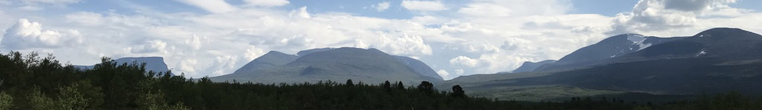

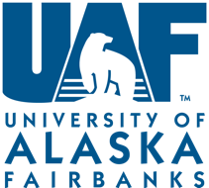
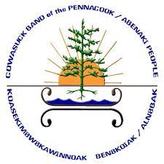

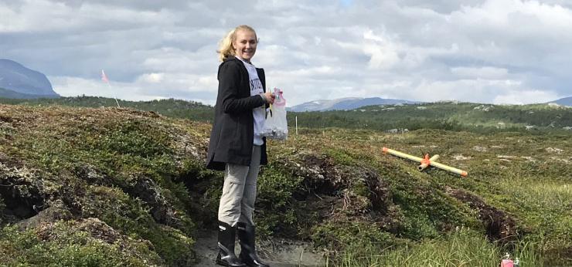
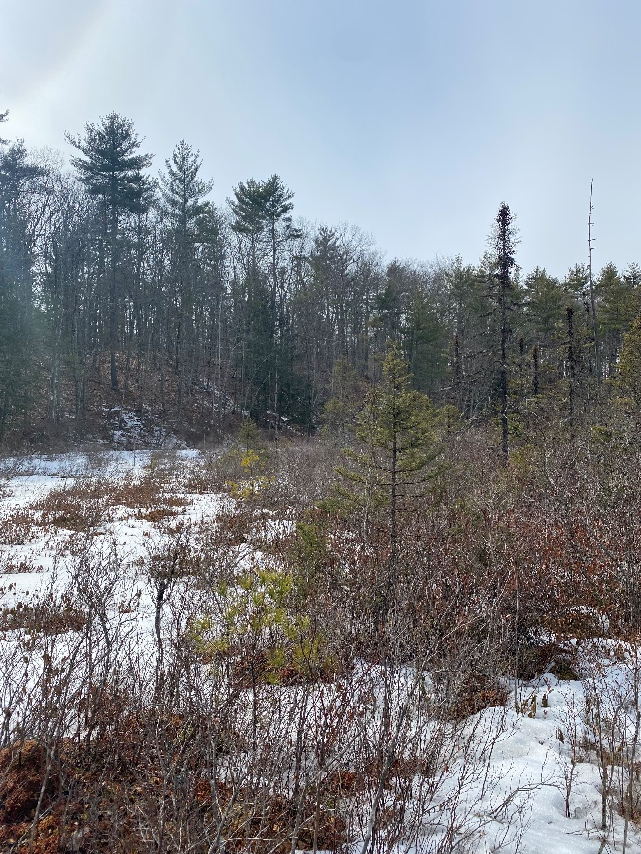
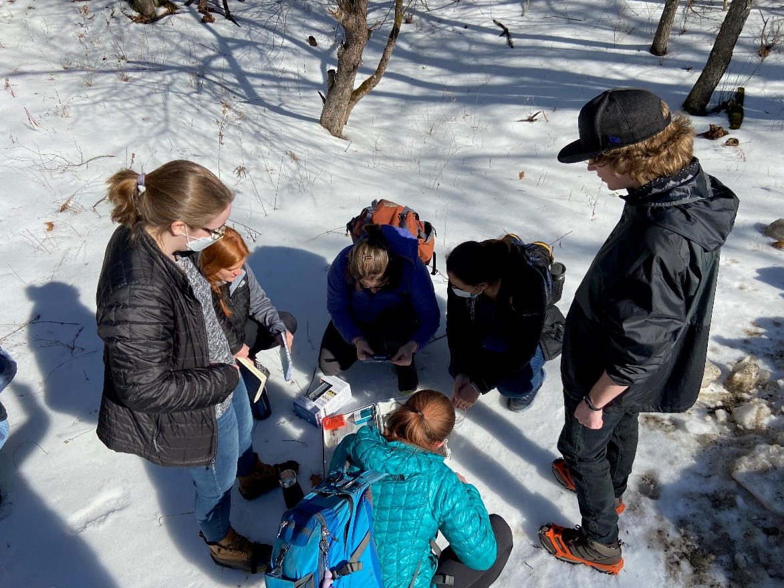
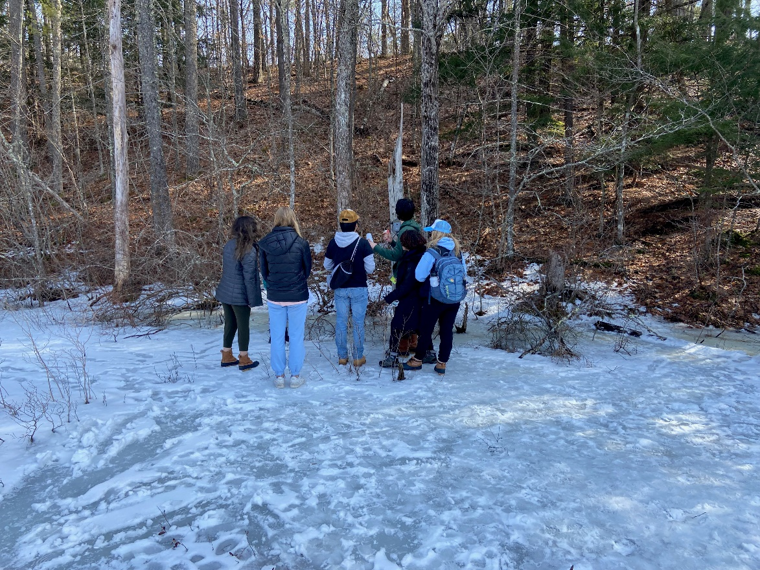
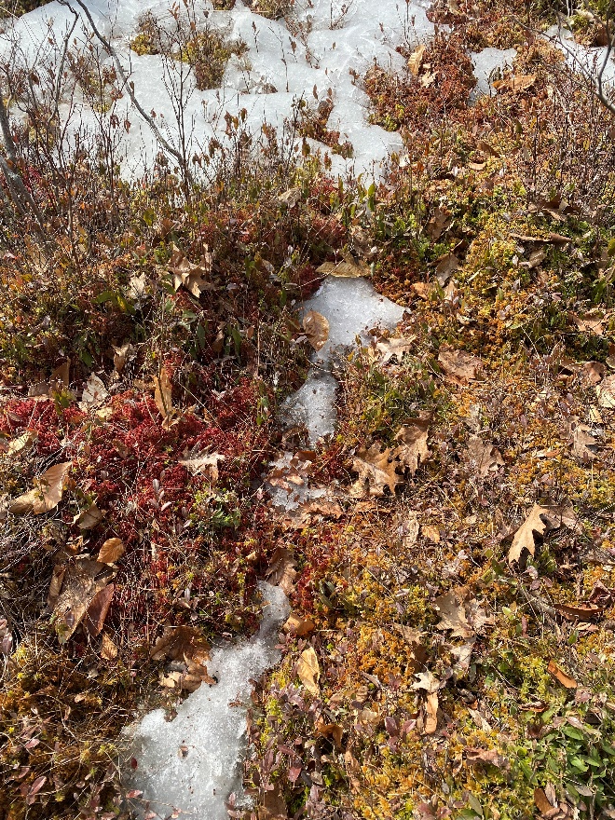
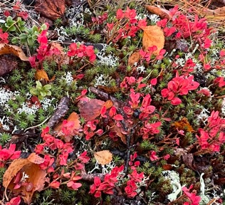
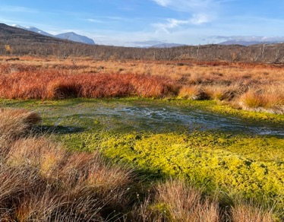
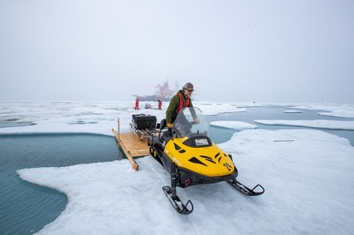
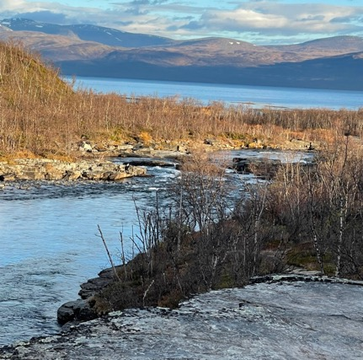
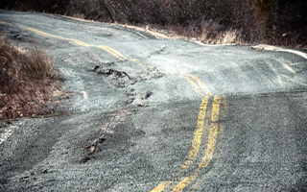
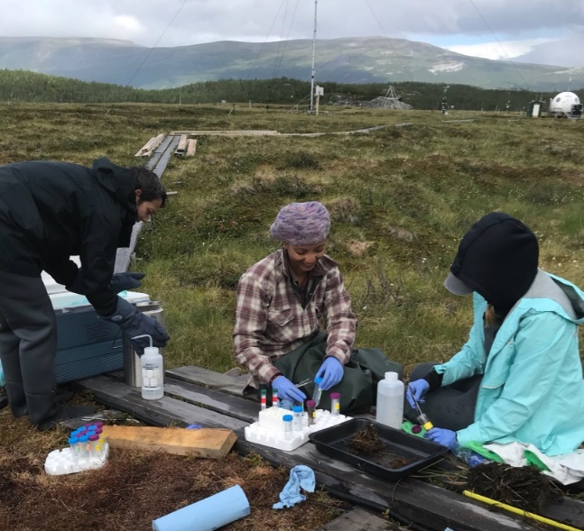
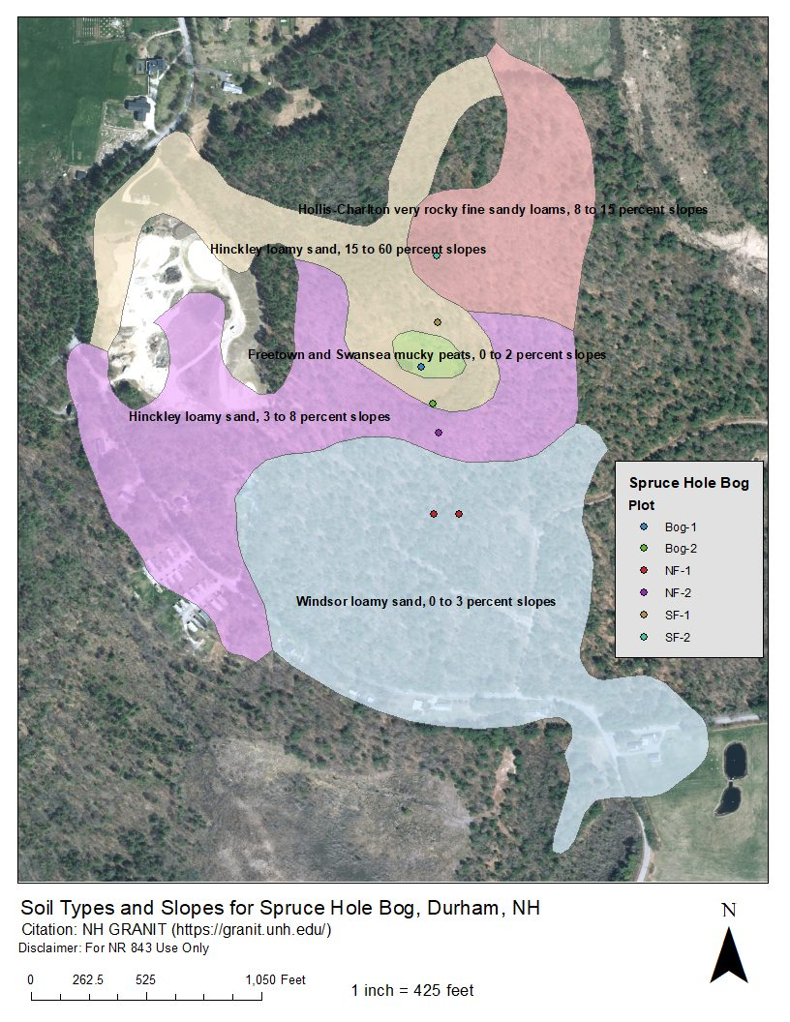
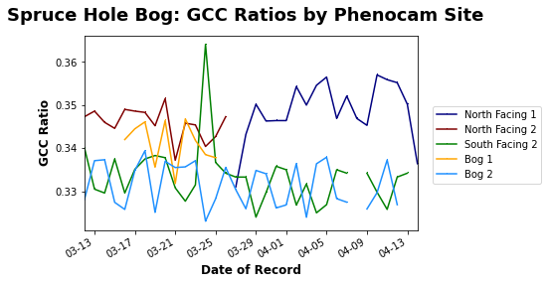
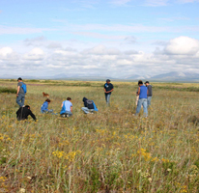
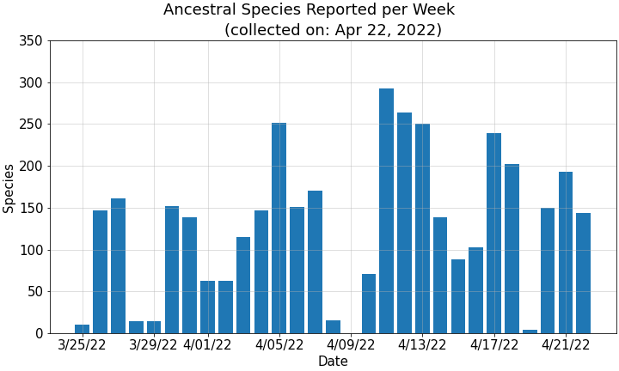
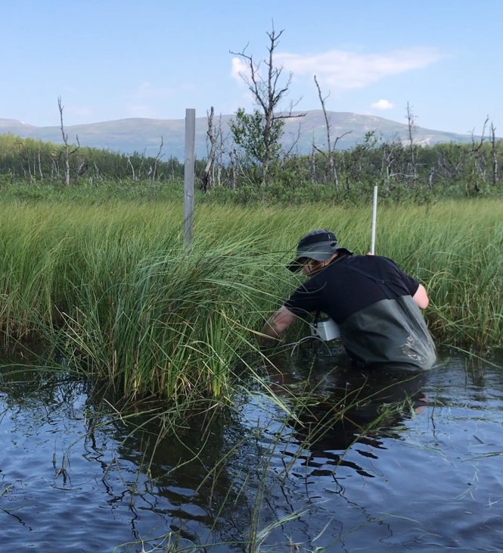
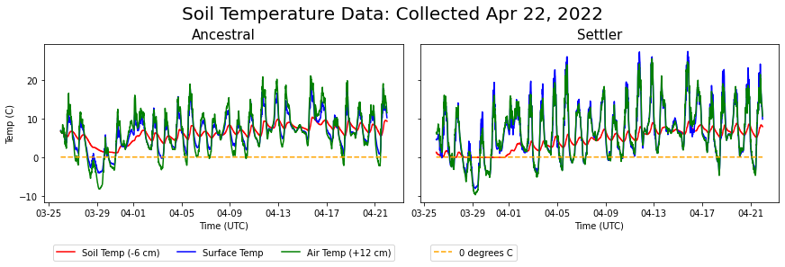

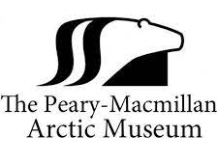

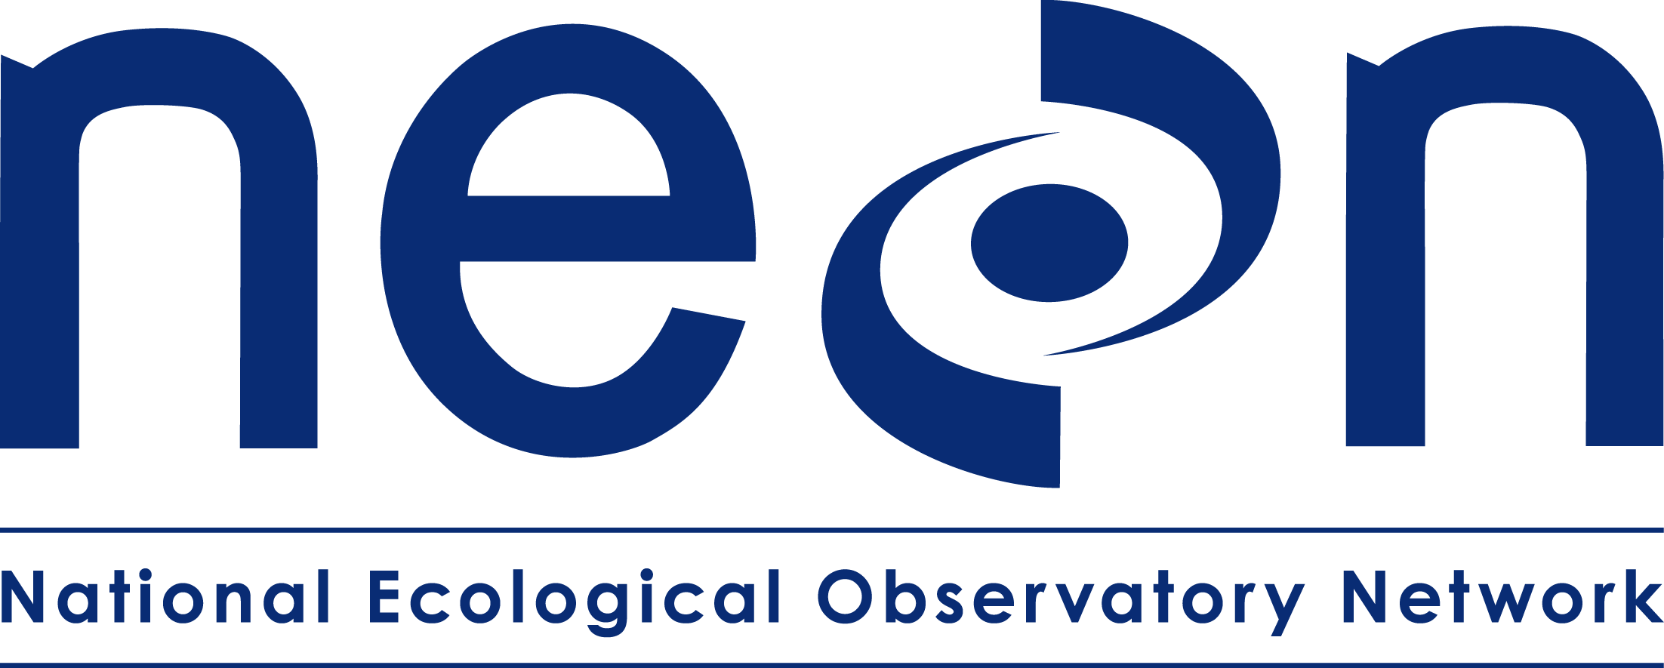
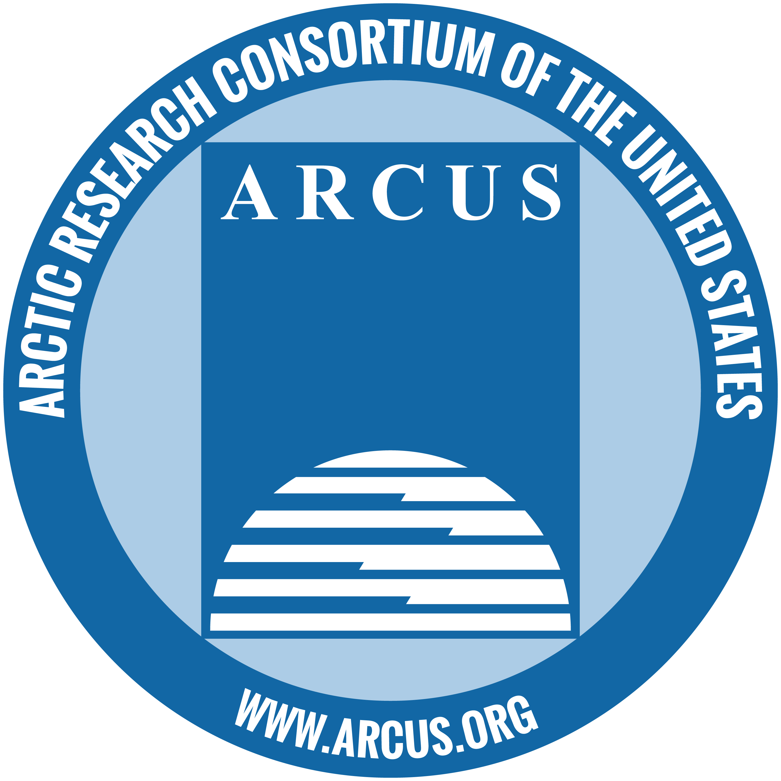

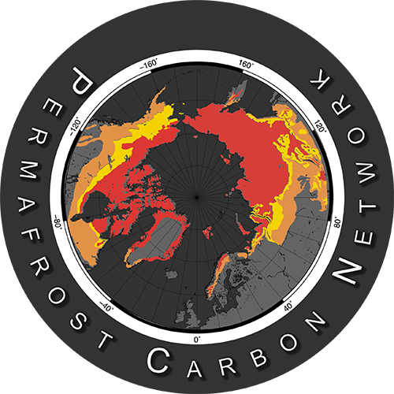

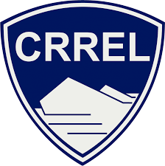

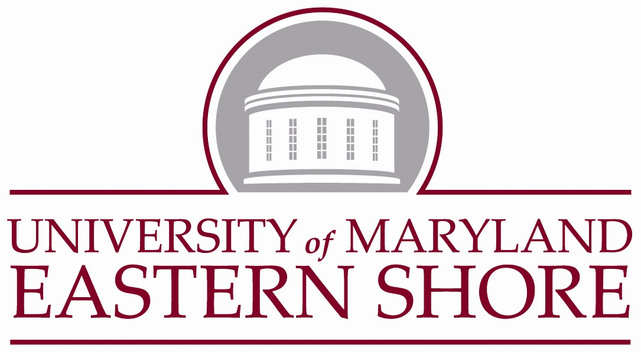

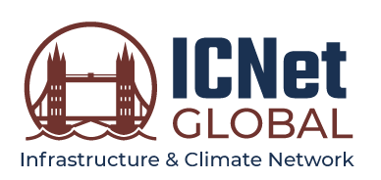
Convergent Arctic Research Perspectives and Education (CARPE)
Ruth Varner (presenter), Jerker Bexelius, Julie Bryce, Elizabeth Burakowski, Alexandra Contosta, Katharine Duderstadt, Jessica Ernakovich, Meghan Howey, Jennifer Jacobs, Charina Knutson, Michael Palace, Denise Pouliot, Paul Pouliot, Elena Sparrow, Katie Spellman, Cameron Wake ruth.varner@unh.edu
Goal
Enhancing Graduate Education
Train graduate students, using a convergence research framework and approach, to more fully investigate and understand the interwoven impacts of changing seasonality on Arctic natural and human systems.
    CARPE trainees will:
      Design and conduct convergent research projects focused on the impacts of changing seasonality on the Arctic’s natural and human systems
      Build capacity to engage with Arctic Indigenous and local people
Vision: “CARPE promotes transformative graduate training where convergent scientific research and mutually beneficial partnerships with Indigenous and local communities becomes the norm rather than the exception.”
Training
  Science communication
  Science of team science
  Research ethics
  Convergence theory and practice
Professional Development
  Engaging Arctic communities in research (UAF)
  Cold regions field training (Mt. Washington)
  Decolonizing Science workshops (Abenaki & Sámi)
Changing Seasonality in the Arctic
Disciplines: Earth Sciences, STEM Education, Natural Resources and Environment, Anthropology and Archaeology, Civil and Environmental Engineering, Sustainability, Indigenous Knowledge
The cascading effects of climate change on natural and human systems are more evident in the Arctic than anywhere else on Earth. Rising temperatures, dramatic sea ice reductions, glacier and ice sheet mass loss, and thawing permafrost influence Arctic peoples’ and ecosystems’ daily activities and well-being. Particularly profound changes result from shifts in seasonality including the timing of cultural, biological, physical, and chemical events.
  Spring: Earlier snowmelt, ice out of lakes, thawing of the soil profile and the initiation of plant photosynthesis and soil nutrient cycling
  Fall: delays in leaf senescence, fruit ripening, animal migration, soil freezing, snowpack development, and the icing in of lakes and rivers
  Implications: phenological mismatches as well as effects on Arctic residents’ hunting and foraging, fishing, shipping, mobility, and community infrastructure.
CARPE Cohort 1
R. Varner
R. Varner
The first cohort of CARPE graduate students began with the Spring 2022 “Arctic Ecology and Society” co-led by UNH faculty Jessica Ernakovich, Alexandra Contosta, and Meghan Howey and Denise and Paul Pouliot of the Cowasuck Band of the Pennacook-Abenaki People, addressing:
Foundational understanding about how changing seasonality is altering Arctic systems – exploring the ways humans interact with the changing environment through lectures, literature, guest speakers, and interdisciplinary small group projects.
Knowledge co-production with communities and stakeholder groups – including working with Abenaki colleagues to co-develop research question and engaging the town of Durham to develop protocols for monitoring on kettle hole bog conservation lands.
Decolonizing Science – learning about Sámi communities and concerns as well as the theory of decolonizing science and Indigenous engagement through a workshop designed by Charina Knutson and Jerker Bexelius of the Gaaltije Foundation.
Hands-on experience building sensor suites to monitor environmental change – installed sensors at Spruce Hole Bog and a protected Abenaki archeological site (air temperature, relative humidity, soil temperature & moisture, acoustic recorders, and time-lapse cameras).
Alfred Wegener Institute/Lianna Nixon
R. Varner
Research
Examples of Challenges Requiring Convergent Research and Community Engagement
  Infrastructure and Mobility: Travel in northern latitudes relies on stable permafrost and winter freezing, on roads and frozen snow-covered land, lakes, rivers, and coastal waters. Changes in Arctic climate are affecting winter mobility with shorter freezing seasons, increased freeze-thaw cycles, ephemeral snowpacks, and rain-on-snow events.
Pathogens and Toxins: Toxins and pathogens released from thawing soils and melting ice can move through the environment and ecosystems and potentially affect the well-being of Arctic residents, endangering human and animal health and threatening food supplies.
Green chromatic coordinate (GCC) over region of interest from PhenoCam at Spruce Hole Bog
R. Varner
Permafrost Biogeochemistry and Food Security: Foraged foods are an essential source of dietary nutrients. Berries (e.g., blueberries, crowberries, and cloudberries) are a crucial source of phytonutrients for Arctic people, offering affordable access to local nutrients. Changing seasonality has increased the variability in the timing and yield of berry harvests and may affect the nutrient profile of berries.
Occurrence of bird calls at the Abenaki ancestral site using Wildlife Acoustics audio recorders and Cornell BirdNET sound ID
National Park Service
Aquatic Ecosystems and Greenhouse Gas Exchange: Arctic aquatic ecosystems are important sources of methane, a strong greenhouse gas. Altered seasonality is driving earlier ice out and longer ice-free seasons, leading to earlier release of methane trapped under lake ice and in lake sediments. Declining ice thickness and timing of ice-out impact tourism and fishing activities as well as animal migration. Permafrost thaw is also causing “old” stored carbon to become available for decomposition.
Time series of soil, surface, and air temperatures
R. Varner
Preliminary Data: courtesy of the Arctic Ecology and Society class with Emma Burkett, Tim Hoheneder, Cheristy Jones, Tamara Marcus, Mahsa Moradi Khaneghahi, Jess Steketee, and Megan Verfaillie of CARPE.
Learn More and Apply
Funding Acknowledgement
UNH Land Acknowledgement – As we all journey on the trail of life, we wish to acknowledge the spiritual and physical connection the Pennacook, Abenaki, and Wabanaki Peoples have maintained to N’dakinna (homeland) and the aki (land), nebi (water), olakwika (flora), and awaasak (fauna) which the University of New Hampshire community is honored to steward today. We also acknowledge the hardships they continue to endure after the loss of unceded homelands and champion the university’s responsibility to foster relationships and opportunities that strengthen the well-being of the Indigenous People who carry forward the traditions of their ancestors.
Please visit the CARPE website: https://marine.unh.edu/carpe-nrt
Questions? carpe-nrt@unh.edu
This project is supported by the National Science Foundation Research Traineeship (NRT) and Navigating the New Arctic (NNA) programs (NRT-NNA #2125868, PI Varner)
Scan here

