Slide 1
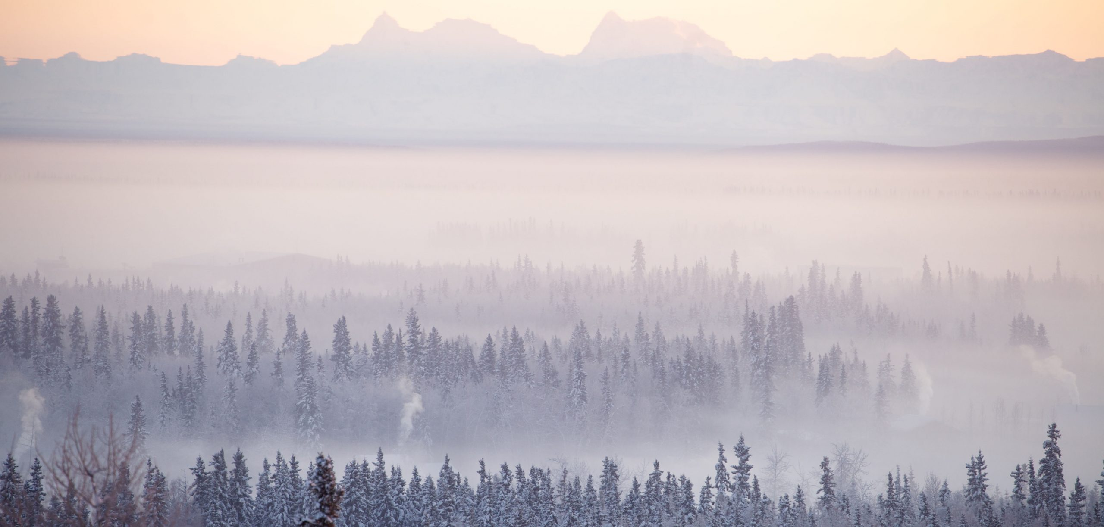
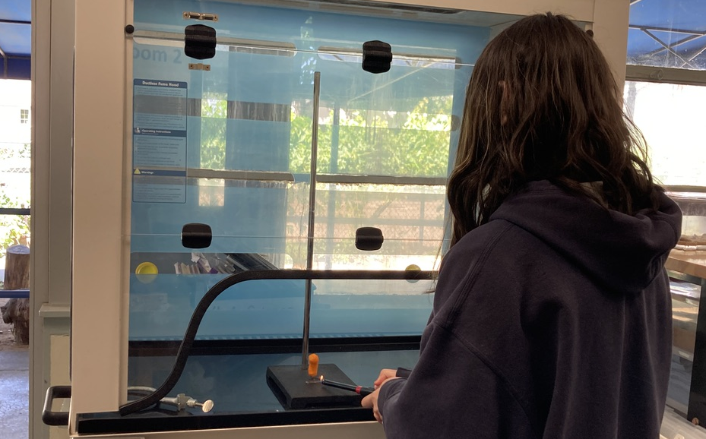
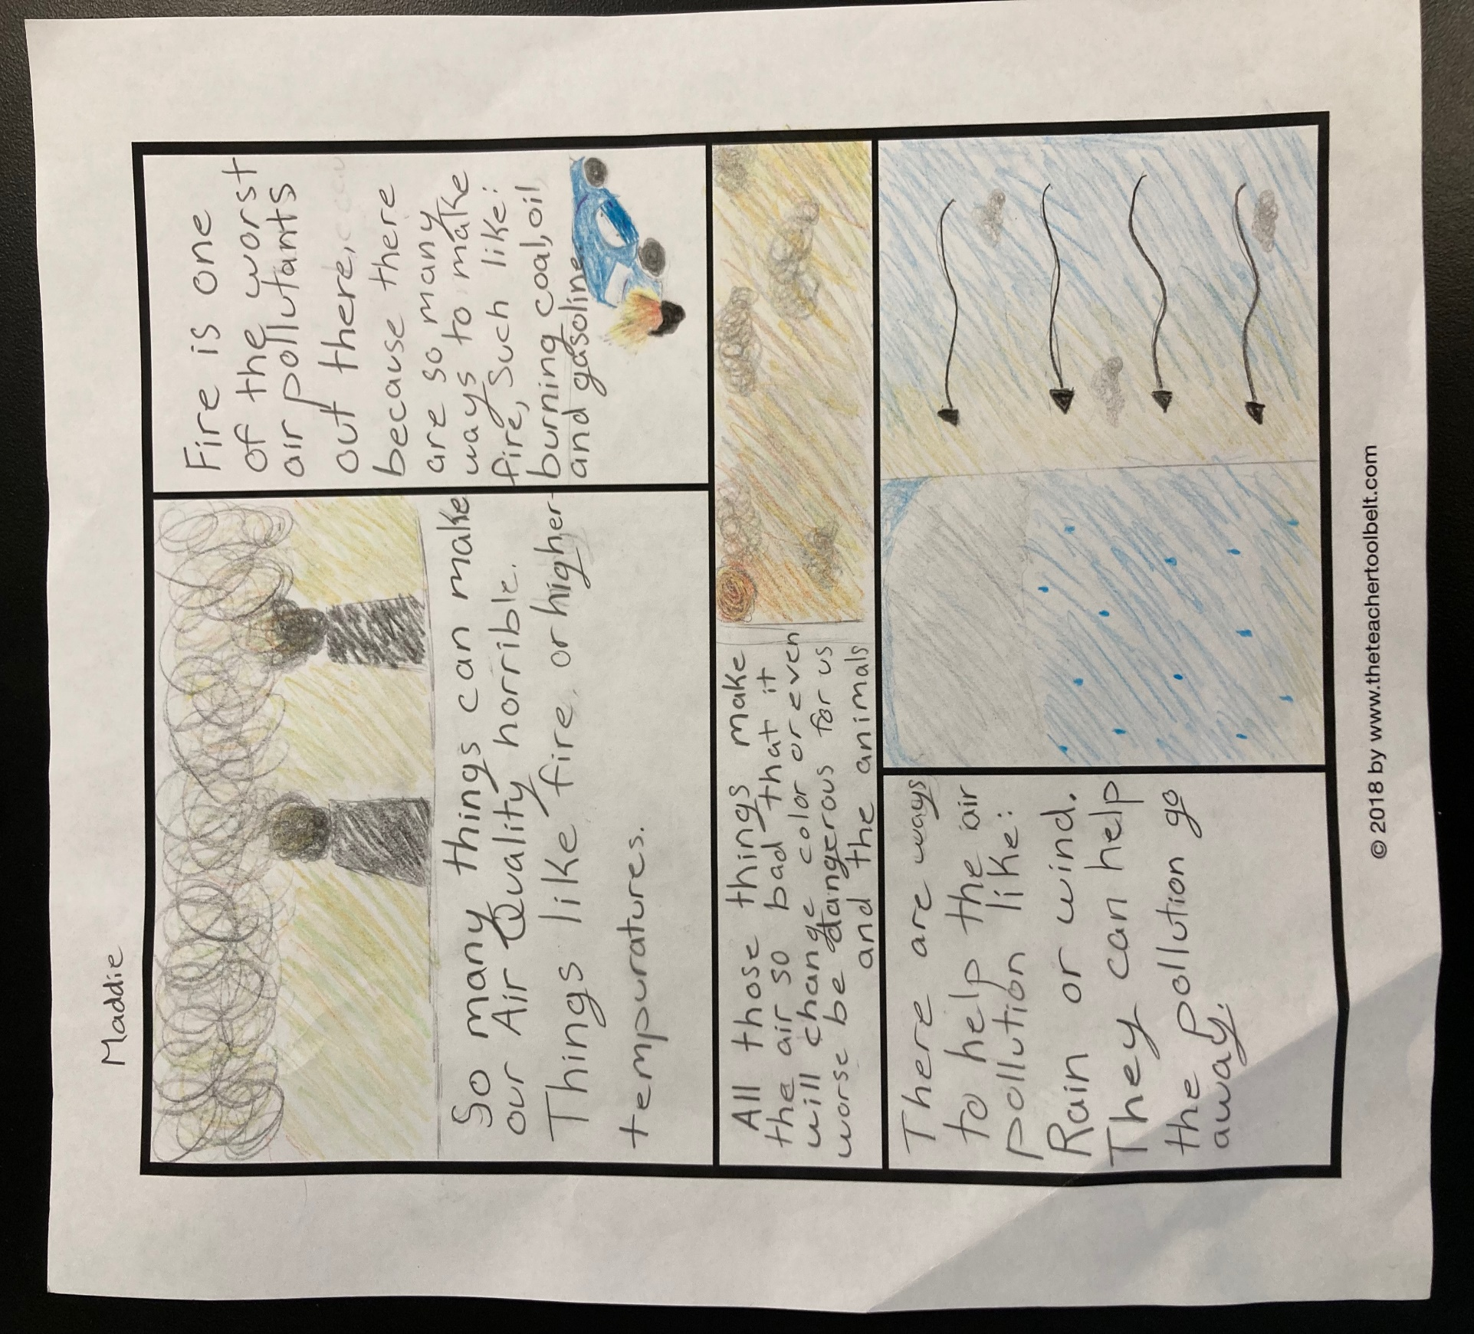
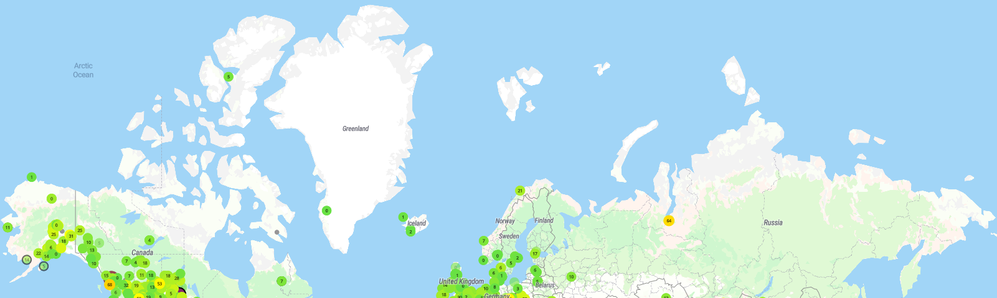
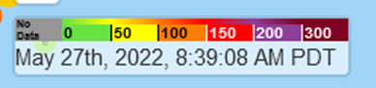
Air Pollution Lessons for Middle School Students: Regional Exploration of Air Quality
Laura Heinlein,¹ Jack Dibb (presenter),² Cort Anastasio¹ (¹University of California, Davis, ²University of New Hampshire)
Purpose
Figure 1. Winter Particle Pollution in Fairbanks, Alaska. Source: Fairbanks Winter Air Study Website.
Particle pollution in the US causes over 350,000 premature deaths annually, and is a significant, yet uncertain, driver of climate change. Air quality has been highlighted in the media in recent years as incidents of wildfire have worsened globally, and as our understanding of the impact of particles on human health has improved. Particle pollution can come from both local sources or can be transported through the atmosphere from distant places. The major drivers of air quality are region-specific: levels of particle pollution vary drastically across different climates and between urban, suburban, and rural areas. With the advent of low-cost sensors such as PurpleAir, it is now possible to measure particle pollution in real-time in several locations across the country. Here, we describe two weeks of hybrid-style lessons (in-person and remote) exploring local drivers of particulate matter pollution that we delivered to a group of 8th grade students in Davis, California.
Air Pollution Lessons
Two weeks of lessons (ten in total) were developed to explore drivers of local air quality using data collect from PurpleAir particulate matter sensors and an in-class experiment to test how various factors impact air quality. Lessons were prepared for the Davis School of Independent Study in Davis, CA, where students attend lessons in-person two days per week (Monday and Friday) and work at-home three days per week (Tuesday – Thursday).
Week I
Week II
Introduction
The lessons began with an overview of air quality. The class discussed various types of air pollution they were familiar with (i.e. CO₂) and were introduced to fine particle pollution (PM2.5). Students brainstormed factors they thought influenced air quality, which were explored in subsequent lessons.
Experiments
The class measured PM2.5 produced from burning one match, one lighter (for 15 seconds), and a Cheeto. Students worked as a group to record PM2.5 data measured by the Dylos at 15 second time points for 5 minutes.
At-Home Lessons
At home, students completed a hands-on activity to help visualize the size of PM2.5. Students then read an article about different sources of PM2.5 around the world. Next, students explored PM2.5 data from local PurpleAir sensors (Figure 2) to explore daily, seasonal, and regional variations in PM2.5 pollution. The class identified trends and brainstormed causes for changes in PM2.5 levels.
At-Home: Lab Report
Students completed a worksheet where they stated the experimental purpose, wrote a hypothesis, graphed the PM2.5 levels as a function of time, made observations about their data, related their experiments back to real-world sources of PM2.5, and drew conclusions about PM2.5 produced from different combustion processes.
Figure 3. Student ignites a Cheeto.
Figure 2. PM2.5 data in urban and rural locations near Fairbanks, Alaska.
Final Project
As a final project, students produced a one-page summary of the two weeks of lessons incorporating art, science, and writing. On the last day of class, students presented their summaries.
Experimental Design
At the end of the first week, each student thought of a factor that influenced particle pollution and brainstormed methods to test their factor in class using a Dylos PM2.5 monitor. The class was interested in wildfires, car exhaust, dust, and pollen as factors that produce PM2.5, and rain and wind as factors that remove PM2.5. As a group, the class chose to test combustion as a source of PM2.5 and designed three experiments to examine PM2.5 levels produced from the burning of various materials.
Figure 4. A ”One-Pager” summary assignment by a student.
Adapting Our Lessons to Your Classroom
Figure 5. PurpleAir PM2.5 samplers in high northern latitudes
We are happy to share materials if you are interested in using or adapting these lessons. Please contact us at lmheinlein@ucdavis.edu for more information.
As shown in Figure 5, there are a number of PurpleAir sensors in or near the Arctic. These data, which are publicly available at https://map.purpleair.com, could be used to construct Arctic-specific lessons on air pollution for local schools. In addition, PurpleAir sensors are relatively inexpensive and can be set up at your site relatively easily, although they do require AC power and an internet connection.
Acknowledgements. This project is funded by the National Science Foundation as part of a Collaborative Research project (grant #s 2109011 and 2109023). We thank Lori McKee for providing feedback on our modules and assisting us in lesson development. Thanks to Ms. McKee’s 8th grade science class for hosting us and for their enthusiasm about air quality!

