Slide 1
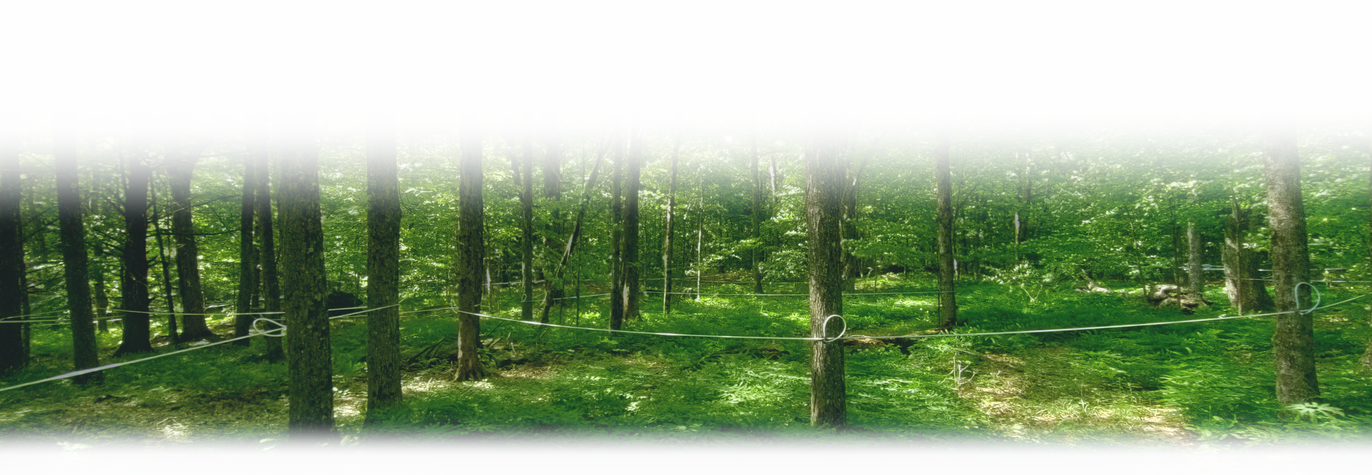
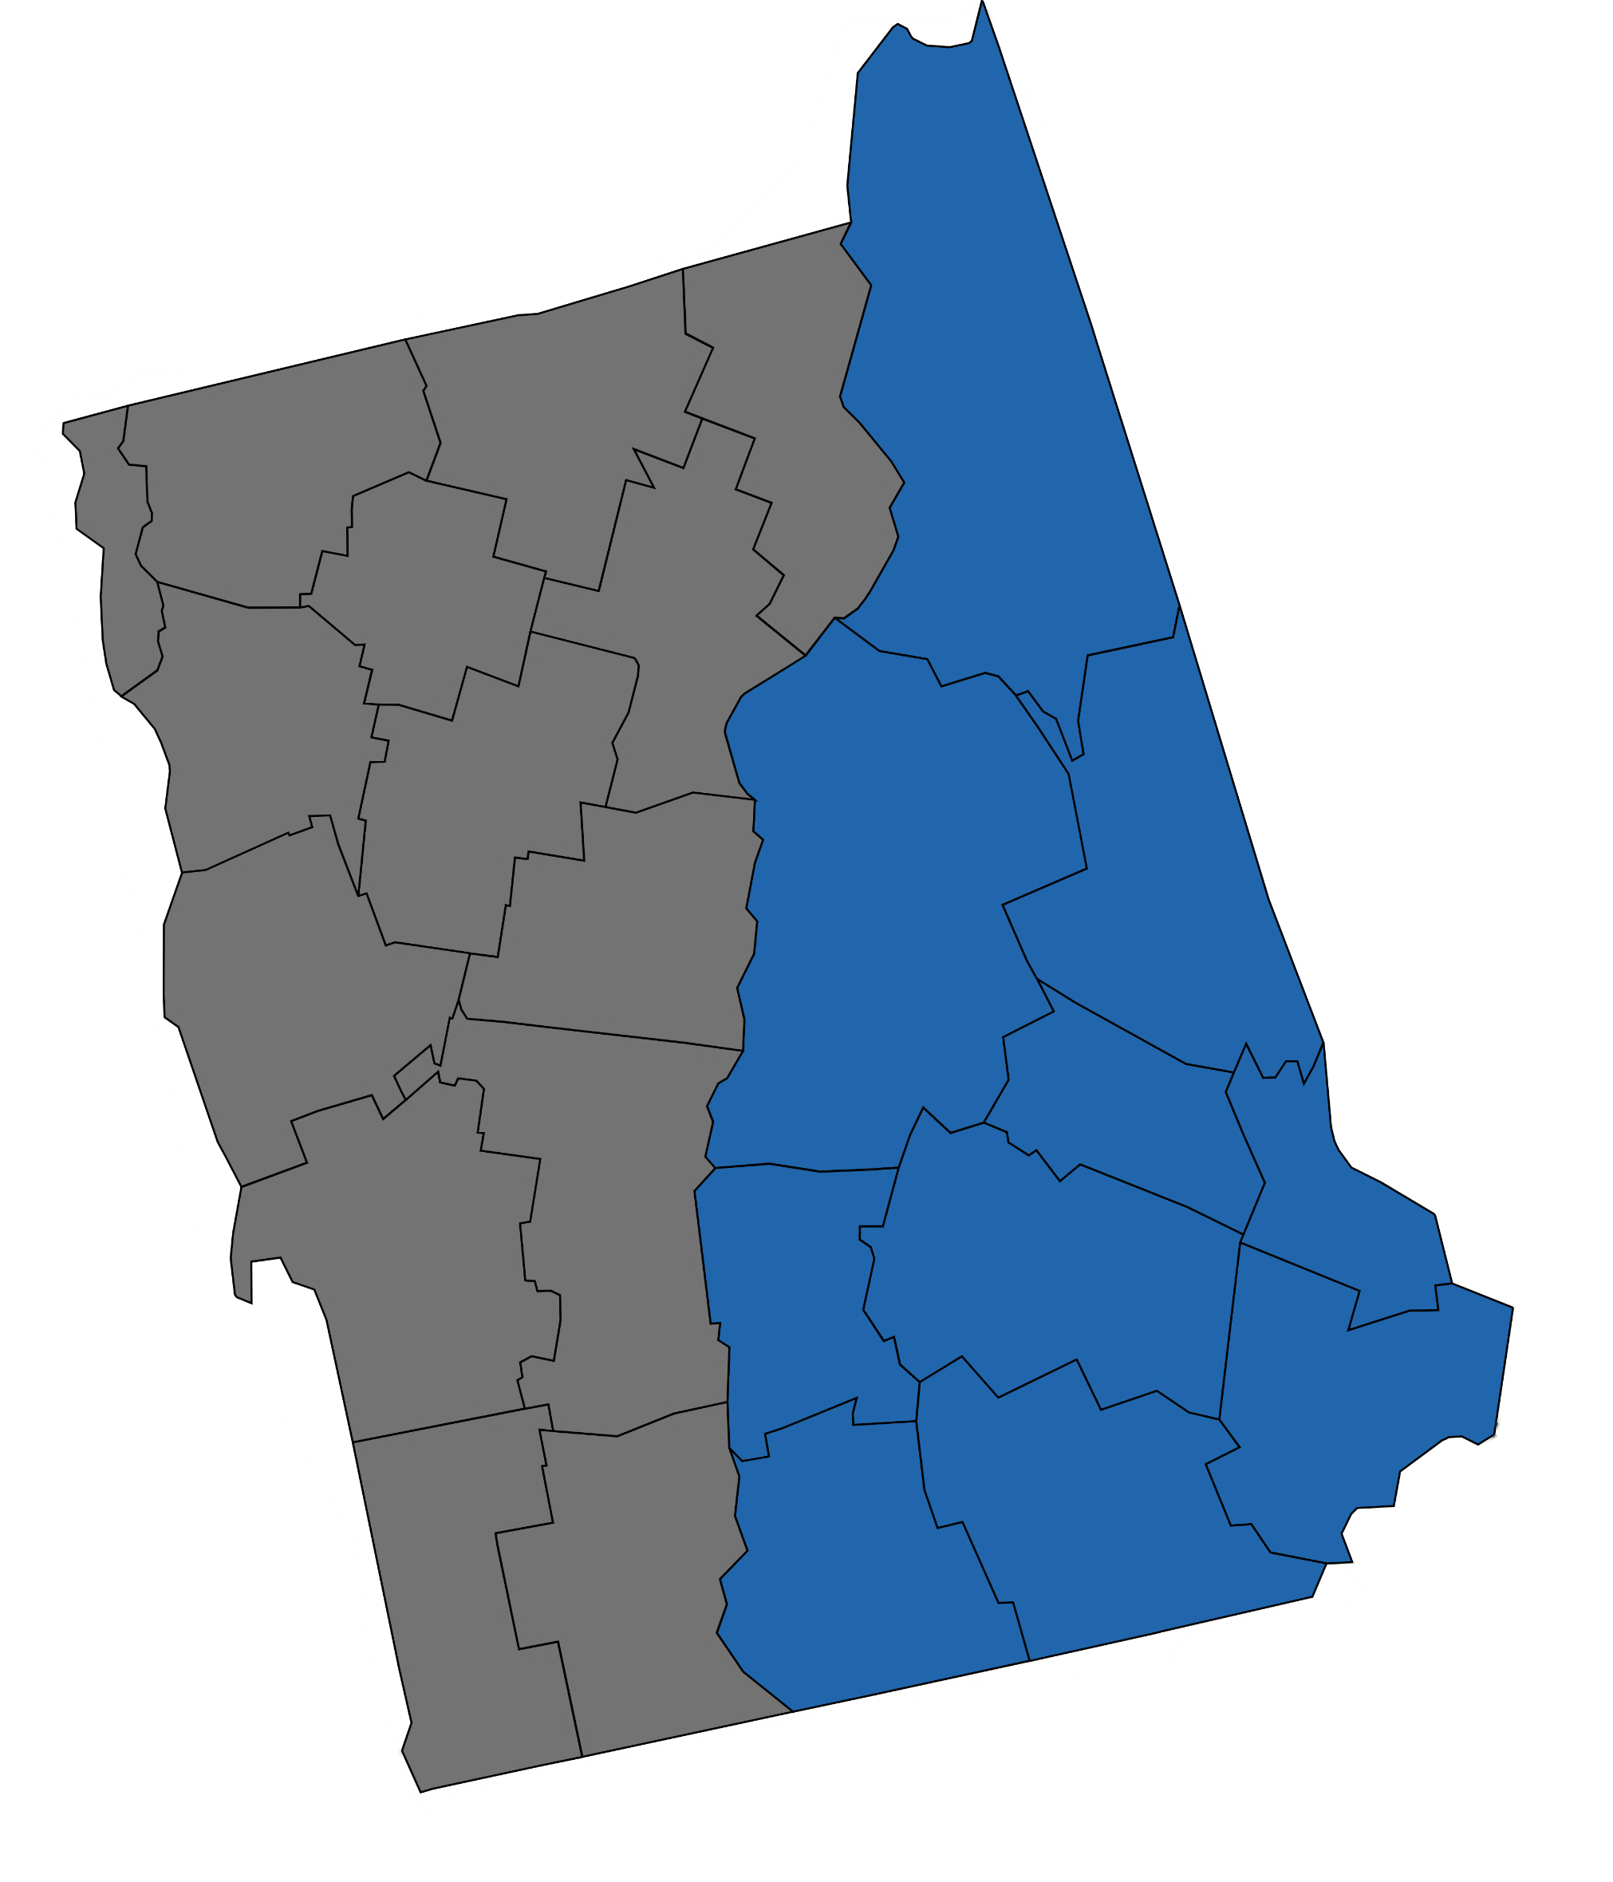


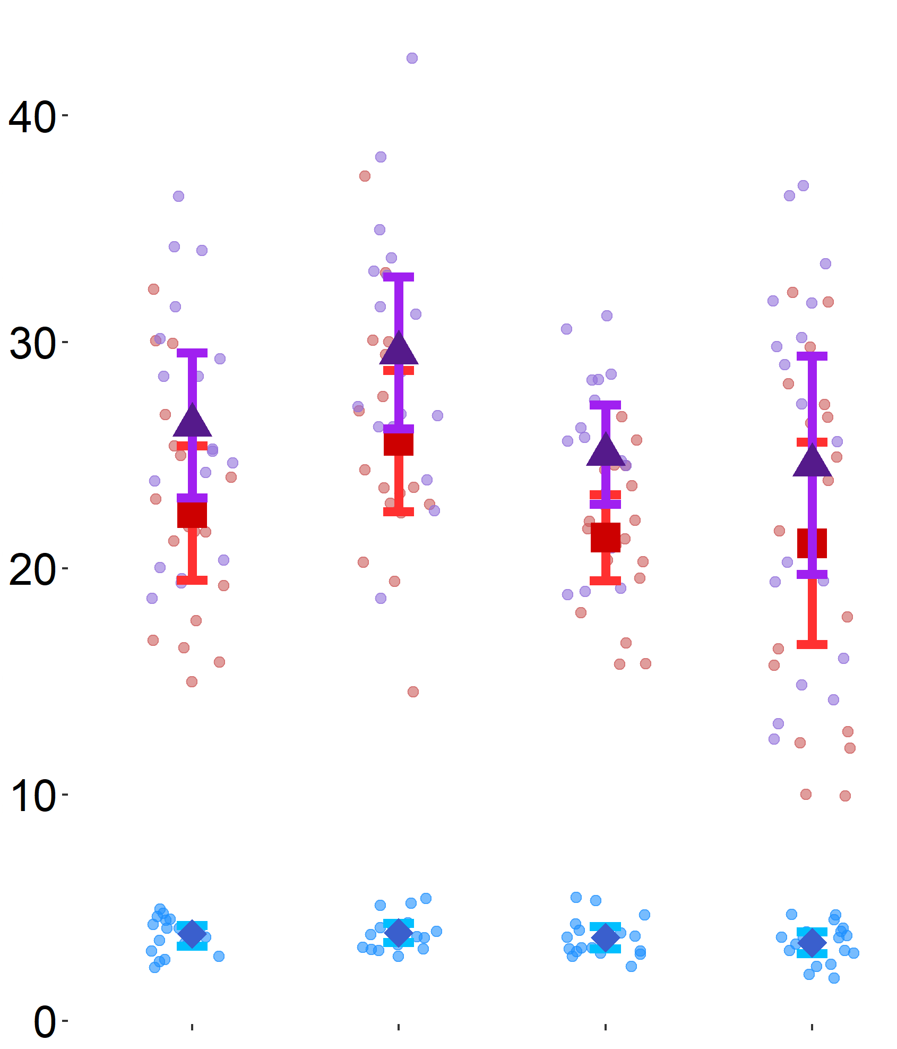




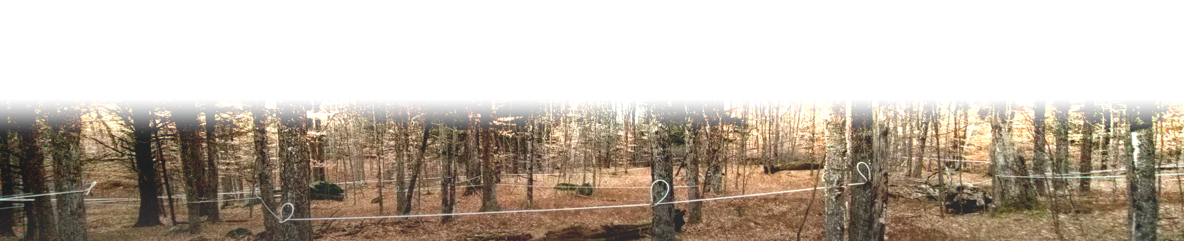






Precipitation has a Greater Impact on
Sugar Maple Summer Energy Stores than Tapping for Syrup
Jeffrey L. Hamilton¹, Matthew Vadeboncoeur¹, Cameron McIntire², & Heidi Asbjornsen¹
¹University of New Hampshire, Durham, ²U.S. Forest Service, Forest Health and Protection, Durham
Preliminary results: drier sites have higher levels of summer
NON-STRUCTURAL CARBOHYDRATES than wetter sites
INTRODUCTION
Sugar Maple (SM) is an integral part of northeastern forests and the predominant species for syrup production, a major non-timber forest product in New England.
Climate change induced drought stress, tapping, and defoliation may impact SM energy balance (Figure 1).
New England may receive more total precipitation but also more frequent droughts¹.
Knowledge of SM vulnerability and resilience to drought, tapping, and defoliation is relevant for managing risks and forest health.
We hypothesize that non-structural carbohydrates (NSCs, i.e., sugar and starch) can serve as a useful indicator of SM energy balance, health, and productivity.
METHODS
We collected short cores from six sugarbushes and six untapped SM sites representing a drought gradient in Northern Vermont for NSC analysis² (Figure 2).
Short cores (~2.5cm) were taken from six different mature canopy SM trees per site.
We used MANOVA and post-hoc testing to evaluate NSC concentrations across moisture and tapping treatments.
OBJECTIVE
Our goal is to chronicle the NSC dynamics of SM sapwood through two years.
RESULTS
Short cores collected in summer and fall 2021 are being analyzed for NSCs.
Total NSC concentrations of summer samples are different between sites (p=0.001, Figure 3), but tapping has no apparent effect.
Growing season precipitation also explained differences (p=0.01); drier sites have more total NSCs.
Starch differences are driven by site (p<0.0001) and precipitation (p=0.004).
Sugars were consistent across sites.
Vermont
New Hampshire
Figure 2: We have four types of SM Field sites in northern Vermont (FEMC & USGS). Site Categories are: ●Drier Tapped, ■Drier Untapped, ●Wetter Tapped, & ■Wetter Untapped.
DISCUSSION
Contrary to expectations, our preliminary analysis indicates that drier sites have higher total NSCs than wetter sites, which is driven by differences in starch.
Our study indicates that SM trees on drier sites may be more stressed, and therefore more conservative with their energy usage, than trees on wetter sites.
Starch variation is mainly due to site, reflecting aggregate differences in latitude, precipitation, aspect, elevation, and soil properties.
CO₂
Energy
▲
Total
■
Starch
⯁
Sugar
Sugars are consistent, but lower than starches, suggesting that SM trees maintain a readily available supply of energy across a moisture gradient through summer.
Leaves
H₂O
COMING UP
Analyze fall 2021 short cores and collect additional samples in 2022.
Results will allow us to see how SM NSCs change through time and explore the mechanisms leading to higher NSC concentrations at drier sites.
O₂
Respiration
Summer Sapwood NSCs $\left({mg NSC}/{g tissue}\right)$
Sugar
Defoliators
Growth
LITERATURE CITED
¹ Hayhoe, K., et al. (2007). Climate Dynamics. 28, 381–407.
² Landhäusser, S. M., et al. (2018). Tree Physiology, 38(12), 1764–1778.
Tapping
Starch
Moisture
Drier
Tapped
Drier
Untapped
Wetter
Tapped
Wetter
Untapped
Figure 1: Conceptual model for interactions between SM NSCs, drought, and defoliators. Dashed lines are processes under stomatal control. Black lines are the carbon cycle and blue lines are the water cycle. Defoliation, reduced moisture, and tapping may negatively affect energy balance in a tree.
Figure 3: Sugar, starch, and total NSC concentrations across sites collected in late summer 2021. Points are individual trees. Error bars represent 1 standard error (n=3).
ACKNOWLEDGEMENTS
We thank Steven Roberge & Tanner Frost (UNH), Isabel Munck & Paul Schaberg (USFS), Jim Duncan & Mark Isselhardt (UVM), Joshua Halman & Kathy Decker (Vermont Agency of Natural Resources), and Jamie Shanley (USGS) for the valuable insight, feedback, and assistance with our study. We also thank the private landowners that agreed to participate in this study. This work was funded by a grant from the USFS Evaluation Monitoring Program.

