Slide 1

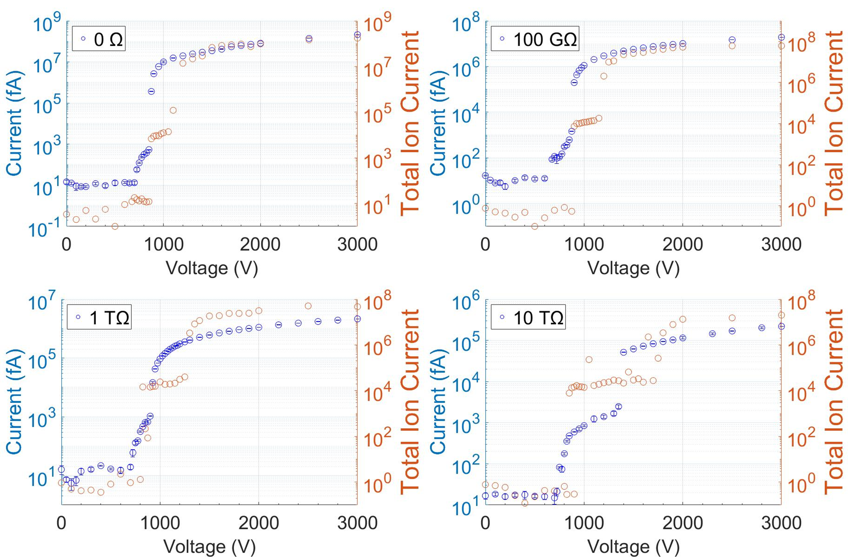
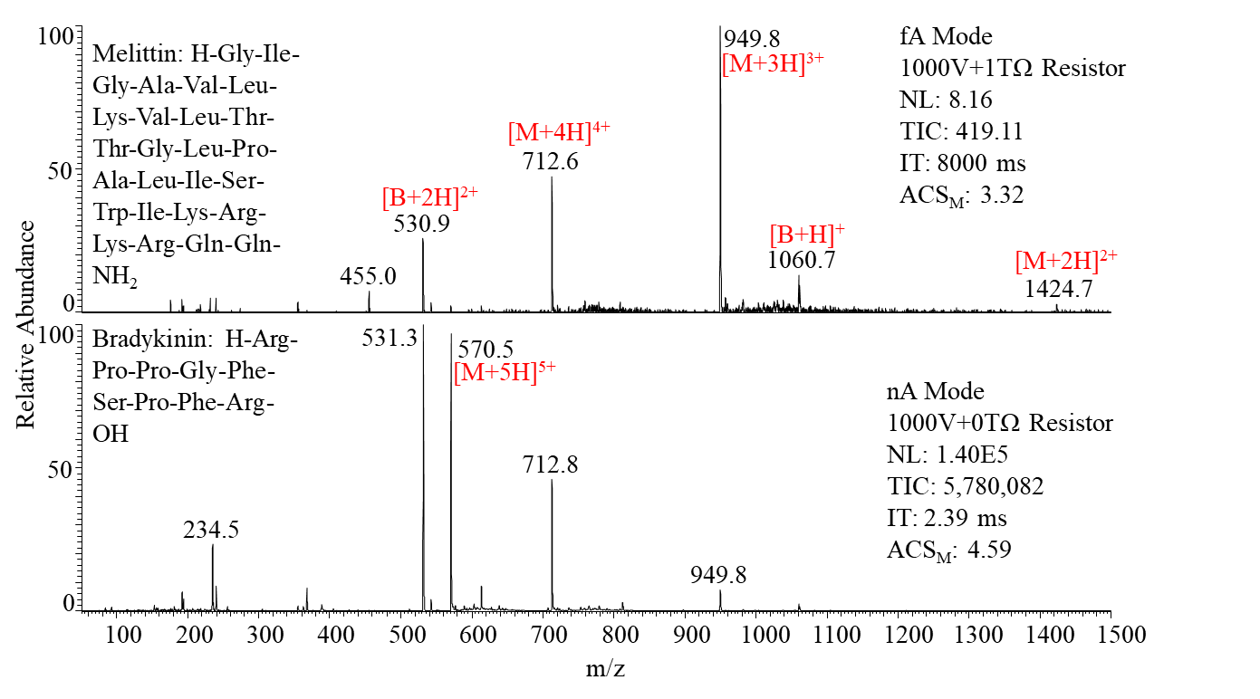
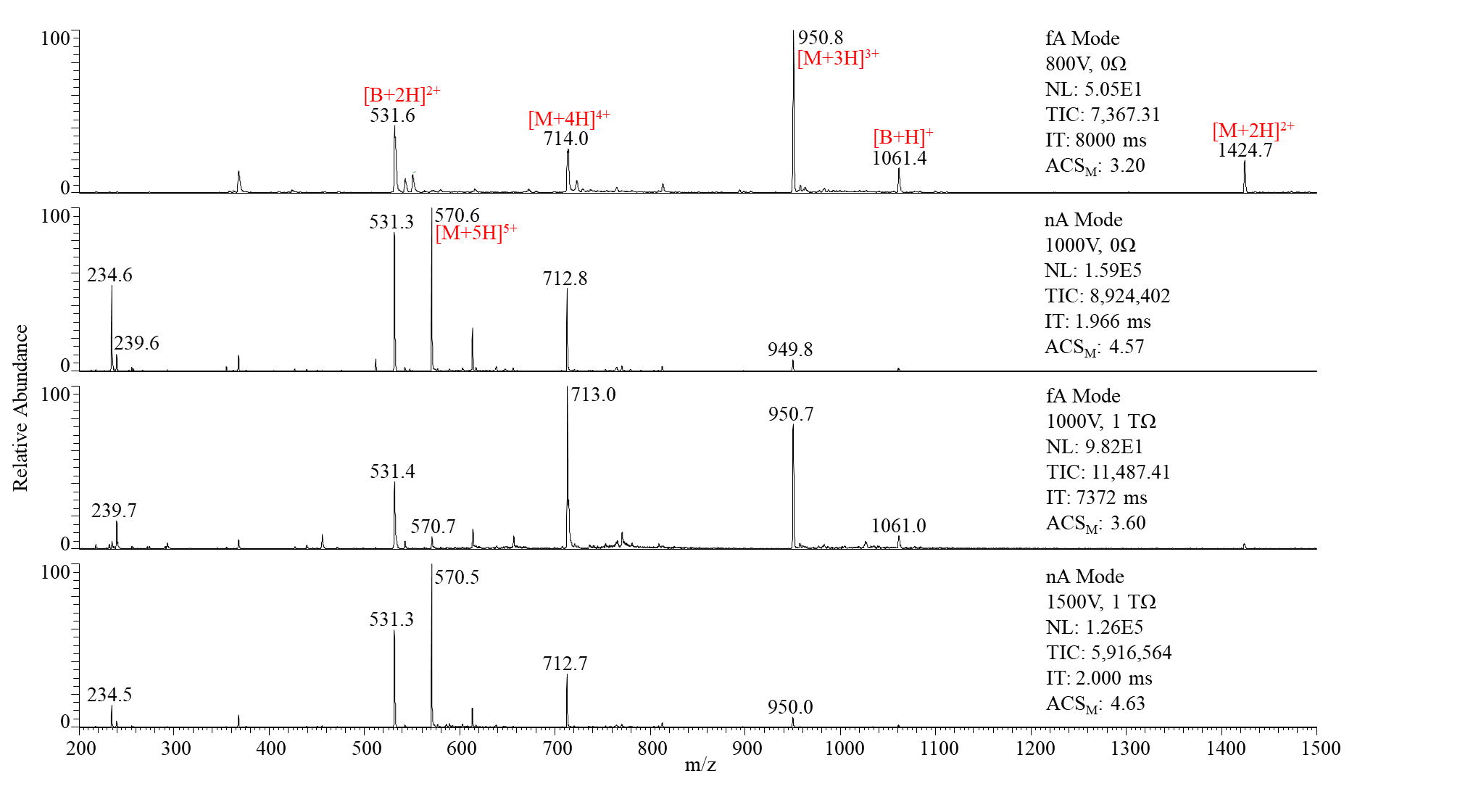
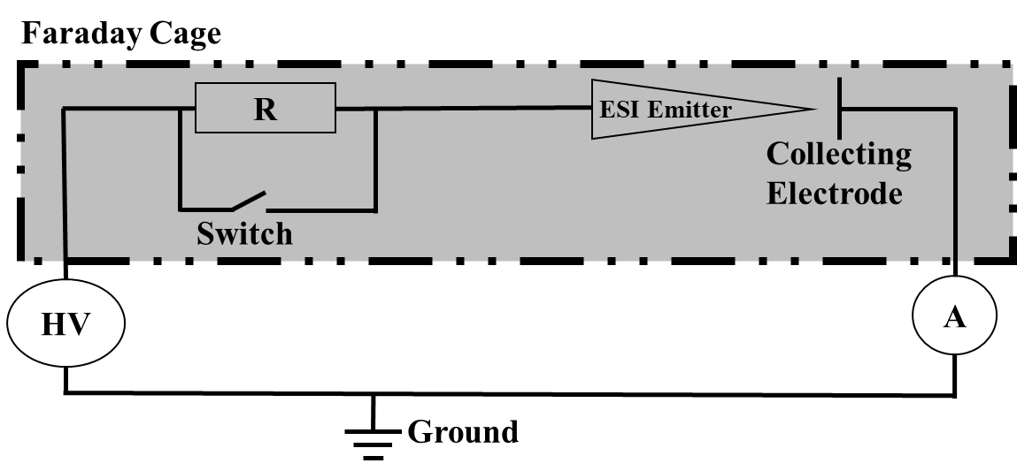
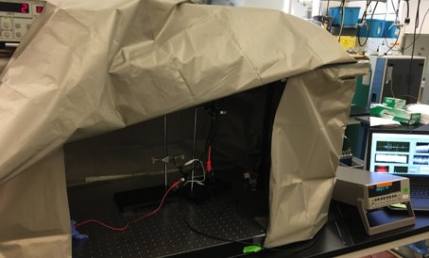
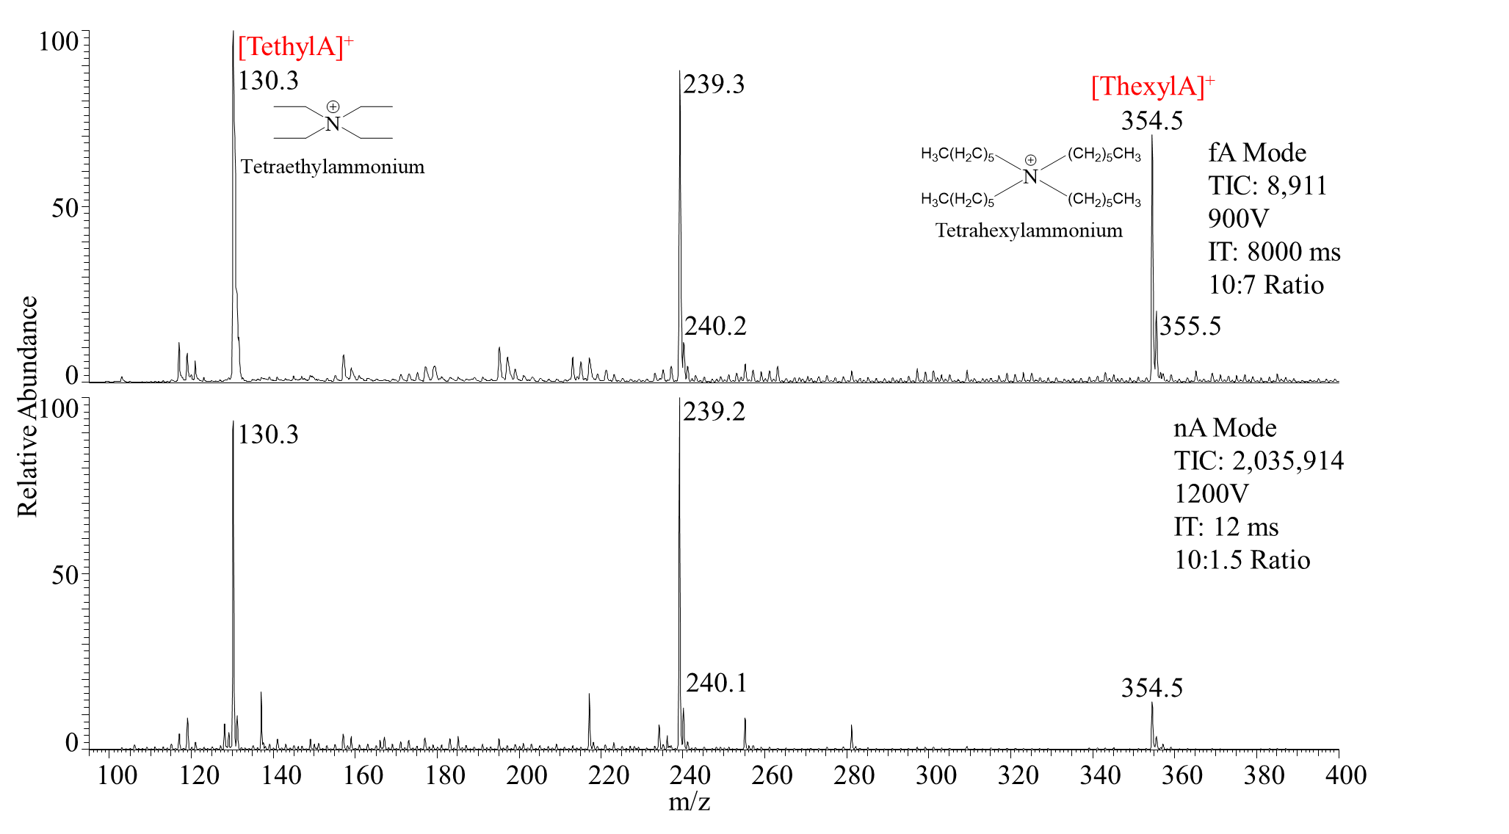
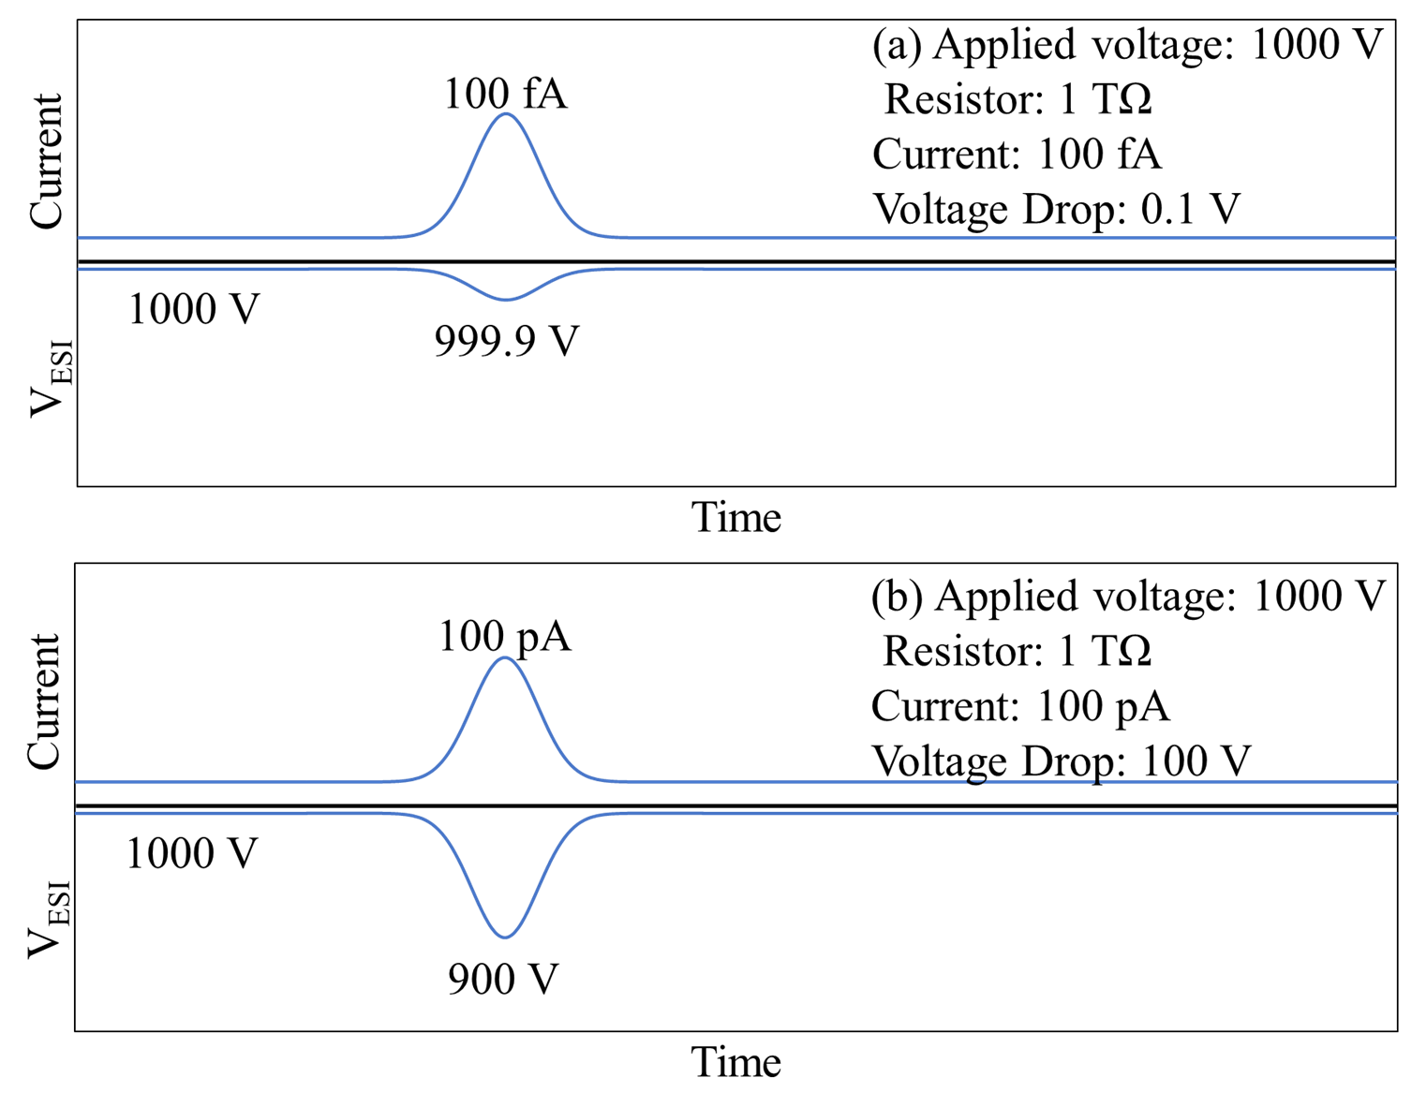
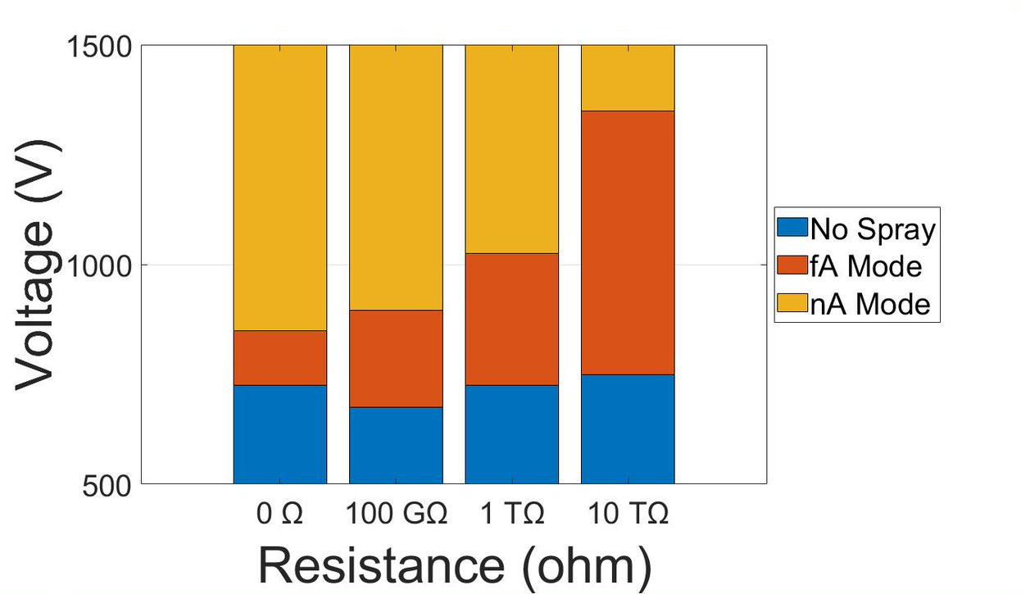
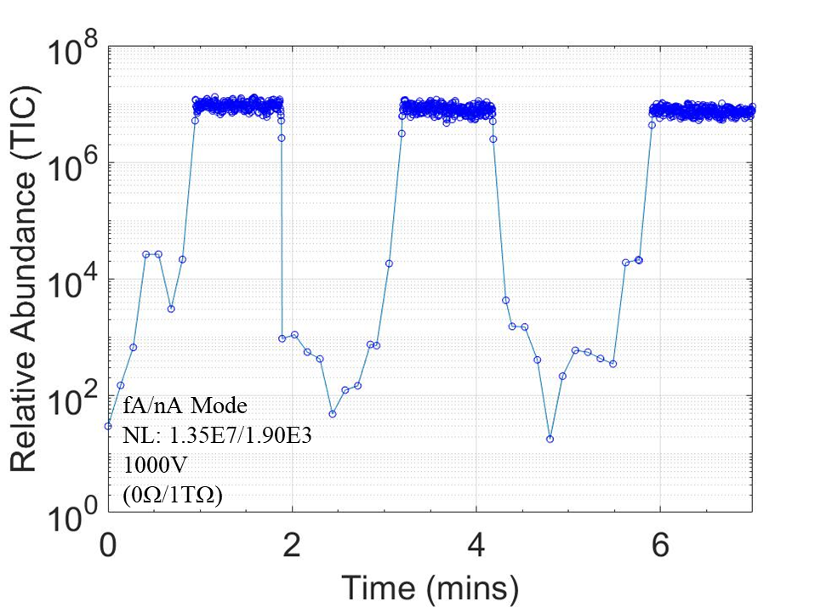


The Utilization of Large Resistors to Control the Femtoampere Mode of Electrospray Ionization
Nicholas R. Allen ^{a,1}, Huishan Li ª, Anyin Li ^{a,*}
ª Department of Chemistry, University of New Hampshire, 23 Academic Way, Durham, NH, 03824, USA
Highlights:
Results 2: Analysis of Large Resistors
Results 4: On Demand fA/nA Switching
Utilization of large resistors increases the voltage range at which femtoampere (fA) electrospray ionization (ESI) signals can be observed
The fA mode may generate smaller initially charged droplets which increase the ionization efficiency of analytes versus the nA mode
Introduction:
Initial charged droplet size influences: ion formation, ionization efficiency, salt adducts, pH changes by evaporation, protein conformation, and other chemical reactions^{[1, 3, 4]}
Reducing the liquid flow rate and charged droplet size, may improve ionization efficiency and matrix suppression^{[2]}
Large resistors may be used to introduce a voltage drop which expands the voltage range for generating fA ESI currents
Alternation between the fA and nA modes achieved by applying consistent voltage (1000 V) and utilizing or bypassing a 1 TΩ resistor
Decrease in ACS_{M} occurs when transitioning from the nA to fA mode
The bradykinin (B) peak is more intense relative to the melittin peaks in the nA mode vs the fA mode^{[1]}
Methods:
Electrometer and faraday cage were used to measure ionization currents (DC) as low as 20 fA^{[2]}
Ion trap and orbitrap with extended injection time (up to 8 s) to accumulate detectable signal for ion flux as low as 1 ion/s^{[2]}
I-V and TIC-V curves for 4 resistors 0 Ω-10 TΩ showing an increase in the fA voltage range from 0 Ω (125 V) to 10 TΩ (600 V)
Red dashed box highlights the femto mode of ESI
Results 5: Melittin/Bradykinin Peptide Mixture
Current Measurement Scheme
Faraday Cage
Results 3: Improving Relative Ionization Efficiency for Tetraalkylammonium Salt Mixture
Results 1: fA Mode Voltage Window Dependence on Resistor Strength
ACS_{M} decreases from the nA mode (1000 V, 4.57/1500 V, 4.63) to the fA mode (800 V, 3.20/1000 V, 3.60) with a 0 or 1 TΩ resistor
Conclusions and Future Directions:
More facile generation of the fA mode can be accomplished by expanding the voltage range with large resistors
Improved ionization efficiencies and reduced analyte-analyte charge competition
Continue to investigate droplet formation mechanism
In the nA mode, the spectrum for an aqueous equimolar mixture is dominated by [TethylA]⁺, switching to the fA mode yields the [TethylA]⁺ peak and the [ThexylA]⁺ peak observed with a more uniform intensity
Results 4: On Demand fA/nA Switching
Acknowledgements:
TIC vs. Time plot of an equimolar mixture of melittin and bradykinin in 1:1 MeOH:H₂O
nA/fA alternation using 1000 V and a 1 TΩ resistor with a resistor bypass switch
fA-TIC: 1.3E6
nA-TIC: 1.2E9
This poster is based upon work supported by the National Science Foundation under Grant CHE-2203289 and NSF-EPSCoR
(a) and (b) show the voltage drop for a 1 TΩ resistor producing 100 fA and 100 pA currents
This boxplot demonstrates the ranges of the three ESI modes and their dependence on the resistor strength. For 0 Ω, the fA mode is small (~100 V) with much larger no spray and nA modes. This voltage window increases to about ~500 V with a resistor value of 10 TΩ
References:
[1] M. T. Li, H. S. Li, N. R. Allen, T. Q. Wang, L. F. Li, J. Schwartz, A. Y. Li, Chemical Science 2021, 12, 1907-1914.
[2] N. R. Allen, H. S. Li, A. Cheung, G. Q. Xu, Y. L. Zi, A. Y. Li, International Journal of Mass Spectrometry 2021, 469.
[3] A. C. Susa, Z. Xia, E. R. Williams, Anal Chem 2017, 89, 3116-3122.
[4] L. Konermann, E. Ahadi, A. D. Rodriguez, S. Vahidi, Anal Chem 2013, 85, 2-9.
Li⁺ Group Site

